Slide 1
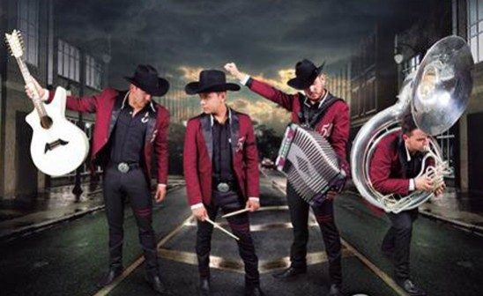
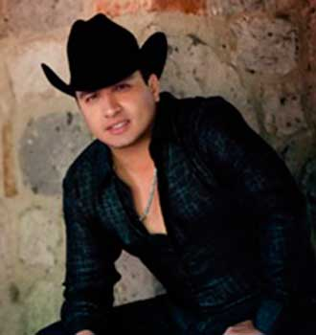
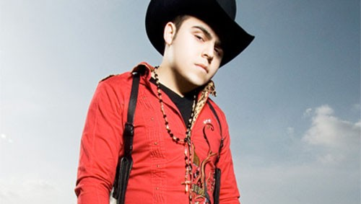
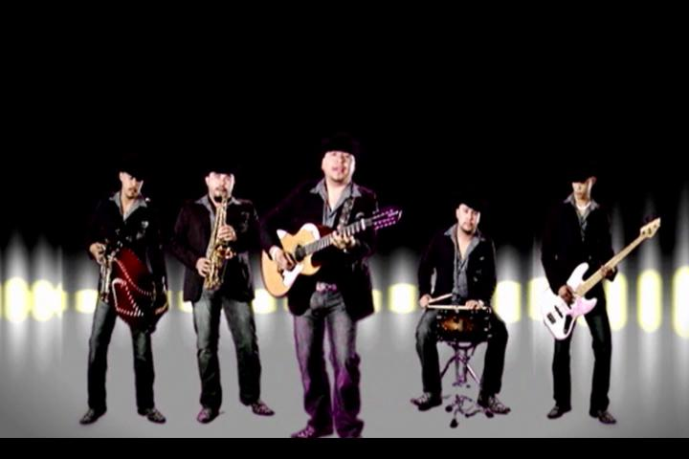
MEDIA KIT
radiolobo1065.com

Slide 2
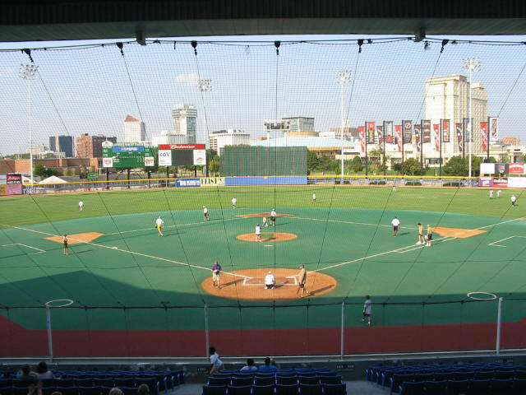
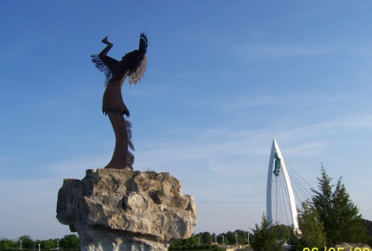
Station Profile
Radio Lobo is the heritage Spanish language radio station for Wichita and the surrounding areas. Radio Lobo plays the best Regional Mexican music, including Norteña, Banda, Ranchero, Cumbia, Grupera, Corridos, and Spanish Oldies. Arnoldo “El Tigre” Gonzalez starts your morning off right, followed by Valentin “El Tlaxcalteca” Maldonado. Erazno y La Chokolata close out your day.
Call Letters/Dial Position
KYQQ/ 106.5- FM
Station Brand
Regional Mexican
Website
www.radiolobo1065.com
Target Audience
Adults 18-49
Company Name
E.W. Scripps Company
radiolobo1065.com

Slide 3
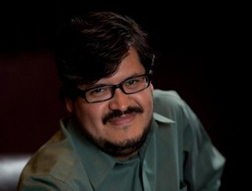
Personality
Lineup
ARNOLDO “EL TIGRE” GONZALEZ
Weekdays: 6:00 AM- 11:00 AM | Saturday 7:00 AM- 11:00AM
Program Director and On-Air Personality, Arnoldo Gonzalez brings the best Regional Mexican Music to Wichita and South Central Kansas. Every weekday morning tune in to Radio Lobo to hear their funny stories, sports updates, entertainment, jokes and Crime Stopper reports.
Valentin “El Tlaxcalteca”
Weekdays: 11:00 AM- 4:00 PM
Valentin "The Tlaxcalteca" is very happy to be working at Radio Lobo 106.5 and to share their experience with the radio audience from 11 am - 4 pm every weekday.
There are many ways to have a great time listening to “El Tlaxcalteca”, if you like old music, if you want to request your favorite song, receive the traffic report, or find out what's happening around the world. If you're working, driving, cooking or just bored, “El Tlaxcalteca will be there for company.
Want to know more about Valentin?
Here are some surprises:
Valentin is a lover of pop music, rock, classic rock, and country.
He likes to read articles from newspapers and the internet rather than a book.
He has a cat named Comet.
Pirates of the Caribbean is his favorite film.
Pink is his favorite color.
Tune in Monday-Friday 11 pm - 4 pm to learn more about Valentin!
radiolobo1065.com

Slide 4
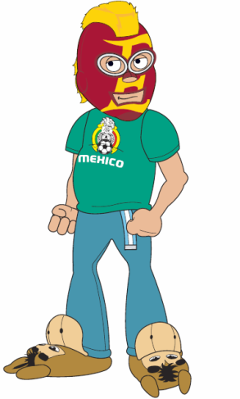
Personality
Lineup
Erazno y La Chokolata, is the afternoon version of Saturday Night Live, it’s a variety show for listeners of all ages and you can join Radio Lobo in bringing the fun to our listeners.
A little more about the show:
La Chokolata runs the show and is a self-proclaimed “diva” who is always maintaining that she’s not “Naca” and loves to put Erazno in his place.
Erazno is a wannabe “Luchador (Mexican Wrestler) who leads the rest of the crew in outrageous skits, parodies and news delivered like never before.
The show features many daily segments, including “El Chokolatazo” during which Choko intervenes in a relationship to find out if cheating is involved, “La Doctorcita” which answers health and love questions from the audience, and “Los 5 del Doggie”in which El Doggie (a man’s man) gives opinions of what’s happening in pop culture and debates with the audience.
The show incorporates all levels of social media to interact with their fans. Elerazno.com, Twitter, Facebook and their You Tube channel feature the funniest segments of what you can’t see live. Check out their ninja episodes on You Tube, they’re classic fun!
radiolobo1065.com

Slide 5
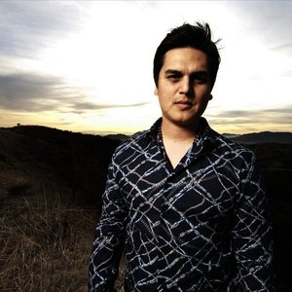
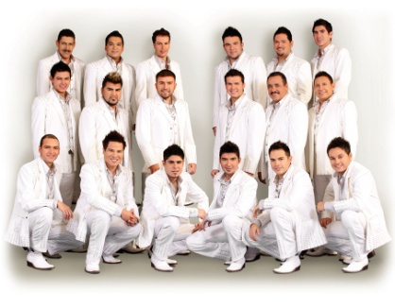
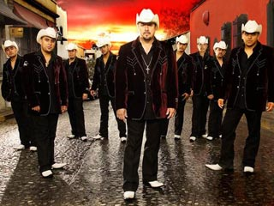
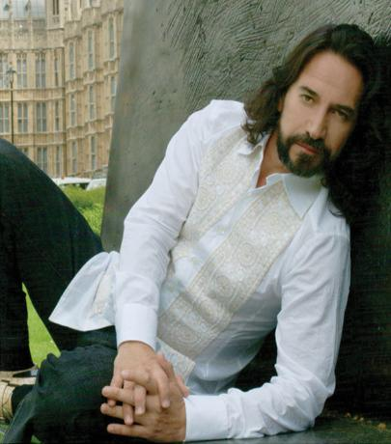
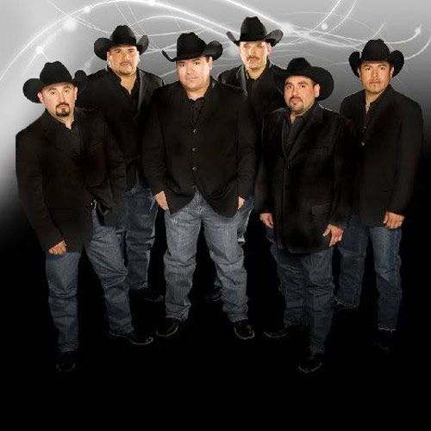
Playlist
Los Tigres Del Norte
Los Huracanes Del Norte
Marco Antonio Solis
Los Temerarios
Conjunto Primavera
Los Rieleros Del Norte
La Arrolladora Banda El Limon
Gerardo Ortiz
Calibre 50
Espinoza Paz
Julion Alvarez
El Trono De Mexico
Montez De Durango
La Original Banda El Limon
Joan Sebastian
Juan Gabriel
Ramon Ayala
Jenny Rivera
Vicente Fernandez
La Banda El Recodo
Intocable
Duelo
Shaila Durcal
Larry Hernandez
Los Tucanes De Tijuana
Regulo Caro
Remmy Valenzuela
radiolobo1065.com

Slide 6
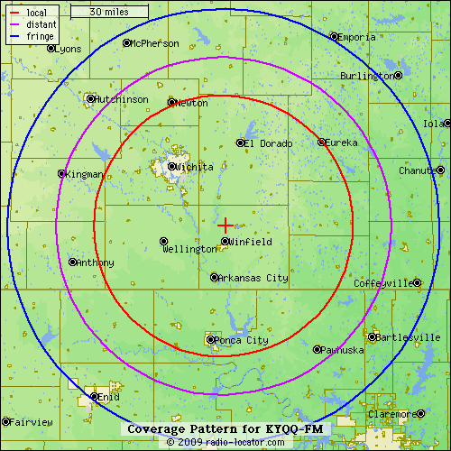
Coverage Map
Covering Mid-Kansas primary markets : Wichita, Hutchinson, Arkansas City, Newton, El Dorado and Ponca City in Oklahoma (represents 14.5% or approximately 82,584 Hispanic persons*)
*Source U.S. Census Bureau: 2010
radiolobo1065.com

Slide 7
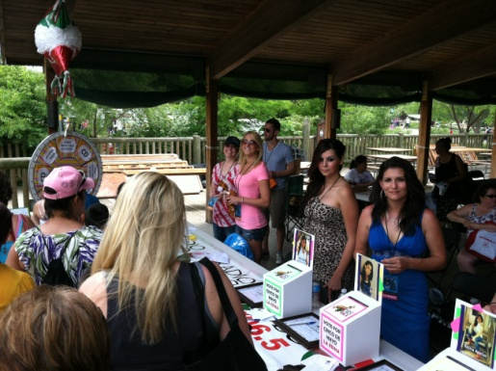
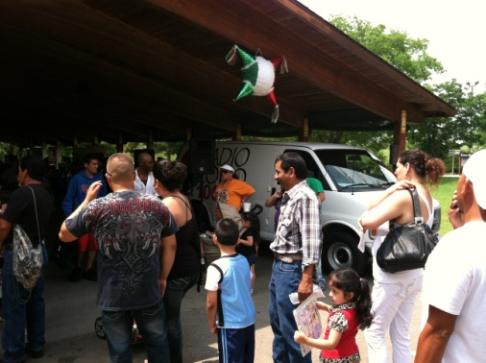
Community
Radio Lobo is an active participant in the Hispanic community. Between involvement with St. Jude, the American Cancer Society, and Christmas Crusade, Radio Lobo helps bring awareness to the issues that concern the community.
Throughout the year Radio Lobo is involved in:
St. Jude – Every year Radio Lobo joins forces with St. Jude’s Children’s Hospital for a Radio-Thon to raise money for the organization
Café Con Leche – Radio Lobo sponsors this Health and Wellness Fair put on by the American Cancer Society, which provides free mammograms to the Hispanic community.
Christmas Crusade – Partnering with the Salvation Army and Wichita Police Department, Christmas Crusade helps to find sponsors for children whose families can not afford gifts for Christmas.
radiolobo1065.com

Slide 8
Contact Us
SummitMedia Corp
4200 N. Old Lawrence Rd.
Wichita, KS 67218
316.838.9141 (Phone)
316.838.3607 (Fax)
Beverlee Brannigan, General Manager…………………………….……………….…316.821.2053
beverlee.brannigan@summitmediacorp.com
Todd Johnson, General Sales Manager………………………….………………….…316.821.2015 todd.johnson@summitmediacorp.com
Justin Case, Operations Manager……………………………………..…….…………..316.821.2002
justin.case@summitmediacorp.com
Jenny Goertzen, Promotions Coordinator…………………………….…….……….316.821.2004
jenny.goertzen@summitmediacorp.com
radiolobo1065.com

