Slide 1
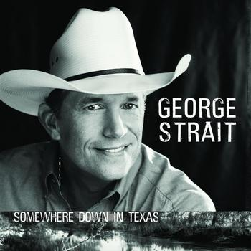
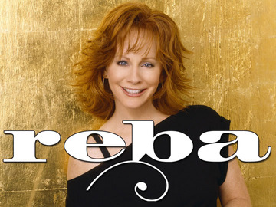
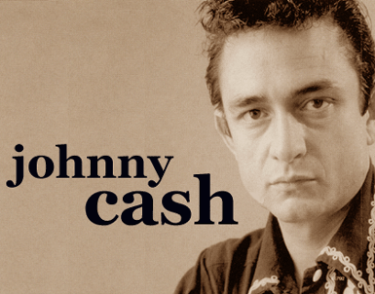
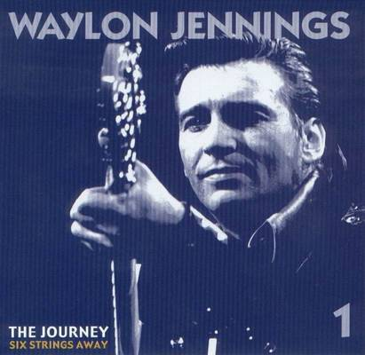
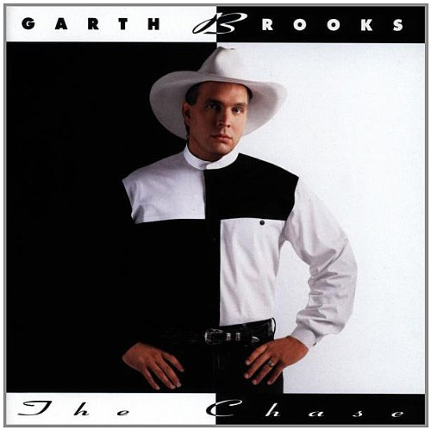
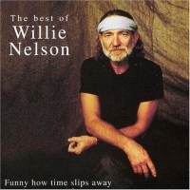
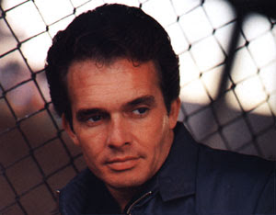
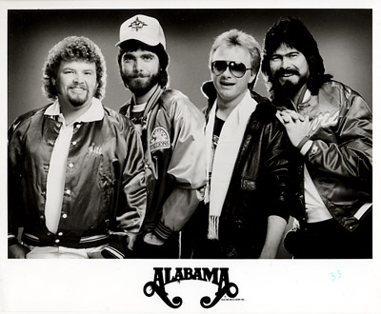
MEDIA KIT
Merle Haggard
classiccountry1070.com

Slide 2
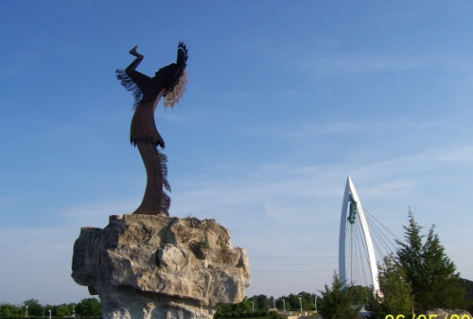
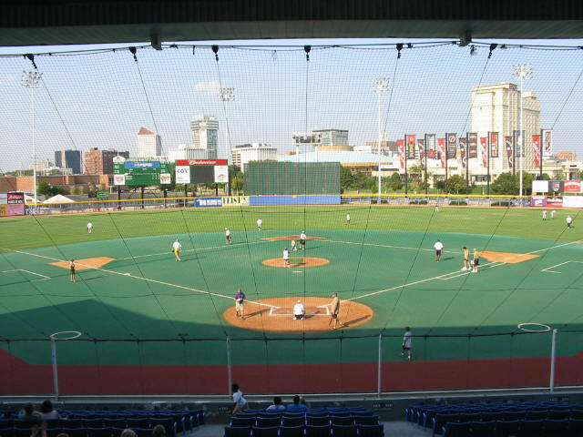
STATION PROFILE
CLASSIC COUNTRY is America's only all classic country 24-hour format. Classic Country 1070 features the biggest country songs and artists from the 70's, 80's and 90's. We play songs that most country stations have stopped playing – but listeners still want to hear. Our personalities know country music and engage listeners through contests, requests, and daily features.
Call Letters/Dial Position
KFTI / 1070 - AM
Station Format
Classic Country
Website
www.classiccountry1070.com
Target Audience
Adults 35-64
Company Name
E.W. Scripps Company
classiccountry1070.com

Slide 3
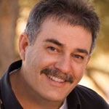
PERSONALITY LINEUP
Jim West
Mornings 5:00 AM- 9:00 AM
Country music has always been a part of Jim's life.
My dad listened to country music on the car radio and we watched every country music special on TV. I loved watching The Buck Owens Show because they were always wearing flashy duds and singing cool songs. I loved the TV specials and movies including
The Johnny Cash specials, Eddy Arnold Specials, The Glen Campbell Goodtime Hour, The CMA Award Show, Urban Cowboy and others. The movie that really helped shaped my musical passion was "Hey Good Looking" The story of Hank Williams Senior. Of course from 1967 who could forget "Hillbillies In A Haunted House"? Country singers on their way to Nashville have car trouble, forcing them to stop at an old haunted mansion.
Remember 8 Track Stereos in cars? My dad had two 8 Tracks; the Best of Buck Owens and The best of Merle Haggard. As a child I sang along with those 8 Tracks until I knew every word of every song. My parents took me to Nashville when I was 12 to see a show at the Grand Ole Opry where I saw Whispering Bill Anderson and others. What a huge impression that made on me too. The mother church of country music.
I got into country radio in 1977 while still in high school and its the only format I've ever worked. I'm sharing this with you because I want you to know I love this music as much as you do and have a deep appreciation for the history of our country music. I would bet like you, It's part of the fabric of our personalities. As I get older, I seem to relate to the lyrics even more.
classiccountry1070.com

Slide 4
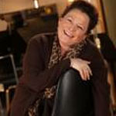
PERSONALITY LINEUP
Linda Flores
Middays 9:00 AM- 2:00 PM
It's a happy accident that I'm in radio. In college I was lucky enough to have a scholarship with the music/theater department and was studying to be a recording engineer. My dad worked for NASA making sure the astronauts could talk back to mission control, so I've been around sound equipment all my life.
One day I visited the on campus radio station to drop off some music that I had just recorded. The manager pulled me aside and asked if I had ever considered being on the radio and I said NO! But he offered to PAY me and so....my radio career started! It's still kinda crazy that I get paid to do something I love!
I love all kinds of music, but have a special place in my heart for Classic Country. I think I know the words to every song I play. Probably my personal favorites are the Outlaws! Folks like Willie, Kris, Waylon! I joke often about how Patsy Cline music is the best to sing when you are doing Karaoke. I say that, because I know first hand, it's a crowd pleaser and no matter where you go, folks sing along with you! Dolly and Merle will always be my two favorite writers and Gene Watson, is by far, my favorite honky-tonk singer.
In my free time, I love movies that are worth two hours of my time, play guitar, enjoy 5k runs, coloring outside the lines and hitting things....softballs, tennis balls, etc. Oh, and in the last year, I've enjoyed shooting things! Going to Ladies Night at the gun range is one of my greatest pleasures! I often bring my targets to the studio. Let's just say, no one messes with me.
classiccountry1070.com

Slide 5
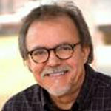
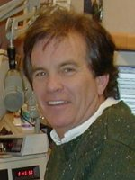
PERSONALITY LINEUP
Jon St. John
Middays 2:00 PM- 7:00 PM
The first '45 that I ever owned was, "Big Bad John" by Jimmy Dean and the first song I ever played on the radio was, "Mama Tried" by Merle Haggard. I am Classic Country through and through and I love radio. My father told me not to be a DJ because I would starve. (His brother was a DJ and...did starve
a few times) At first I listened to him but I had the bug and eventually started my radio career. The first job in radio that I experienced was taking the station out of tape automation and playing the broadcast of network football...you know, playing the local commercials and identifications. Simple enough but believe me I could mess even that up. Eventually I further paid my dues by doing six hour overnight shifts and sometimes doing two six hour weekend shifts back to back...cause I loved it so much. So here I am now on your radio, still playing country music and I still get to play "Big Bad John" and "Mama Tried." I have two boys that live in Nashville so I get to go to Music City USA often and do the tourist thing just like everyone. I love my job. I love playing Classic Country music...most of the songs I grew up in radio, playing as current songs through the years.
Chuck Leary
Nights 7:00 PM- 12:00 AM
Ten-year-old boys dream, and this one wrote a letter to a radio icon at the time, much to the amusement of friends and family. The laughing stopped and the dream began as I stood in my driveway and opened up a return letter from Arthur Godfrey. He told me to stay in school, work hard and pay attention the voice inside me. He had given some good advise to Patsy Cline on his Talent Scouts show, so I took it to heart.
I've always loved music, and my earliest hero was Rick Nelson, who was inspired by Hank Williams, so my country roots were growing. I did form a trio with my brother Rick and a friend, and after some touring and making a demo tape, our manager told us Capitol Records was interested in signing us! Turns out, Uncle Sam was also interested in signing this singing Lieutenant Leary, commissioned out of college, and so I won an all expense paid Southeast Asian vacation to Chu Lai, Viet Nam! How could I refuse?
I have been privileged to share the airwaves across the country with a number of fine stations, and it all comes down to this. If I can bring the music to life for you, introduce you to the thoughts and voices of these great Classic Country artists, and maybe inspire just one more ten-year-old boy, like my heroes did for me, I've had a good day on the radio!
classiccountry1070.com

Slide 6
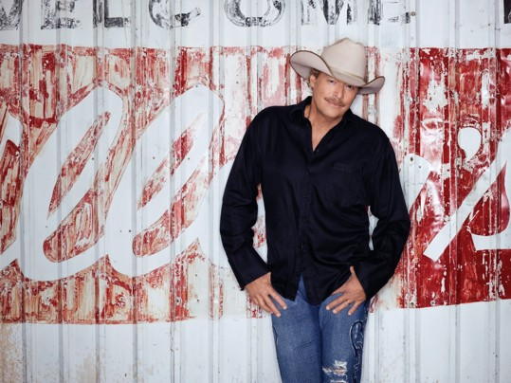
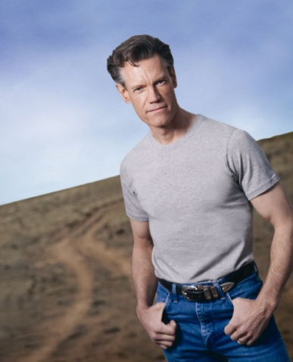
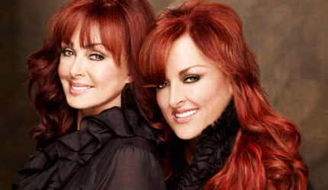
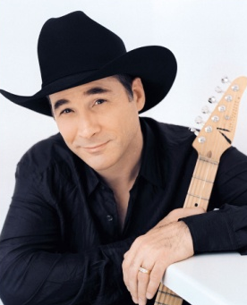
PLAYLIST
George Strait
Randy Travis
Don Williams
Merle Haggard
Johnny Cash
Reba McEntire
Ronnie Milsap
Waylon Jennings
Willie Nelson
Statler Brothers
Oak Ridge Boys
Kenny Rogers
Tanya Tucker
Hank Williams Jr.
Conway Twitty
The Judds
Garth Brooks
Alabama
Clint Black
George Jones
Alan Jackson
Bellamy Brothers
Vince Gill
Charley Pride
classiccountry1070.com

Slide 7
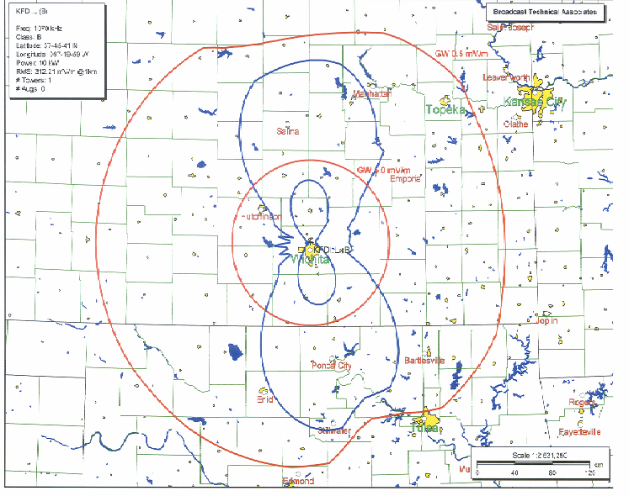
COVERAGE MAP
classiccountry1070.com

Slide 8
Contact Us
SummitMedia Corp
4200 N. Old Lawrence Rd.
Wichita, KS 67218
316.838.9141 (Phone)
316.838.3607 (Fax)
Beverlee Brannigan, General Manager………………….…….…316.821.2053 beverlee.brannigan@summitmediacorp.com
Todd Johnson, General Sales Manager…………..……………...316.821.2015 todd.johnson@summitmediacorp.com
Justin Case, Operations Manager…………………………………..316.821.2002
justin.case@summitmediacorp.com
Jenny Goertzen, Promotions Director…………..….…………….316.821.2004
jenny.goertzen@summitmediacorp.com
classiccountry1070.com

