Slide 1
MEDIA KIT
t95.com

Slide 2
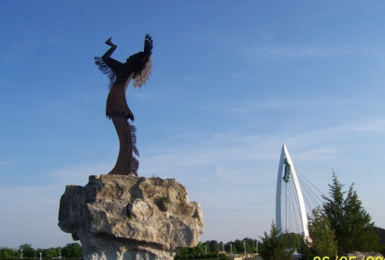
STATION
PROFILE
T-95 has been Wichita’s Heritage Rock Station for over 35 years. The Todd N Tyler Radio Empire morning show is heard every weekday morning from 5am- 10am. Meatball hosts T-95 during the workday from 10am- 3pm. Rick Thomas continues in afternoons from 3pm- 7pm, while Bickham rocks your nights from 7pm-12am.
Call Letters/Dial Position
KICT / 95.1-FM
Station Format
Rock
Website
www.t95.com
Target Audience
Adults 25-54
Company Name
E.W. Scripps Company
t95.com

Slide 3
PERSONALITY
LINE UP
The Todd N Tyler Radio Empire
Weekdays: 5:00 AM- 10:00 AM
Wake up with Todd and Tyler every morning on T-95. The Todd N Tyler Radio Empire developed in 1993 and is a nationally syndicated morning show based out of Omaha. Todd N Tyler have maintained their position as a top-rated morning talk show for
men ages 25-54 years since 1996. Laugh hysterically with Todd and Tyler every morning on T-95.
Meatball
Weekdays: 3:00 PM- 7:00 PM
The name is Meatball! (It’s what came up in one of those “what celebrity do you most look like” survey”.)
I’m easily distracted by bright lights, loud sounds and crowds of people, so it’s no surprise if there’s a live show in town…I’m there. About once a week, I scan through Netflix for something new, but ultimately land on the same three shows: Walking Dead. The Office, and Sons of Anarchy. I listened to T95 growing up around Wichita, and it’s where I learned to love Rock radio. It only seems fitting that I return and give back to the station that inspired me to pursue this career.
Rick Thomas
Weekdays: 3:00 PM- 7:00 PM │ Saturday: 3:00 PM- 7:00 PM
Music Director and Afternoon Host, Rick spends time looking for ways to create more fun and interaction on his afternoon show. He enjoys talking about the issues that both entertain and influence the listeners. Catch Rick Mon-Fri 3pm-7pm.
t95.com

Slide 4
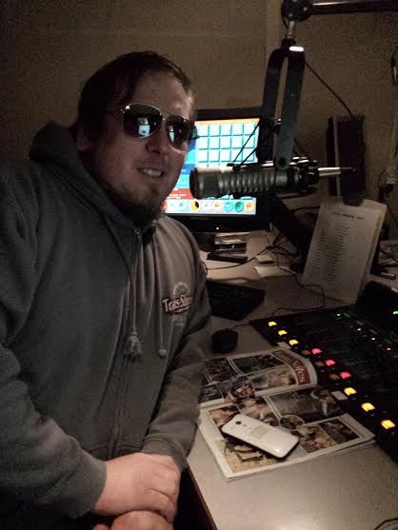
PERSONALITY
LINE UP
Bickham
Weekdays: 7:00 PM- 12:00 AM │ Saturday: 7:00 PM- 12:00 AM
Originally from Chicago, Bickham started his radio career while at the University of Illinois in Champaign, Illinois. After various moves he came to Wichita to work for Journal Broadcast Group. In his spare time he enjoys cheering on the Fighting Illini, the Chicago White Sox, Chicago Bears and the Kansas City Chiefs.
House of Hair with Dee Snider
Sunday: 12:00 PM- 2:00 PM
Best known as the lead singer of the acclaimed rock band, Twisted Sister, Dee Snider is a radio personality, television host, author, screenplay writer, actor, a doting husband of 27 years, and the father of four children. Dee has been hosting his nationally syndicated “House of Hair” for over 15 years. His weekly show can be heard in over 200 markets across the country. House of Hair with Dee Snider is heard from 12pm- 2pm every Sunday on T-95.
Junior
Weekends
Junior is a Kansas native born and raised right here in Wichita so he knows this city like the back of his hand! He’s an avid gym buff that can lift a small house and carry a small car on his back. He has been with T-95 since 2008. You can usually find him out and about either at the gym, old town, or at local sporting events so feel free to introduce yourself! He always looks forward to meeting new people.
t95.com

Slide 5
PERSONALITY
LINE UP
4:00 PM- 4 O’Clock Street Fight
8:00 PM- 80’s at 8
10:00 PM- Mandatory Metallica
Featured Daily:
HardDrive with Lou Brutus
Sunday: 10:00 PM- 12:00 AM
Lou Brutus, award-winning host of the nationally syndicated radio programs hardDrive, which airs on Sunday from 10P- 12A . HardDrive has become a respected and influential extreme rock radio show and is in its 16th year on the air. Lou is heard in nearly 120 markets nationwide. He’s an accomplished photographer of both rock bands and of Major League Baseball. He’s the lead singer of two bands: Grumpy Old Punks and Dead Schembechlers, with whom he has recorded several albums and appeared on HBO and ESPN.
t95.com

Slide 6
PLAY LIST
We play only the best Rock music with songs from artists like these:
AC/DC
Rush
STP
Godsmack
Green Day
Linkin Park
Guns N’ Roses
Aerosmith
Van Halen
Seether
Three Days Grace
Motley Crue
Pink Floyd
Soundgarden
Shinedown
Red Hot Chili Peppers
Led Zeppelin
Ozzy Osbourne
Metallica
Nirvana
Theory of a Deadman
t95.com

Slide 7
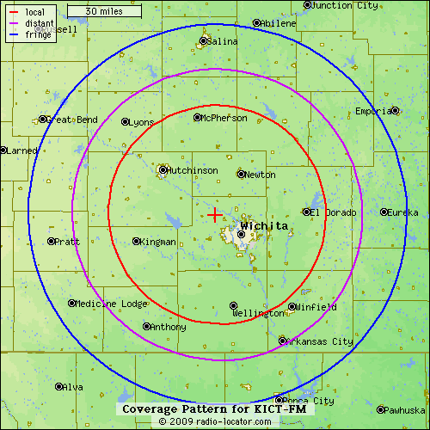
COVERAGE
MAP
t95.com

Slide 8
CONTACT US
SummitMedia Corp
4200 N. Old Lawrence Rd.
Wichita, KS 67218
316.838.9141 (Phone)
316.838.3607 (Fax)
Beverlee Brannigan, General Manager……………………316.821.2053 beverlee.brannigan@summitmediacorp.com
Todd Johnson, General Sales Manager ........….….…….316-821-2015 todd.johnson@summitmediacorp.com
Justin Case, Operations Manager……………..…………...316.821.2002
justin.case@summitmediacorp.com
Jenny Goertzen, Promotions Manager……………….….316.821.2004
jenny.goertzen@summitmediacorp.com
t95.com

