Slide 1
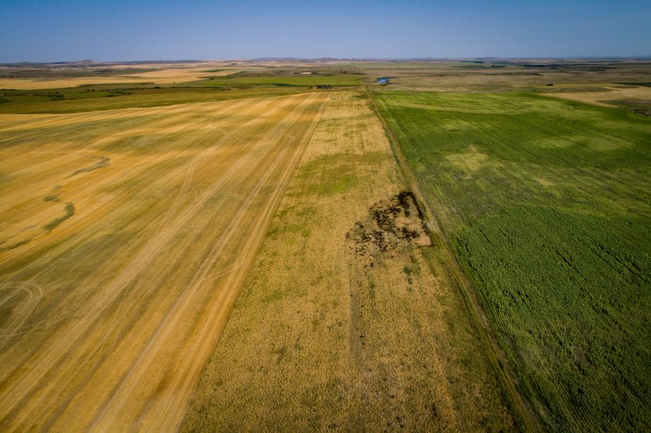
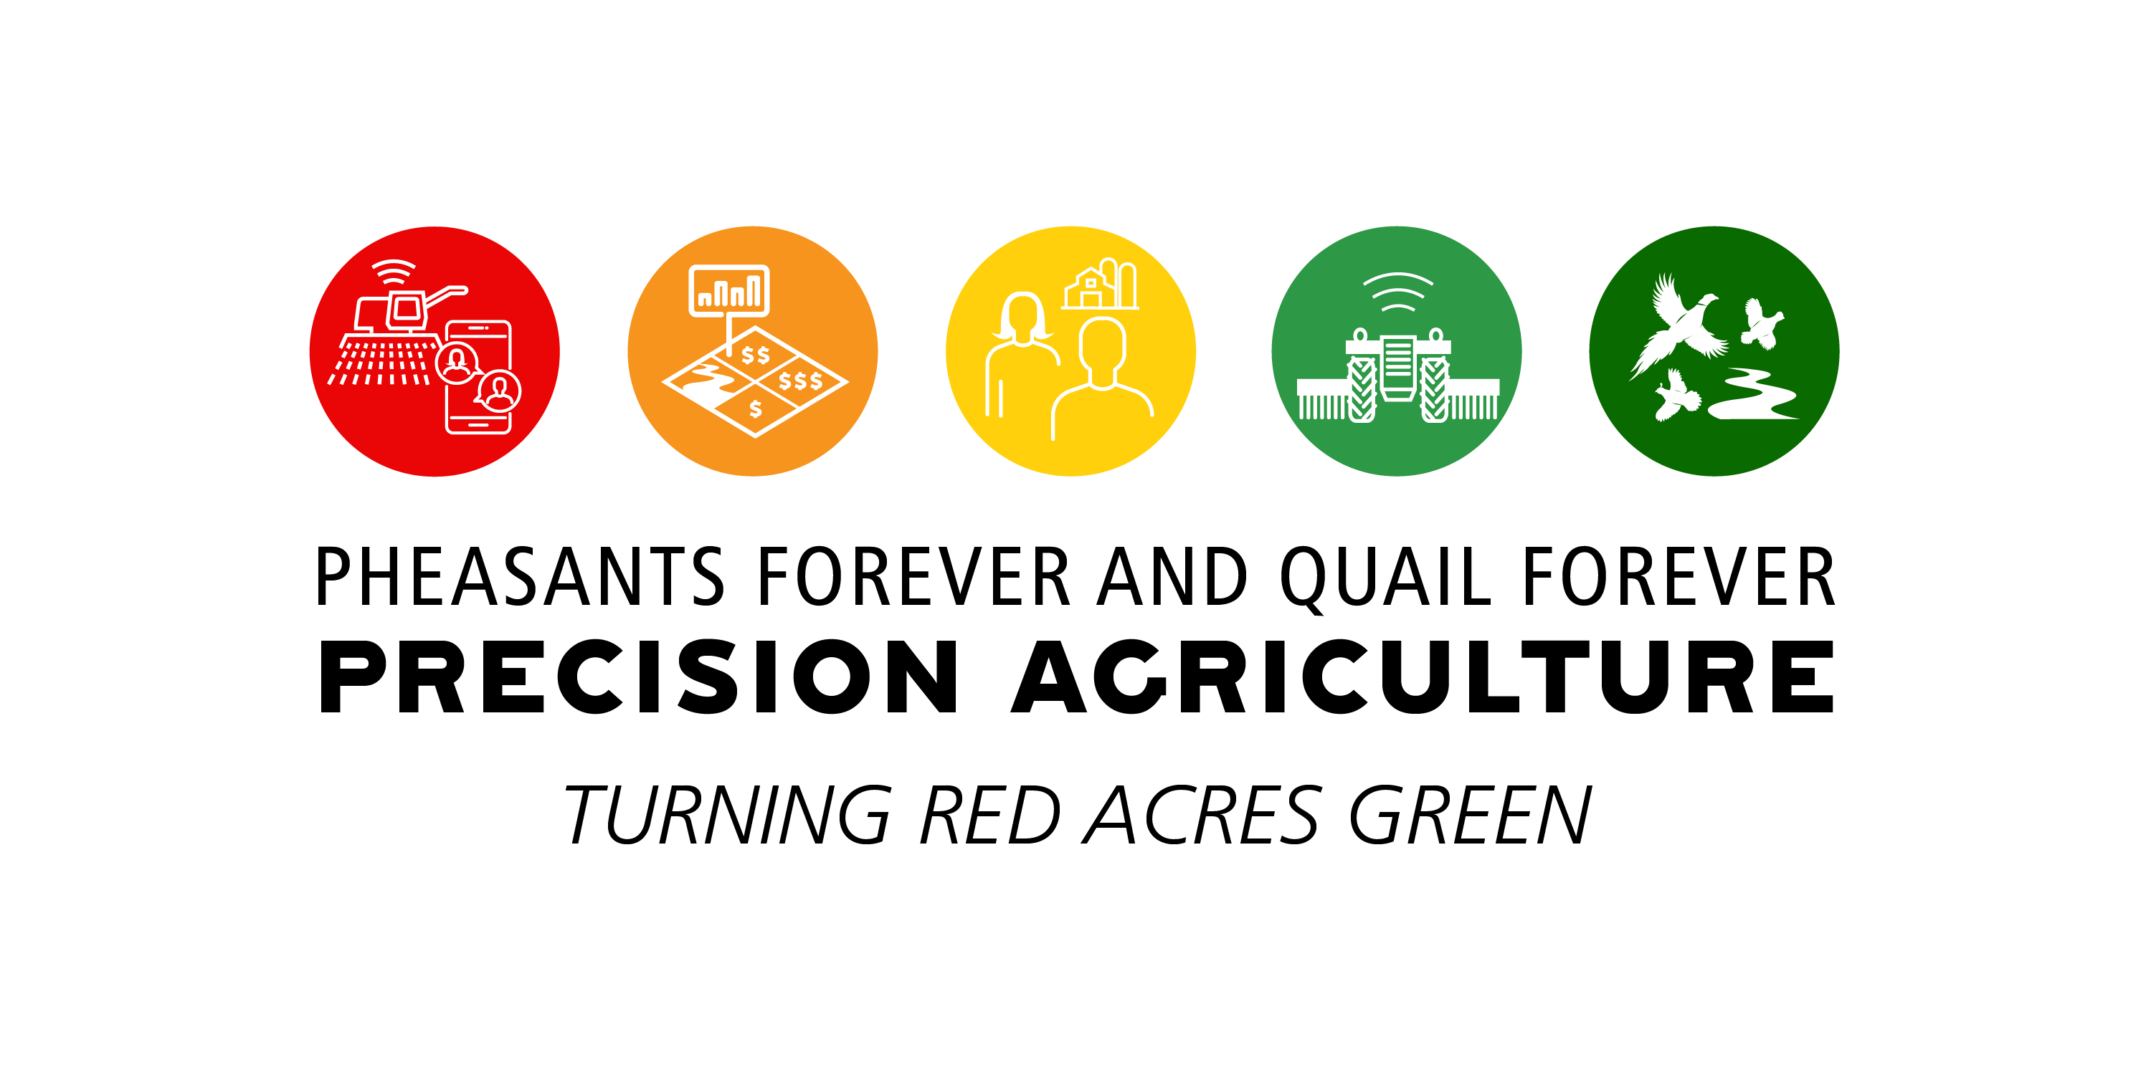
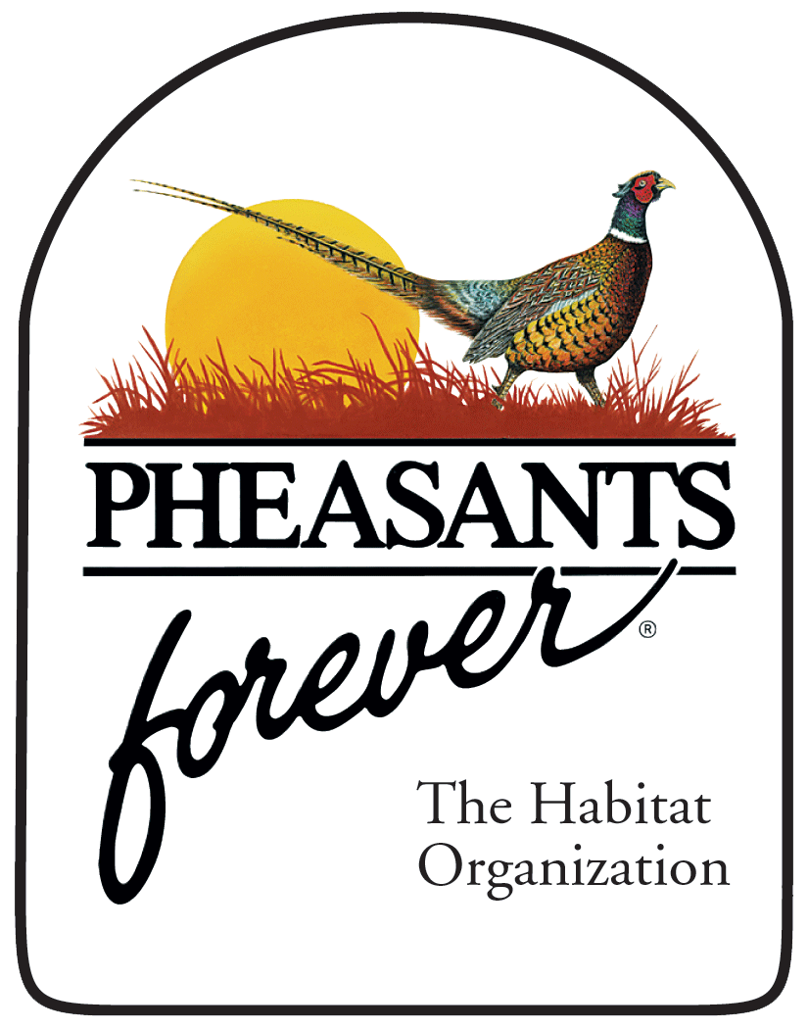
Blue Jay Pollinator Conservation
Austin Lang
Precision Ag & Conservation Specialist

Slide 2
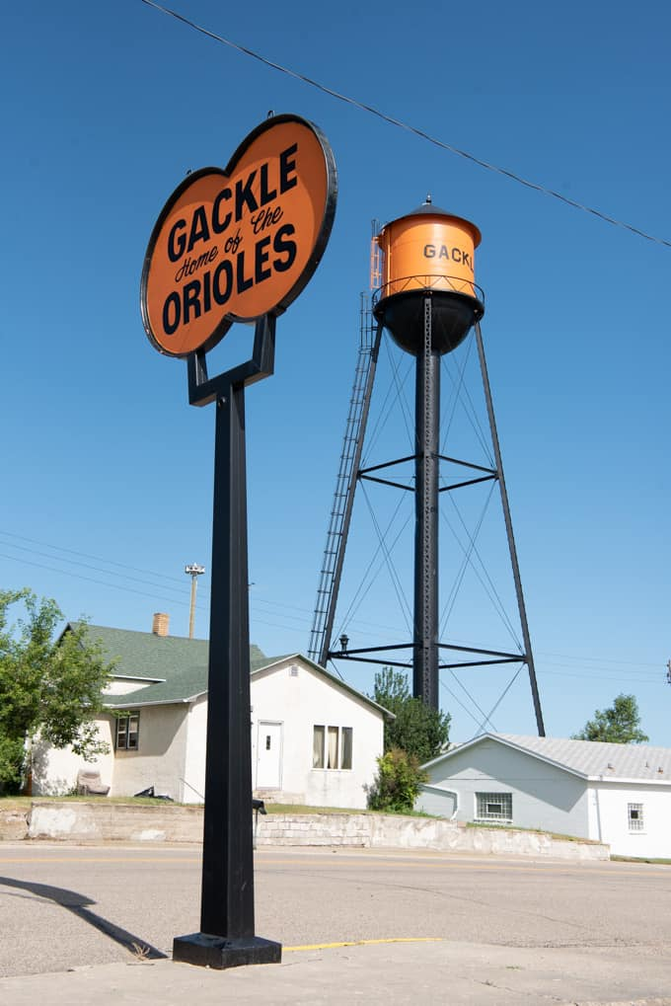
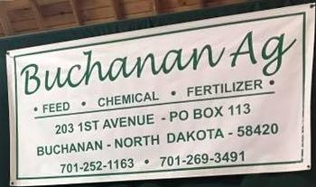
About Me

Slide 3
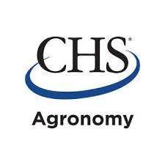
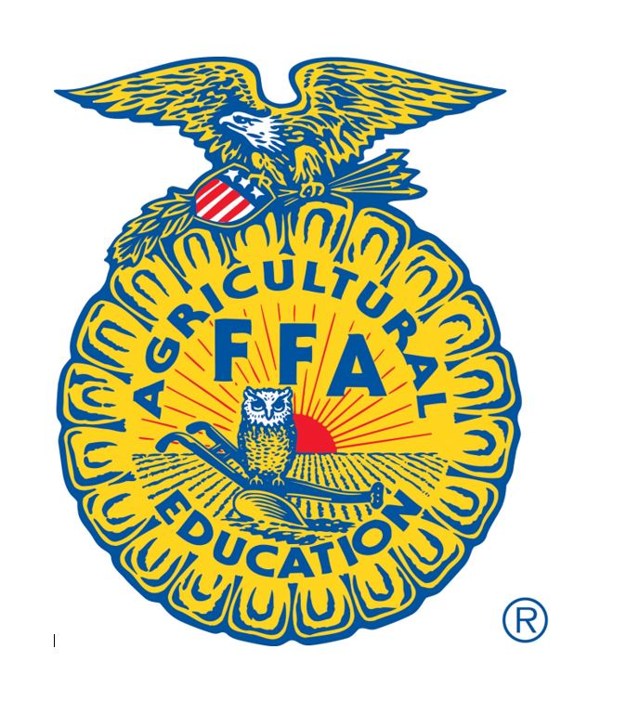
Who Helped Make this Project Happen?
ND Outdoor Heritage Fund
James Valley Pheasants Forever Chapter (Jamestown)
Stutsman Soil Conservation District
Farmers Union Agronomy
YOU and JHS/JVCTC/FFA/Blue Jay Acres

Slide 4
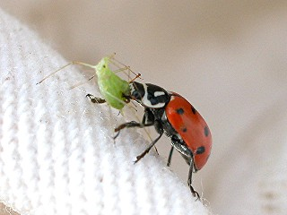
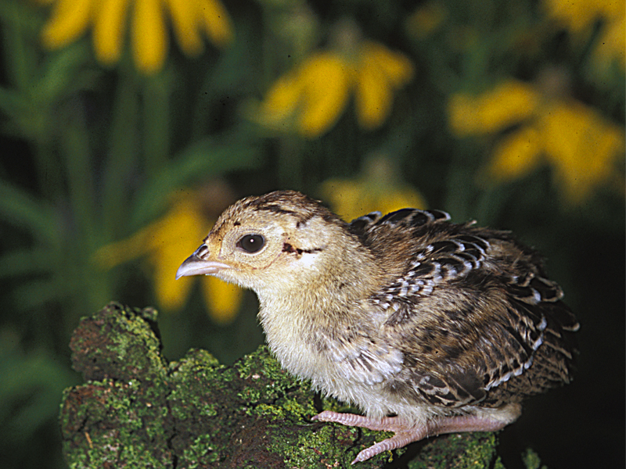
Why Care about Flowering Plants on the Landscape?
-Attract insects needed by wildlife (especially young birds) as a nutritious food source
-Beneficial insects/Biocontrol
-Pollination services: Estimated they help deliver 1/3 of worlds crop production or 1 of every 3 bites of food

Slide 5
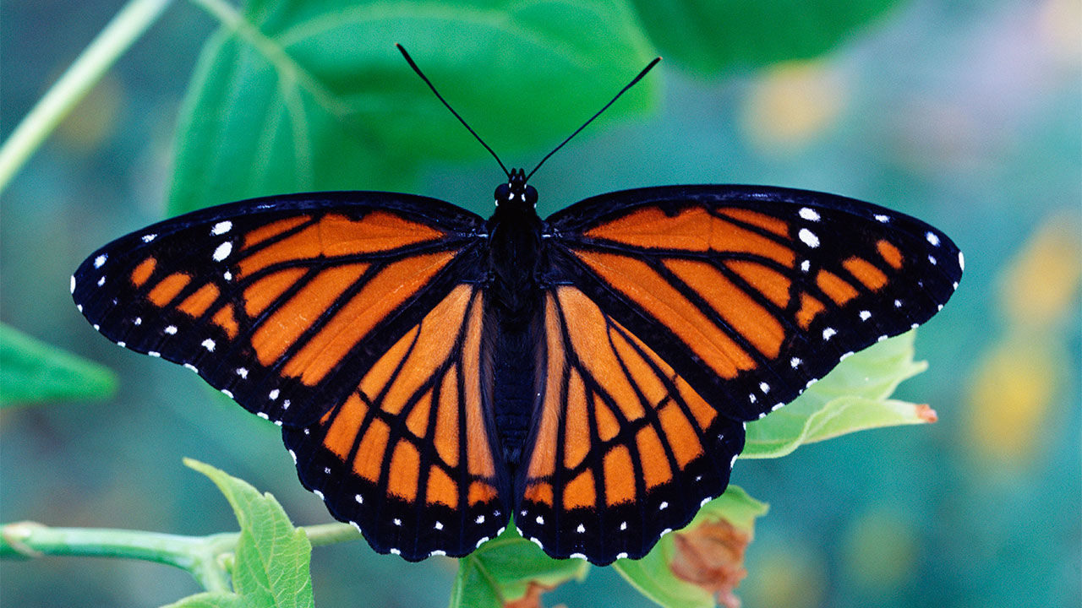
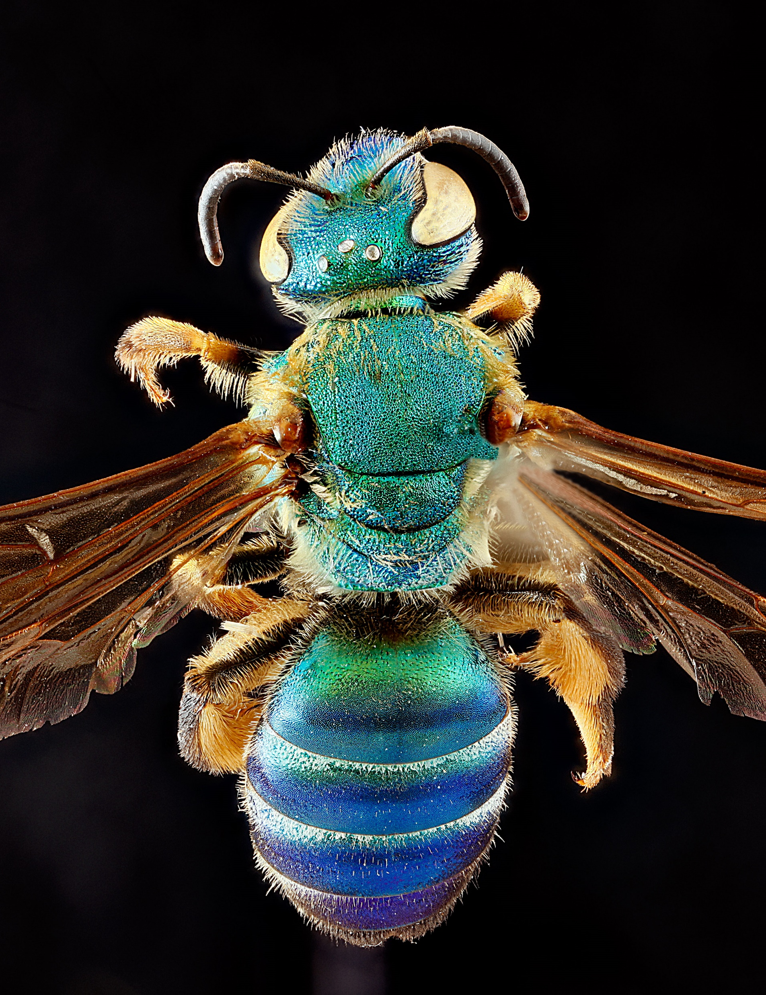
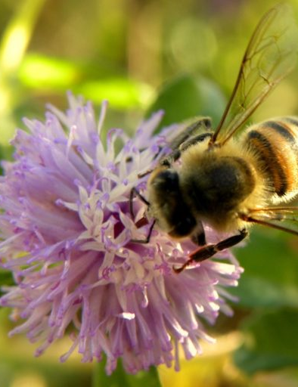
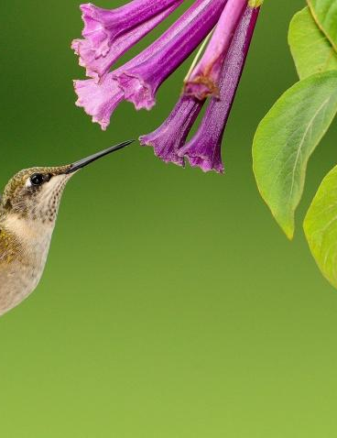
Who are Pollinators?
Birds, bats, butterflies, moths, flies, beetles, wasps, small mammals, and most importantly, bees are pollinators (native and commercial).
They visit flowers to drink nectar or feed off of pollen and transport pollen grains as they move from spot to spot.

Slide 6
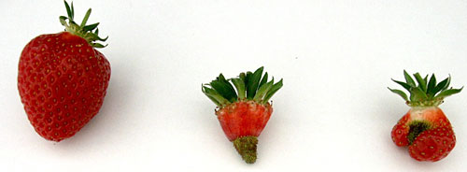
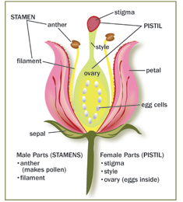
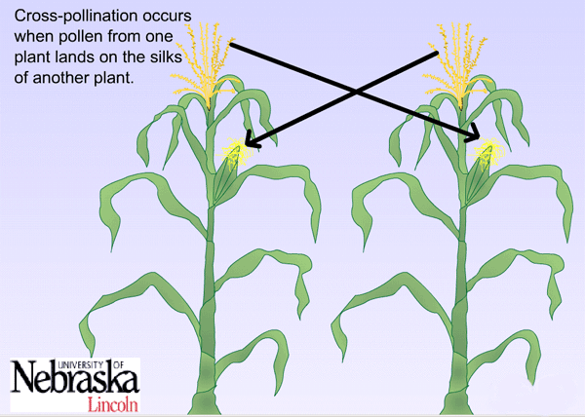
Pollination 101
When a pollen grain moves from the anther (male part) of a flower to the stigma (female part), pollination happens. This is the first step in a process that produces seeds, fruits, and the next generation of plants.
This can happen through self-pollination, wind and water pollination, or through the work of vectors that move pollen within the flower and from bloom to bloom.
Strawberries, Fragaria x annanasa Duch., after open insect-pollination (left), passive self-pollination (middle) and passive self-pollination and wind-pollination (right). (Photo by Kristine Krewenka, Agroecology, Göttingen, Germany.)

Slide 7
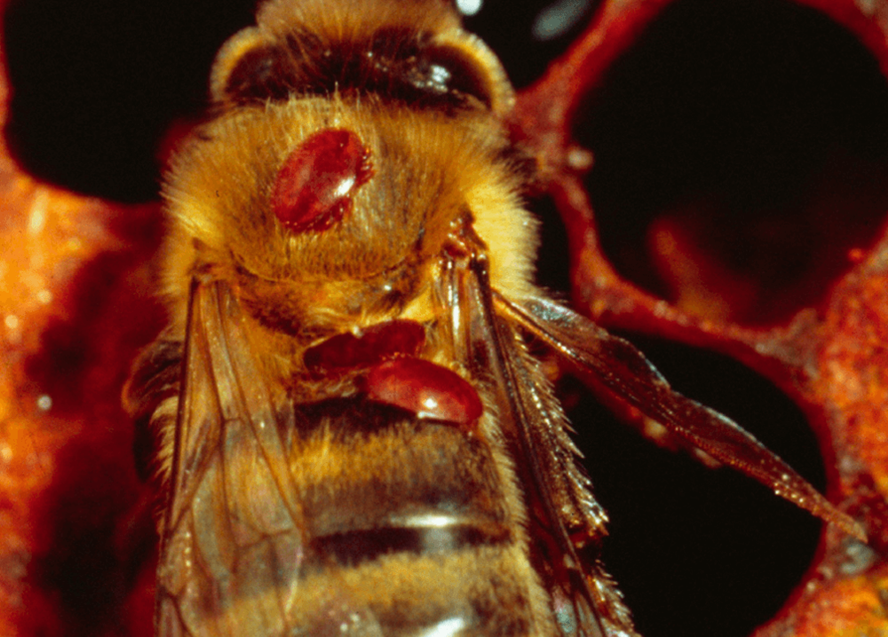
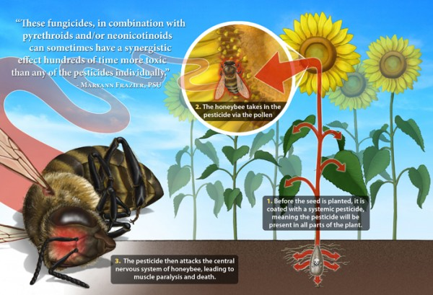
Why are Pollinators Declining?
-Varroa Mite and Colony Collapse Disorder (honey bees)
-Loss of Habitat (through urban and ag)
-Insecticides (Especially neo-nicotinoids)

Slide 8
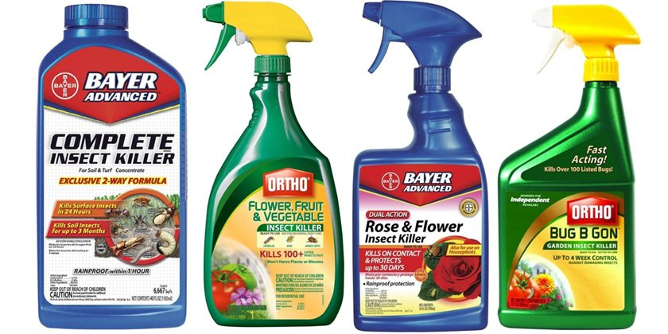
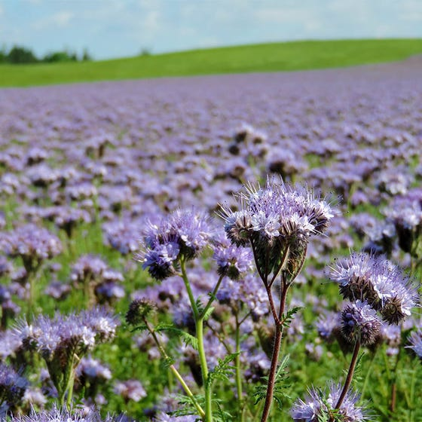
What Can We Do?
-Judicious use of insecticide
-Leaving/planting beneficial plants near gardens and fields (will help yield too!)
-Examine Farming Practices (Integrated Pest Management, Flood to Pivot irrigation, unprofitable areas to habitat)

Slide 9
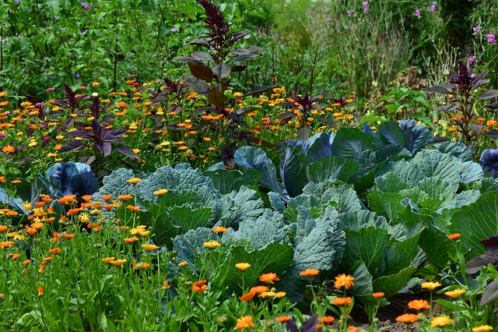
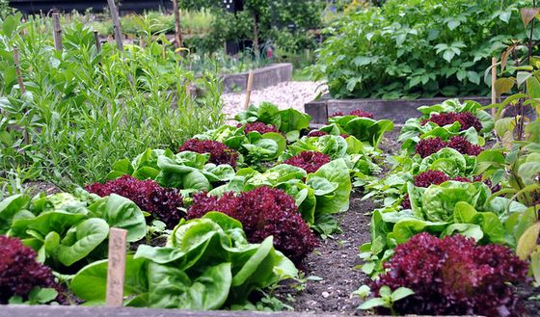
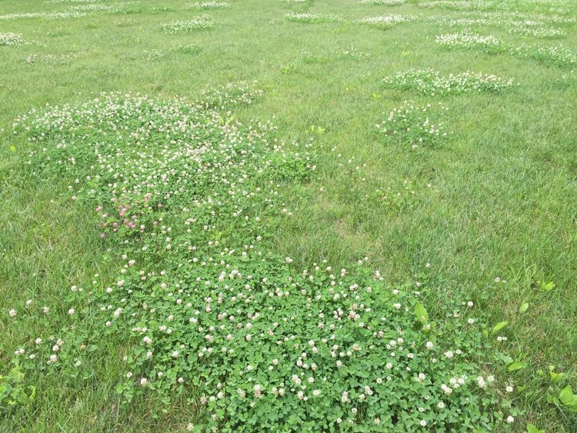
Attracting Pollinators on Smaller Landscapes
Flowering Plants for Garden & Landscaping(besides your crop)
-Bachelors Buttons
-Bee Balm
-Borage
-Calendula
-Chamomile
-Cosmos
-Daisies
-Lavendar
-Marigold
-Nasturtiums
-Sunflowers
-Sweet Alyssum
-Various Trees and shrubs
Can some of this be left?

Slide 10
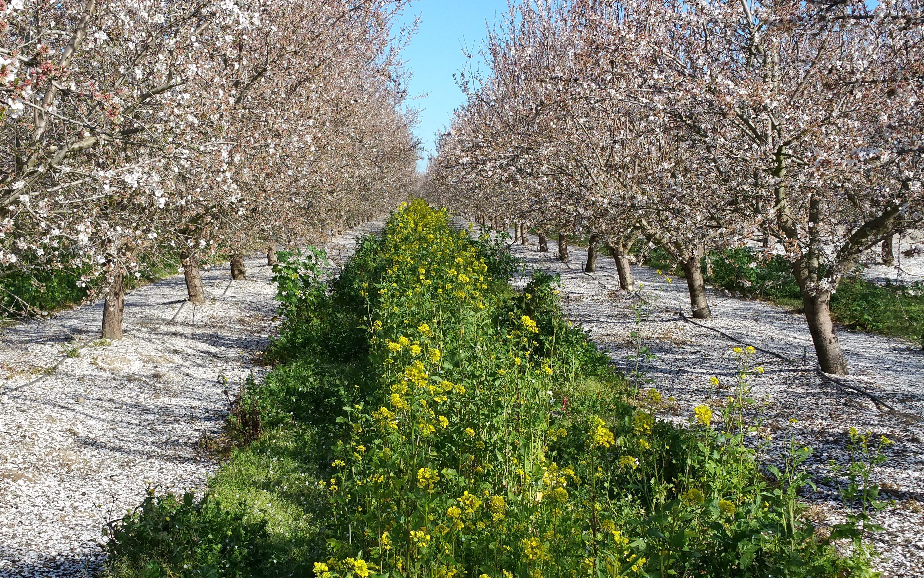
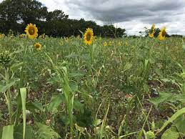
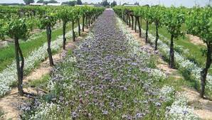
Attracting Pollinators on Larger Landscapes
Opportunities for Flowering Plants on your Farm:
-Legumes (sweet clover, alfalfa, other clovers)
-Sunflowers, Canola, Flax, Peas, Buckwheat, Beans (watch chem’s)
-Shelterbelts/windbreaks (lilac, willow, and flowering shrubs)
-Cover Crops (phacelia, brassicas, sunflower, chicory, chickpea, vetch, buckwheat, flax, most legumes) Wildlife love it!
-Field borders
-Wet/Saline areas
-Prairie Strips/Buffers
-Beneficial Insect lanes
-Well-managed pastures

Slide 11
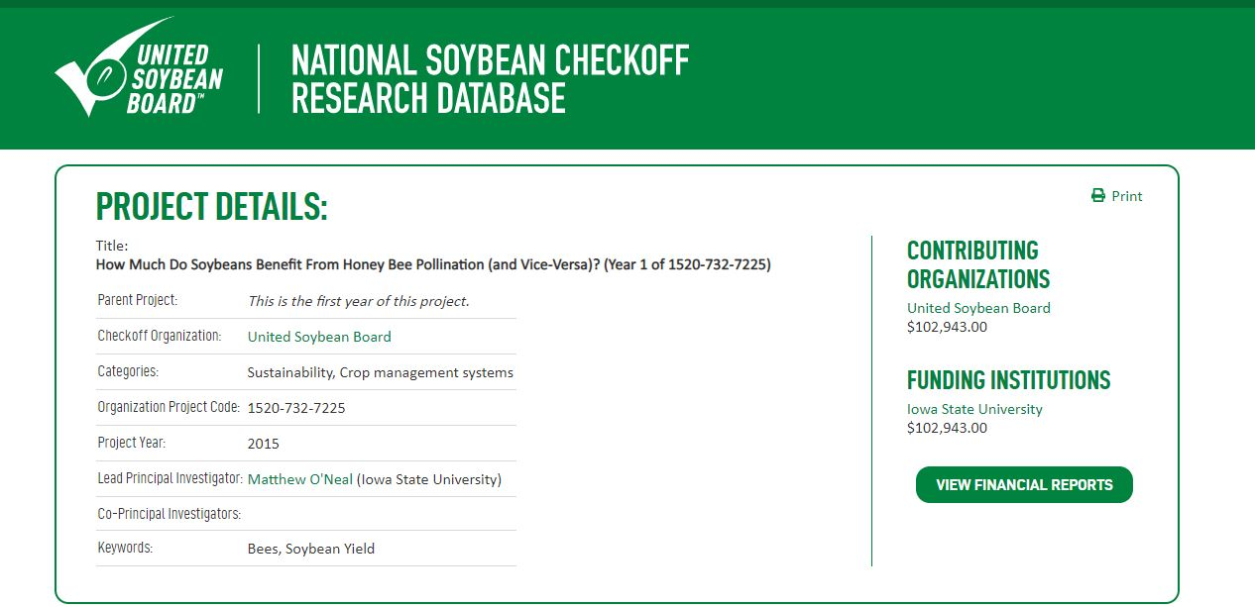

Slide 12
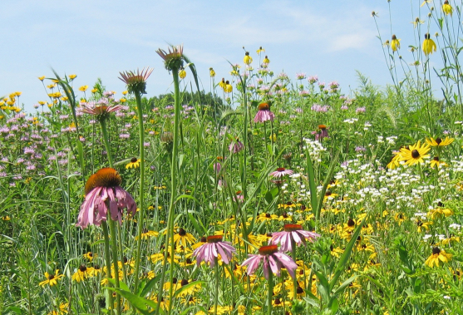
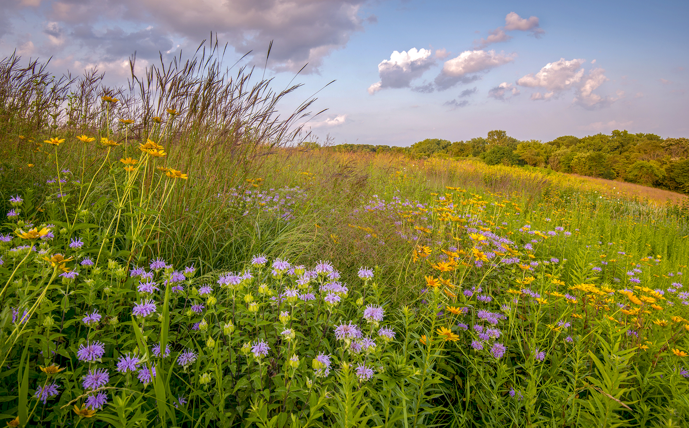
What We Hope to Accomplish

Slide 13
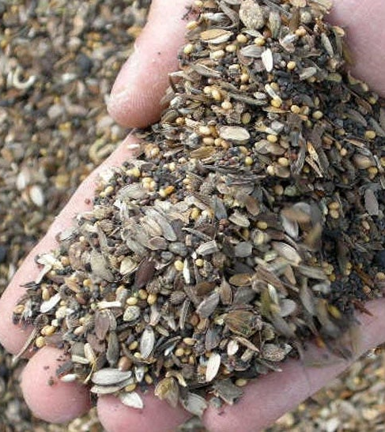
Where We Start
(Sleep, Creep, Leap)

Slide 14
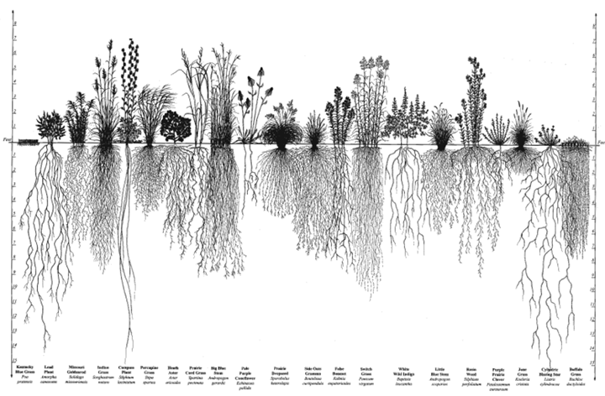
Our Seed Mix- Why Slower Establishment?
-Species are mostly native (root structure)
Think of the song “No Roots” for certain introduced species
Buffalograss
Lawn
grass

Slide 15
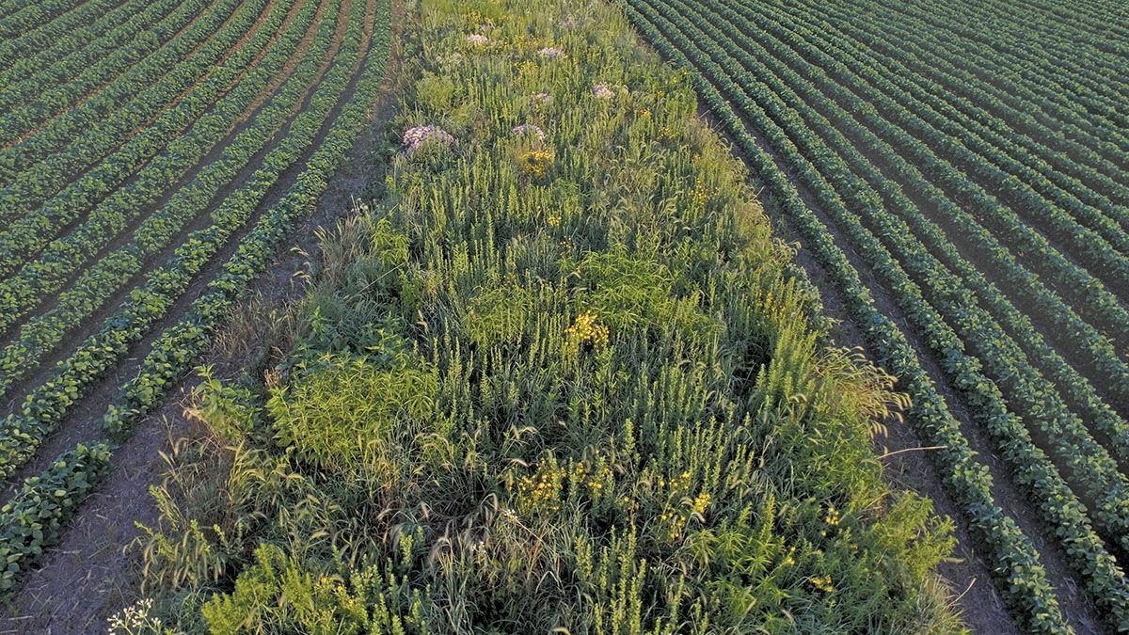
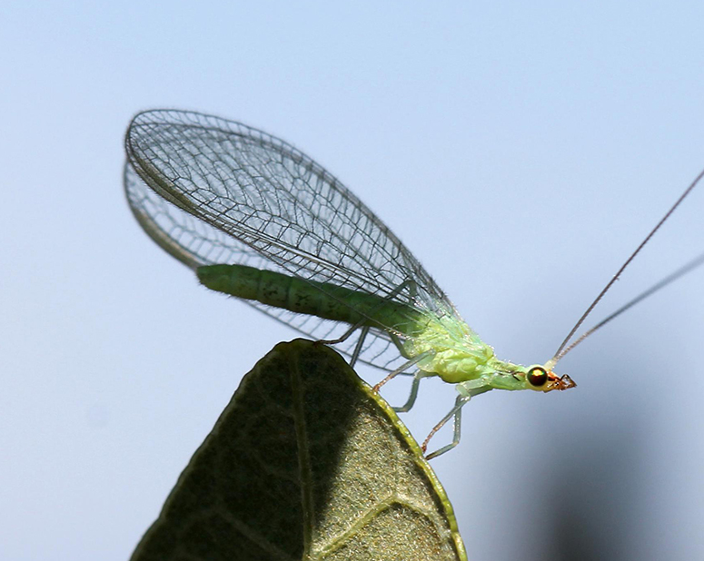
Why This Mix?
-Bunchgrasses for ground-nesting insects
-Grows back on its own every year
-Will increase water infiltration, reduce runoff
-Aesthetically-pleasing once established
-Provide forage/nectar resources
-Beneficial/Predator insect habitat
-Herbal/Medicinal resources (demo)
-Demonstrate different species on-site
-Species adapted to the site

Slide 16
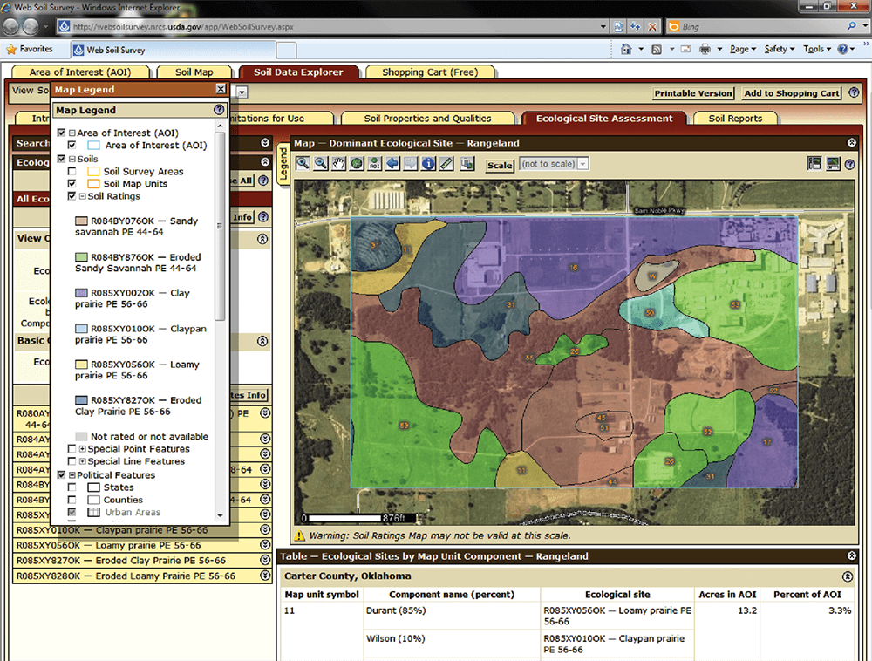
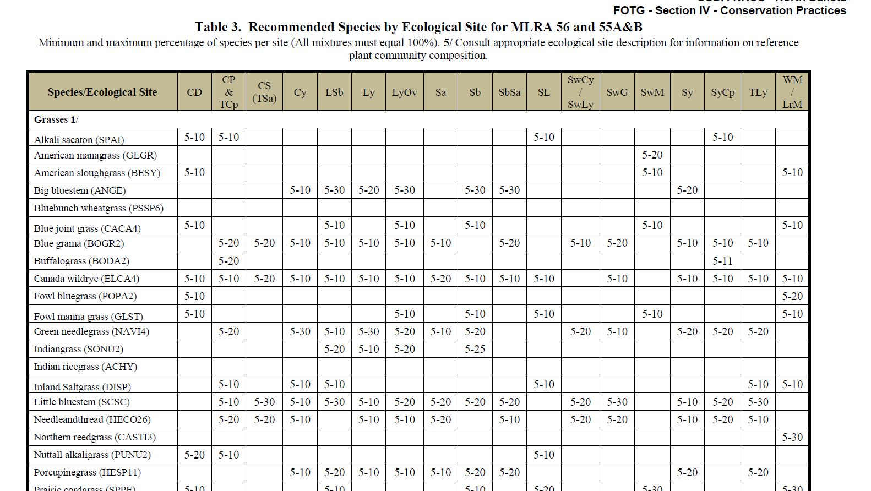
How I Chose Species
-Web Soil Survey to determine soils
-Aerial Images
-Review NRCS Tech guide for species suitability suggestions
-Personal experience
-Cost

Slide 17
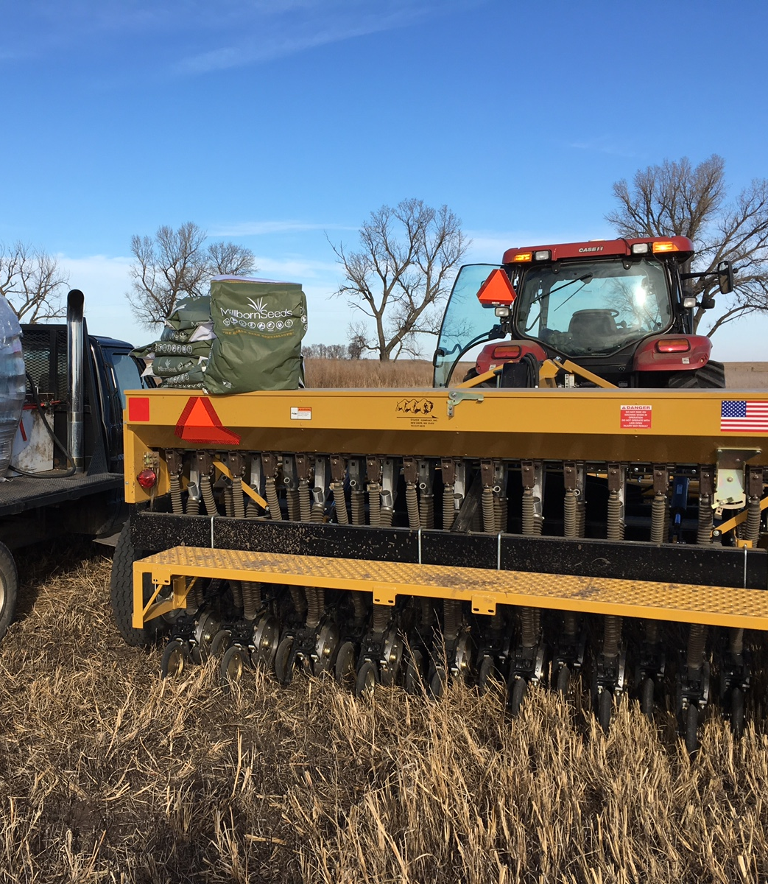
Items to Help Ensure Successful Seeding
-Clean, Weed-Free bed (bean stubble-consistent)
-Correct rate and seeding depth
-Firm soil (undisturbed stubble is best)
-Adequate moisture
-Correct soil temps/planting season
-Correct drill/equipment (grass vs grain)
-Correct species and varieties

Slide 18
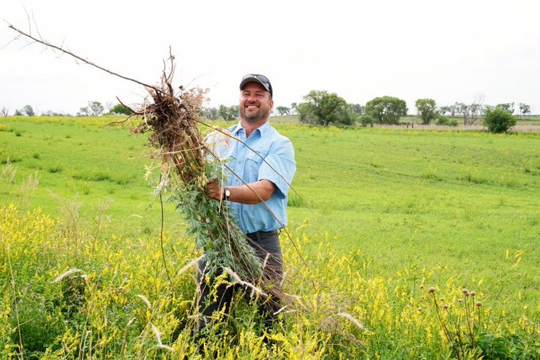
Maintenance
-Once established, every 2-4 years
-Plants are stimulated through use and helps regeneration
-Variety of tools available
-Least negative impact when done early in the year or after nesting season
-Spot-spraying, clipping, or hand-weeding may be required

Slide 19
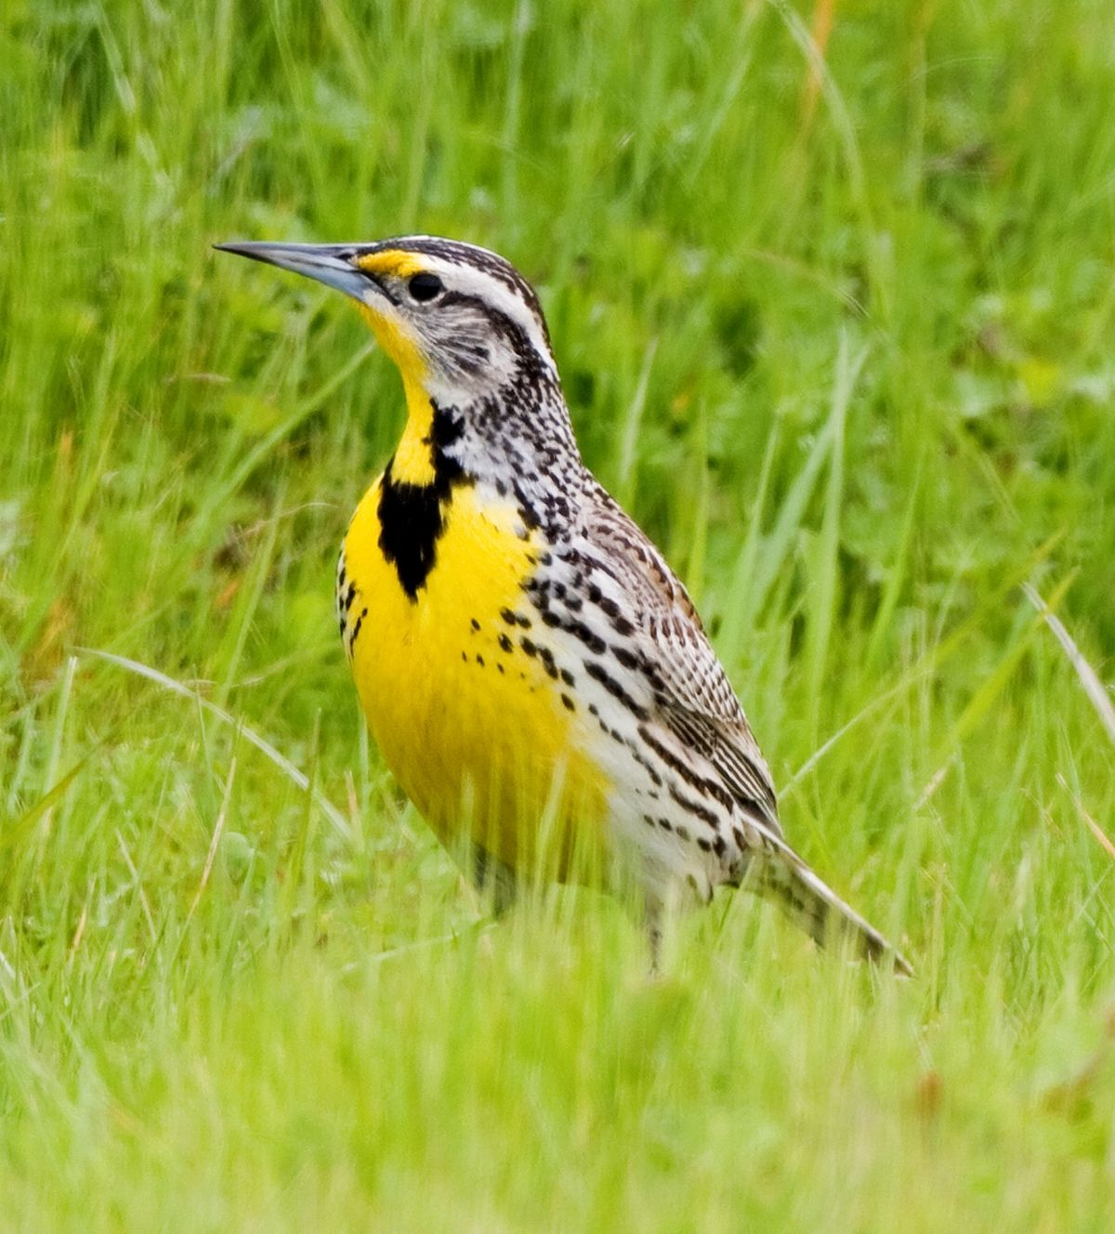
Enjoy!
This space should be a great place for:
-Birders
-Walkers/Joggers
-Outdoor classroom activities
-Community-focused education

Slide 20
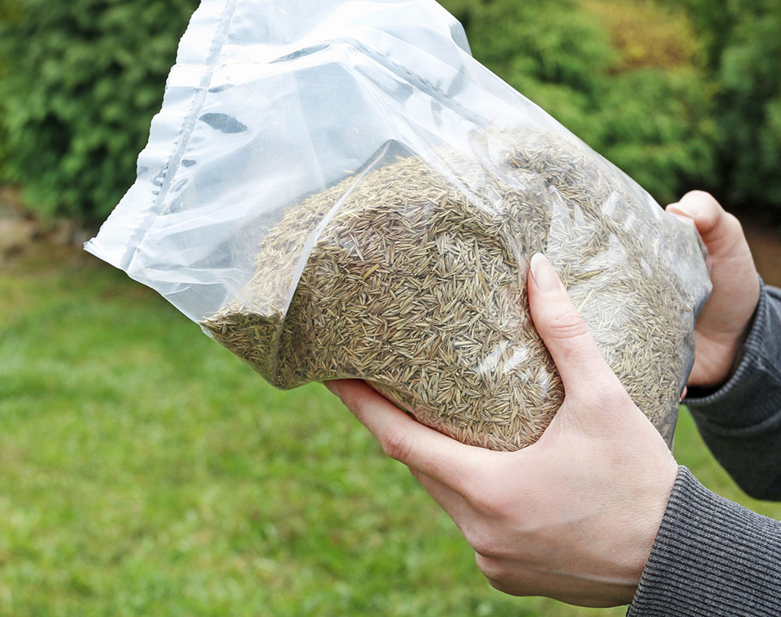
Where’s the Seed Man?

Slide 21
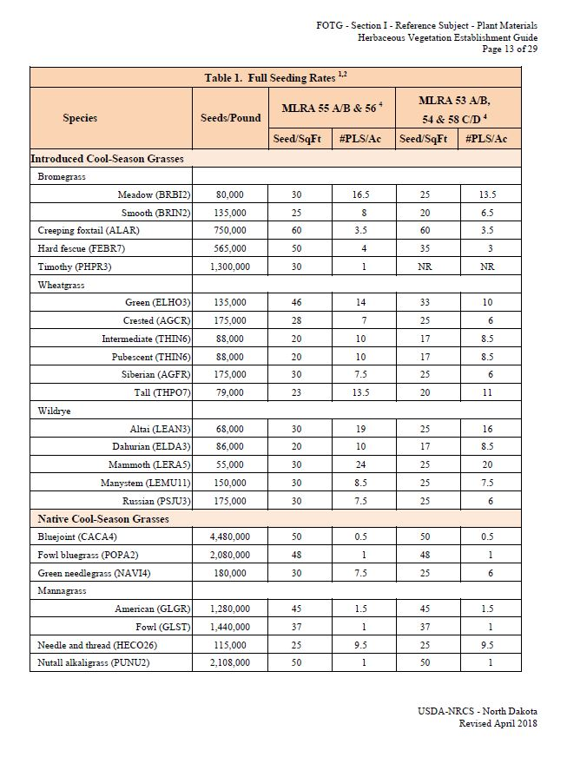
NRCS Herbaceous Vegetation Establishment Guide
-Different seed sizes means each species has a bit different # of seeds per pound
-Each plant has a Pure Live Seed (PLS) pounds per acre recommendation based on the # of seeds per square foot and how many seeds per pound (43,560 sq feet/acre)
-Pure Live Seed vs. Bulk Seed lbs? PLS factors in that there may be impurities in the seed and also that not every seed will germinate (determined from purity and germination #’s on seed lots when blended)
-100 lbs seed @ 95% germ and purity needs about 111 bulk lbs to get 100 PLS lbs.

Slide 22
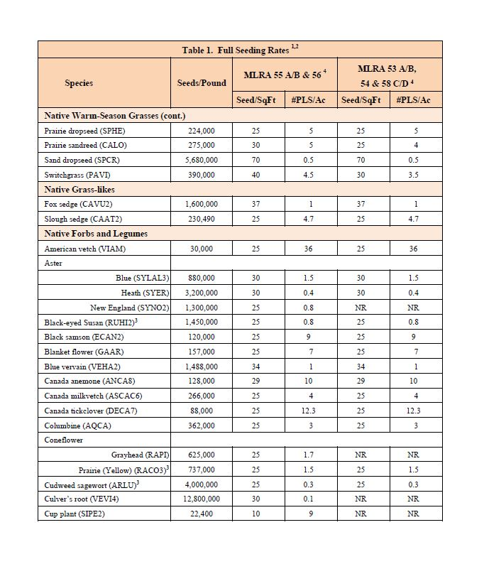
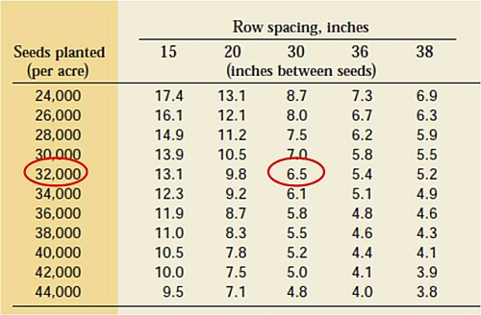
Compare Rates
Corn:
-Seeded around 30k seeds per acre (=0.69 plants/sq. ft.)
-1 unit (about 50 lb bag) has 80,000 seeds
Perennials
Soybeans:
-Seeded between 130k-180k seeds per acre (4 plants/ sq.ft)
-1 unit is 140k seeds
-Commonly 2300-3200 seeds/lb depending on variety and lot #
WHOAH!
No wonder this is expensive!

Slide 23
Some Numbers from our Mix
- Plains Coreopsis 1.65 M
Blue Aster 880,000
White Clover 800,000
Wild Bergamot 1.2 M
Coneflower ~700,000
Evening Primrose 1.376 M
Western Yarrow 2.8 M
-Big Bluestem 176,000
-Switchgrass 390,000
-Green Needlegrass 180,000
-Western WG 112,000
-Canada Wildrye 115,000
-Maximillian Sunflwr 250,000
-Blanketflower 157,000
-Canada Milkvetch 266,000

Slide 24
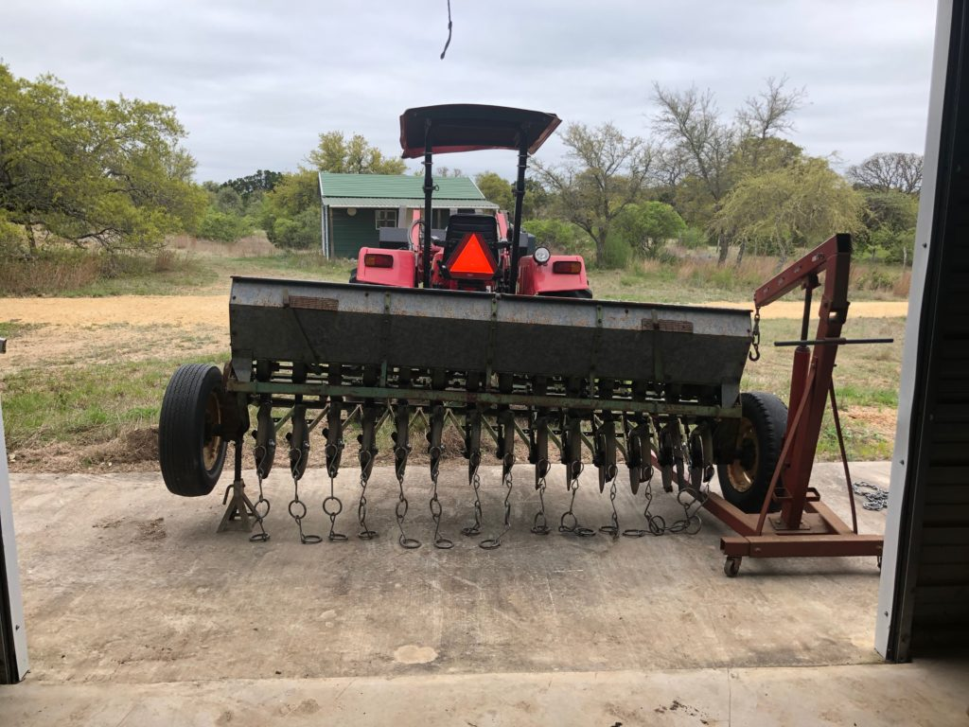
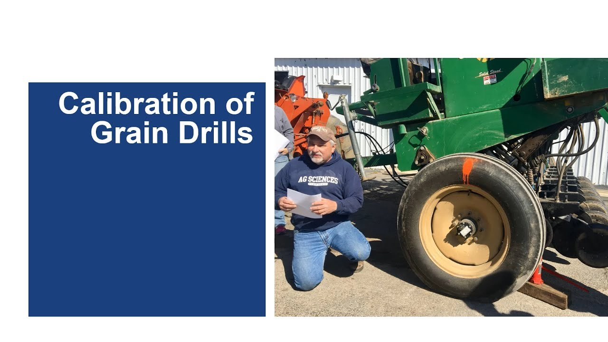
Take Away…CALIBRATE YOUR DRILL!

Slide 25
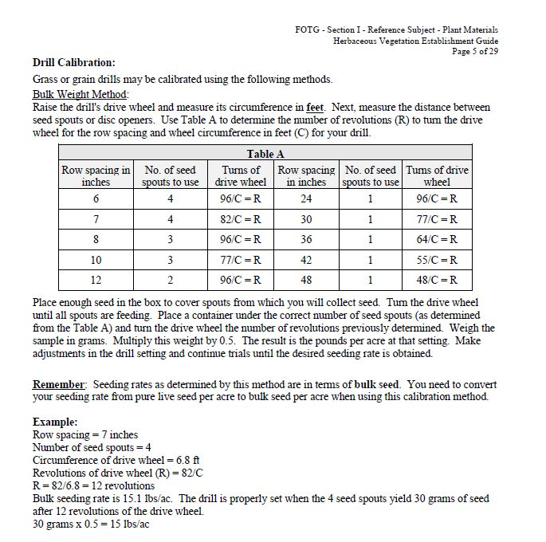
In Summary:
Turn Wheel
Collect Seed
Weigh Seed
Adjust

Slide 26
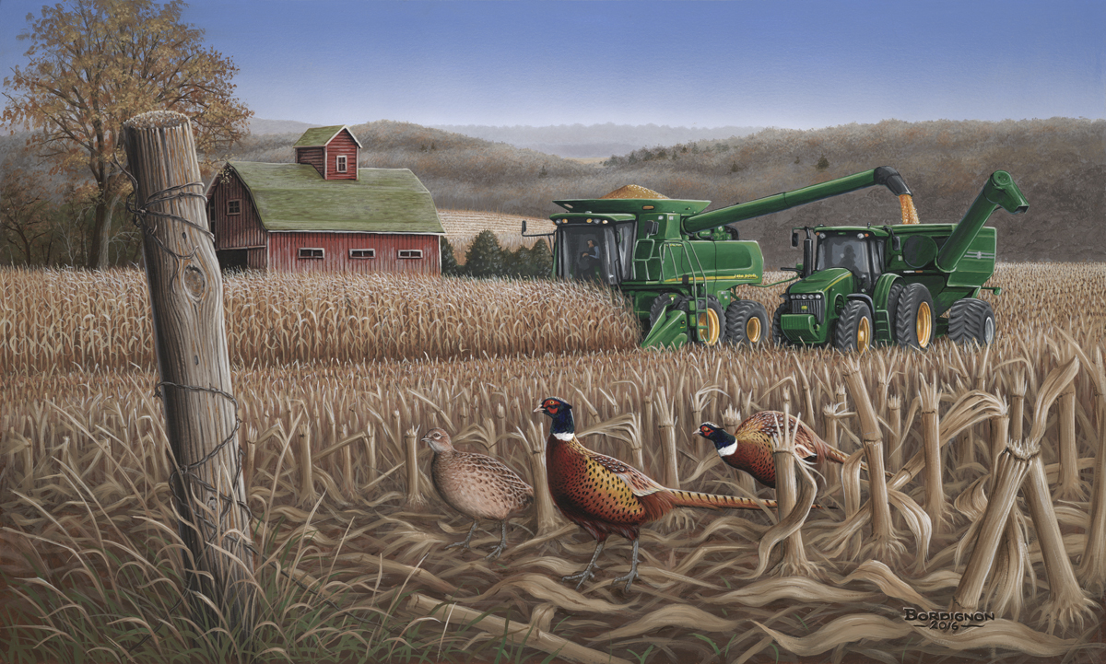
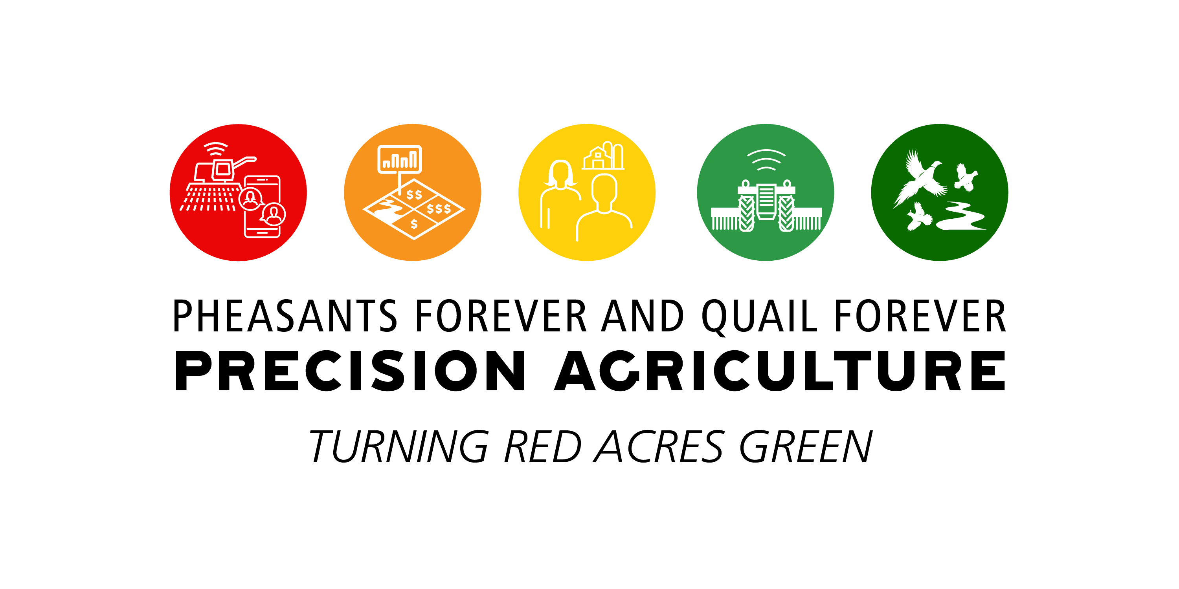
Thanks for your Time! Questions ??
Austin Lang
alang@pheasantsforever.org
701-840-3062
Twitter: @NDBountiful

