Slide 1
Today’s Hottest Music
Full Power Radio/ Jammin 107.7 WWRX/ P: 860.464.1065 / F: 860.464.8143 jammin1077.com

Slide 2
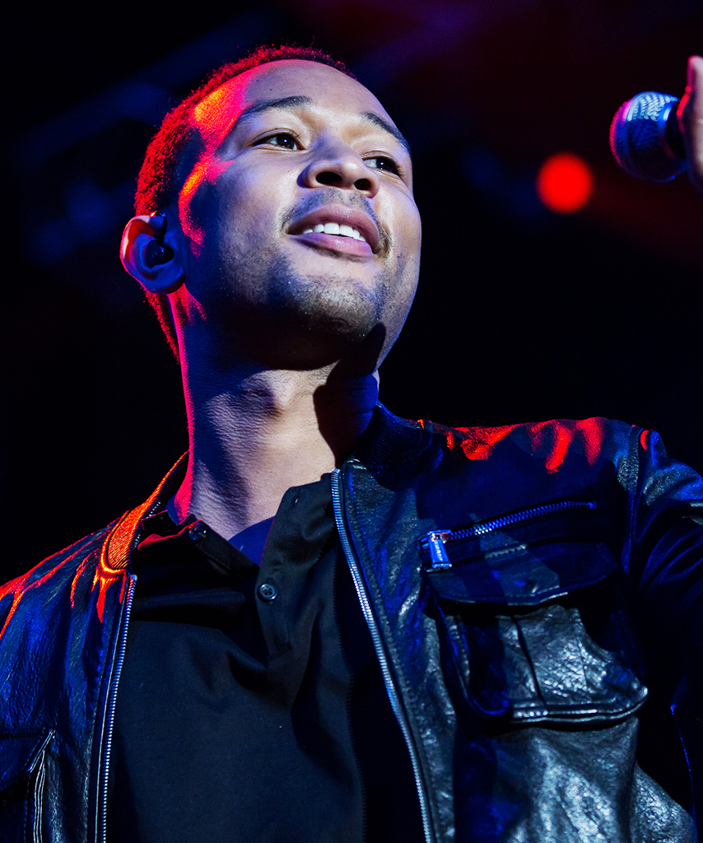
Our Music
Jammin 107.7 plays today’s hottest music. The Jammin 107.7 Programming Team is constantly conducting music studies and research to ensure that we are playing the music that our listeners want to hear.
Call Letters: WWRX
Dial Position: 107.7 FM
Web Site: www.jammin1077.com (listenonline!)
Format: Top 40
Coverage: Eastern CT /Southern RI / Eastern Long Island
Audience: Adults 25-49 / Women 25-49
The Artists
Rihanna, Bruno Mars, Justin Timberlake, Alicia Keys, Beyonce, Kanye West, Pitbull, Katy Perry , Mariah Carey,
and more.
Our Listeners
The Jammin 107.7 listener is in the “age of acquisition.” A young adult probably married, with at least one child, maybe two, in their first home, buying their first and second family vehicle. They are coming into their own, established in their career and life choices. They are spending money on products and services like furniture, life insurance, automobiles, electronics, clothing, outdoor activities and much more .

Slide 3
Pebbles & Boomer
Pebbles & Boomer consider themselves the hosts of the party on their live and local radio show The Morning Jam. Broadcasting live from Jammin Studios in Ledyard, Pebbles & Boomer entertain listeners with up-to-the-minute entertainment and pop culture information, todays hottest music, and regular features such as Entertainment News named “Jammin Juice” and the ever-popular prank feature “Phone Check.” All of which have made Pebbles and Boomer one of the most popular morning shows in all of Southern New England.

Slide 4
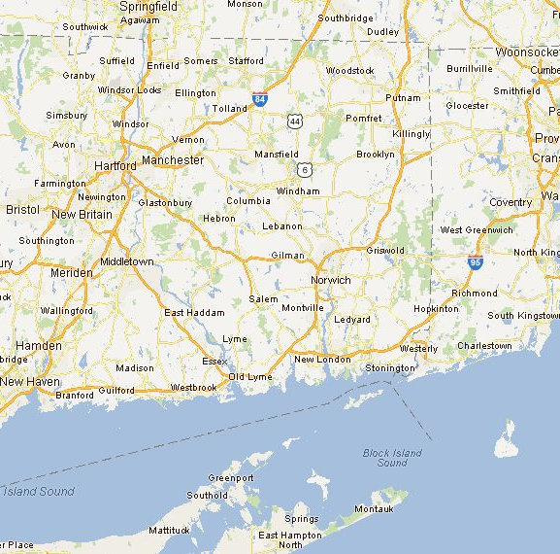
Coverage Map

Slide 5
Full Power Radio’s Family Of Radio Stations
New London
Hartford/Waterbury
Springfield
New Haven/ Bridgeport
Providence
Burlington, VT

