Slide 1

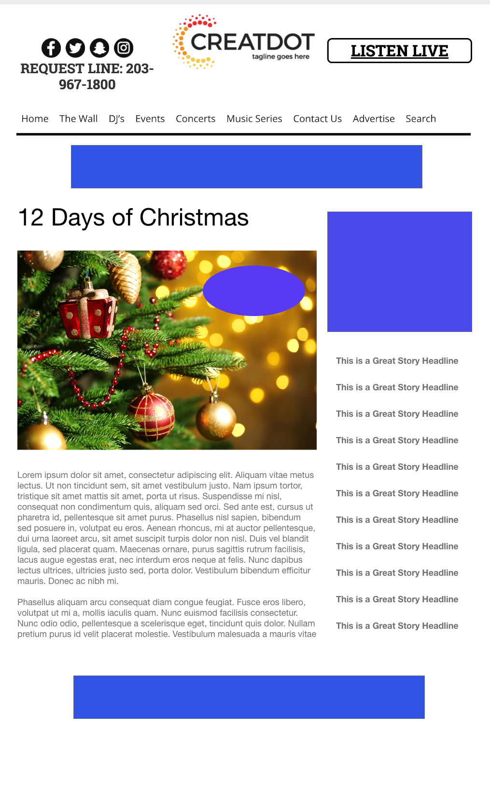
12 Days of Christmas
This daily Survey-Based Sweepstakes offers a daily prize and entry reward coupon for up to 12 different sponsors.
WITH YOUR INVESTMENT, YOU RECEIVE:
Lead List of All Entrants & Survey answers
Coupon distribution
12 Recorded Promos (for specific day)
Branded Website Landing Pages
300x250 Banner
Two 768x90 Leaderboard Banners
$X,000
Bob Salesperson
bsalesperson@yourdomain.com
800-555-1212

