Slide 1
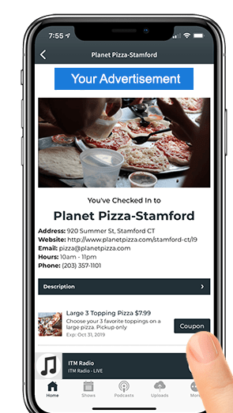
App Check-In Scavenger Hunt
During this X WEEK PROMOTION, the audience goes on a scavenger hunt around the city using using the station app to find clues! The clues (at the various sponsor businesses) guide them to the next location. Each business supplies a coupon and a clue!
INVESTMENT: $X,000
WITH YOUR INVESTMENT
Website & App branding
Coupon to all entrants
300x250 on website landing page
320 x 50 on app landing page
M,T,W,Th,F, Liners
Website, App Business Profile & Landing Pages
Bob Salesperson bsalesperson@yourdomain.com 800-555-1212

