Slide 1
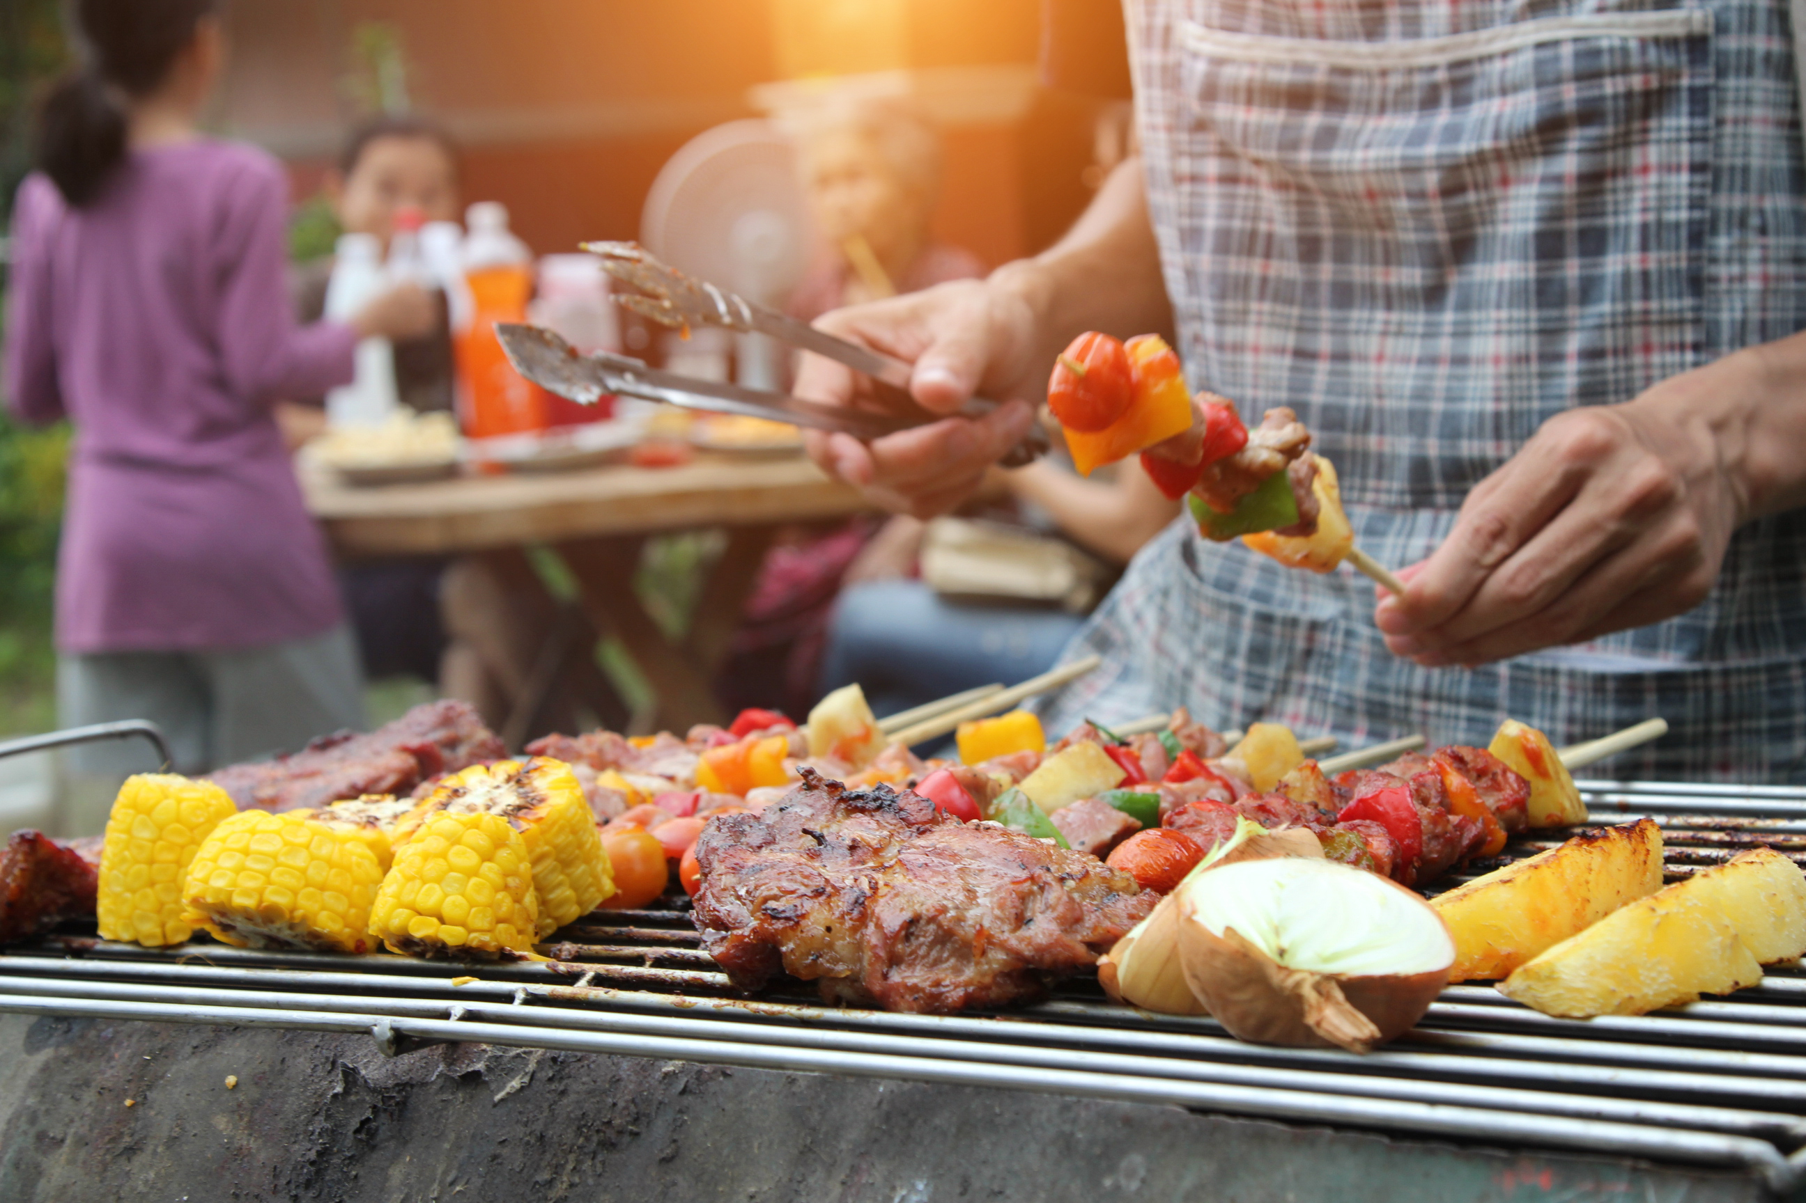
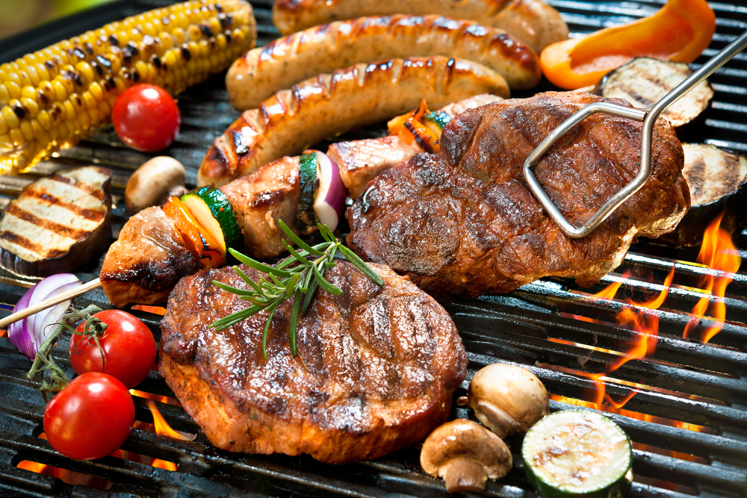
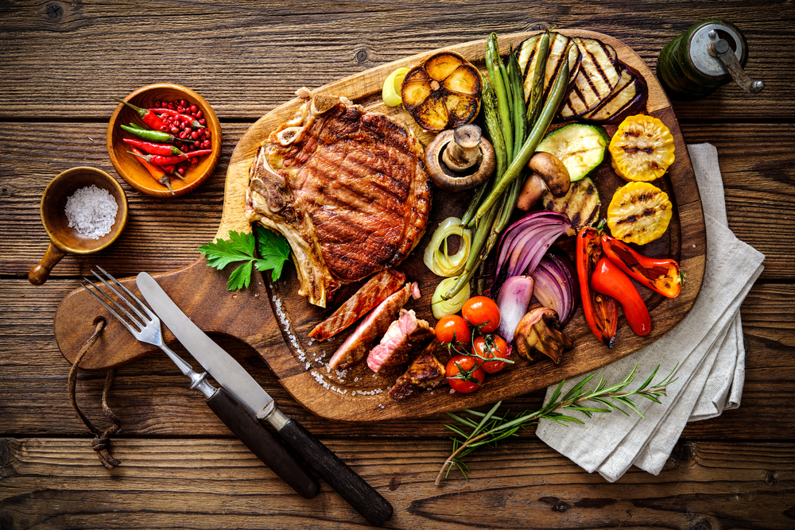
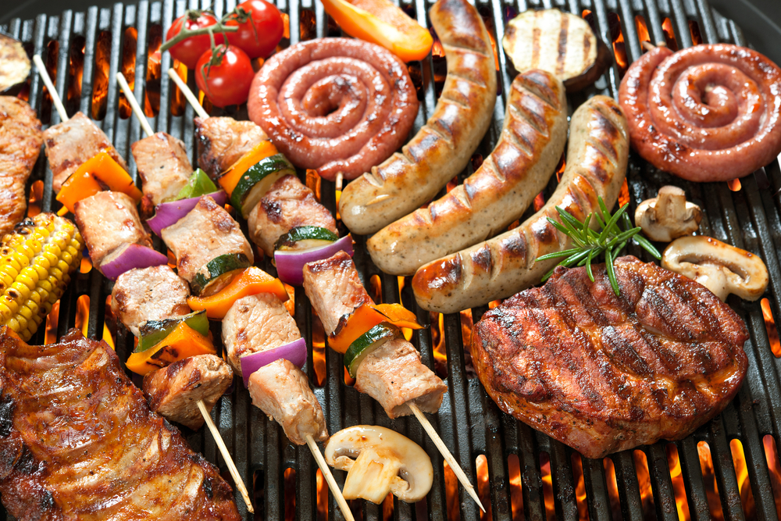
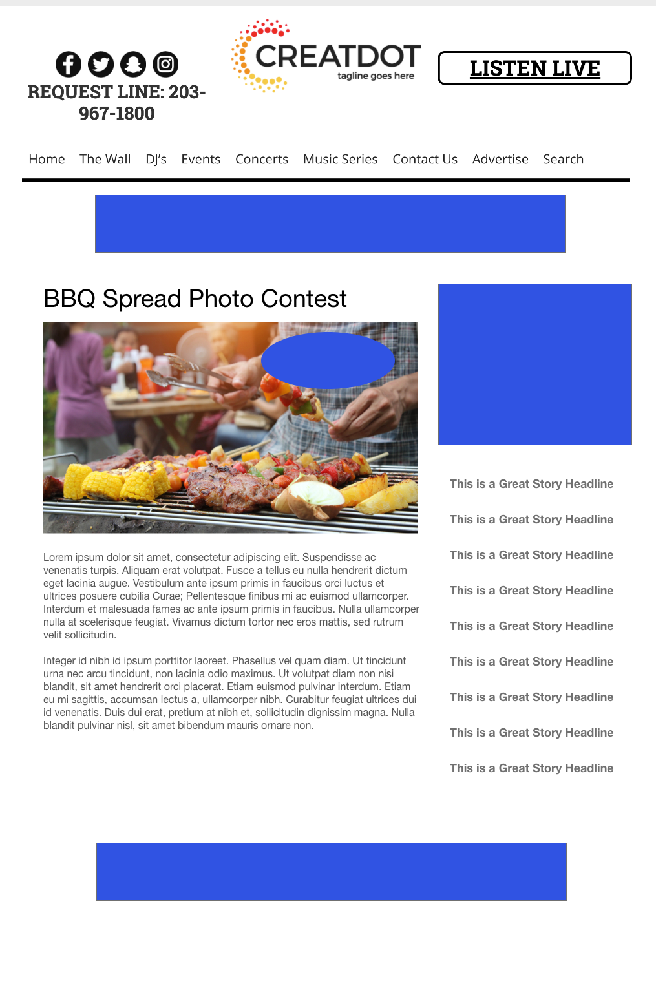
SPREAD
PHOTO CONTEST
During this 2 WEEK PROMOTION, the audience submits photos of their best BBQ spreads. Juicy steaks, mouthwatering burgers and tender chicken dripping with sauce!
After the photos are all submitted, the public votes on who has the best spread of delicious grilled food!
The winner receives a prize that revolves around BBQ’ing / outdoors
With Your Investment, You Get
Lead List of All Entrants
App Open Pre-roll
Branded Website Landing Pages
X Recorded Promos
X :15 Second Commercials
Investment
$X,000 + Prize
Bob Salesperson
bsalesperson@yourdomain.com
800-555-1212

