Slide 1


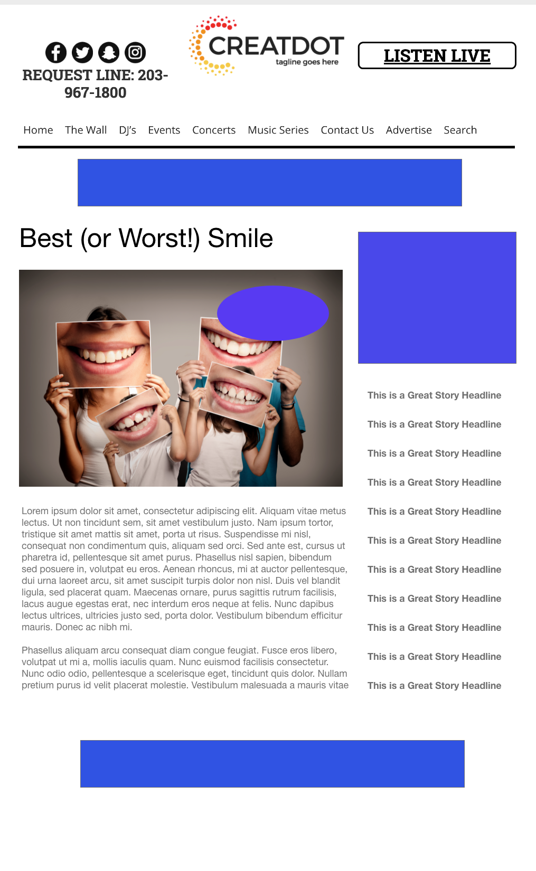

BEST (OR WORST!)
SMILE
During this X WEEK PROMOTION, the audience uploads their best (or worst!) smiles.
After submissions are received, front-end voting helps pick a winner
INVESTMENT: $X,000 + Prize
WITH YOUR INVESTMENT, YOU GET
Lead List of All Entrants
X Live Segments
App 320x50 Banner
Branded Website Landing Pages
300x250 Banner
X Recorded Promos
Bob Salesperson bsalesperson@yourdomain.com 800-555-1212

