Slide 1

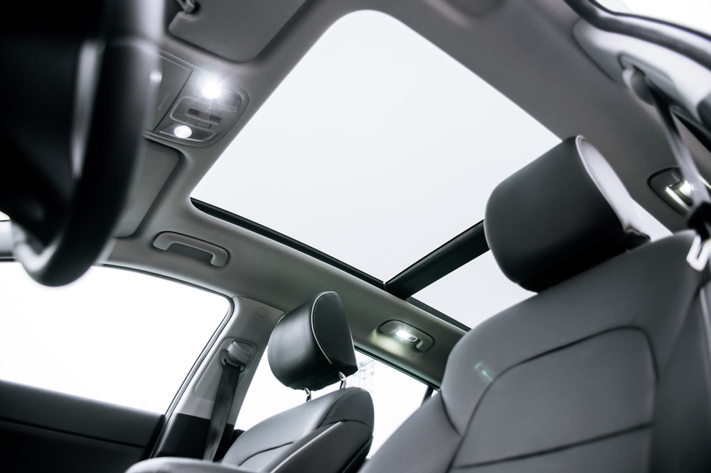
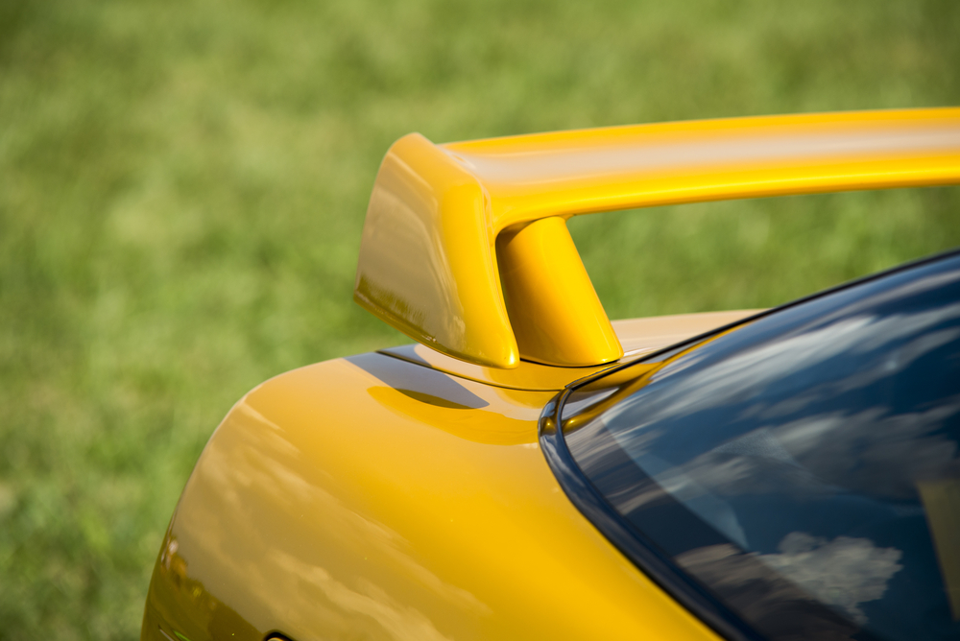
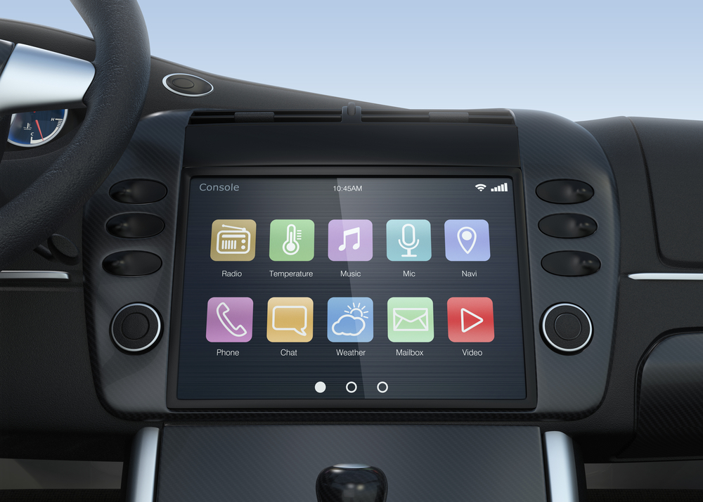
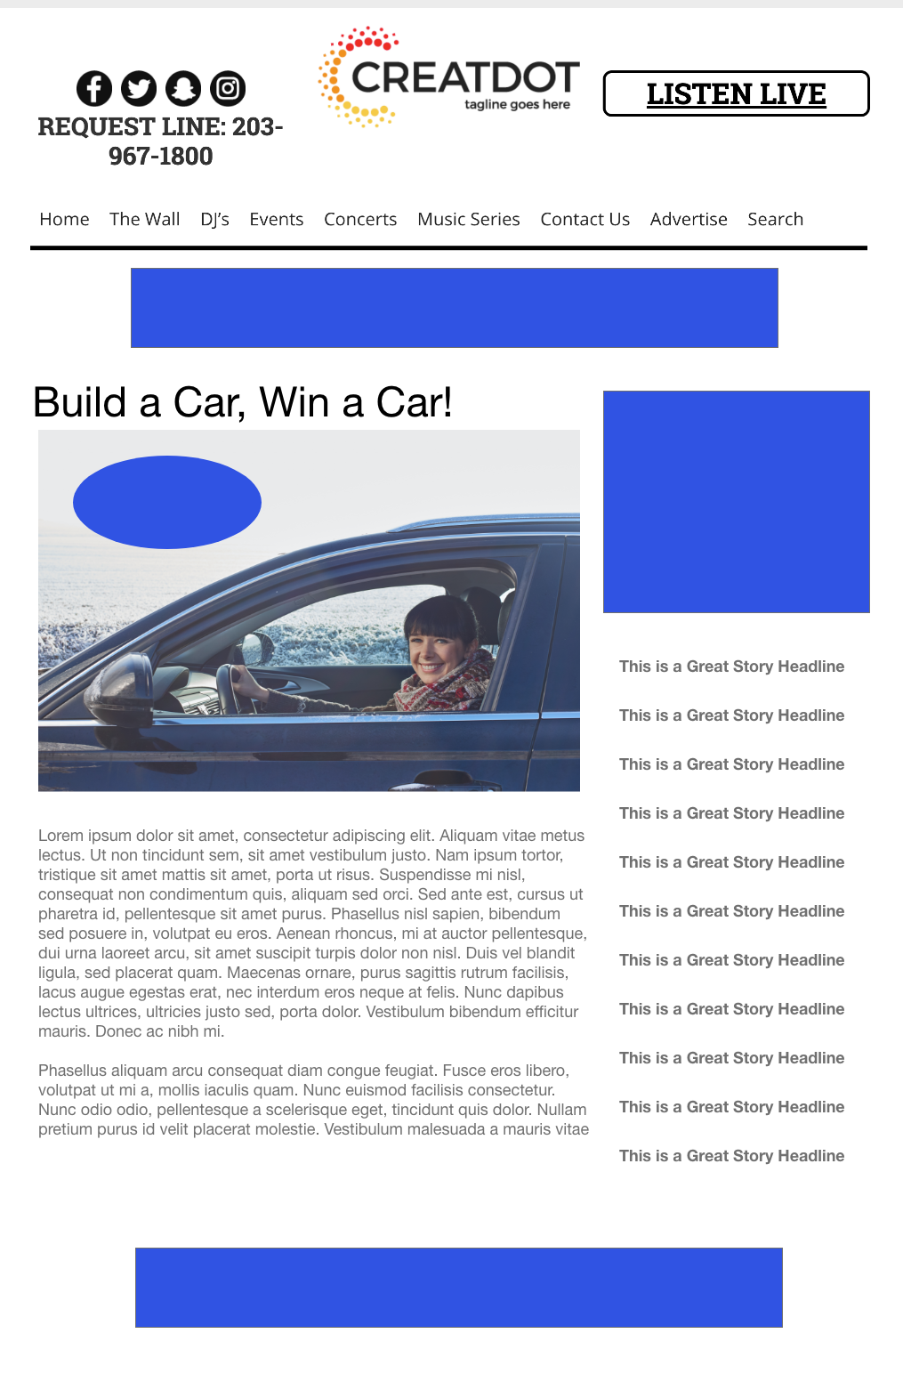
BUILD A CAR
WIN A CAR
During this X WEEK PROMOTION, the audience fills out weekly surveys around a different aspect of a car (car color, interior, options, etc.) from fixed choices.
Each entrant would have a unique build depending on what they selected each week.
At the end of the promotion, the winner receives a free 1 year lease for a car that matches the “build” they created.
With Your Investment, You Get
Lead List of All Entrants
X Live Segments
App Open Pre-roll
App 320x50
Branded Website Landing Pages
X Recorded & live Promos
X :15 Second Commercials
Investment
$X,000 + Prize
Bob Salesperson
bsalesperson@yourdomain.com
800-555-1212

