Slide 1
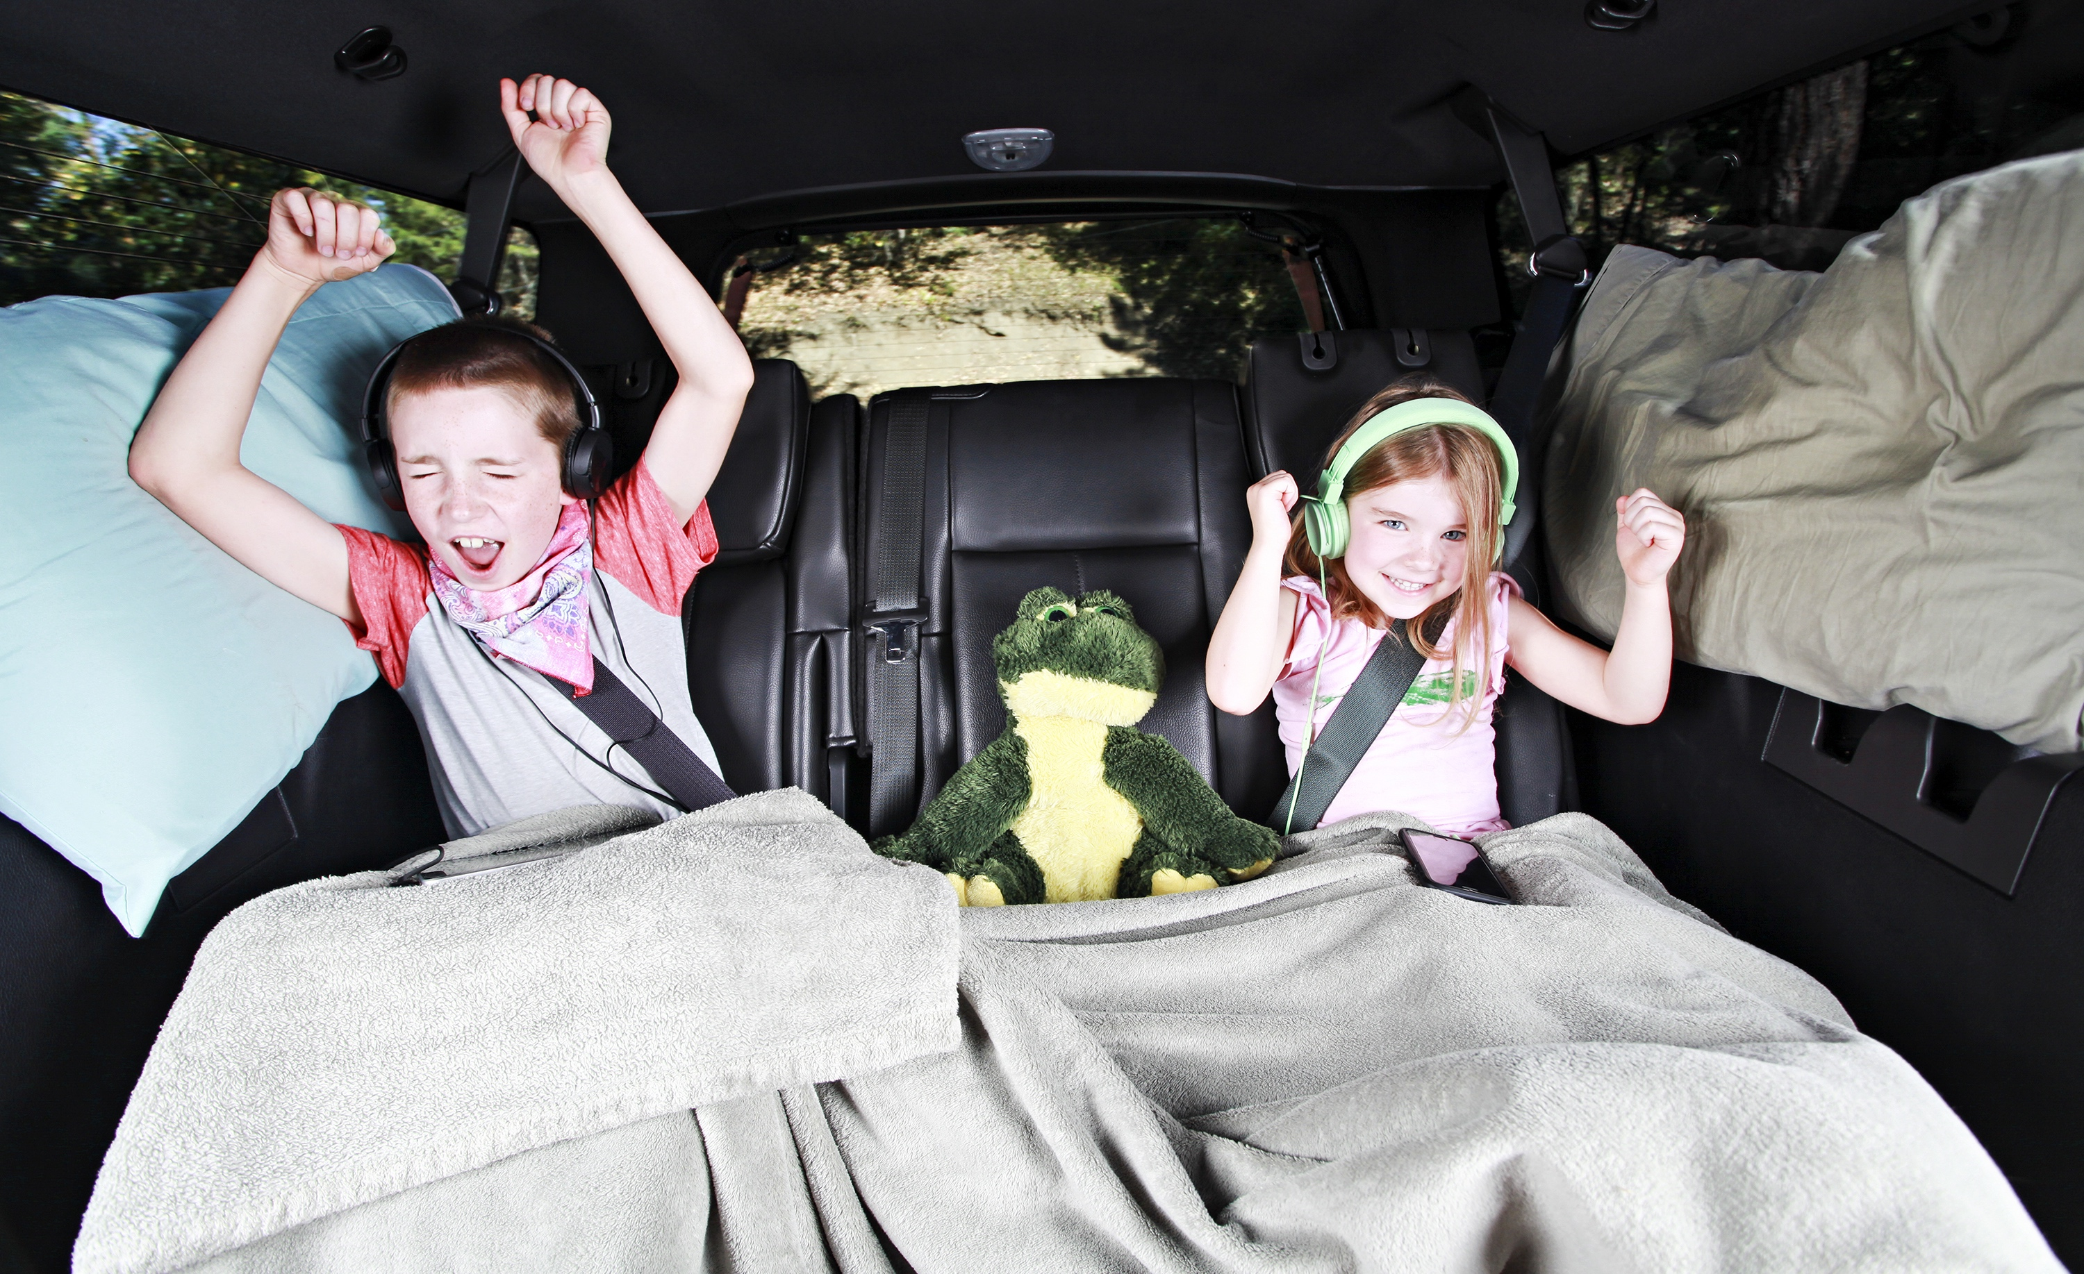
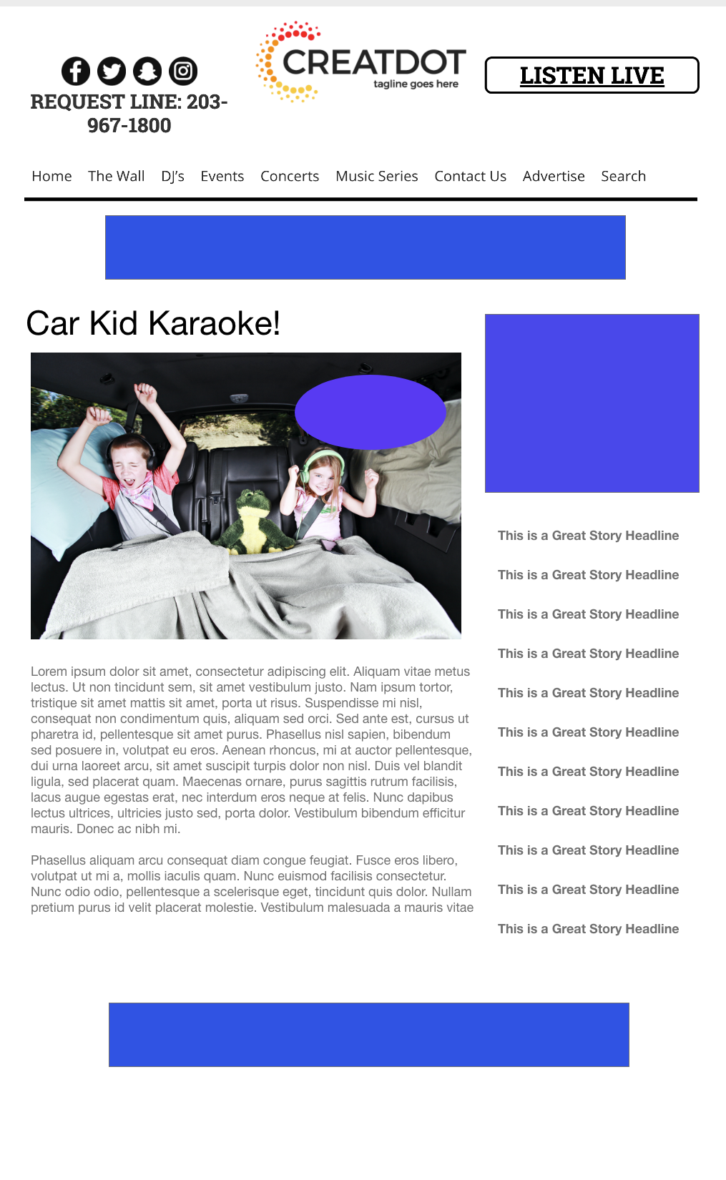
Car Kid
Karaoke
During this X WEEK PROMOTION, the audience uses the station app to upload a video of their kids singing to today’s hottest songs in the car!
Your Investment gets you
Lead List of All Entrants
Three Live Weekly Segments Two Weekly Liners
Streaming Pre-roll Video Website & App 320x50 Banner
Branded Website Landing Pages
300x250 Banner
X Recorded Promos
X :15 Second Commercials
investment
$X,000 + Kick Off Prize
Bob Salesperson
800-555-1212
bsalesperson@yourdomain.com

