Slide 1
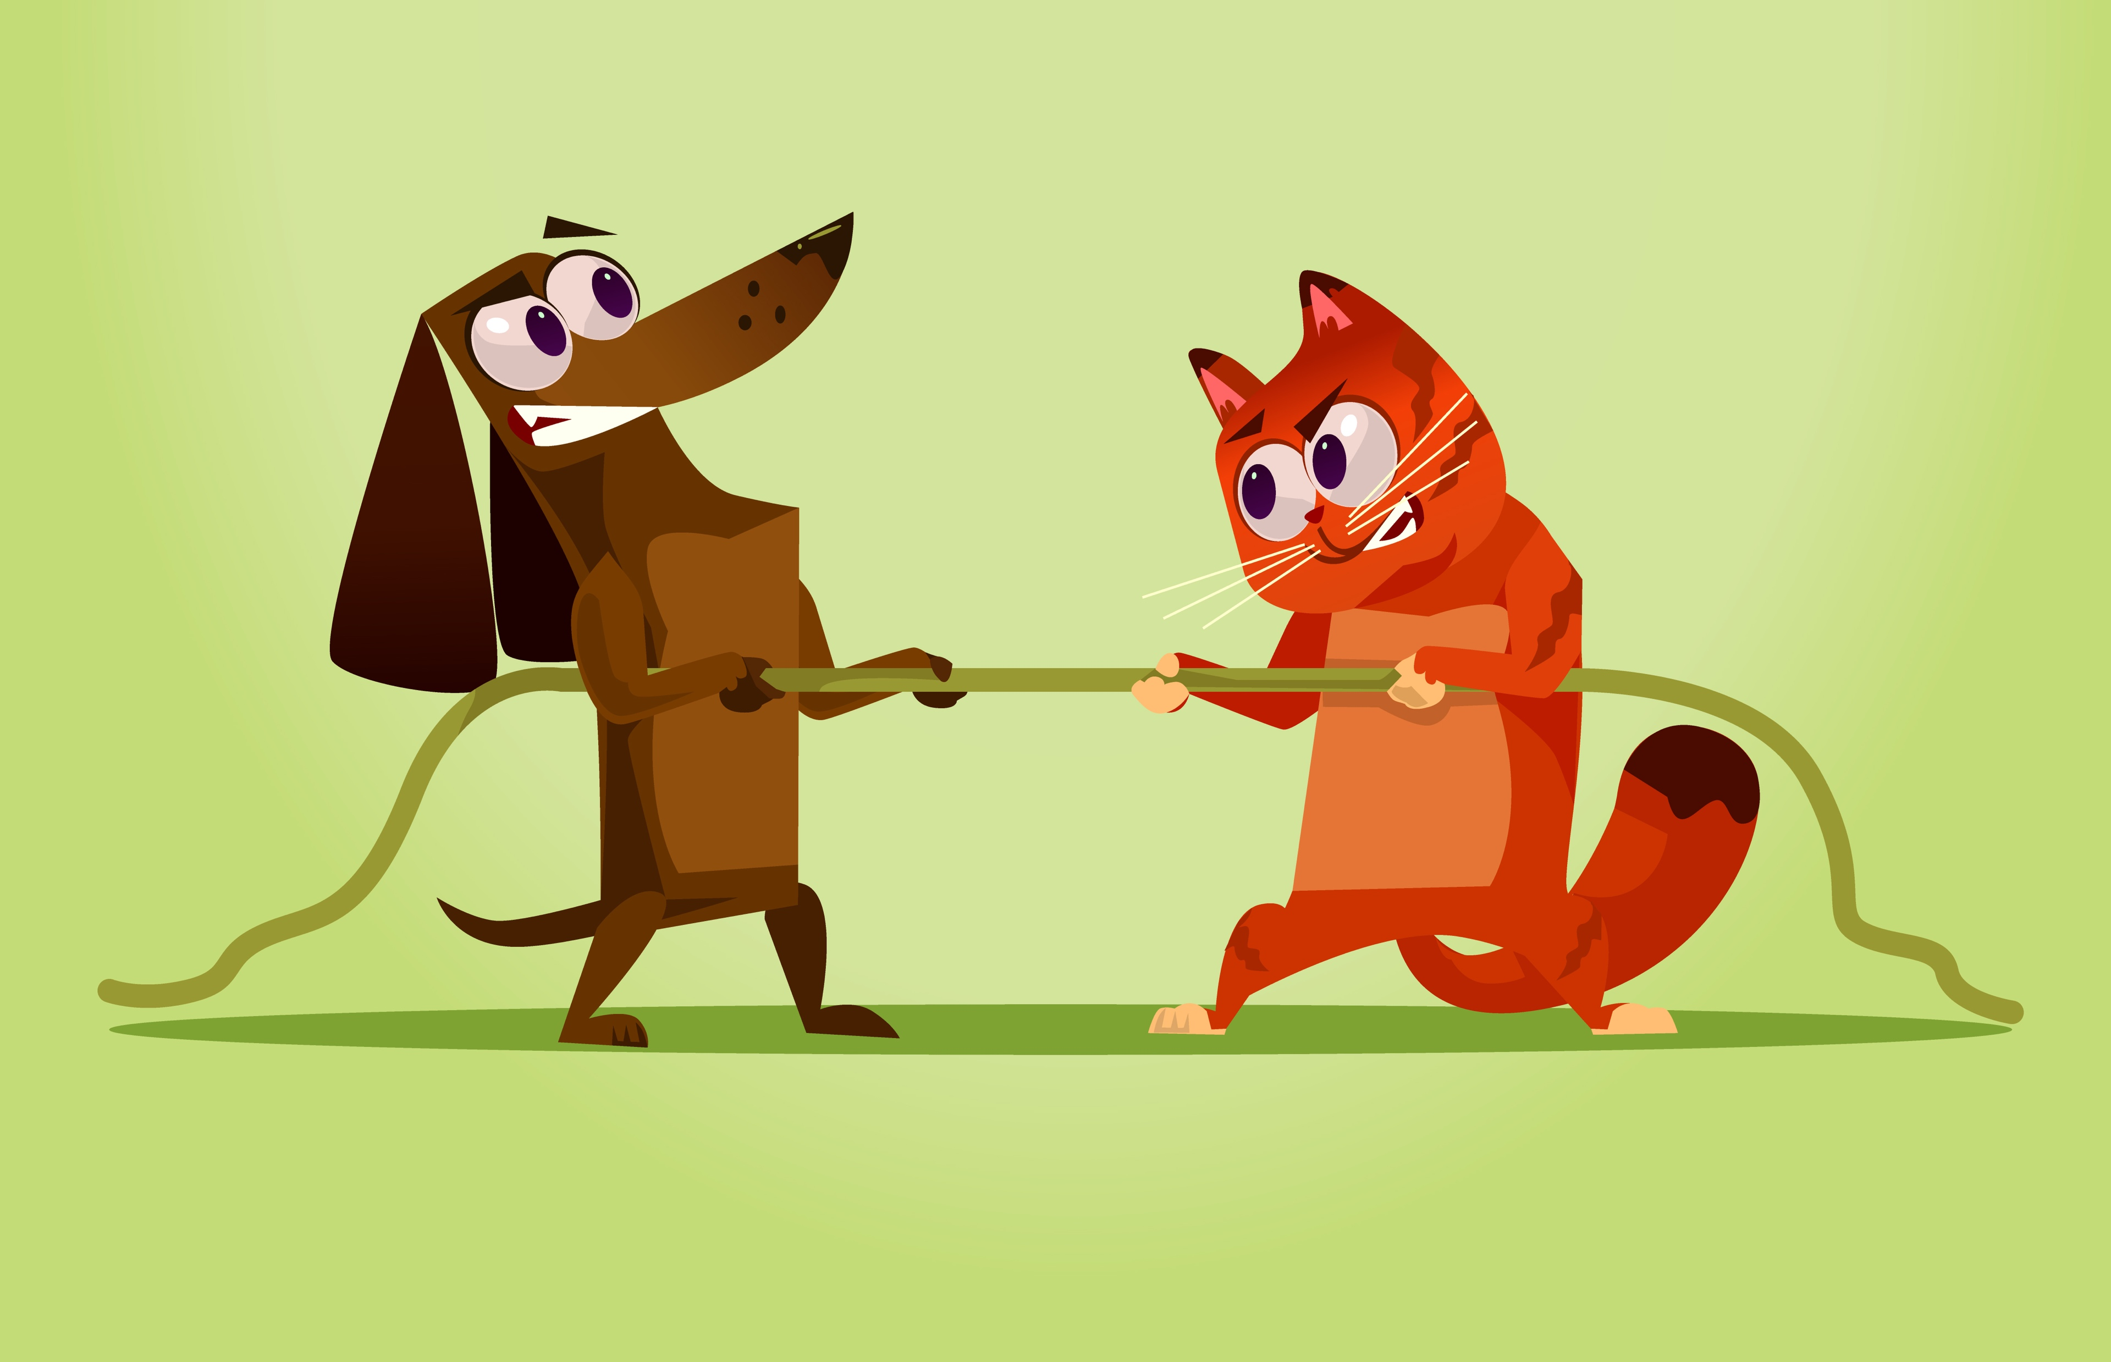
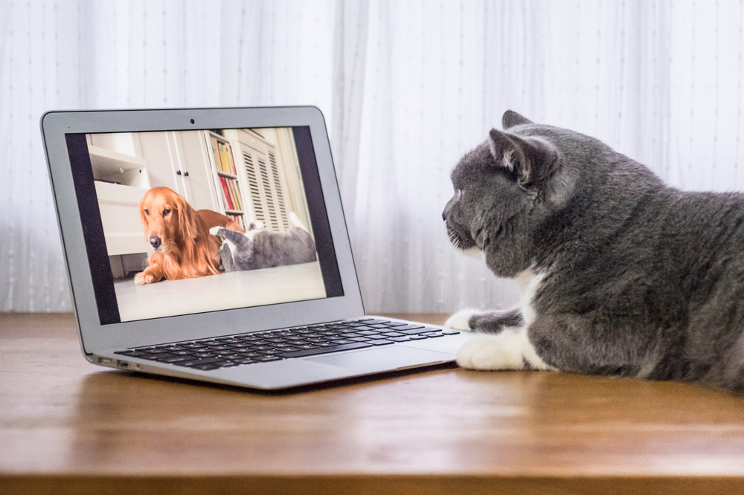
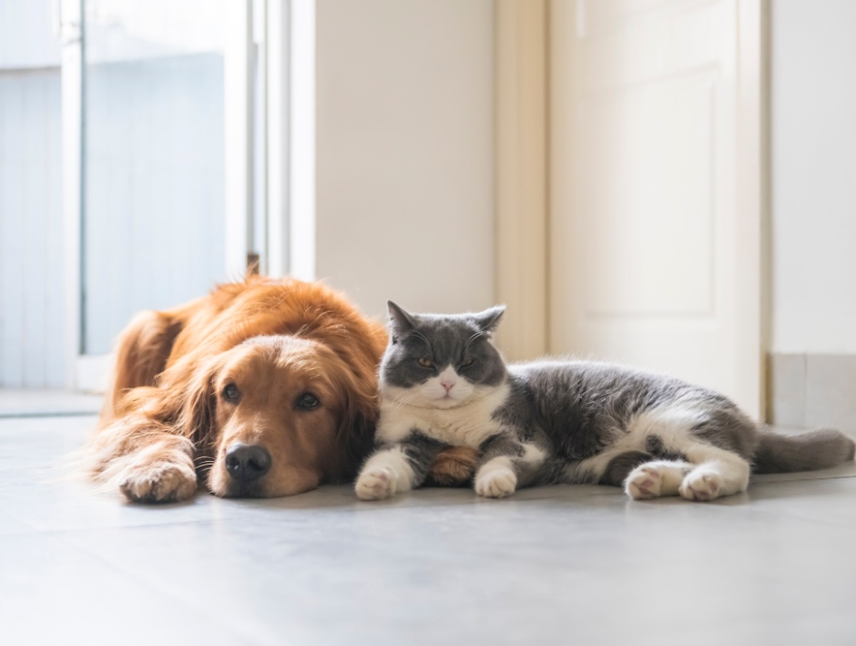


CATS VS. DOGS
During this X WEEK PROMOTION, we finally find out who truly is man’s best friend: CATS or DOGS.
The audience uses the app to upload a picture of their furry feline or loyal canine. All submissions go onto the website & app for public voting.
With Your Investment, You Get
Lead List of All Entrants
Five Live Segments
Streaming Pre-roll Video Website
& App
App Open Pre-roll
App 320x50
Branded Website Landing Pages
300x250 Banner
X Recorded Promos
X Live Promos
X :15 Second Commercials
Investment
$X,000 + Prize
Bob Salesperson
bsalesperson@yourdomain.com
800-555-1212

