Slide 1
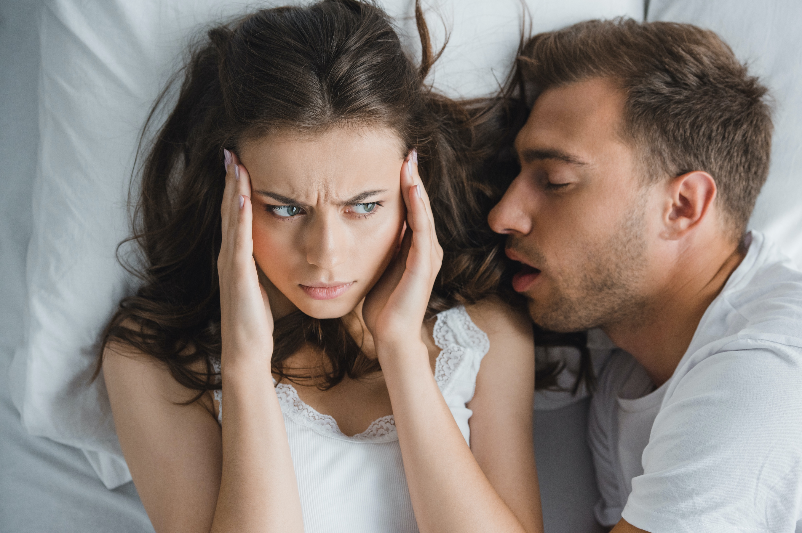

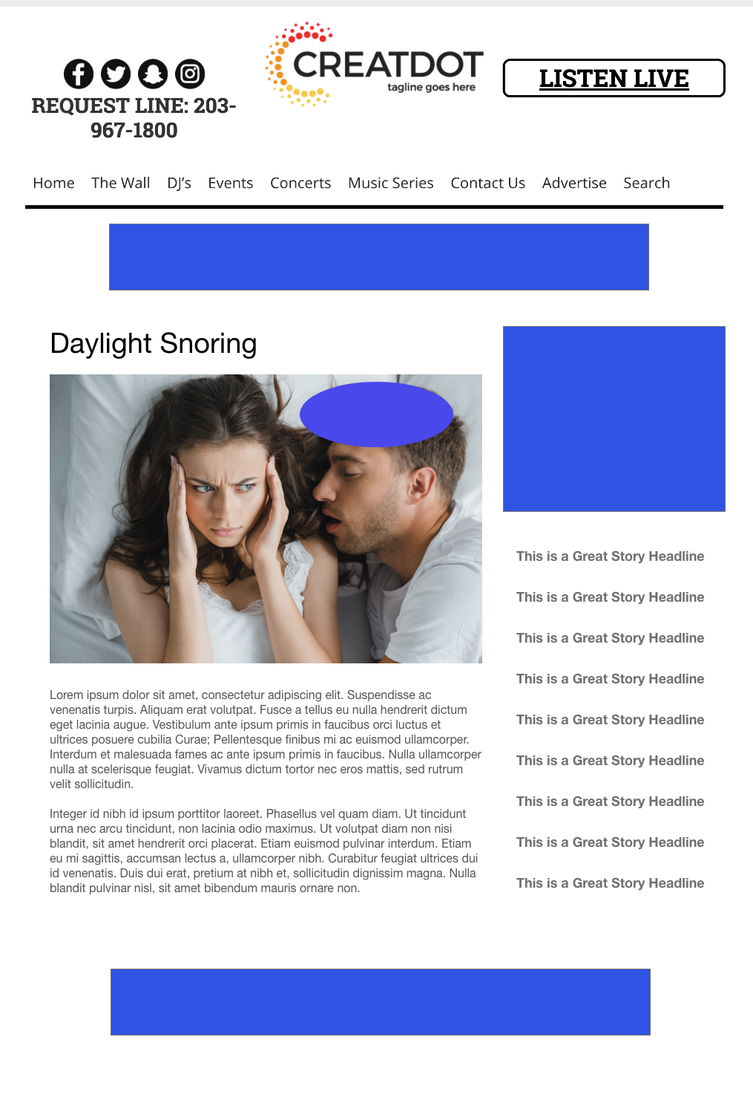
SNORING
Daylight Savings
Do you have someone in your life that snores all the time? Does the time change make them saw logs right in your ear?
Upload an audio clip of them snoring for a chance to win a 2 Night Stay at <sponsor name> Hotel!
Your Investment gets you
Marketing list of all entrants
Website & App branding,
Coupon to all entrants, 4 Daily
Recorded Promos
Weekly Winner Liner announce
investment
$X,000 + Prize
Bob Salesperson
800-555-1212
bsalesperson@yourdomain.com

