Slide 1

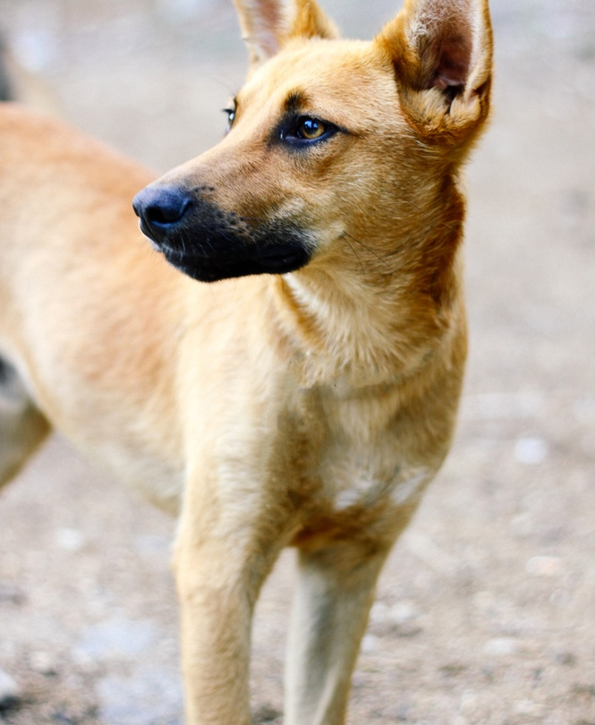
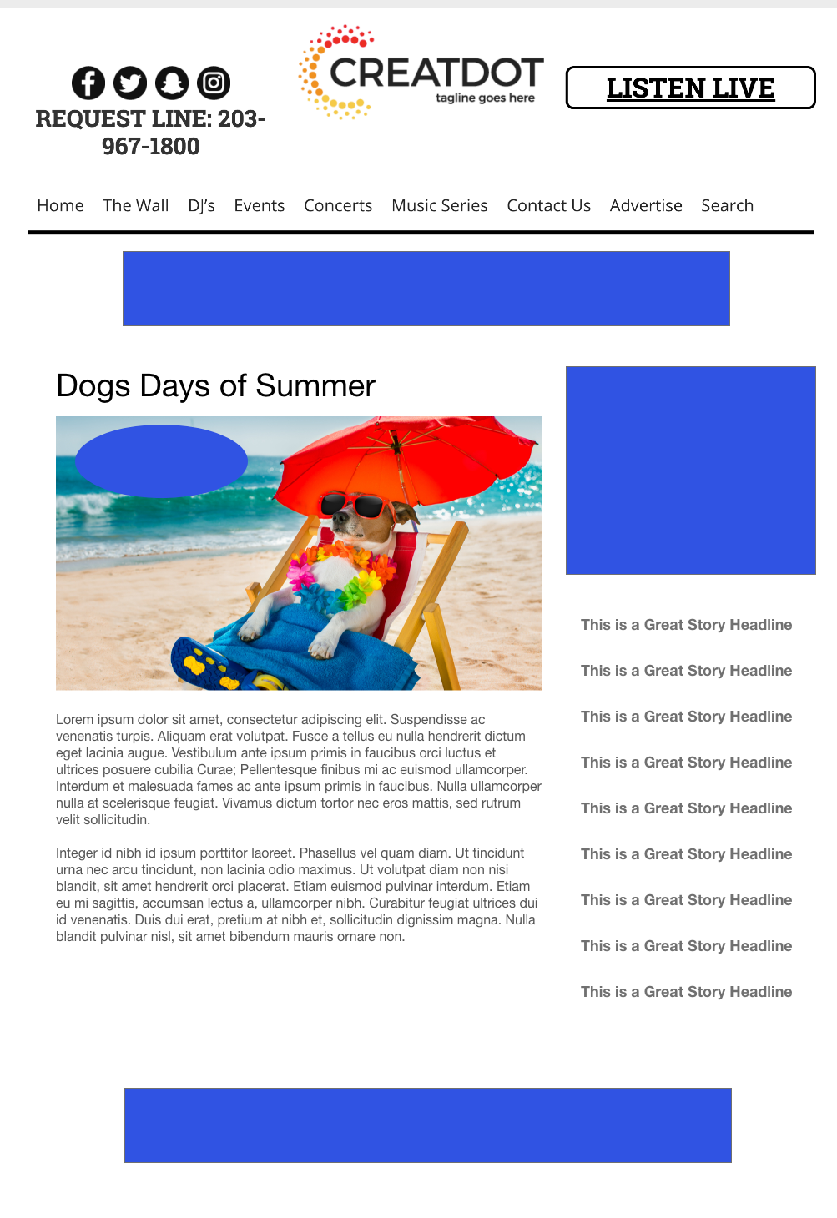
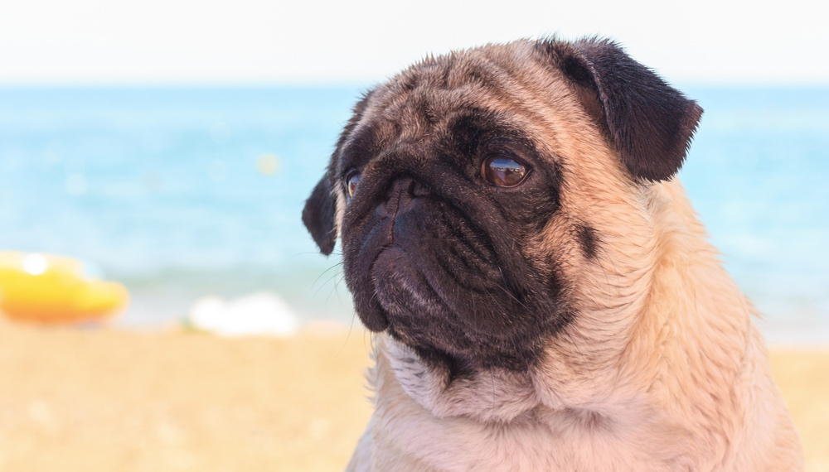
DAYS
OF
SUMMER
INVESTMENT: $X,000 + Prize
WITH YOUR INVESTMENT, YOU GET
Lead List of All Entrants & Survey answers
Offer distribution
Branded Website Landing Pages
300x250 Banner
X Recorded Promos
X Live Promos
X :15 Second Commercials
During this X WEEK PROMOTION, the audience uploads pictures of their sweet canines via the website or app.
The public votes on who has the best looking furry friend!
Bob Salesperson bsalesperson@yourdomain.com 800-555-1212

