Slide 1
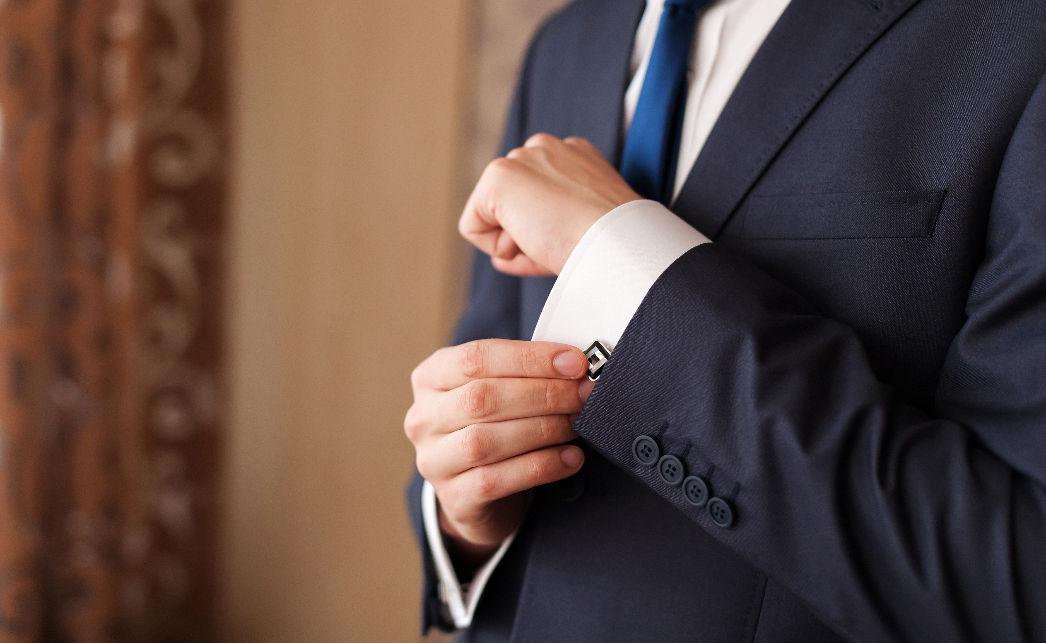
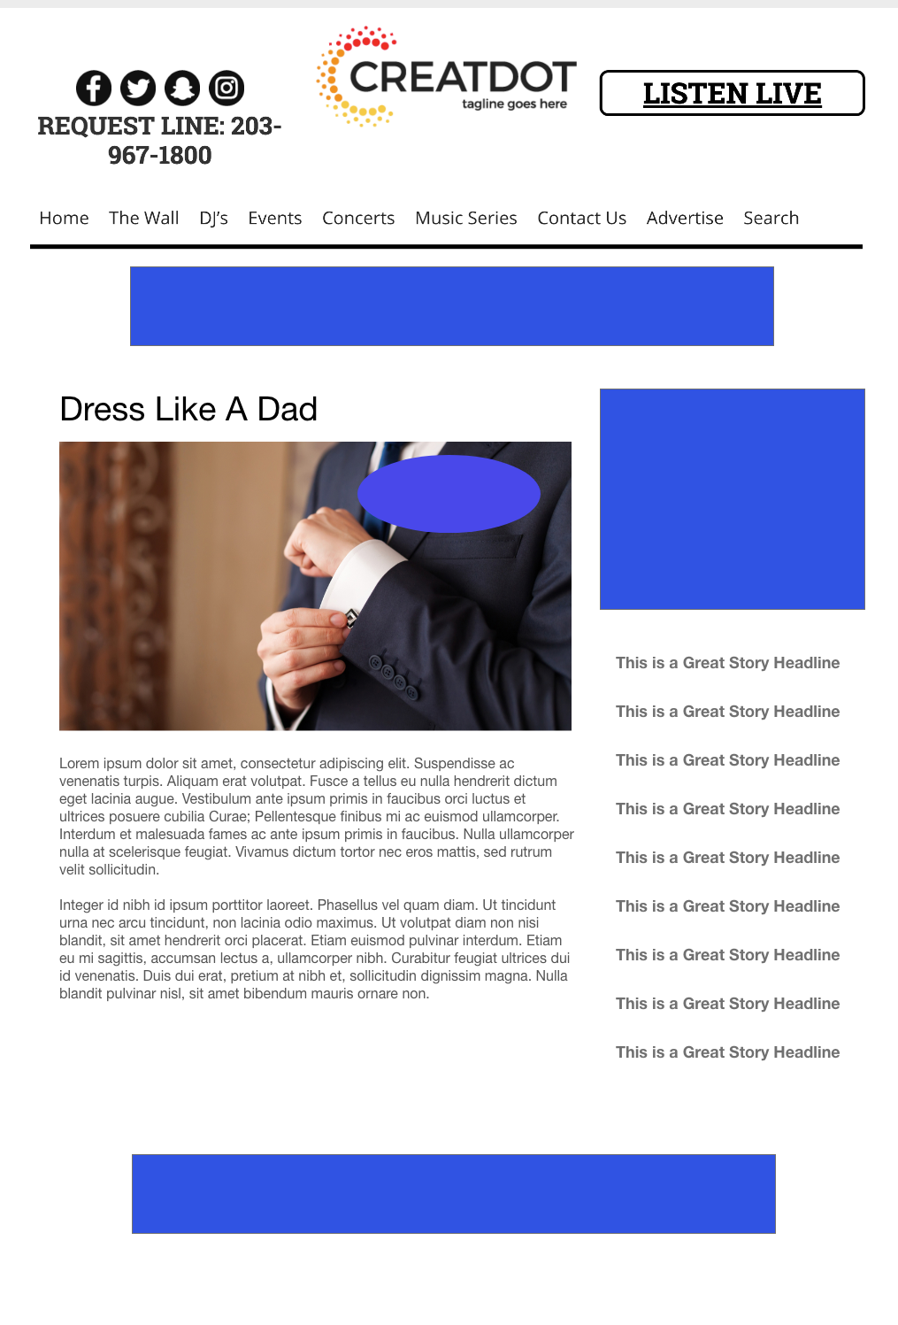
Dress Like a
DAD
Photo Contest
The audience submits images of their dads dressed to impress. Public voting picks the best-looking dad!
Your Investment gets you
Lead List of All Entrants
Streaming Pre-roll Video Website & App 320x50 Banner
Branded Website Landing Pages
300x250 Banner
X Recorded Promos
X :15 Second Commercials
investment
$X,000 + Prize
Bob Salesperson
800-555-1212
bsalesperson@yourdomain.com

