Slide 1
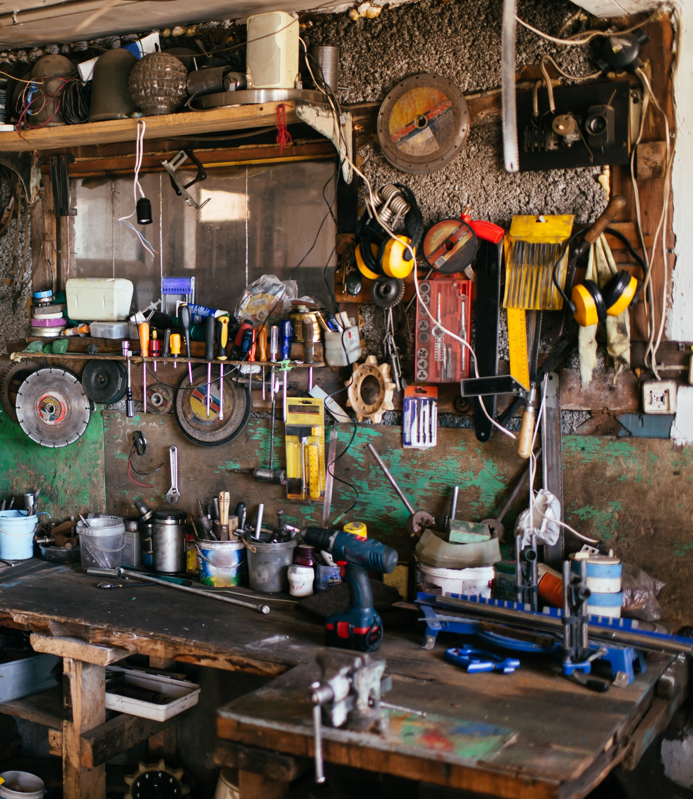
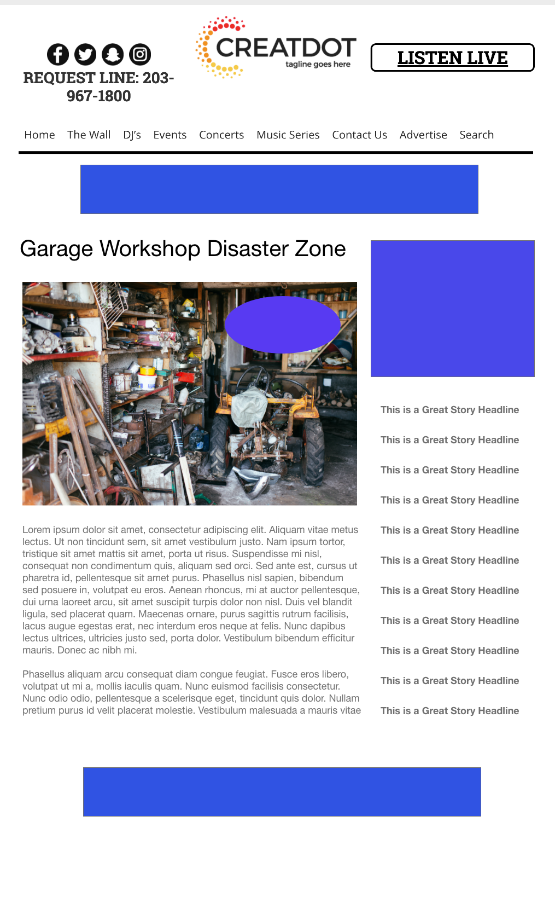
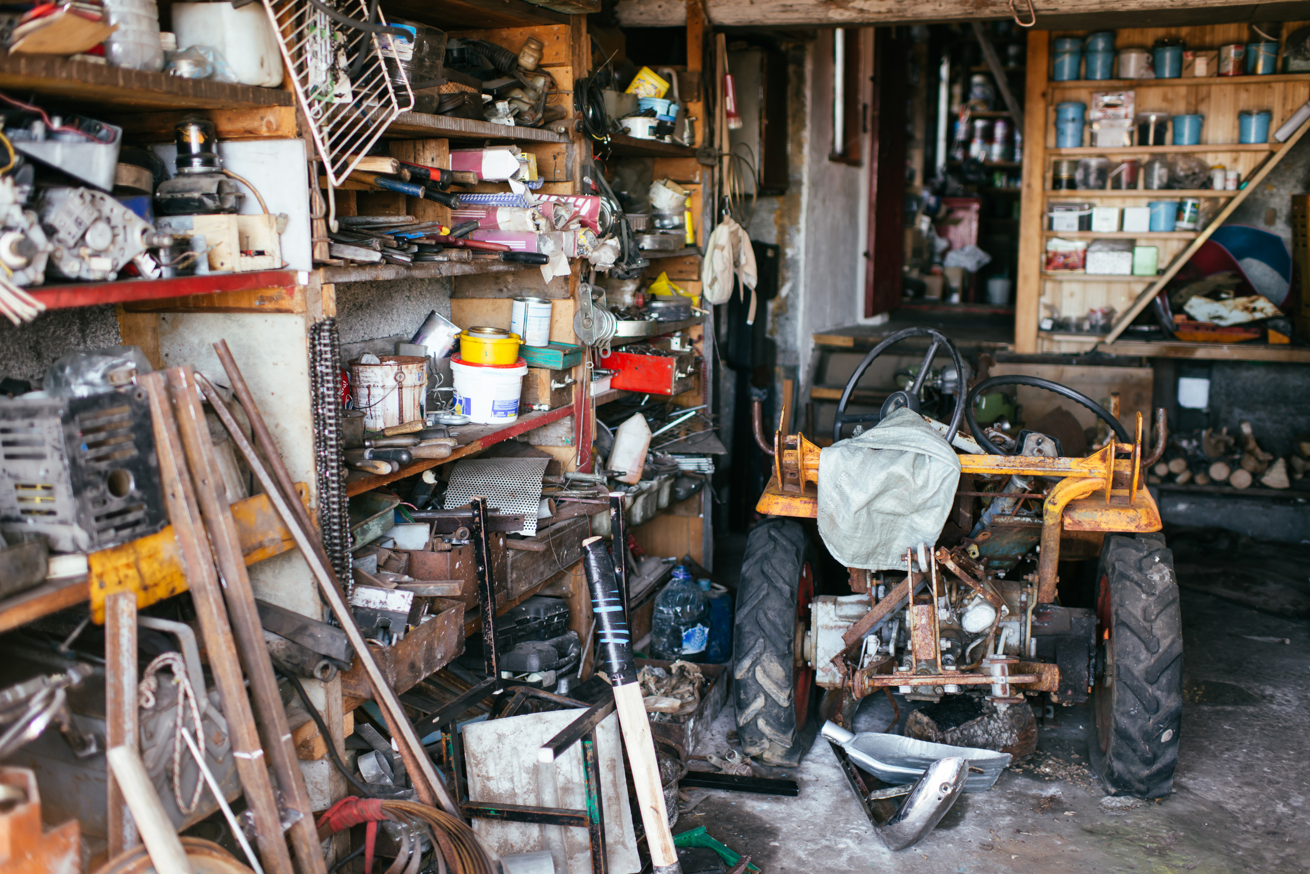
Garage Workshop Disaster Zone
INVESTMENT:
$X,000 + Prize
WITH YOUR INVESTMENT, YOU GET
Lead List of All Entrants
X Live Segments
Streaming Pre-roll Video Website & App
App Open Pre-roll
App 320x50
Branded Website Landing Pages
300x250 Banner
X Recorded Promos
X Live Promos
X :15 Second Commercials
During this X WEEK PROMOTION, the audience uses the station app to upload a video for a garage / workshop makeover. Creativity and Presentation count! The best/worst five videos will enter finals for front end vote off for sponsor prize.
Bob Salesperson bsalesperson@yourdomain.com 800-555-1212

