Slide 1
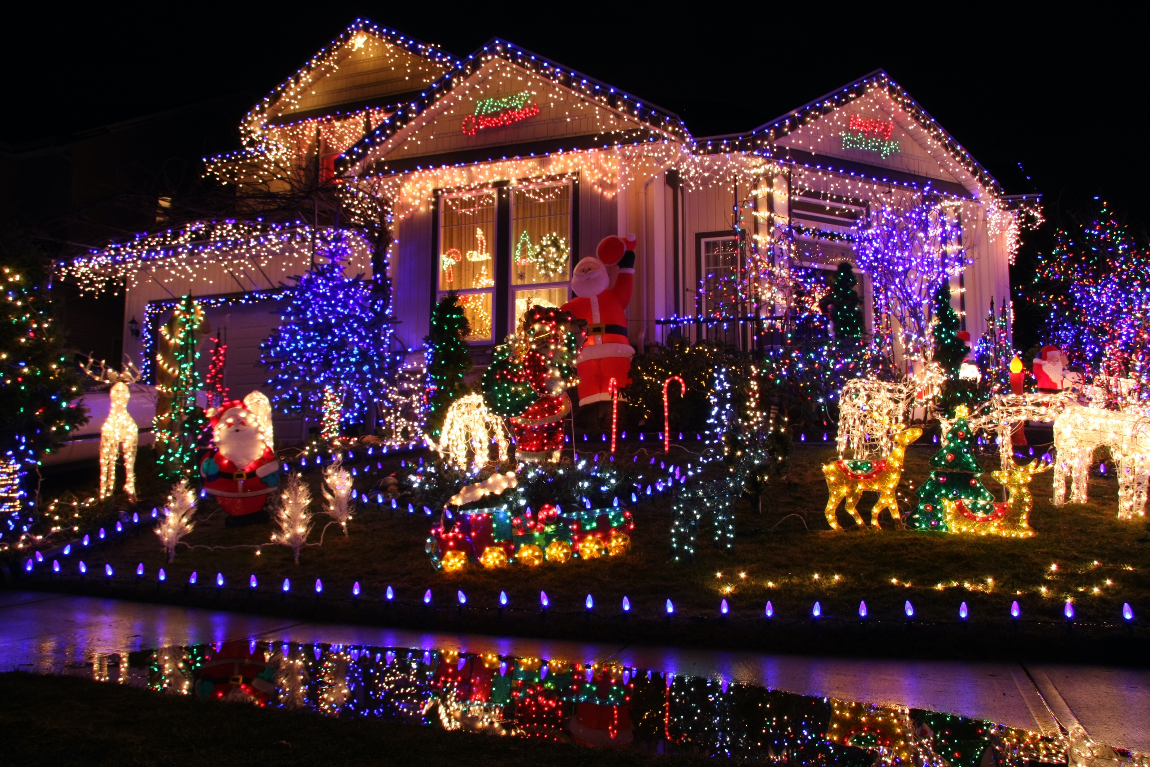
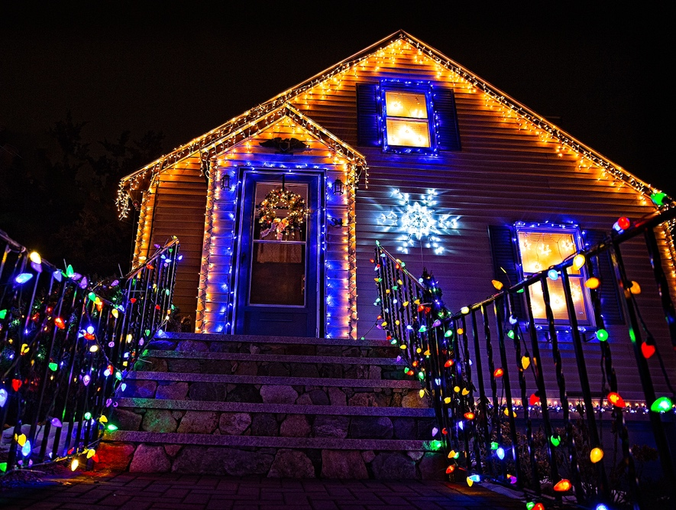
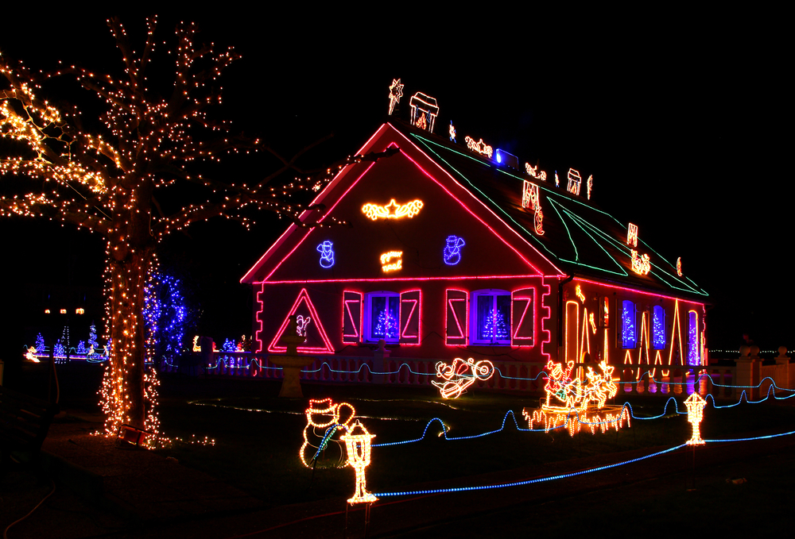
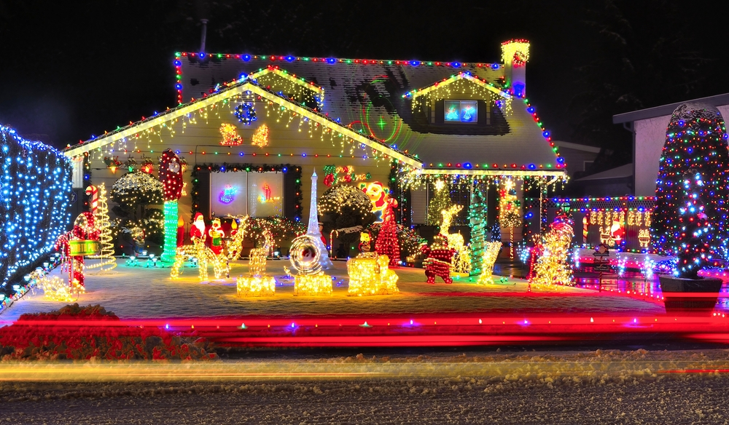
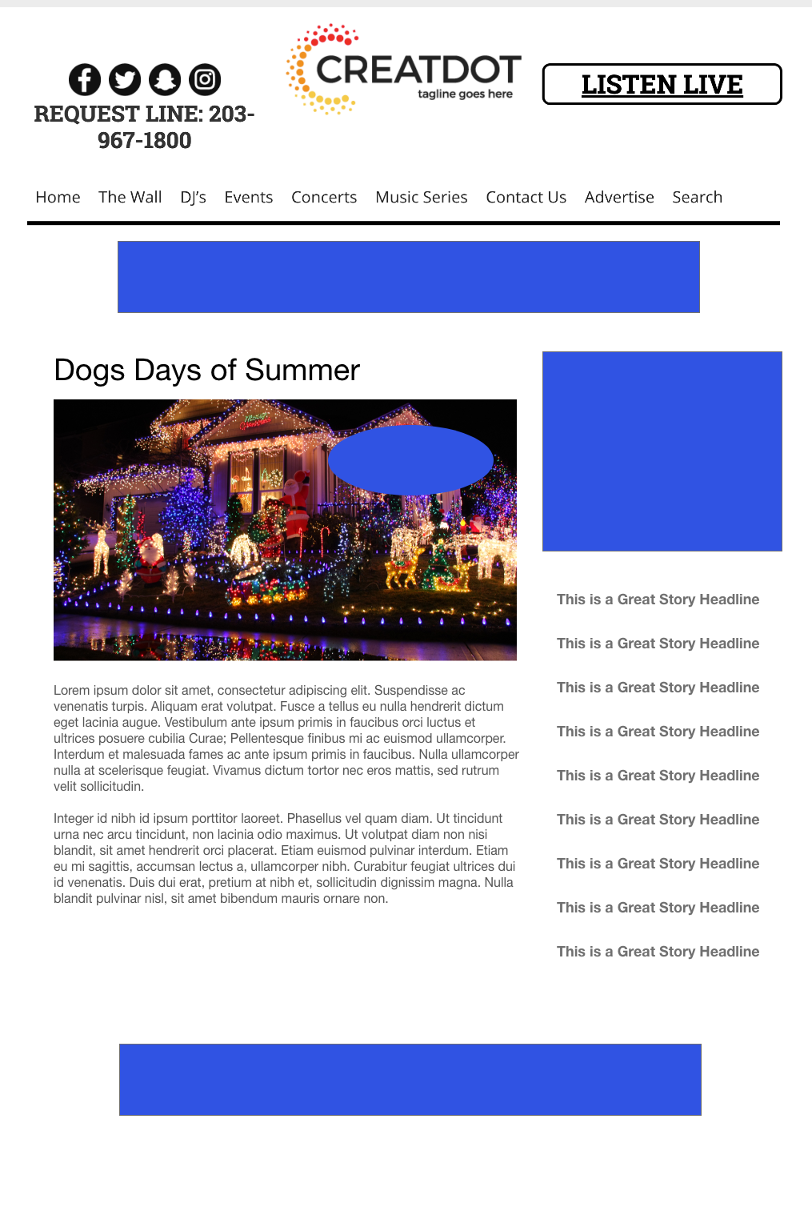
Holiday Light
Display Contest
During this 4 WEEK PROMOTION, the audience submits photos of their beautiful displays of light that would make Clark Griswold proud.
Public voting determines the ultimate winner who gets their electricity for the month of December paid for (plus a prize)!
With Your Investment, You Get
Lead List of All Entrants
Five Live Segments
App Open Pre-roll
App 320x50
Branded Website Landing Pages
X Recorded & live Promos
X :15 Second Commercials
Investment
$X,000 + Prize
Bob Salesperson
bsalesperson@yourdomain.com
800-555-1212

