Slide 1
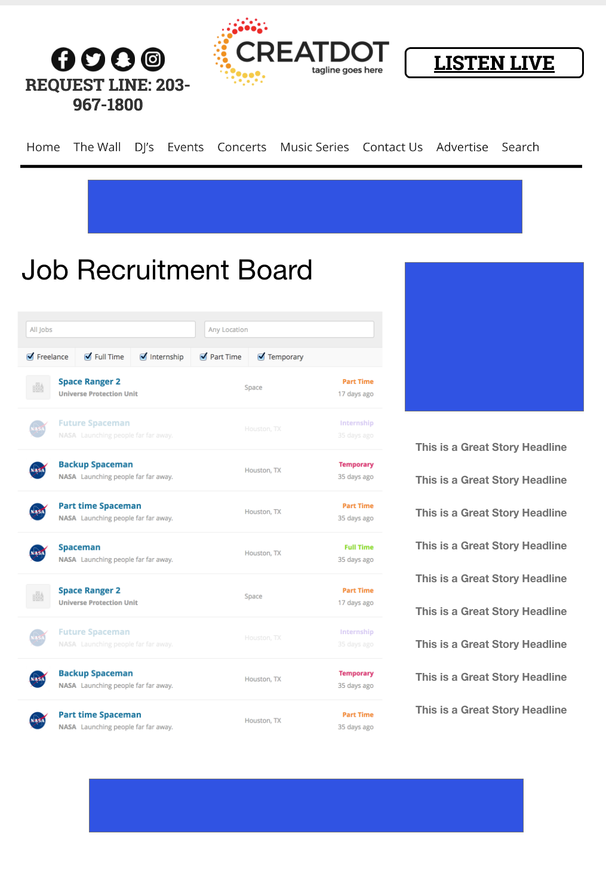
Recruitment
Board
What it is:
A website that lists jobs and resumes
Enables simple and enhanced listings by employers
Contains search engine for job seekers
Displays employment tips by experts
What your business receives:
Listings of employment positions you need to fill
Optional detailed summary of position and requirements
Optional display advertising to promote company and/or specific listings
Ability to provide employment tips
Investment
$XX per listing per month for basic listing
$XX per listing per month for:
Basic listing
Enhanced description
$XX per listing per month for:
Basic listings
Enhanced description
Display ads
Benefits to your business
Precise targeting of job seekers
Geo-targeting of local and regional job seekers
More prospects to choose from, resulting in better hires
Bob Salesperson bsalesperson@yourdomain.com 800-555-1212

