Slide 1

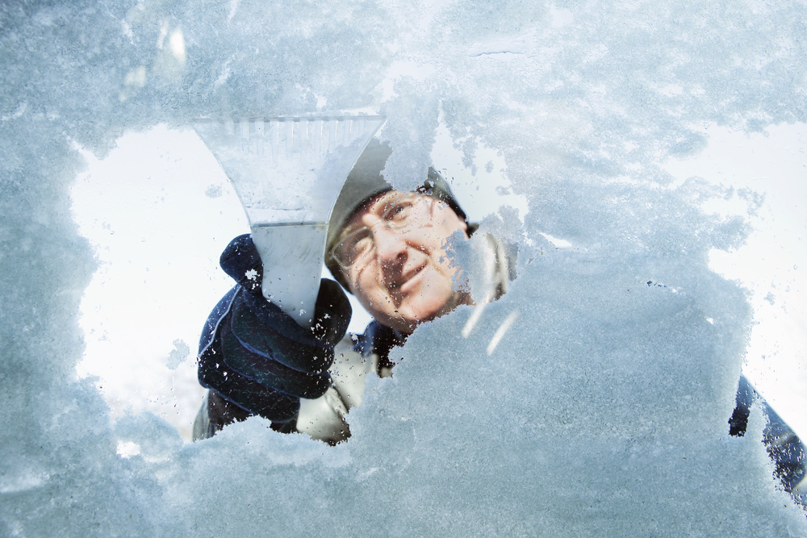
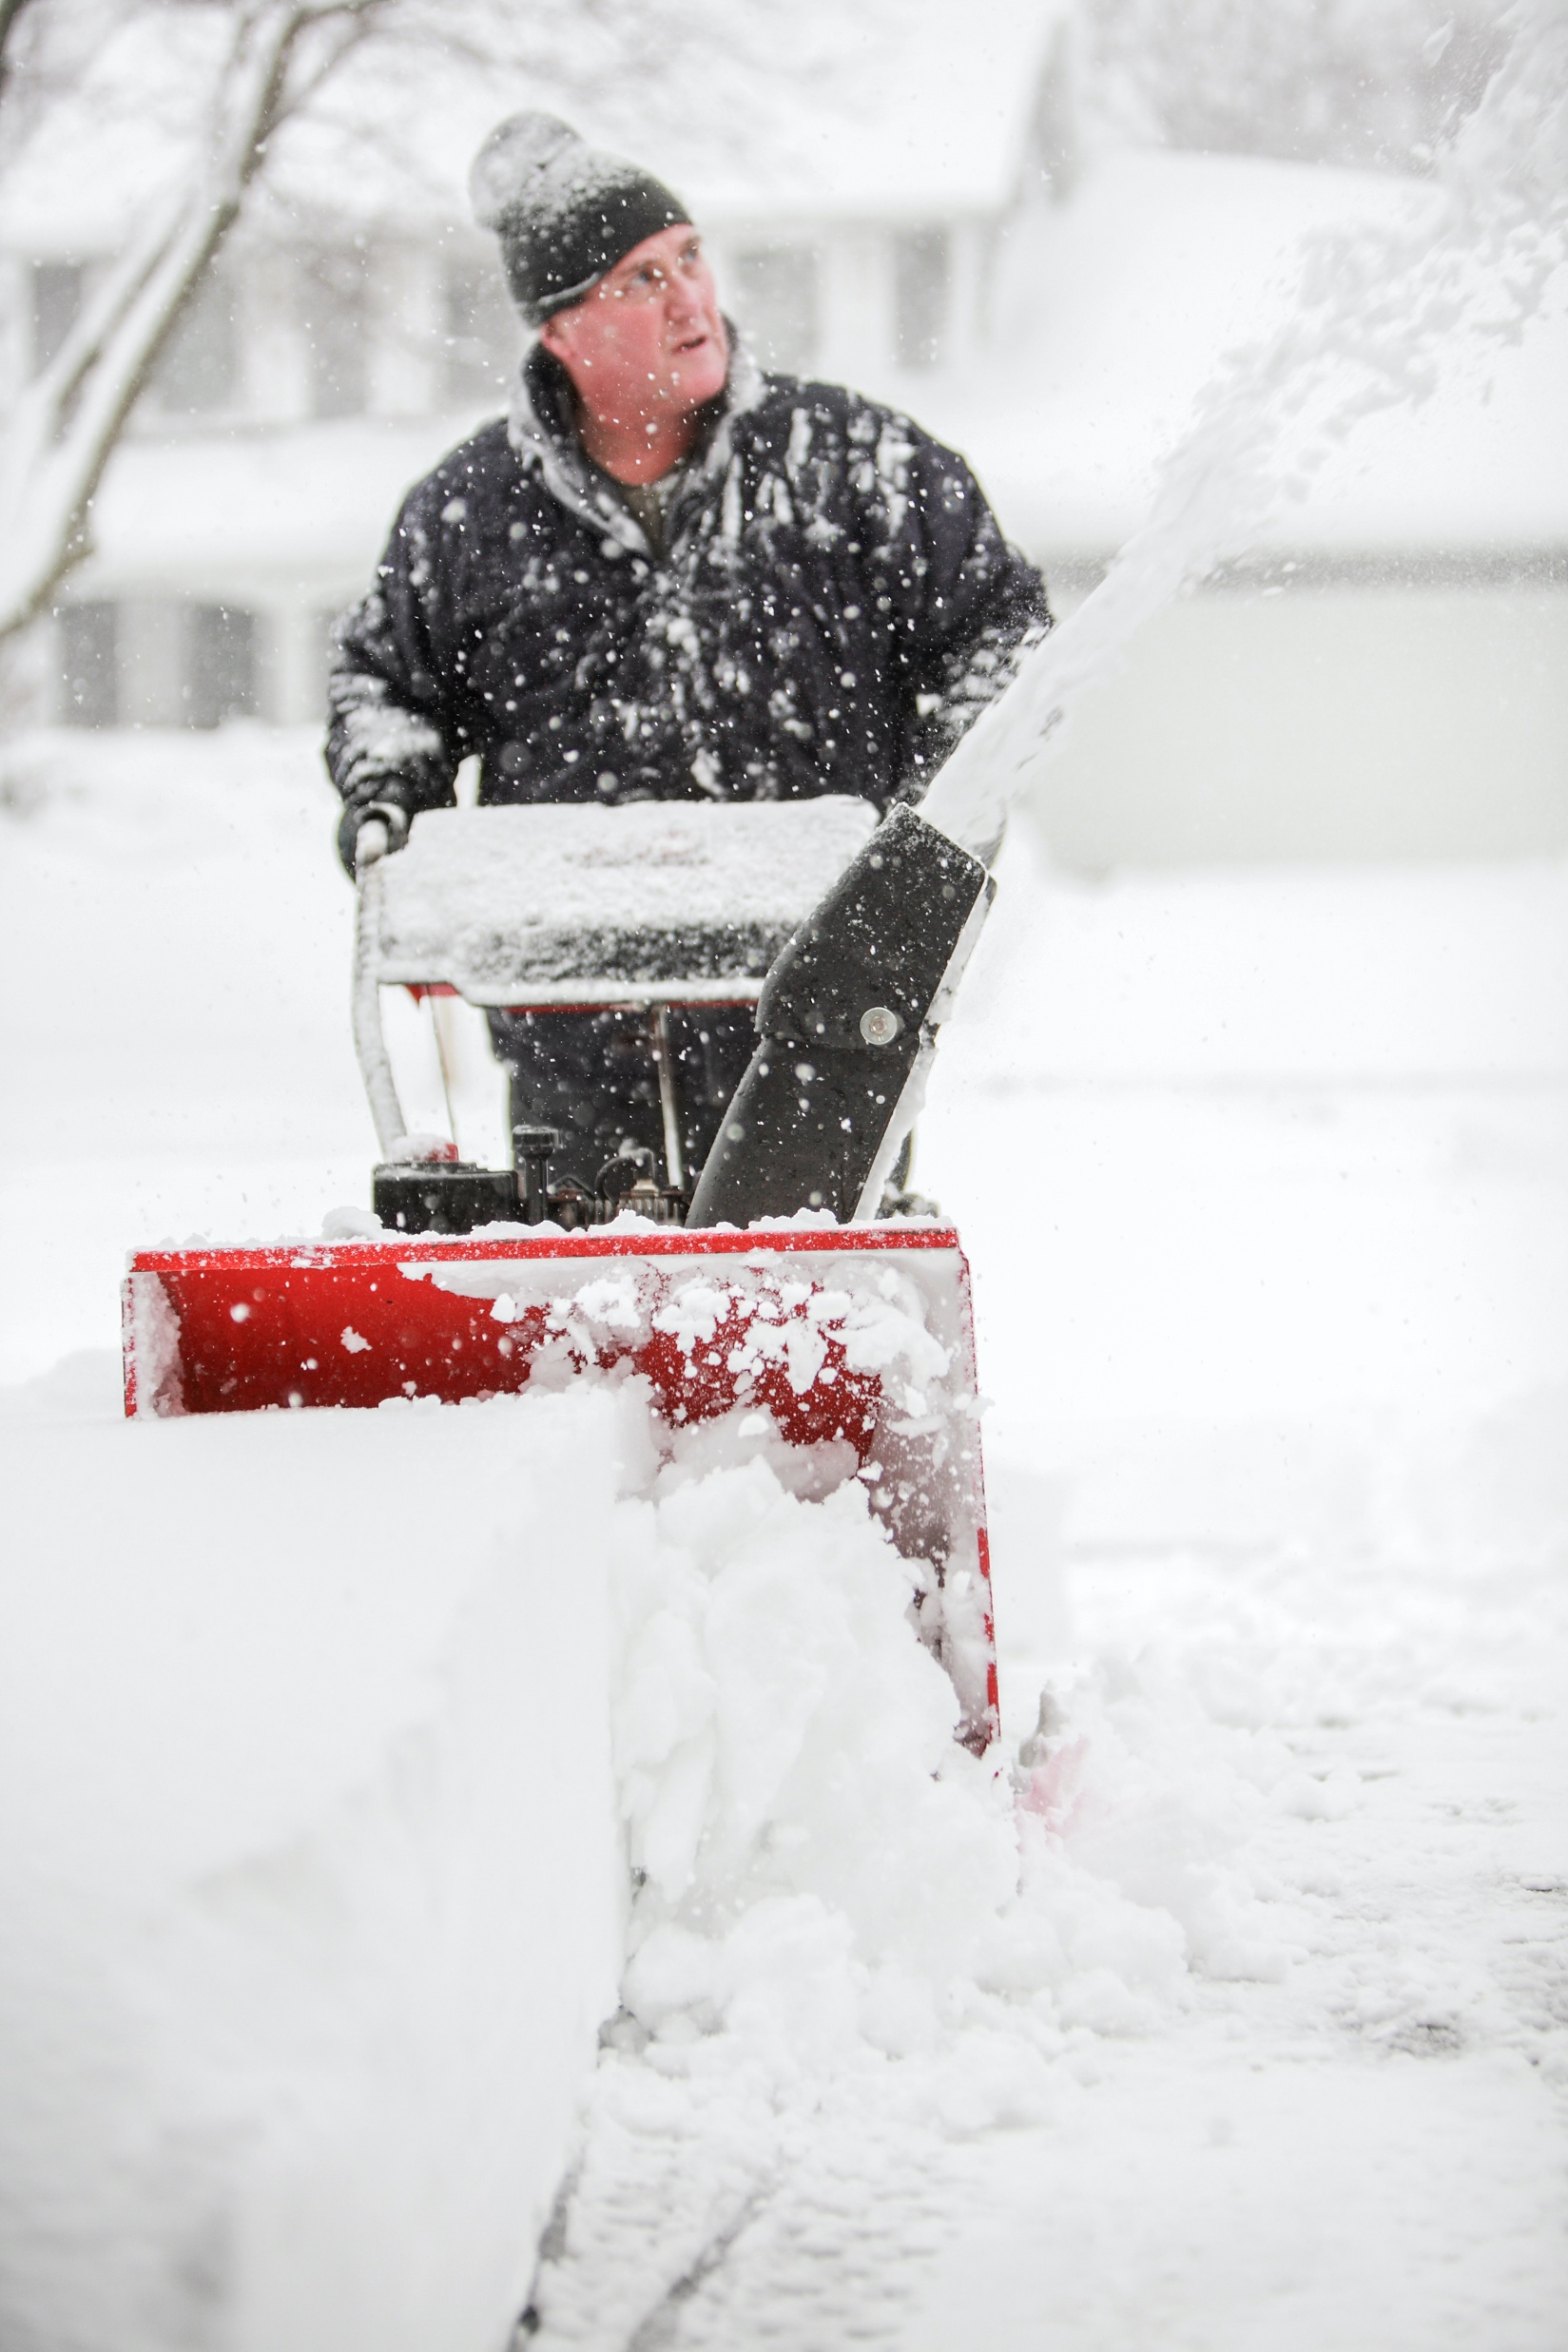
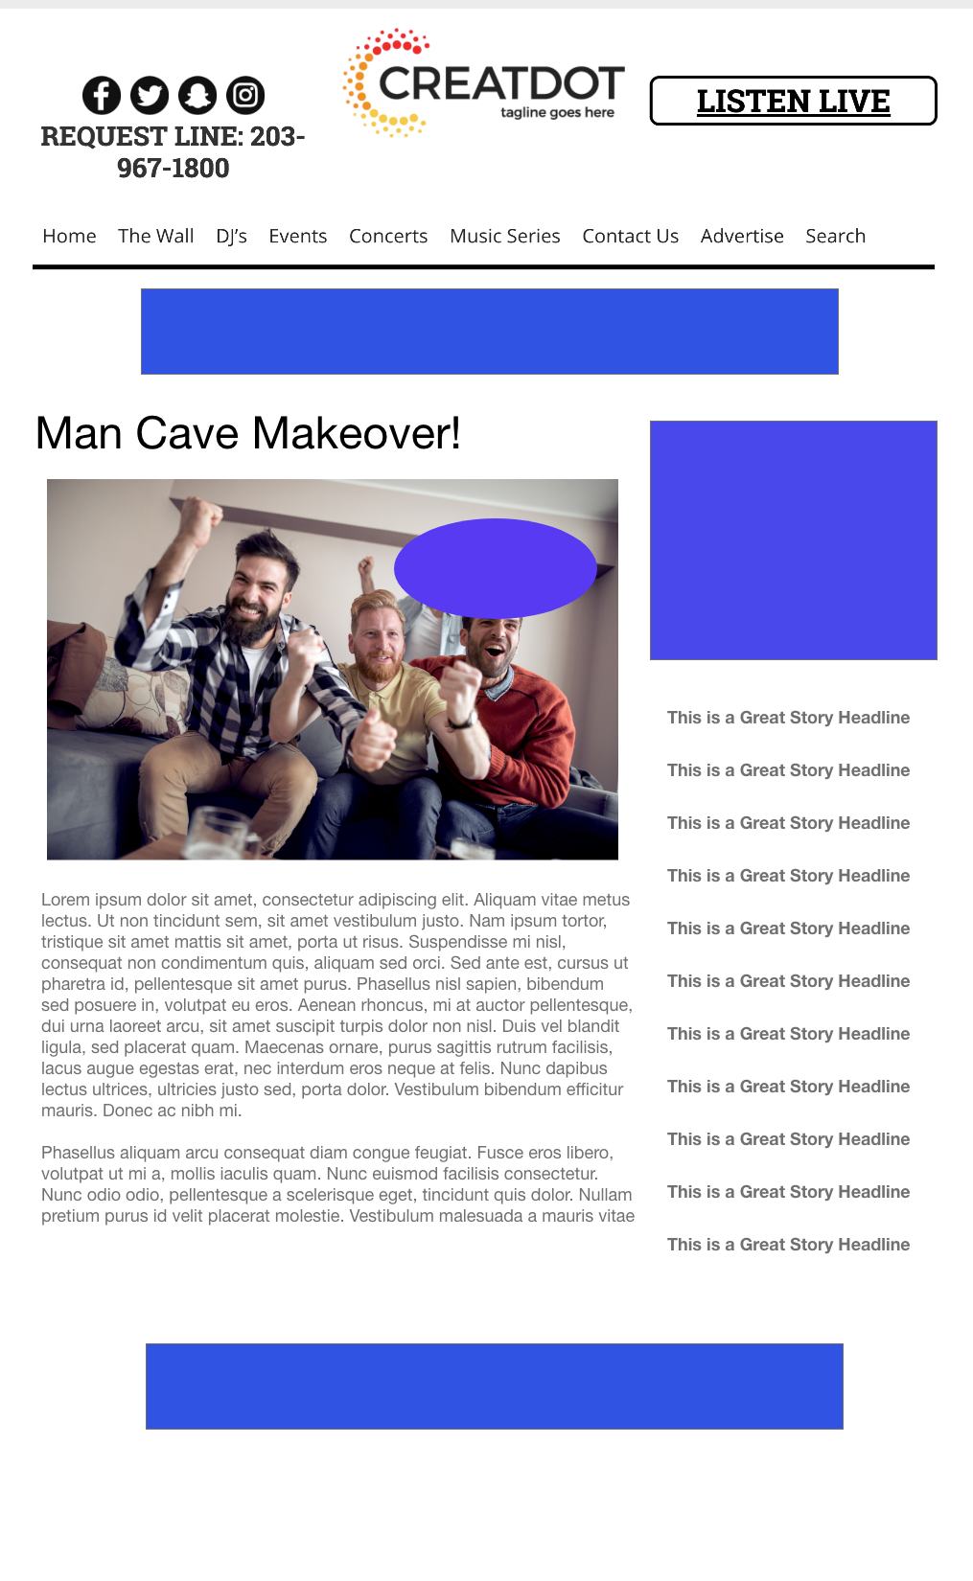
MOST MISERABLE SNOW PHOTO
During this X WEEK PROMOTION, the audience uploads images and videos of their most miserable snow photos. Car buried by a plow? Snow piled in front of your door? The audience will vote and decide who hates winter the most!
INVESTMENT:
$X,000 + Prize
YOUR INVESTMENT GETS ALL THIS:
Lead List of All Entrants
X Live Segments
Streaming Pre-roll Video Website & App
App Open Pre-roll
App 320x50
Branded Website Landing Pages
300x250 Banner
X Recorded Promos
X Live Promos
X :15 Second Commercials
Bob Salesperson bsalesperson@yourdomain.com 800-555-1212

