Slide 1



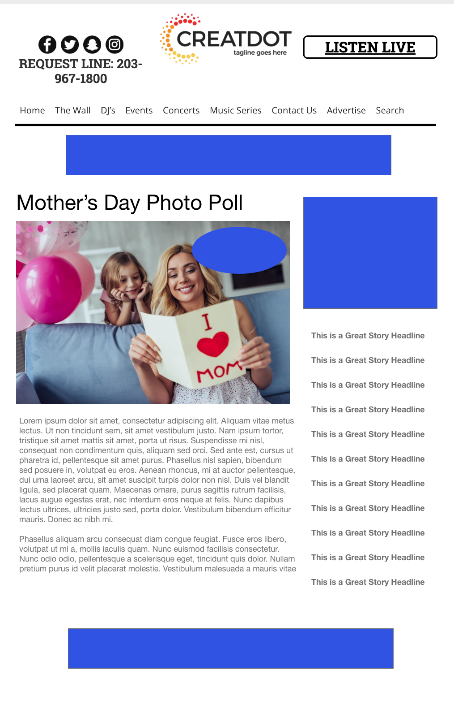
Mother’s Day
Photo Poll
During this X WEEK PROMOTION, the audience uses the station app & website to upload a picture of their mothers with a comment on why they are the best mom ever! Branded voting takes place on the website, with a mom crowned at the end!
WITH YOUR INVESTMENT, YOU GET:
Lead List of All Entrants
X Live Segments
Streaming Pre-roll Video Website & App
App 320x50
Branded Website Landing Pages
300x250 Banner
X Recorded & Live Promos
X :15 Second Commercials
INVESTMENT: $X,000 + Prize
Bob Salesperson
bsalesperson@yourdomain.com
800-555-1212

