Slide 1
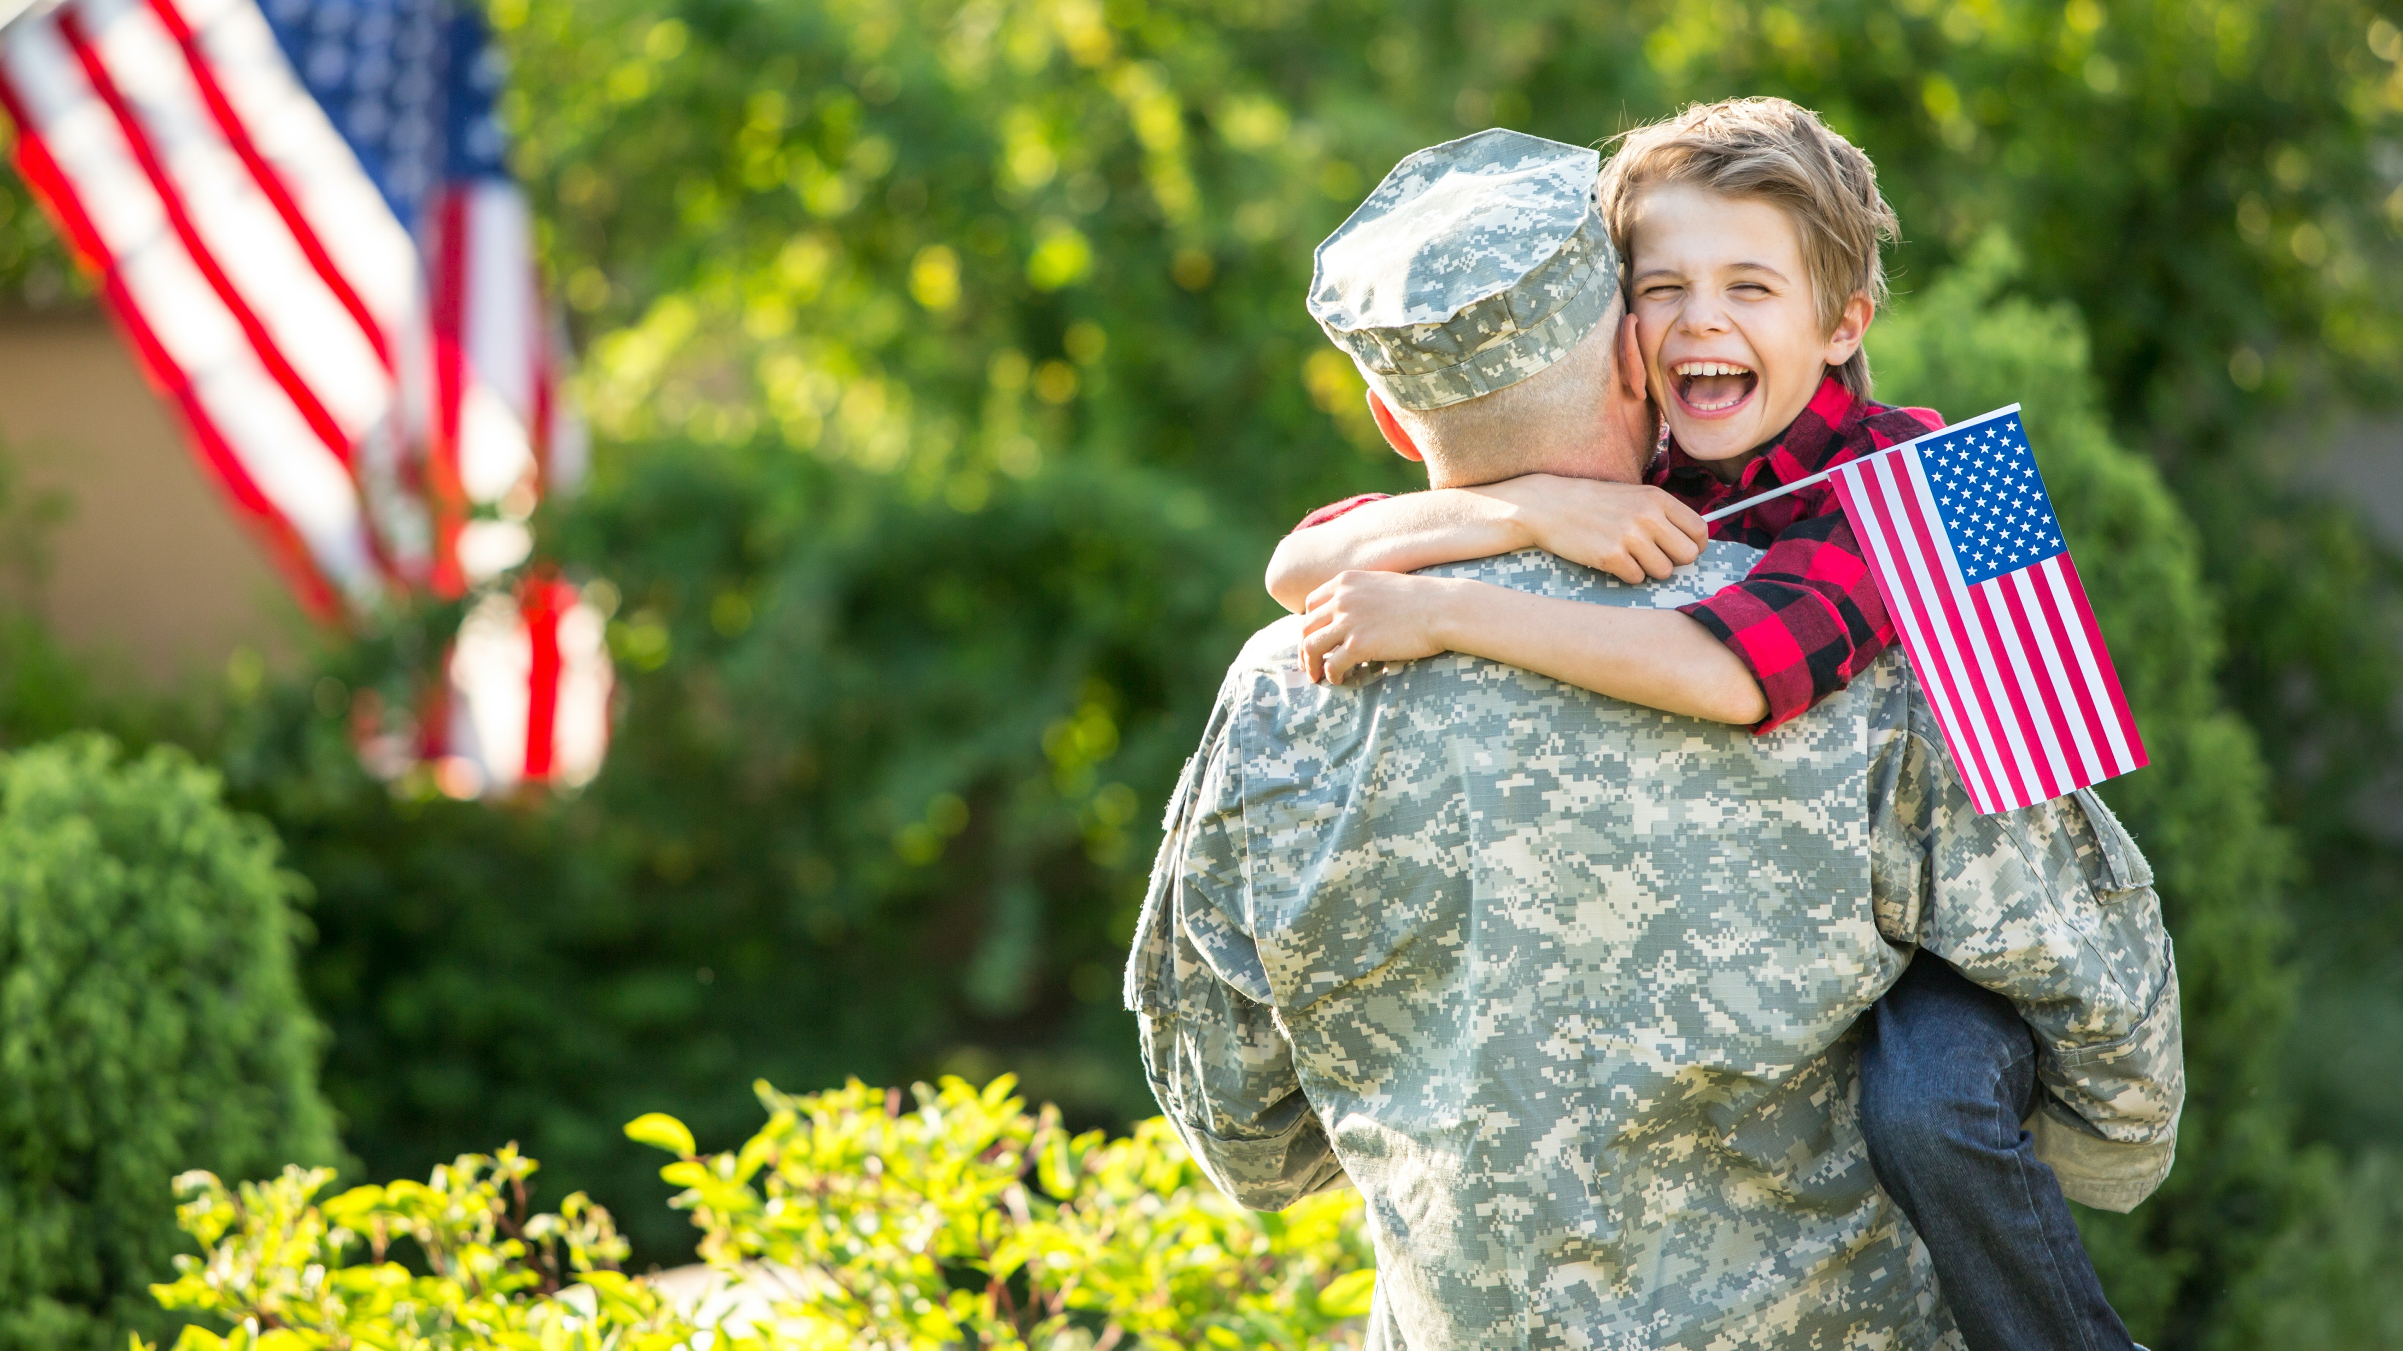
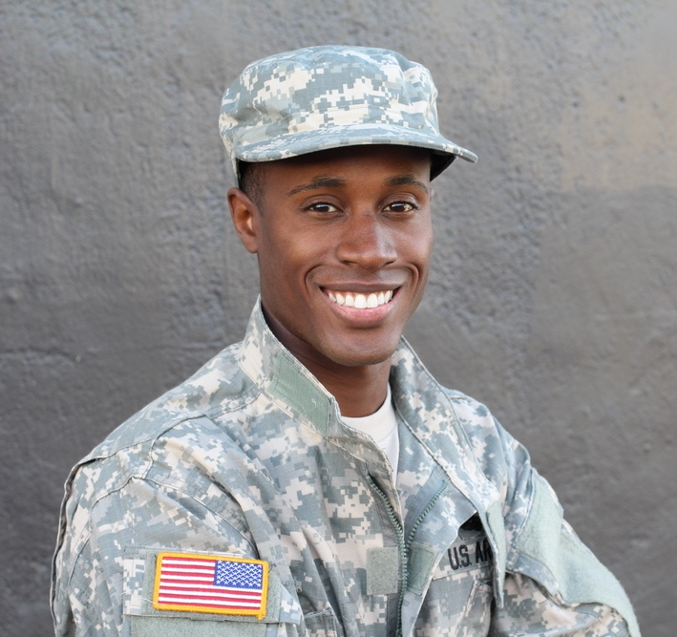

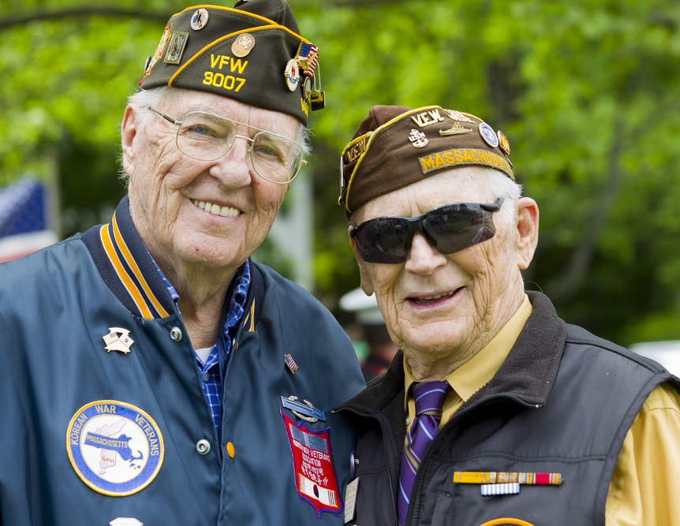
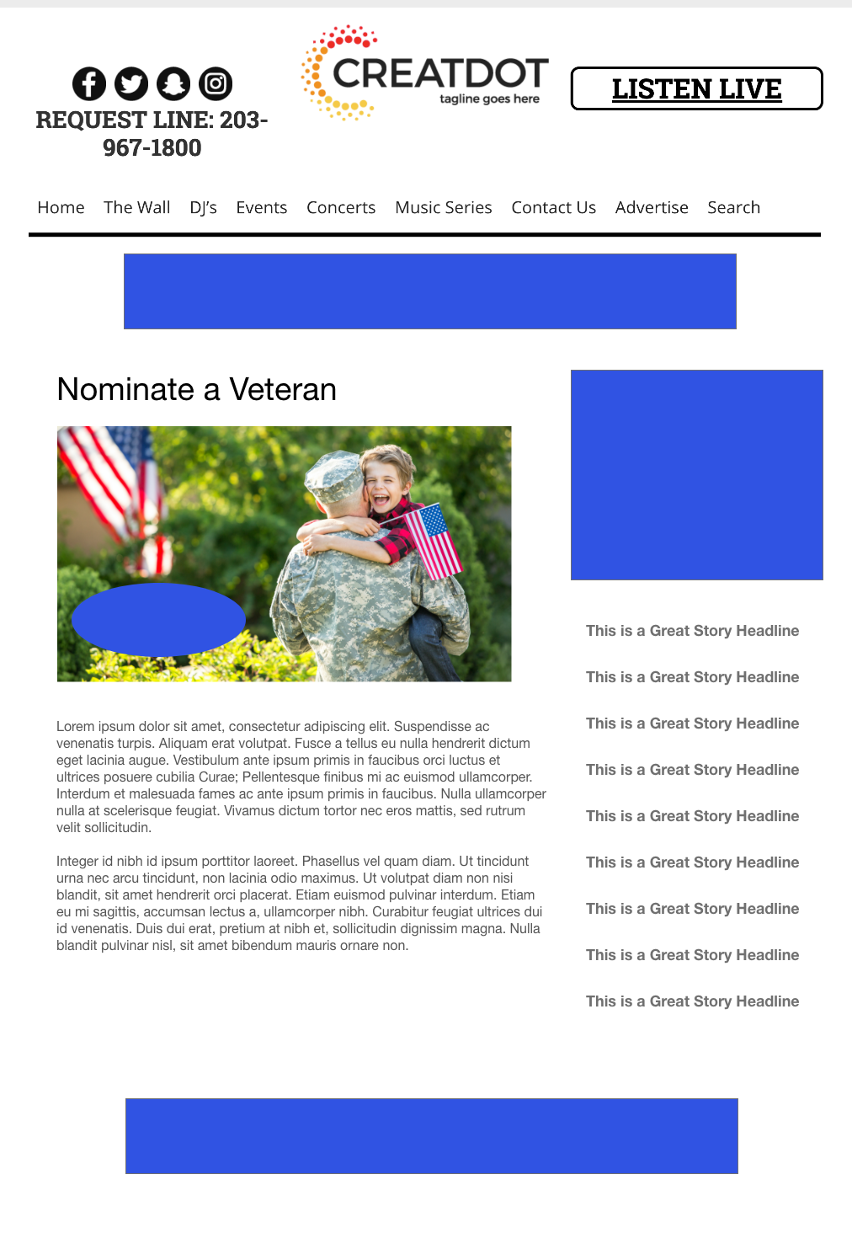
Nominate a
Veteran
During this X WEEK PROMOTION, the audience submits details of a special veteran in their life. A biography, photos, awards, recognitions and more create a story around someone who risked their life for our freedom.
A Veteran is selected by the station to be honored on air with a prize furnished by the sponsor(s).
With Your Investment, You Get
Lead List of All Entrants
X Live Segments
App Open Pre-roll
App 320x50
Branded Website Landing Pages
X Recorded & live Promos
X :15 Second Commercials
Investment
$X,000 + Prize
Bob Salesperson
bsalesperson@yourdomain.com
800-555-1212

