Slide 1
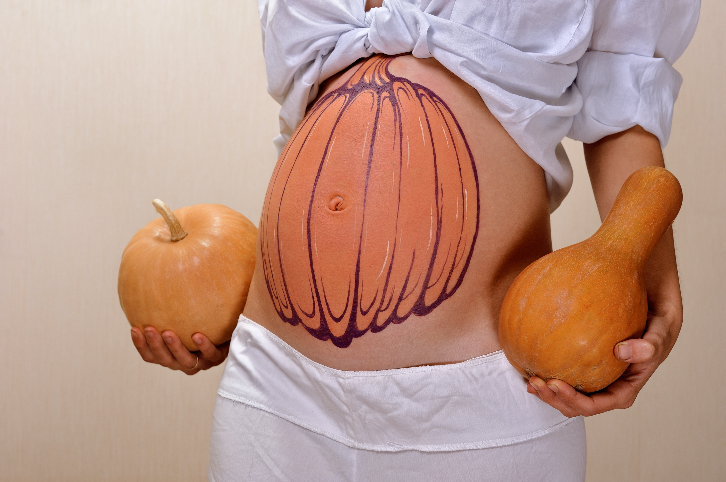
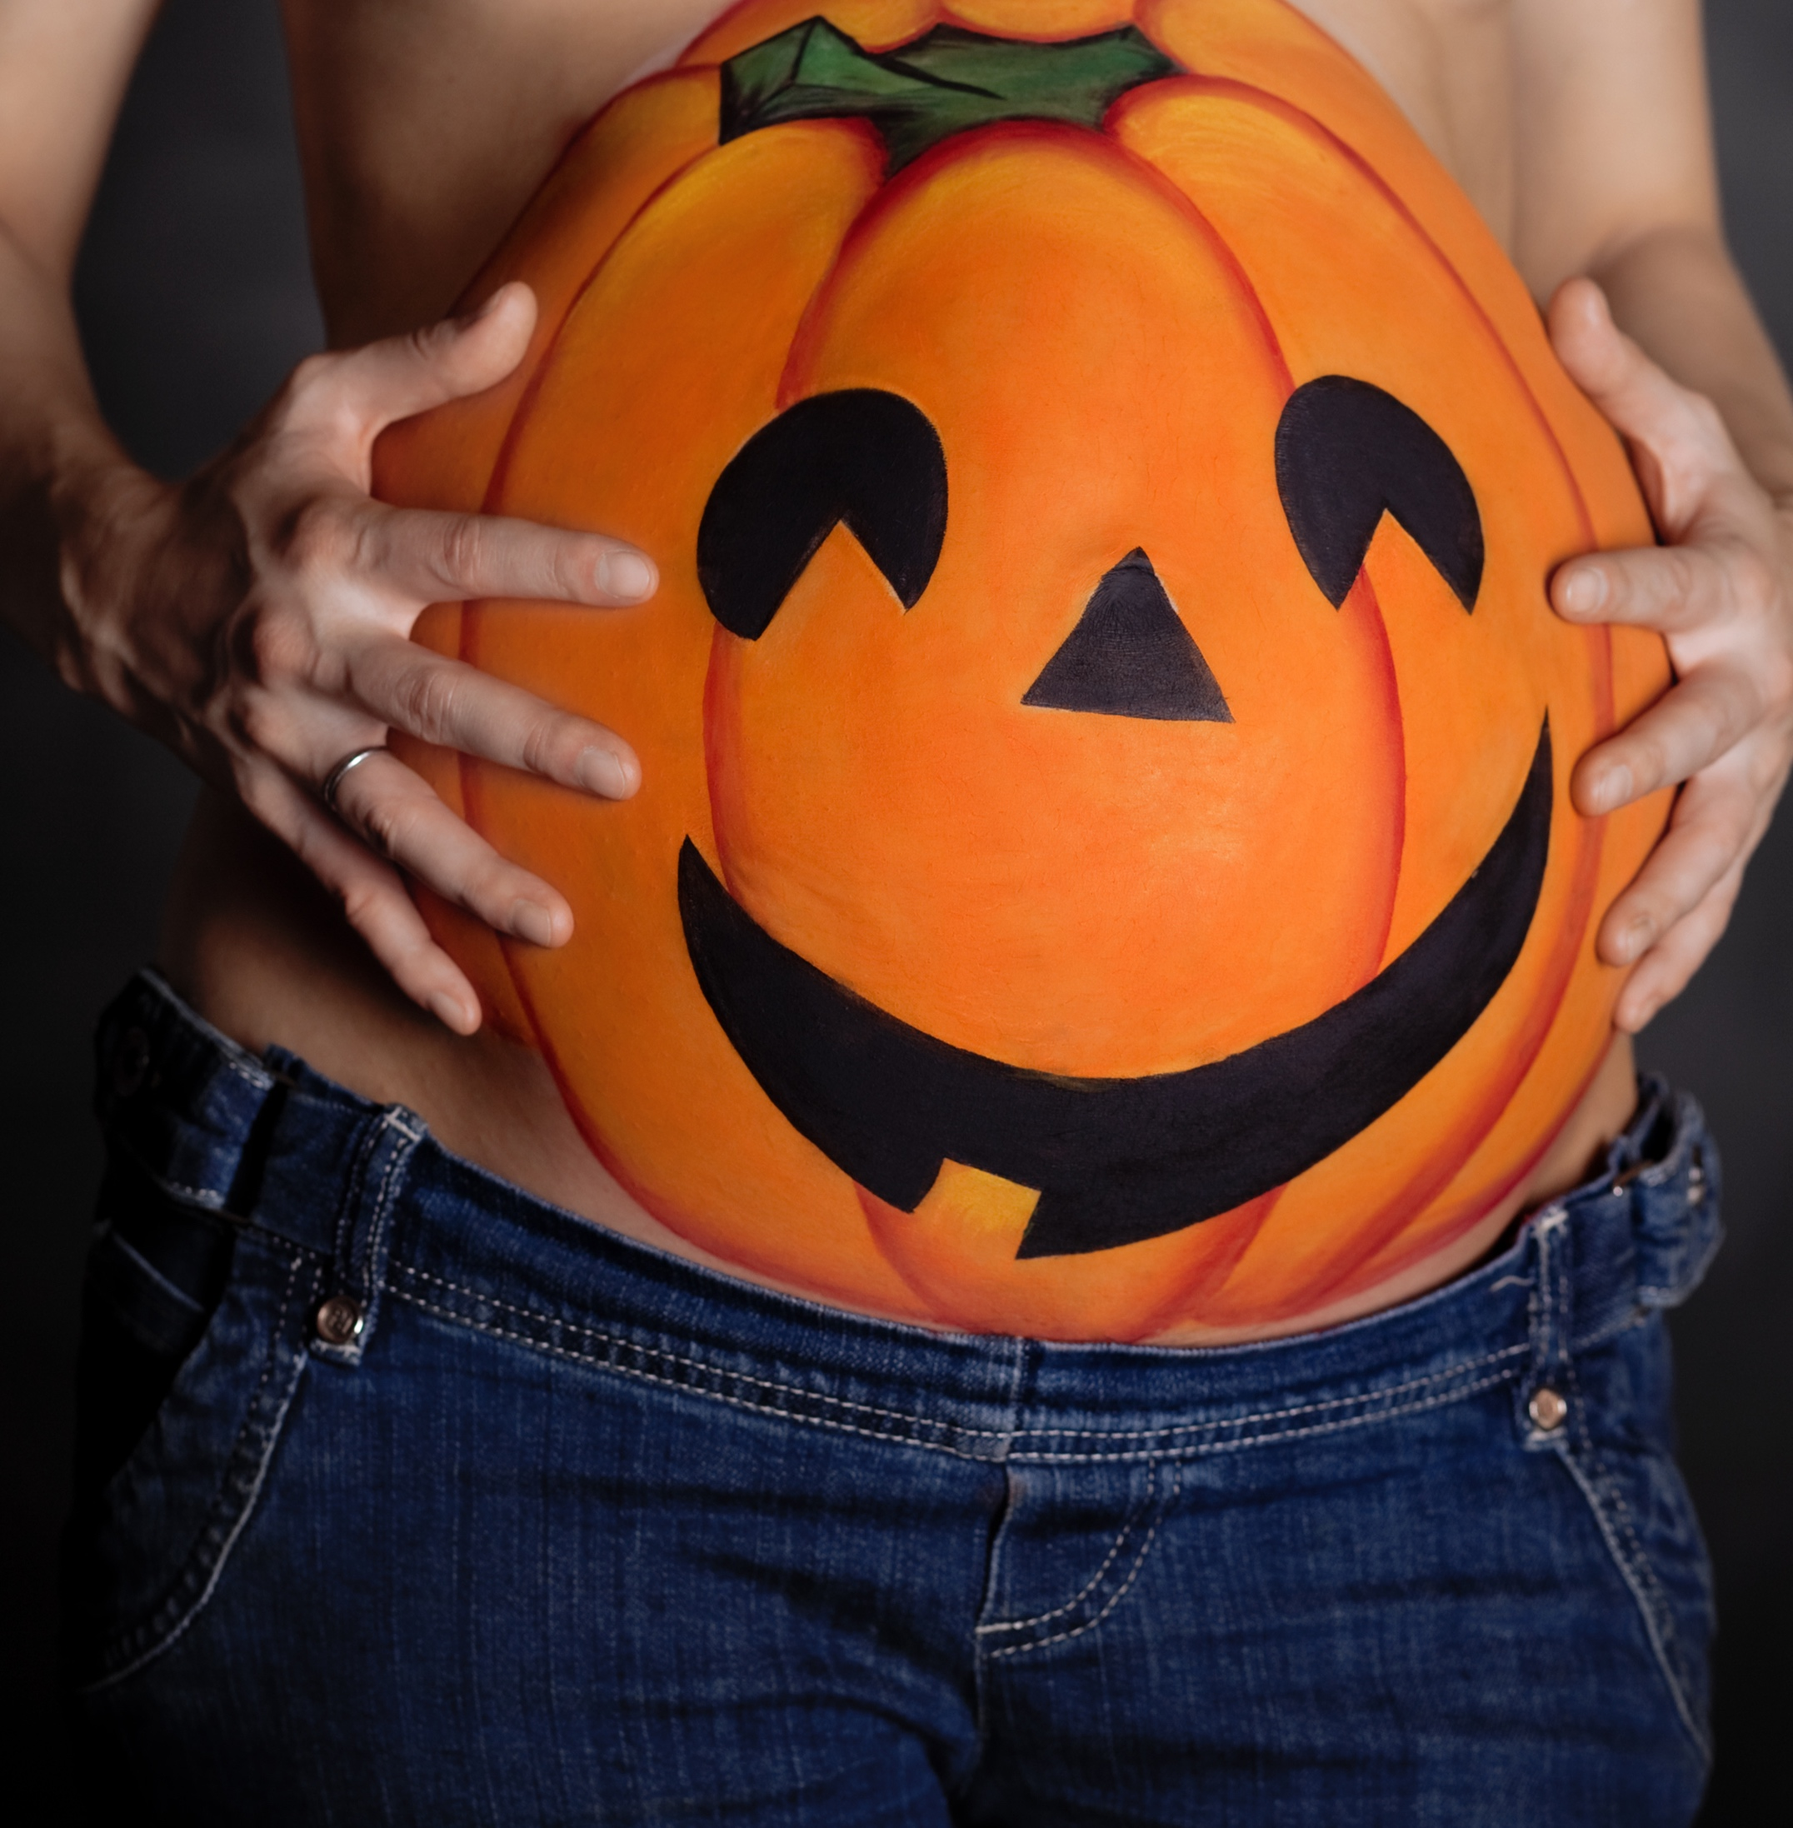
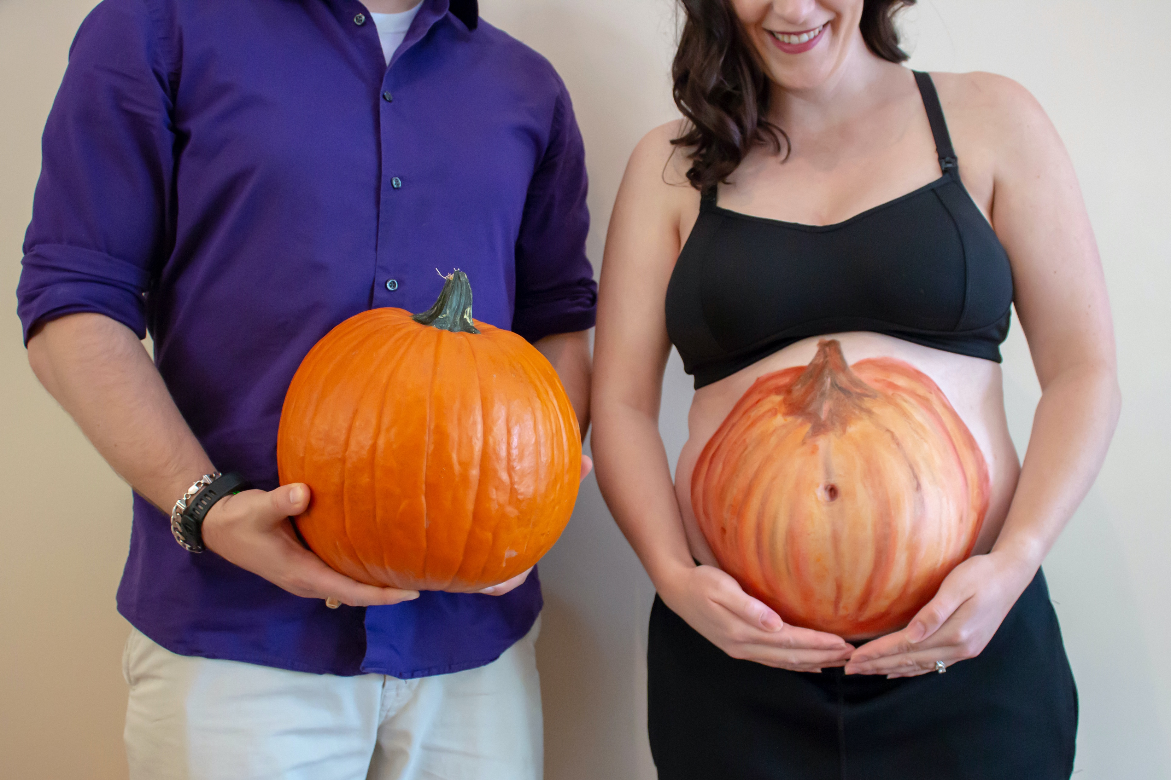
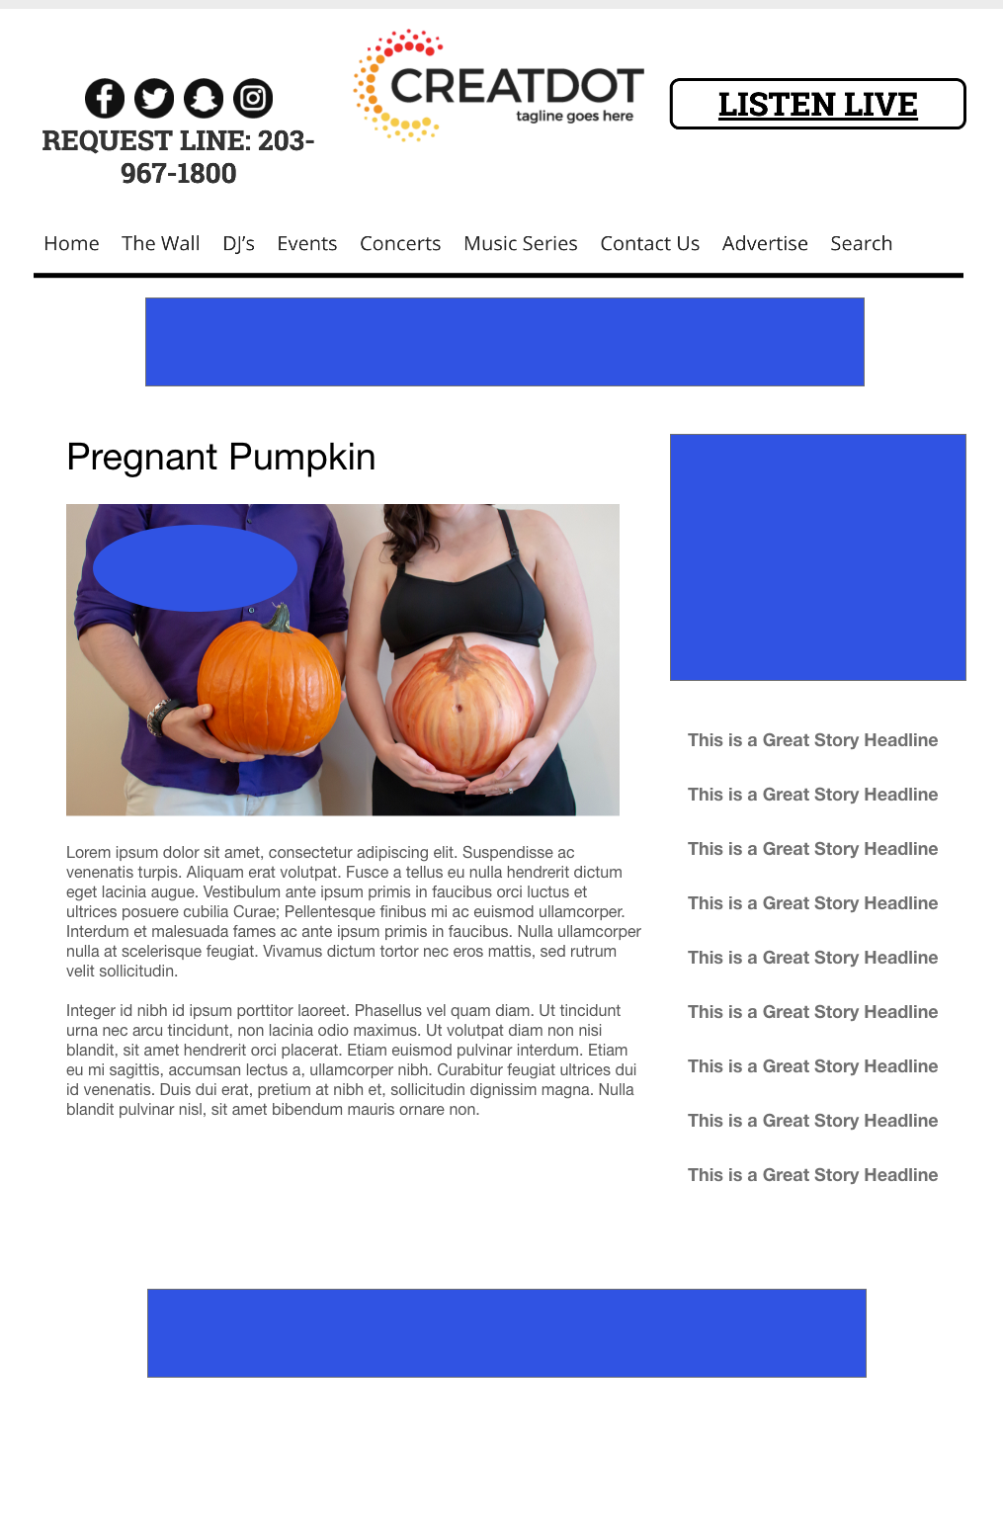
Pregnant Pumpkin
12 Days of Christmas
During this X WEEK PROMOTION, the audience uses the station app to upload a picture of their pregnant bellies painted as pumpkins!
All submissions will enter a final website vote for a sponsor prize!
WITH YOUR INVESTMENT, YOU GET:
Lead List of All Entrants
Streaming Pre-roll Video Website & App
App 320x50
Branded Website Landing Pages
300x250 Banner
X Recorded & Live Promos
X :15 Second Commercials
INVESTMENT: $X,000 + Prize
Bob Salesperson
bsalesperson@yourdomain.com
800-555-1212

