Slide 1
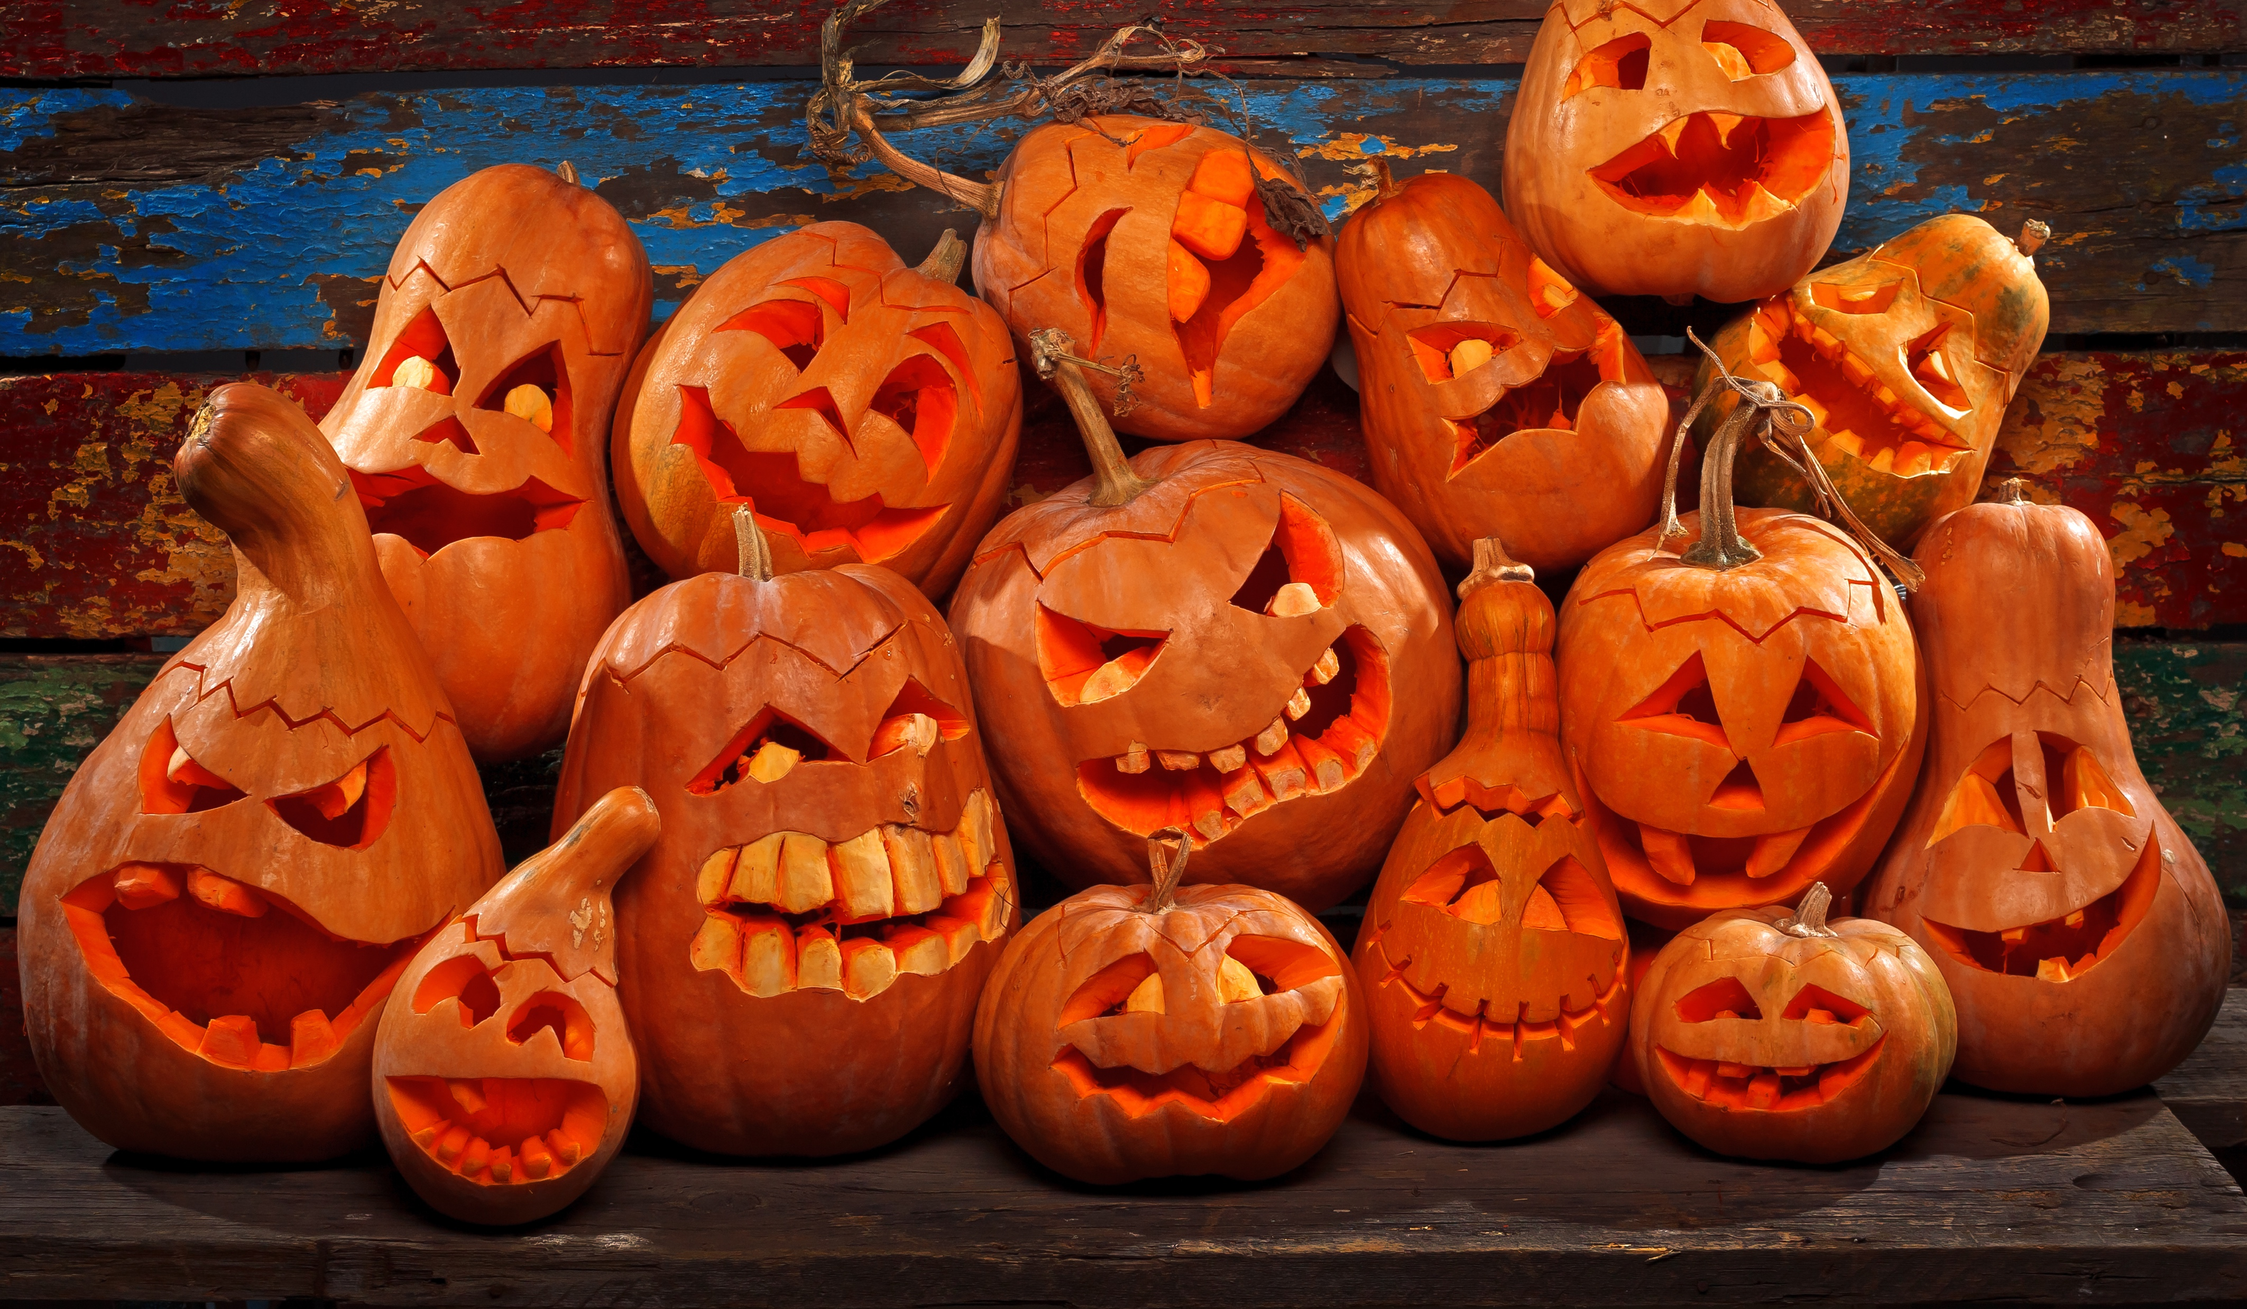
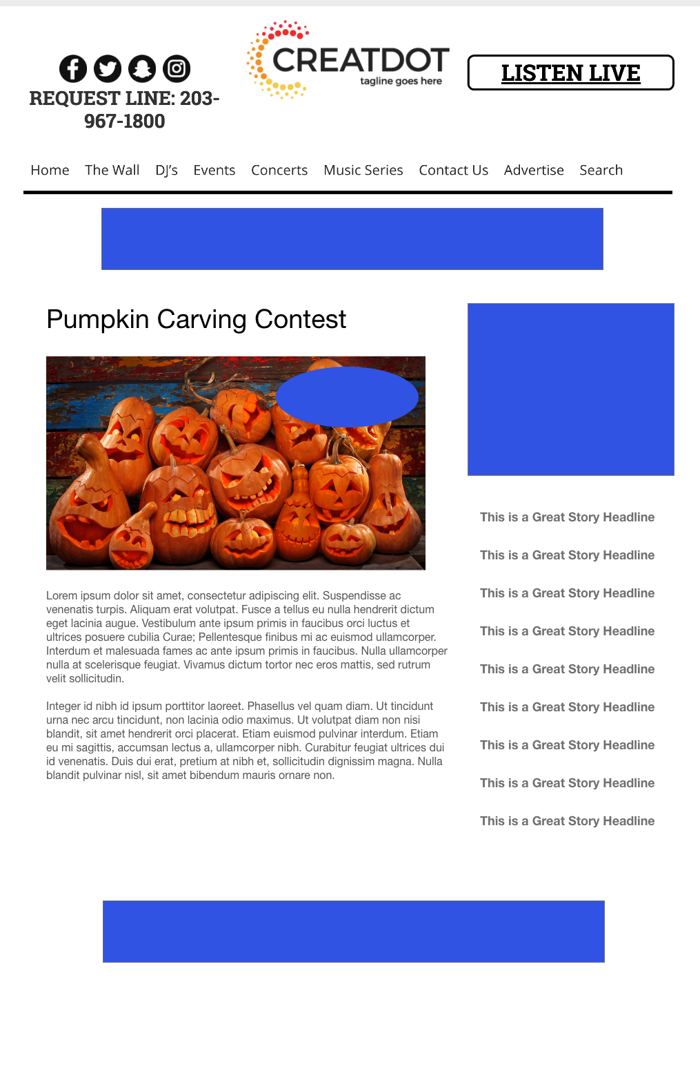
CARVING CONTEST
Listeners carve their pumpkin, snap a photo, and upload it via the station app or website.
Public voting determines who has the funniest, scariest or all-around best carved pumpkin!
Your Investment gets you
Marketing list of all entrants
Website & App branding,
Coupon to all entrants
Recorded Promos
Weekly Winner Liner announce
investment
$X,000 + Prize
Bob Salesperson
800-555-1212
bsalesperson@yourdomain.com

