Slide 1
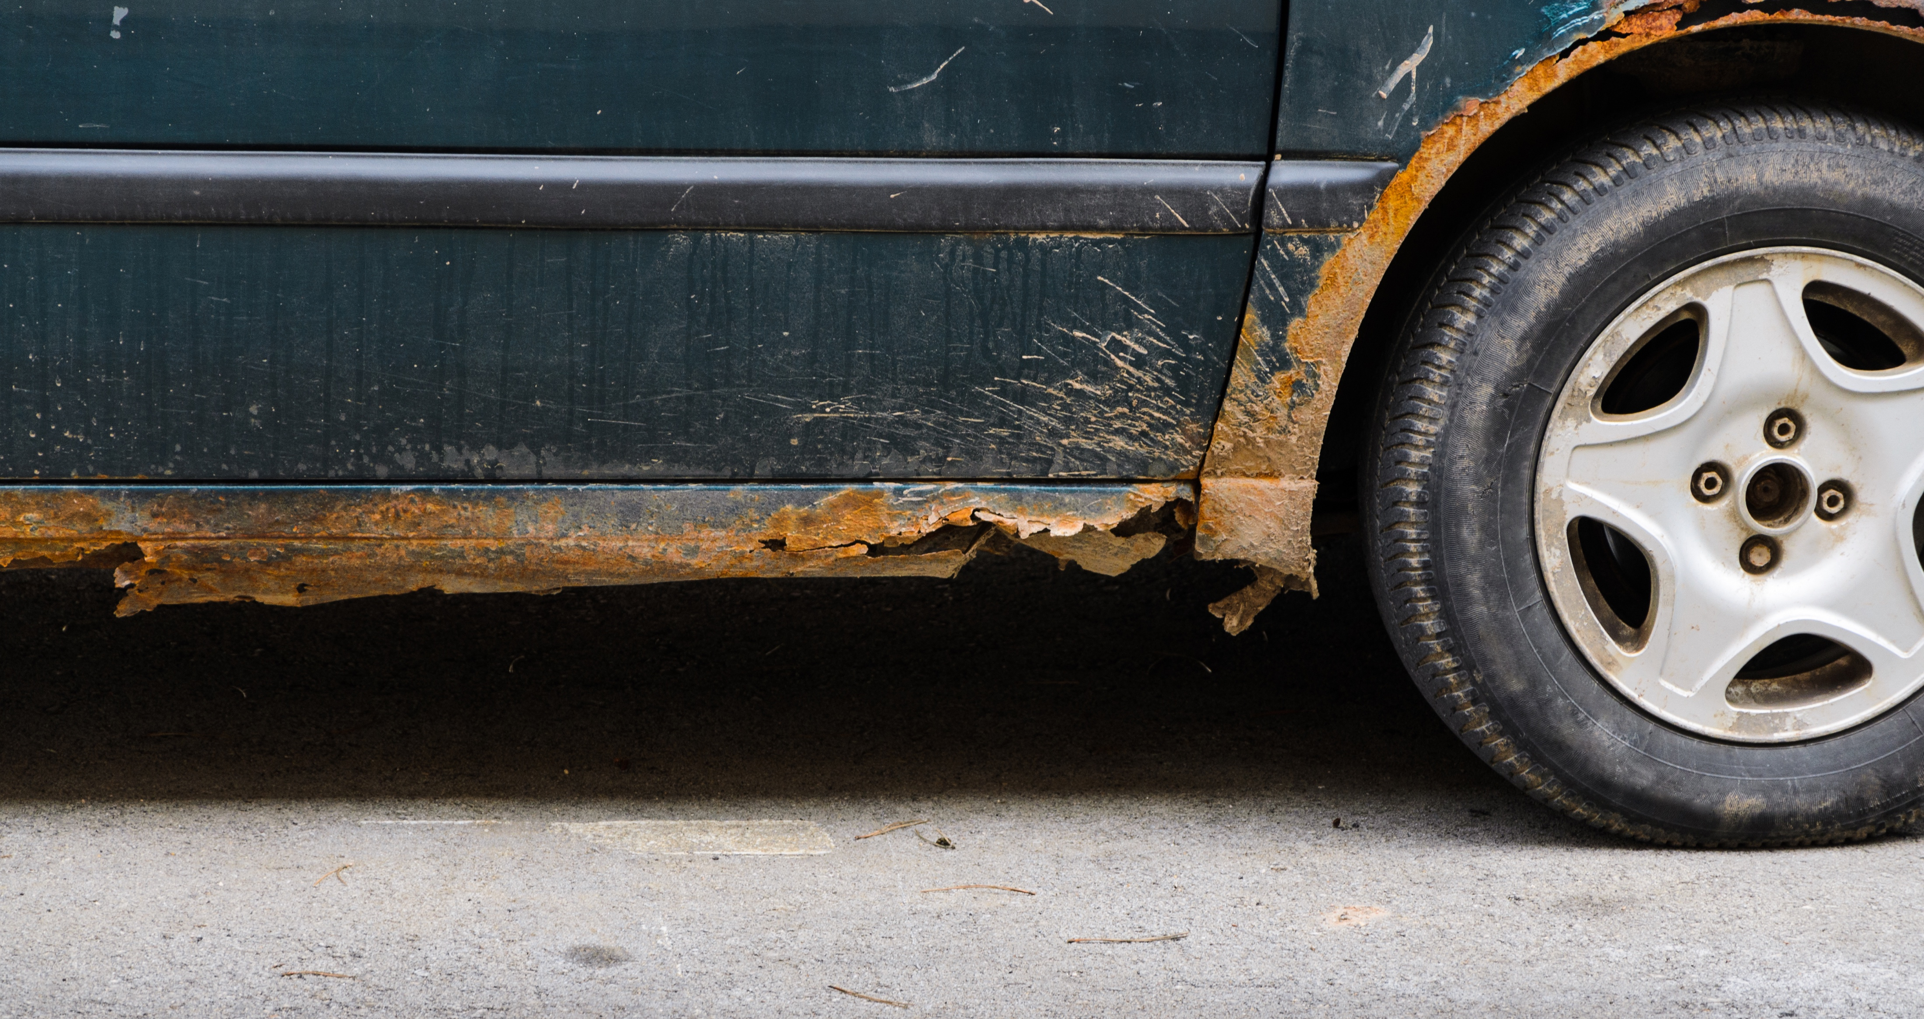
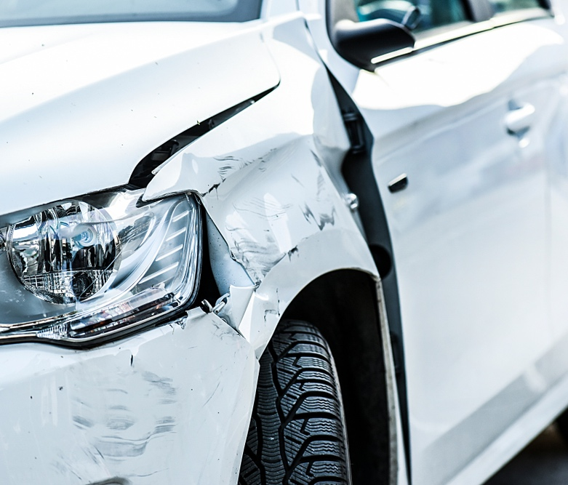
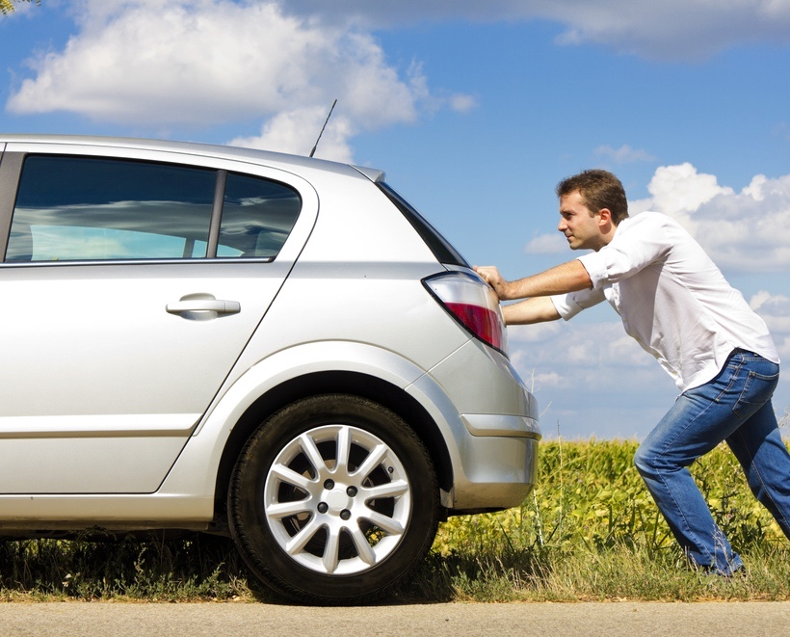
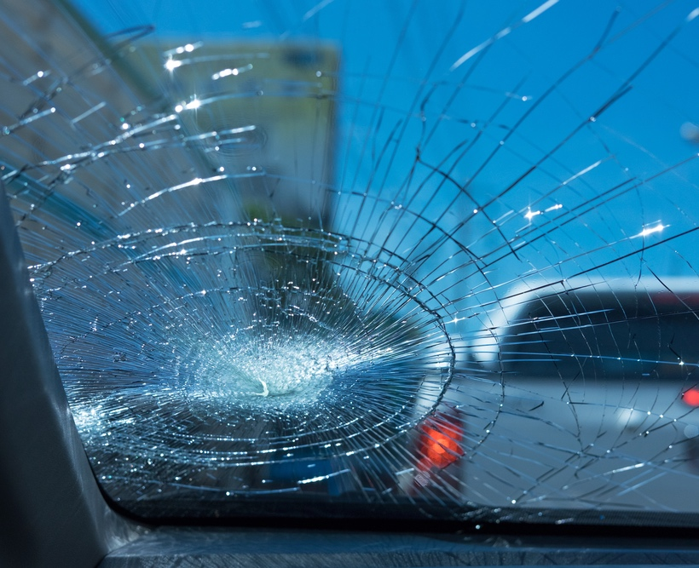
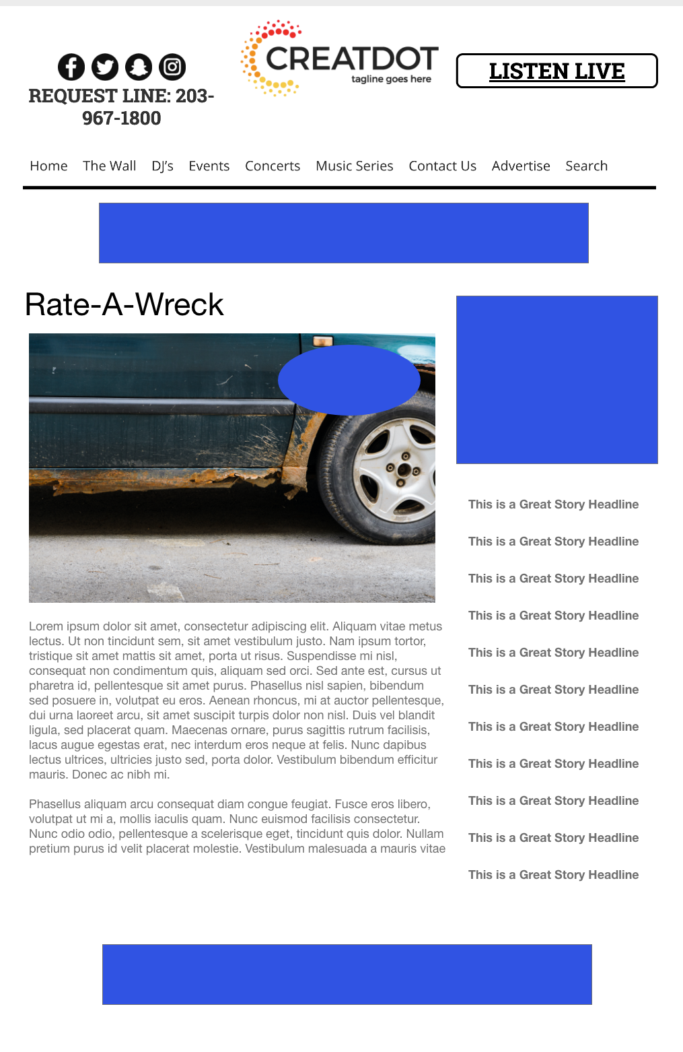
RATE-A-
WRECK
During this X WEEK PROMOTION, the audience uses the station app to upload a video of their dirty/filthy/ rusted out car.
Five car videos will enter finals for front end vote off for sponsor prize.
With Your Investment, You Get
Lead List of All Entrants
x Live Segments
Streaming Pre-roll Video Website
& App
App Open Pre-roll
App 320x50
Branded Website Landing Pages
300x250 Banner
X Recorded Promos
X Live Promos
X :15 Second Commercials
Investment
$X,000 + Prize
Bob Salesperson
bsalesperson@yourdomain.com
800-555-1212

