Slide 1



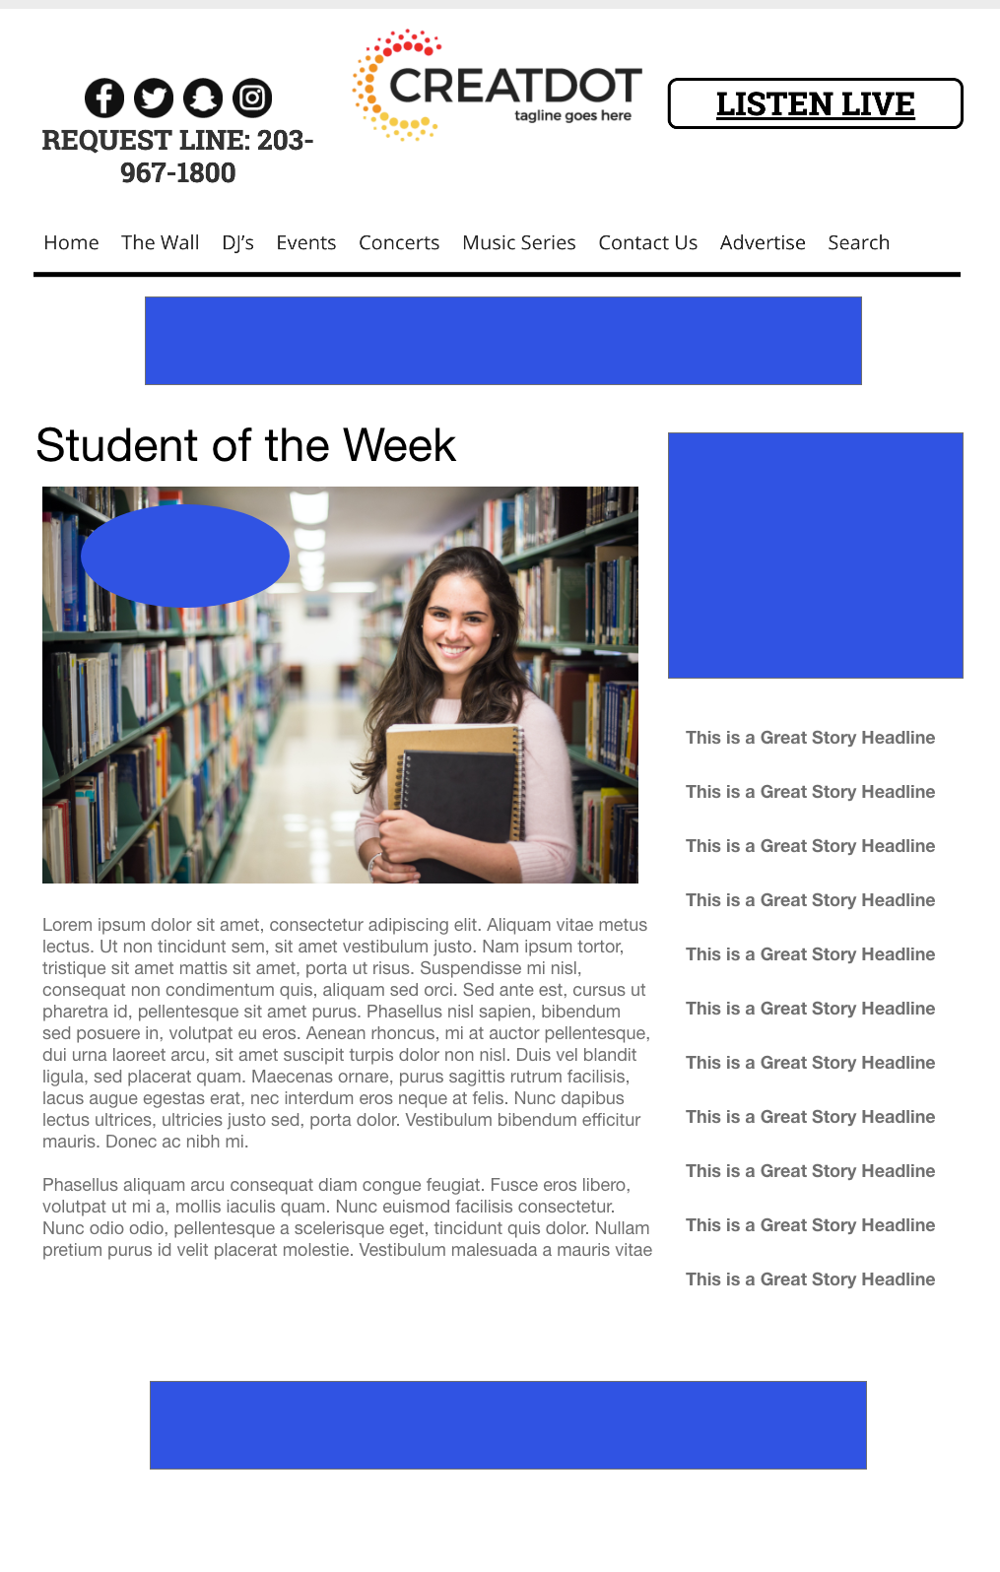
Student of the Week
During this SCHOOL-YEAR LONG PROMOTION, the audience uses the station app & website to upload a picture of their student nomination with a comment on why they should be Student of the Week. Branded voting takes place each week, with a new winner every week!
WITH YOUR INVESTMENT, YOU GET:
Lead List of All Entrants
X Live Segments
Streaming Pre-roll Video Website & App
App 320x50
Branded Website Landing Pages
300x250 Banner
X Recorded & Live Promos
X :15 Second Commercials
INVESTMENT: $X,000
Bob Salesperson
bsalesperson@yourdomain.com
800-555-1212

