Slide 1


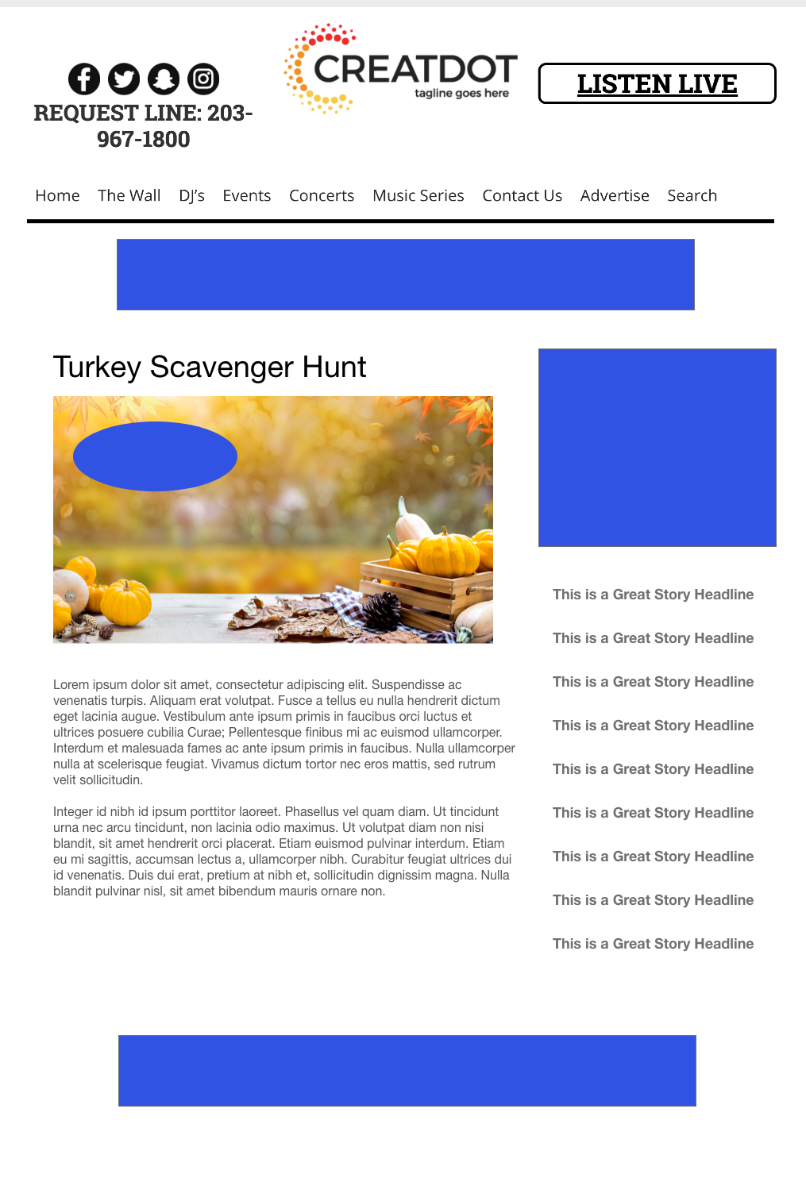
TURKEY
SCAVENGER HUNT
INVESTMENT: $X,000 + Prize
WITH YOUR INVESTMENT, YOU GET
Lead List of All Entrants & Survey answers
Offer distribution
Branded Website Landing Pages
300x250 Banner
X Recorded Promos
X Live Promos
X :15 Second Commercials
During this X WEEK PROMOTION, a Turkey is hidden in a different spot every day on the station website. The audience searches the website to find it! Those who find it are entered to win!
Bob Salesperson bsalesperson@yourdomain.com 800-555-1212

