Slide 1

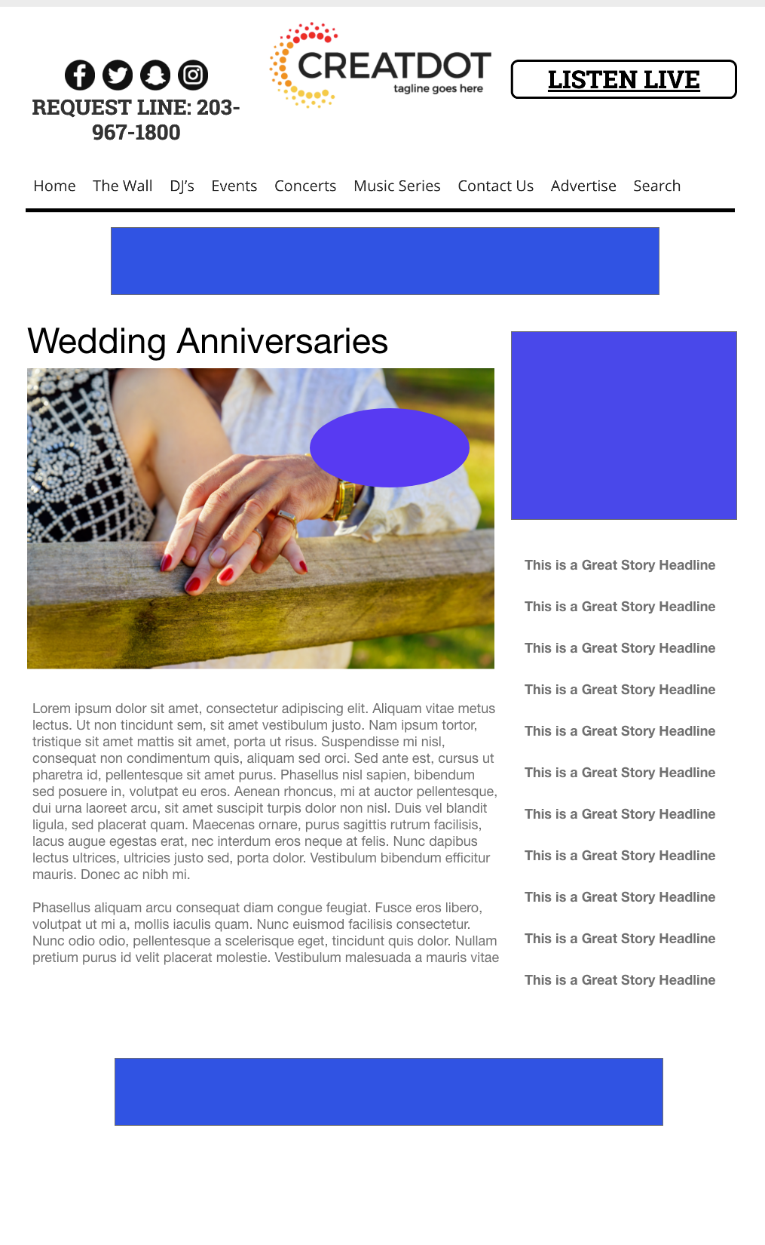

Wedding Anniversary Text-In
This unique promotion has the audience text in their anniversary date, name and their spouse’s name for a chance to win a Sponsor Prize.
After the sweepstakes ends, there will be daily anniversary announcements from the text- in list with a branded segment that include additional solicitations to text in for new submissions.
What a marketing opportunity for your business to have a list of couple names and anniversary dates for ongoing marketing!
Your Investment gets you
Lead List of All Entrants
X Live Segments
App 320x50
Branded Website Landing Page
300x250 Banner
Daily Branded Liner
investment
$X,000 + Kick Off Prize
Bob Salesperson
800-555-1212
bsalesperson@yourdomain.com

