Slide 1
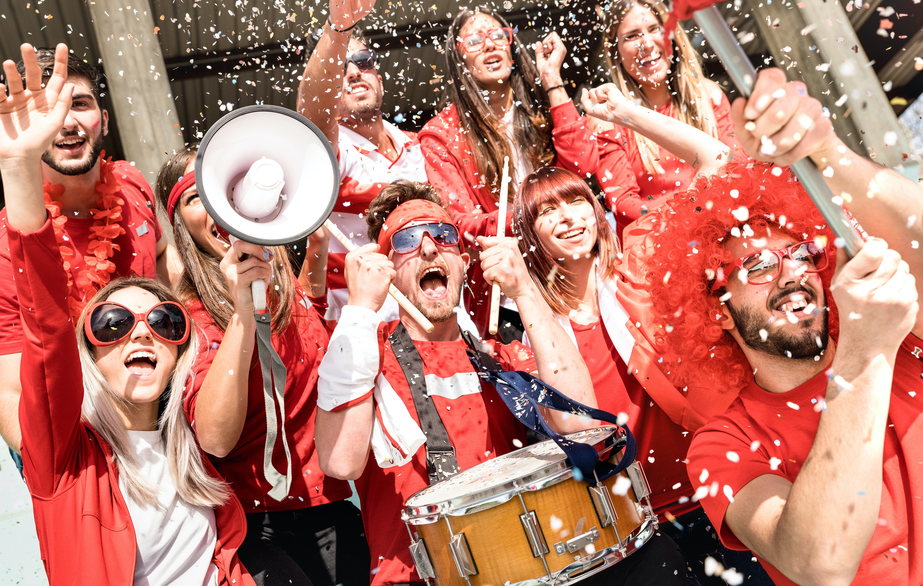
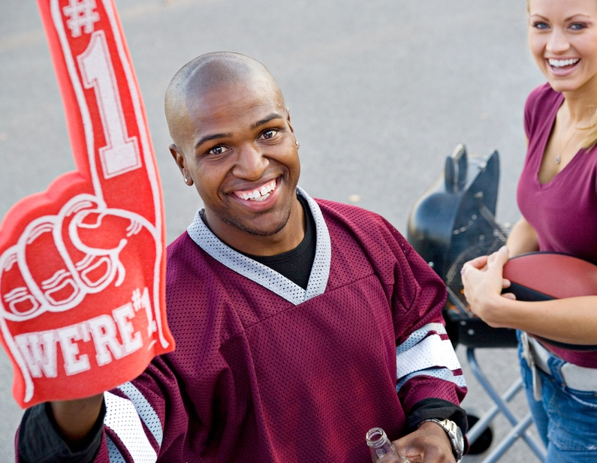
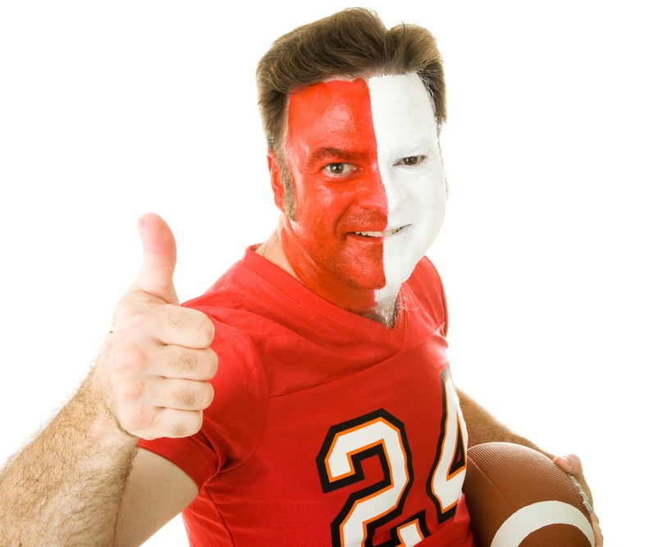
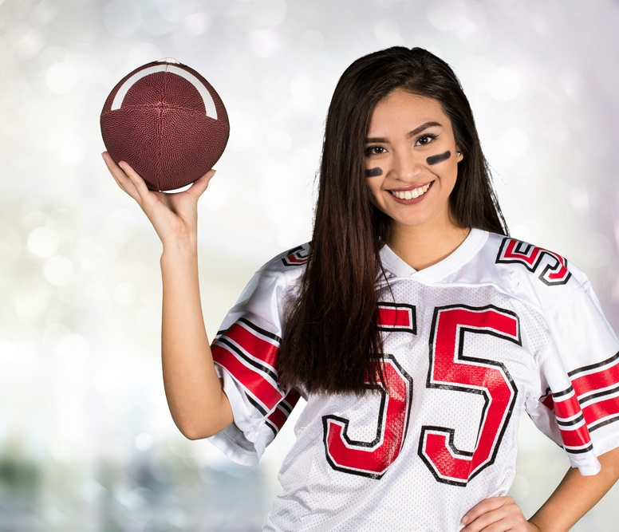
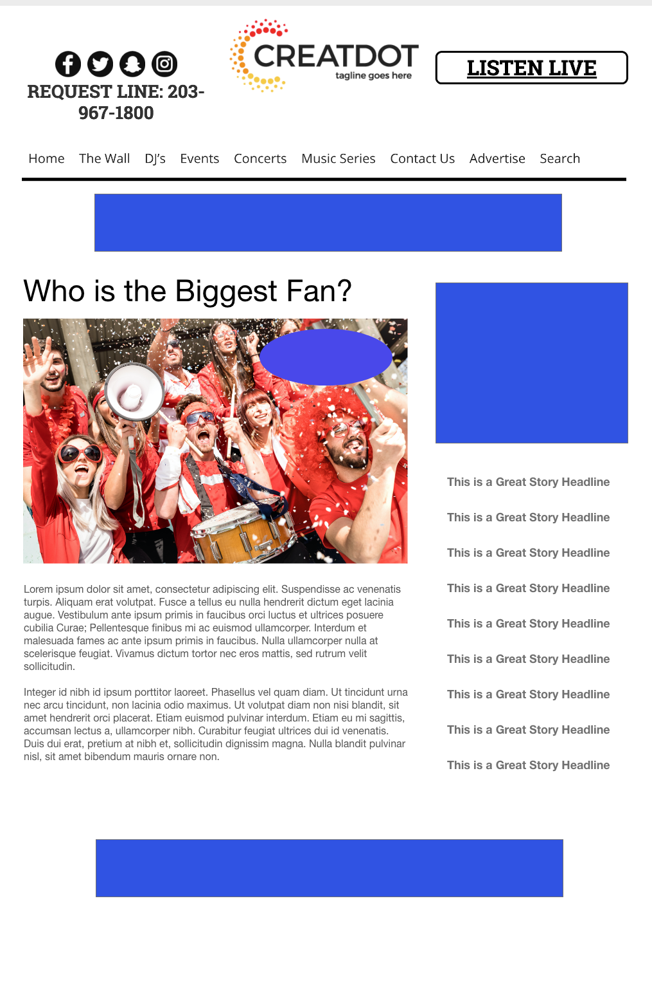
WHO IS THE
BEST FAN?
During this X WEEK PROMOTION, we finally find out who is truly the biggest football fan.
The audience uses the app to upload a picture of them in their #1 fan outfit. All submissions go onto the website & app for public voting.
With Your Investment, You Get
Lead List of All Entrants
X Live Segments
App Open Pre-roll
App 320x50
Branded Website Landing Pages
X Recorded & live Promos
X :15 Second Commercials
Investment
$X,000 + Prize
Bob Salesperson
bsalesperson@yourdomain.com
800-555-1212

