Slide 1
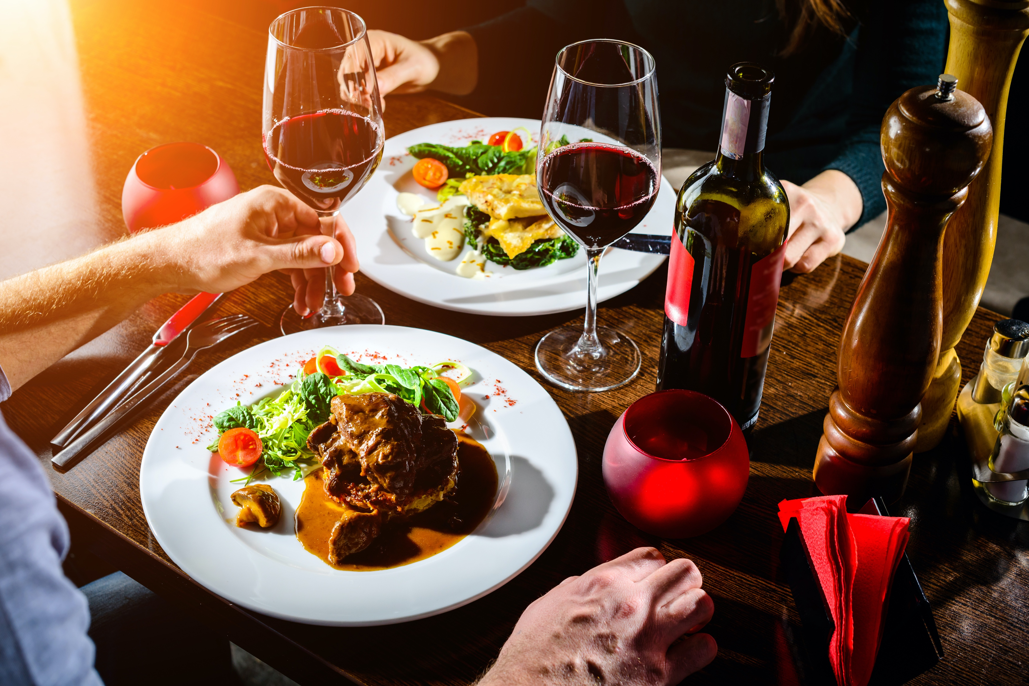
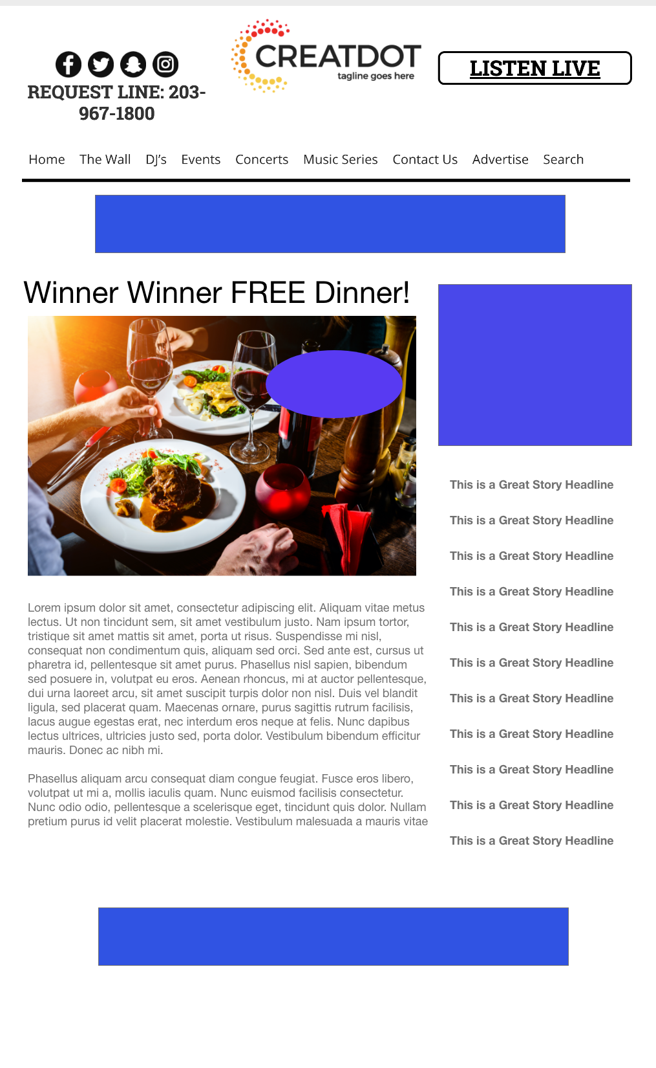
Winner Winner
FREE Dinner!
During this X WEEK PROMOTION, the audience uses the station app to enter a weekly sweepstakes for a free dinner at a local restaurant!
Your Investment gets you
Website & App branding,
Coupon to all entrants, 4 Daily
Recorded Promos.
Weekly Winner Liner announce.
investment
$X00 per week + Prize
Bob Salesperson
800-555-1212
bsalesperson@yourdomain.com

