Slide 1


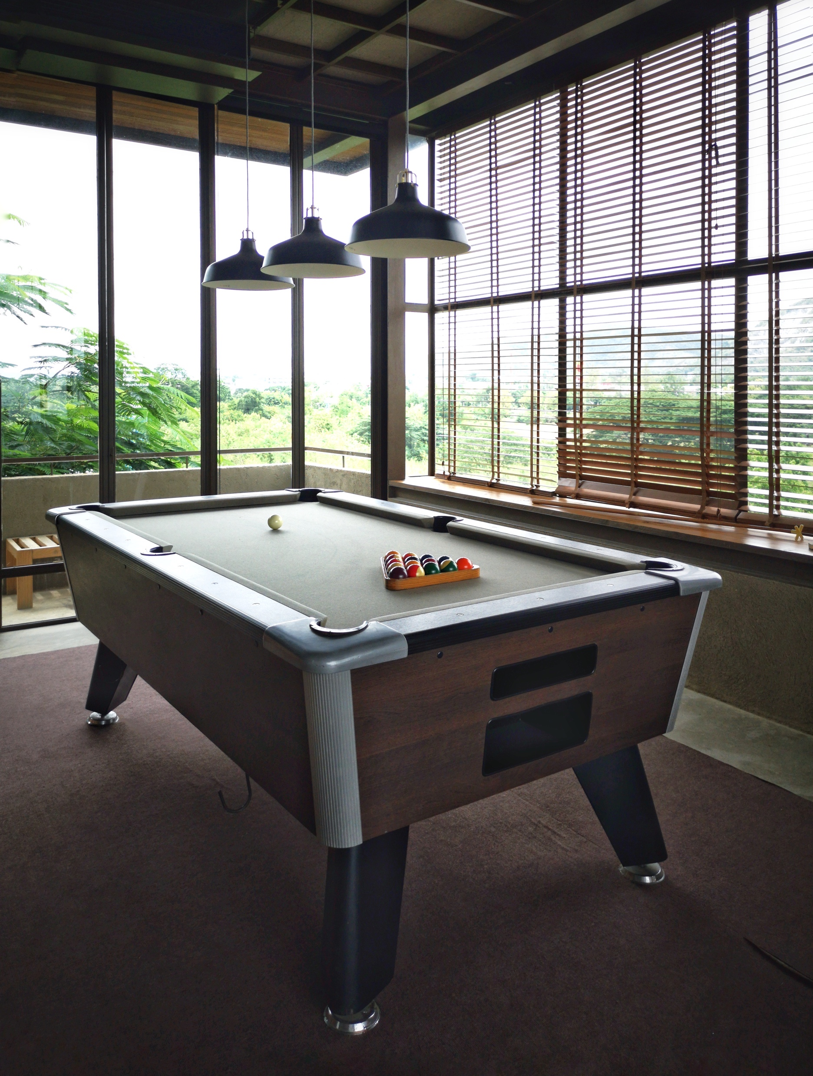
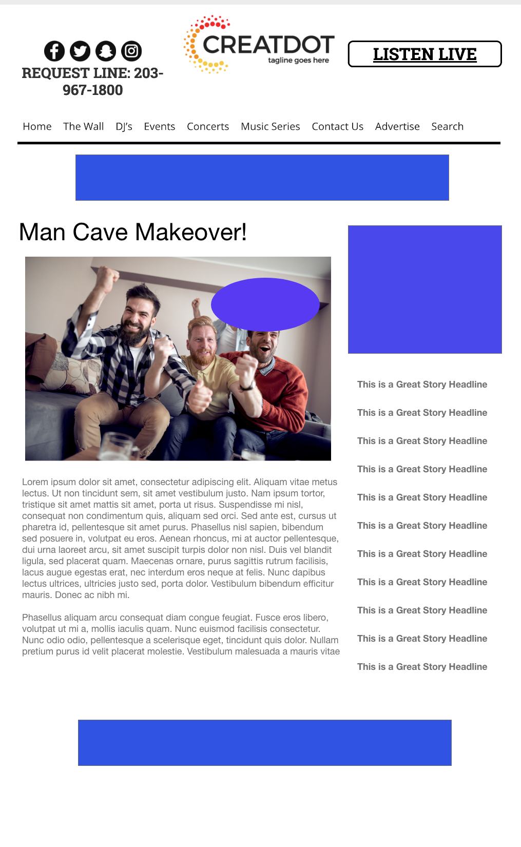
MAN CAVE
MAKEOVER
During this X WEEK PROMOTION, the audience uploads videos of their worn-out man cave that needs a serious upgrade in furniture and tech. In their videos, they narrate why they should win the ultimate Man Cave Make Over!
INVESTMENT:
$X,000 + Prize
YOUR INVESTMENT GETS ALL THIS:
Lead List of All Entrants
X Live Segments
Streaming Pre-roll Video Website & App
App Open Pre-roll
App 320x50
Branded Website Landing Pages
300x250 Banner
X Recorded Promos
X Live Promos
X :15 Second Commercials
Bob Salesperson bsalesperson@yourdomain.com 800-555-1212

