Slide 1
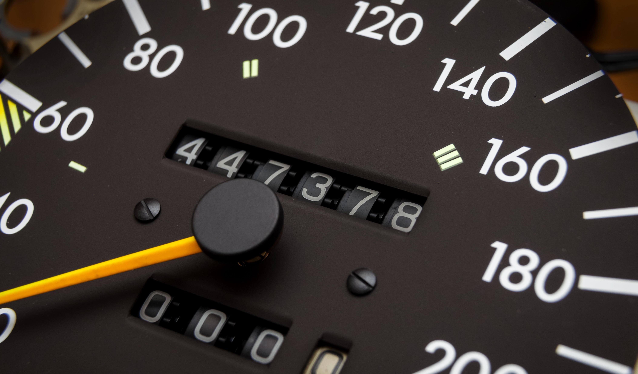
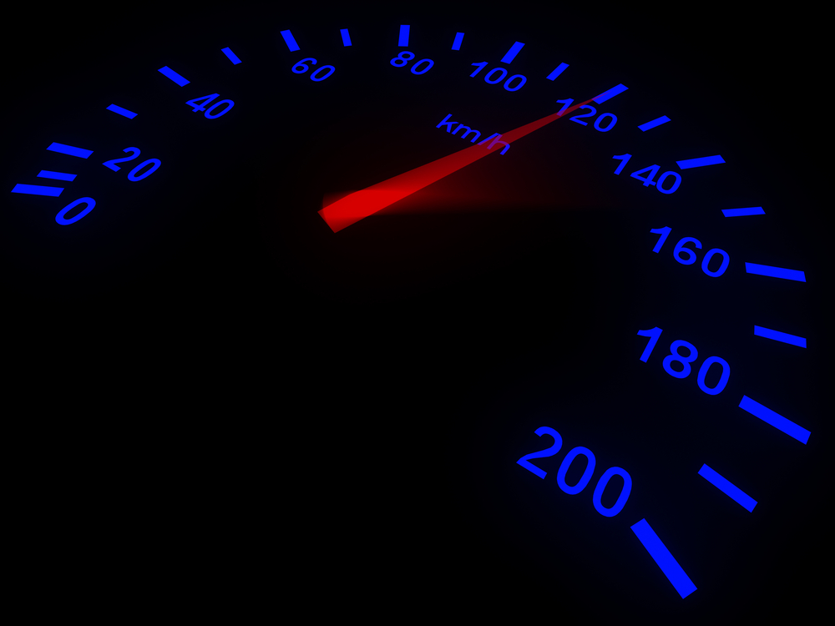
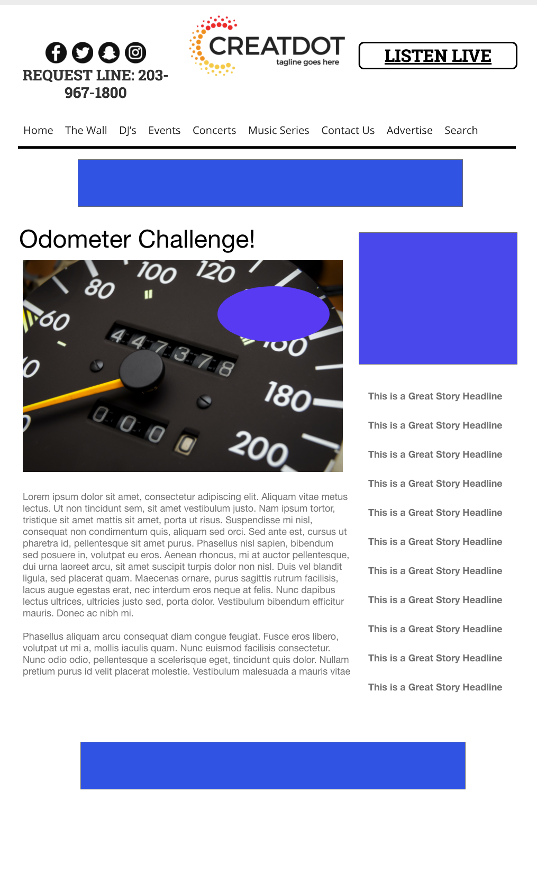
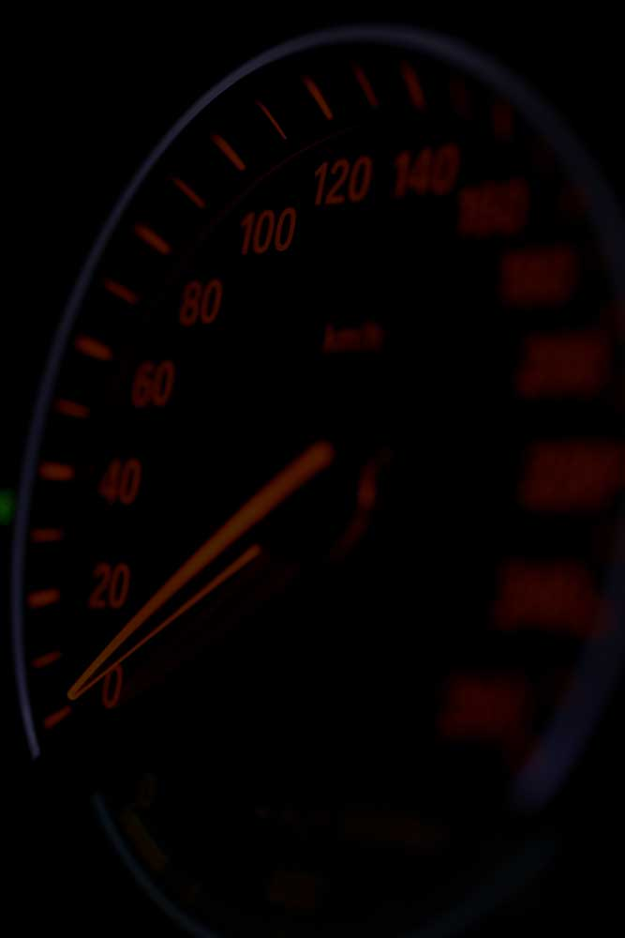
Odometer
Challenge
The audience submits images of their their super high mileage odometers.
Random (or highest mileage) submissions are picked as winners!
Your Investment gets you
Lead List of All Entrants
X Live Weekly Segments Two Weekly Liners
Branded Website Landing Pages
300x250 Banner
X Recorded Promos
X :15 Second Commercials
Investment
$X,000 + Prize
Bob Salesperson
800-555-1212
bsalesperson@yourdomain.com

