Slide 2
J.D. Sims
Keep Jackson Beautiful
Coordinator
Welcome
Keep Jackson Beautiful Members
Master Gardeners

Slide 3
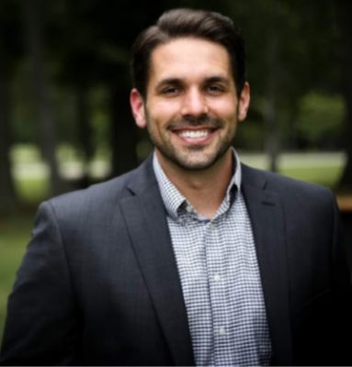
Mayor Scott Conger
Invocation and Opening
Remarks

Slide 4
Robin Chance
Keep Jackson Beautiful
Chairman
Announcement of Awards
Presentation and Pictures
with Mayor Conger

Slide 5
Robin Chance
Keep Jackson Beautiful
Chairman
Announcement of Awards
Presentation and Pictures
with Mayor Conger

Slide 6
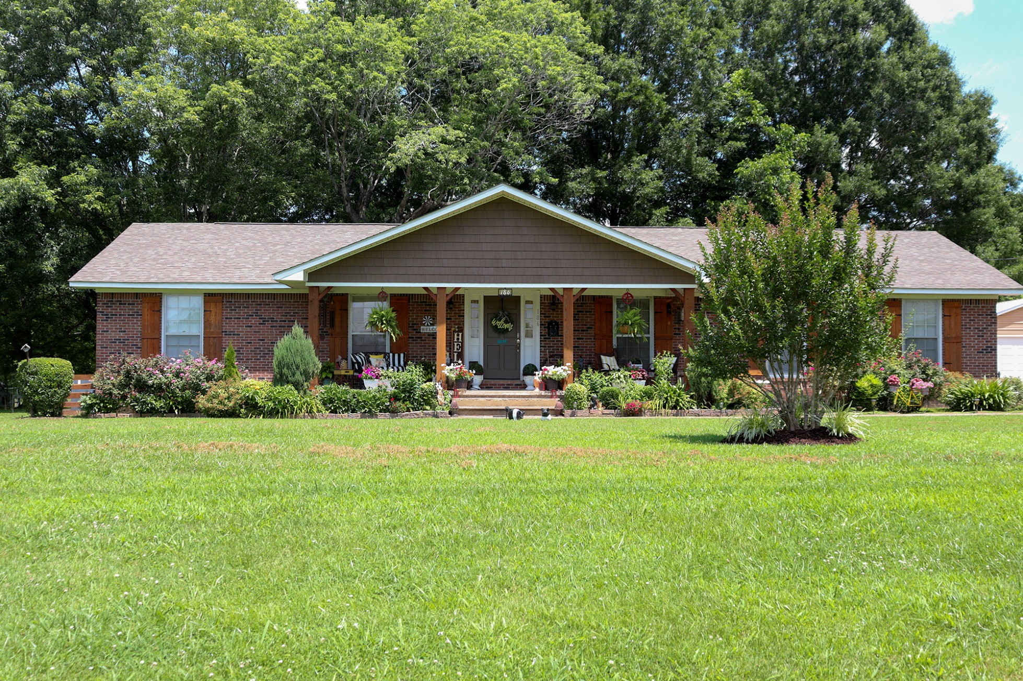
South District Awards
Kendrick Worley
Winner

Slide 7
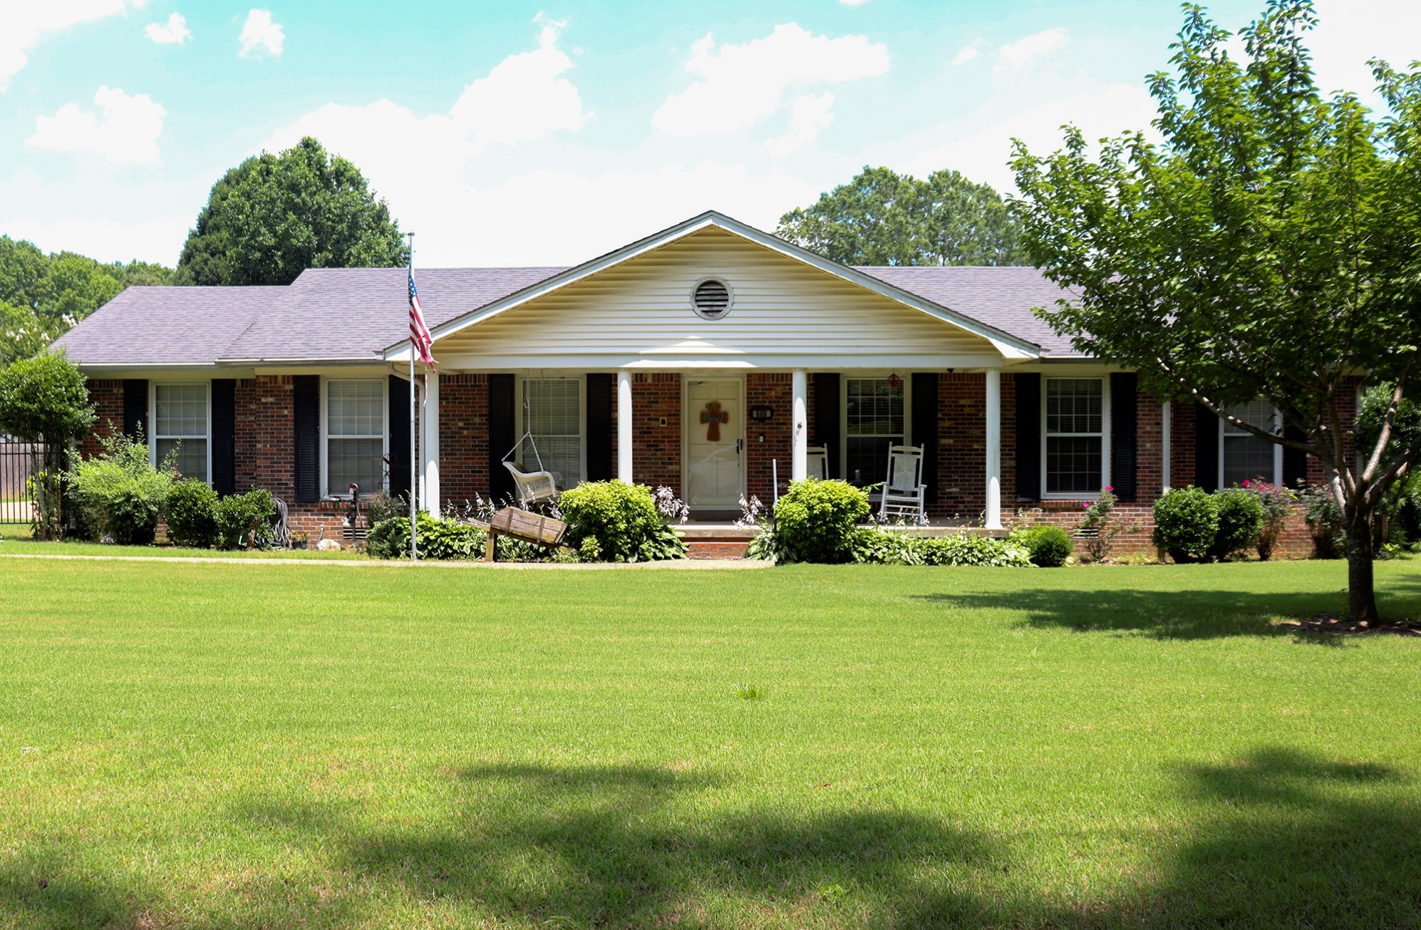
South District Awards
Joe Morris
Honorable Mention

Slide 8
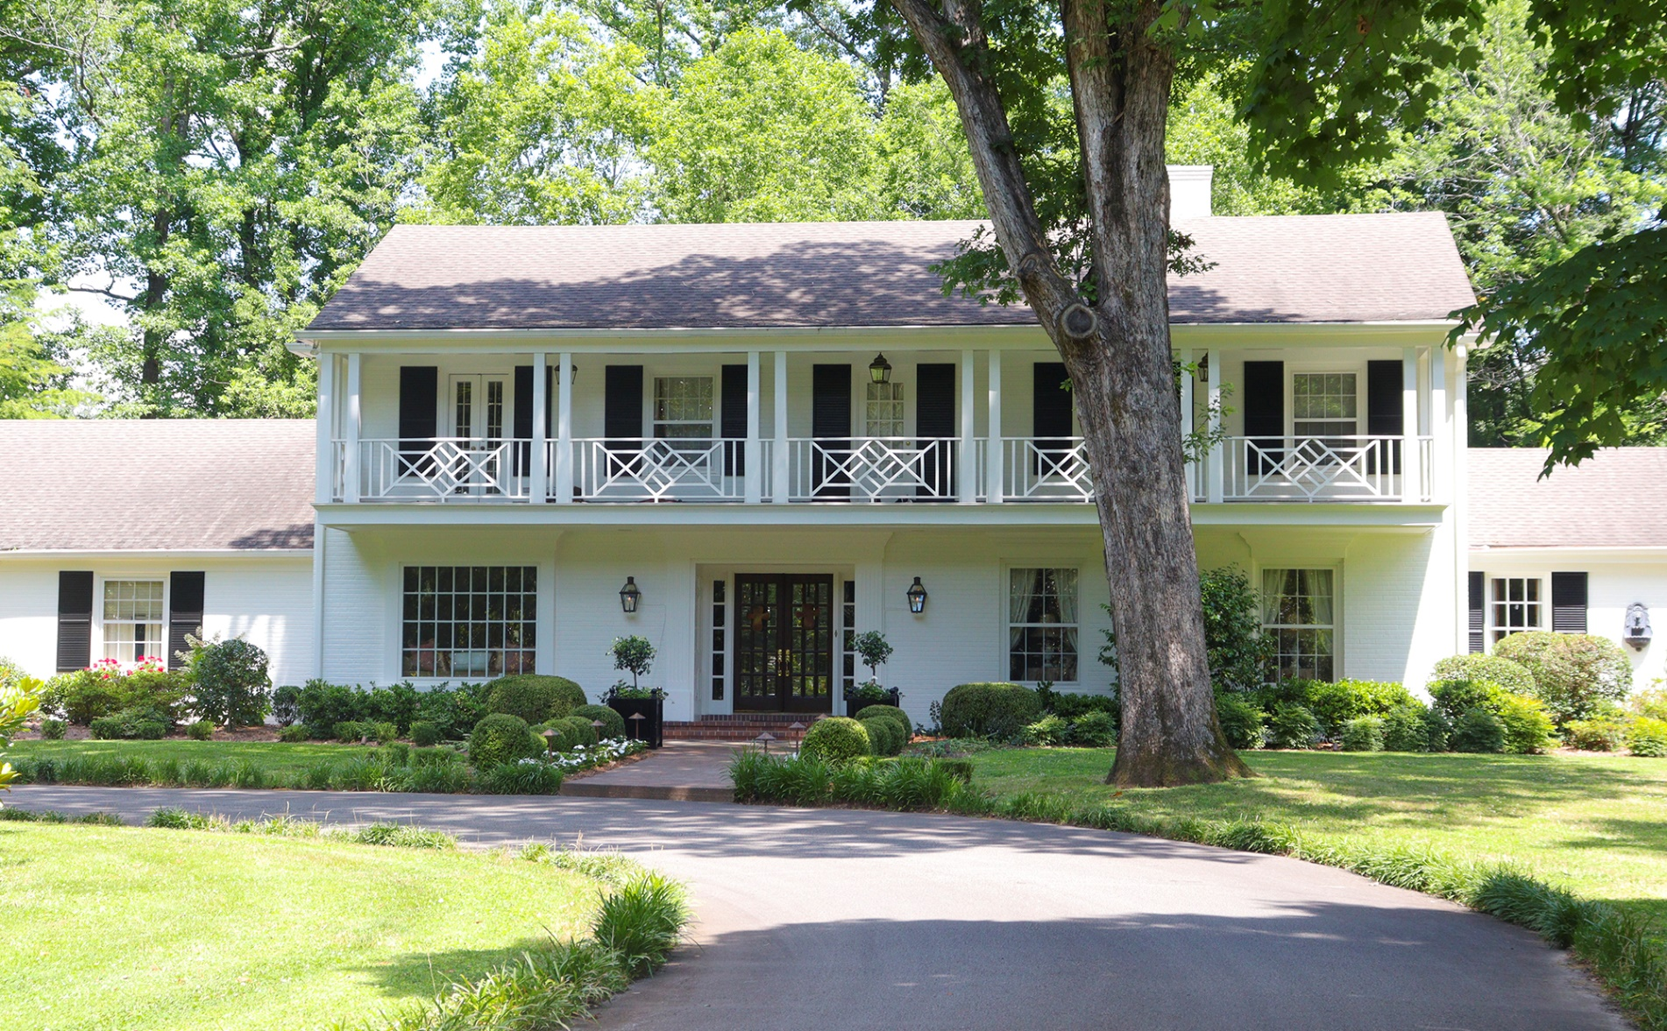
East District Awards
John and Anne Garrad
Winner

Slide 9
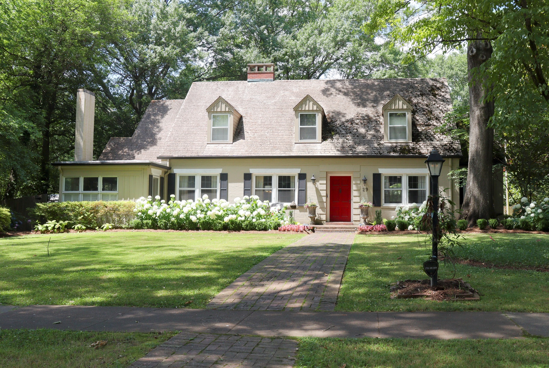
East District Awards
Michael Cash
Honorable Mention

Slide 10
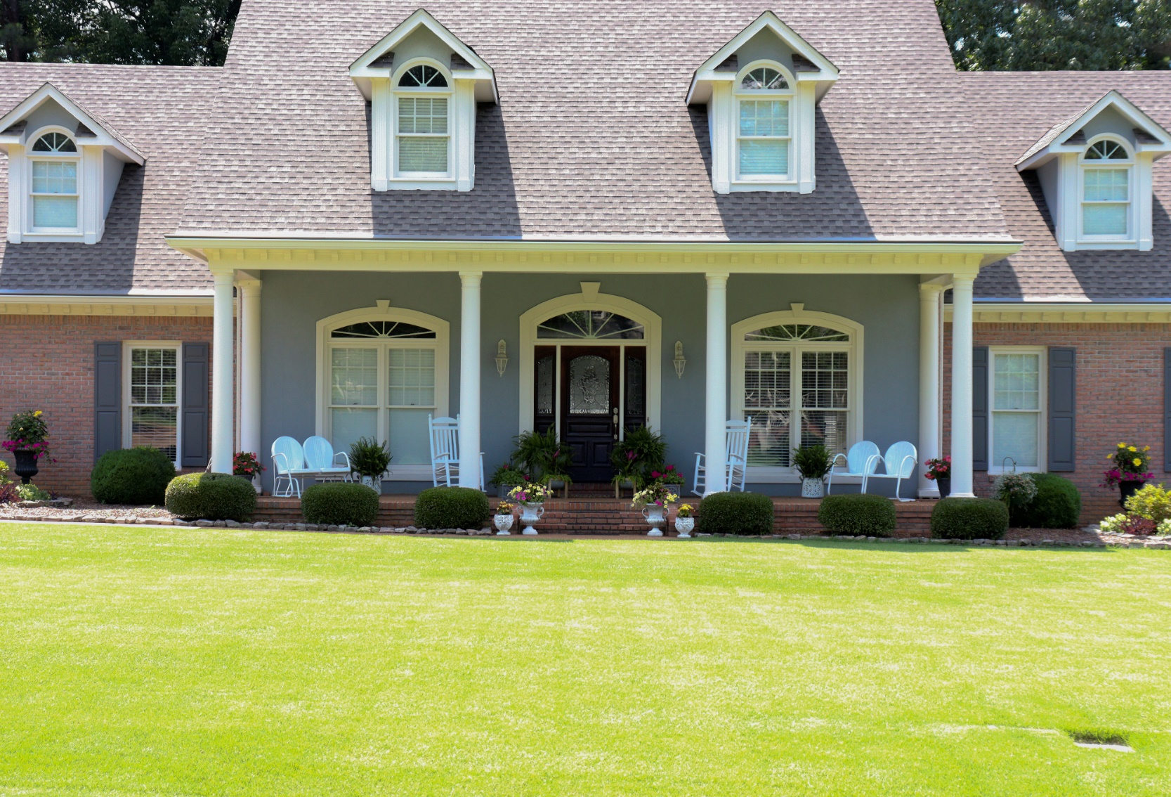
Northeast District
Awards
Greg Yates
Winner

Slide 11
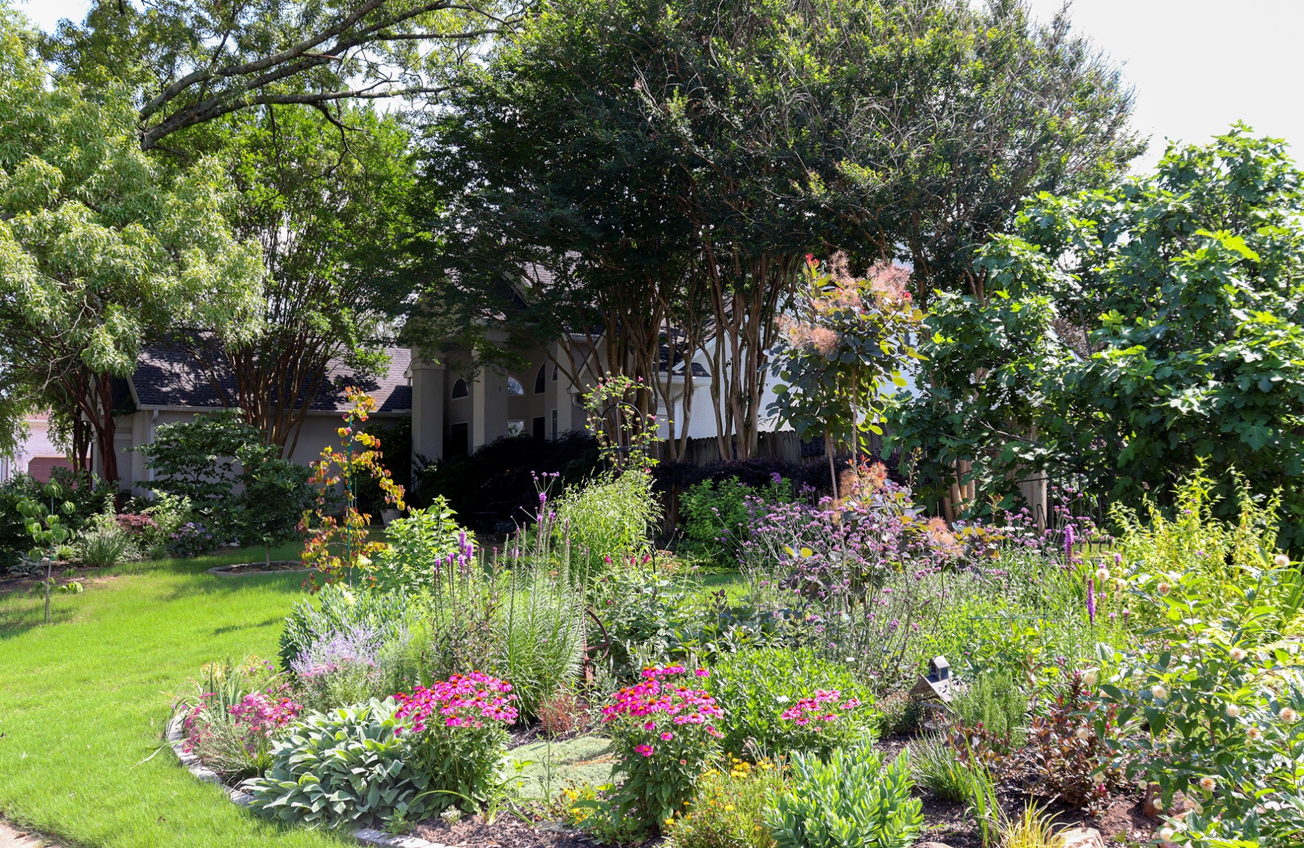
Northeast District
Awards
Everett Bennett
Honorable Mention

Slide 12
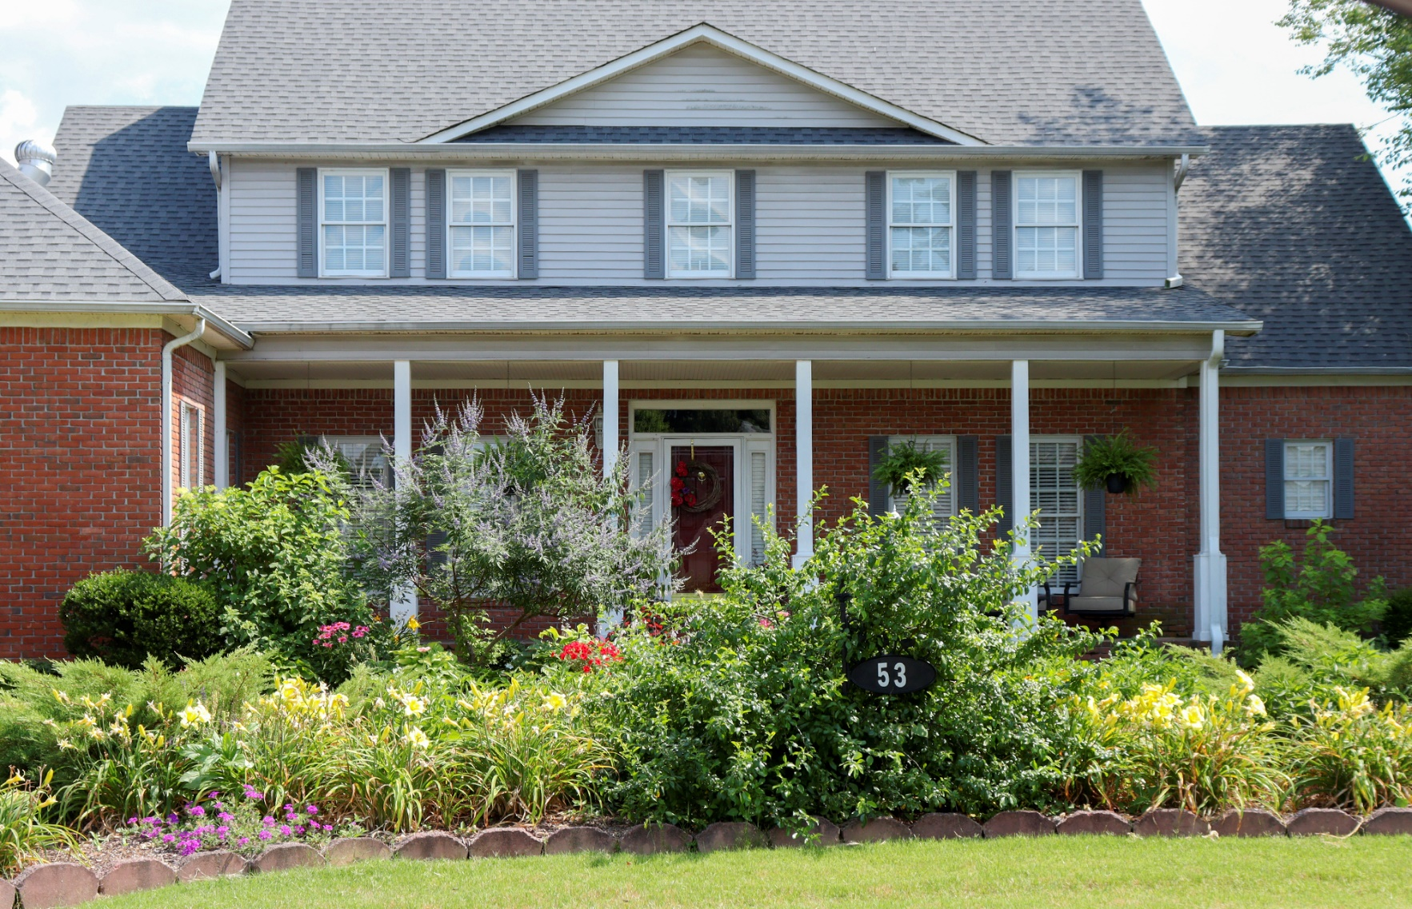
Northwest District
Awards
Scott Harris
Winner

Slide 13
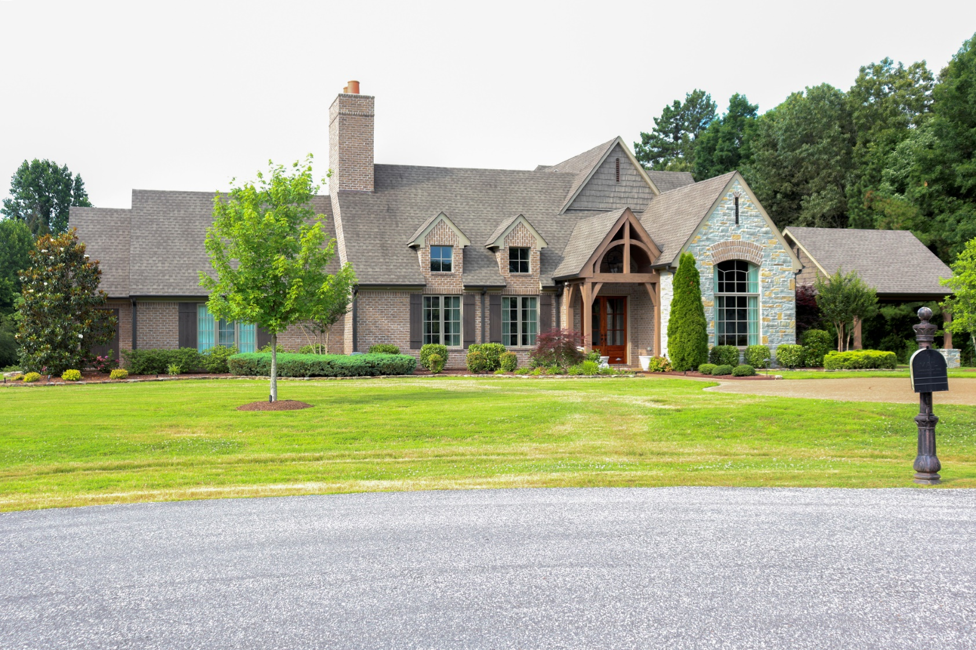
Northwest District
Awards
George and Elizabeth Dement
Honorable Mention

Slide 14
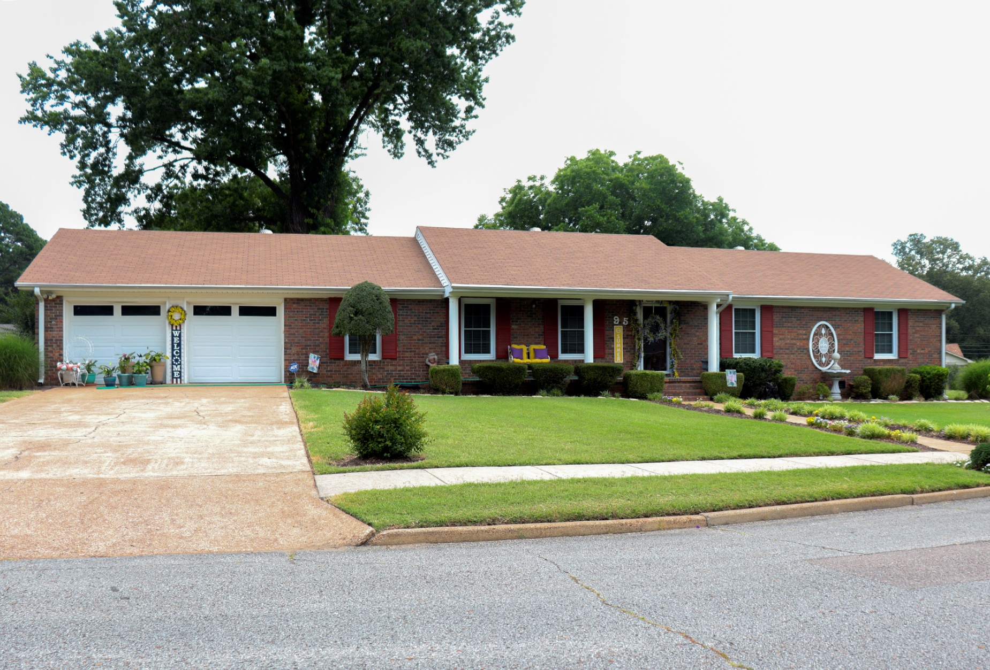
West District Awards
Andrew and Barbara Pruitte
Winner

Slide 15
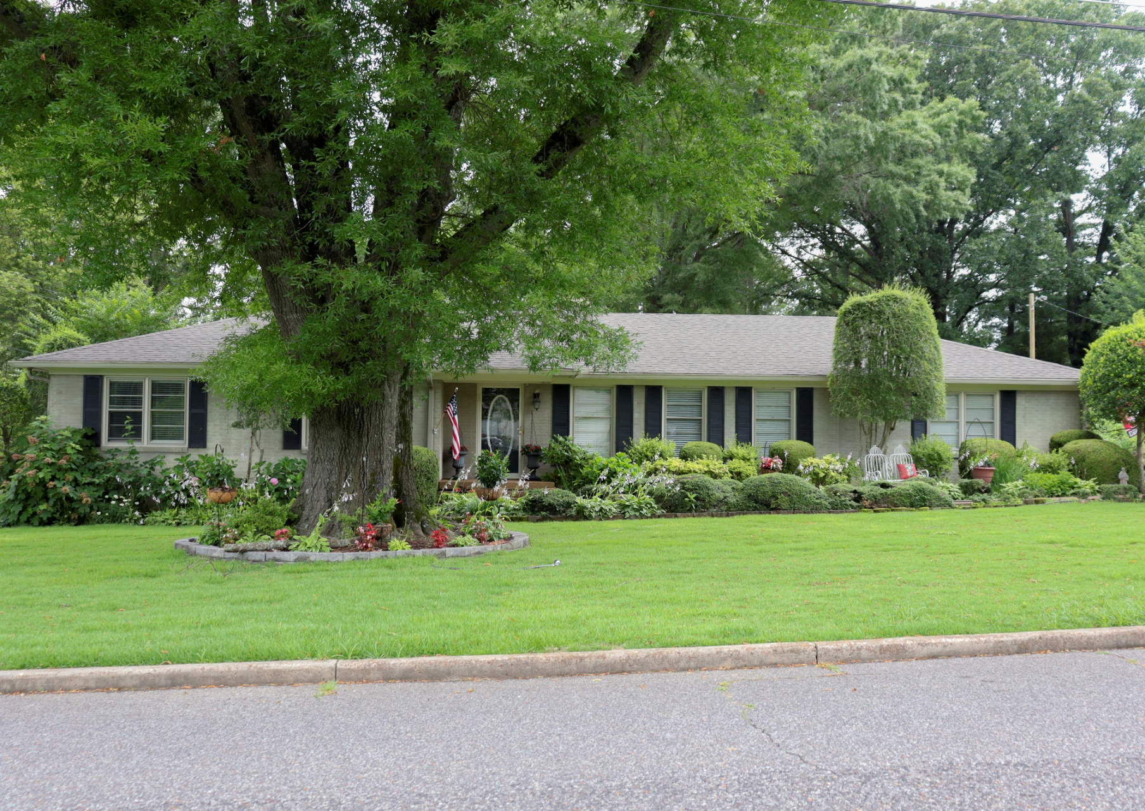
West District Awards
Bobby Morgan
Honorable Mention

Slide 16
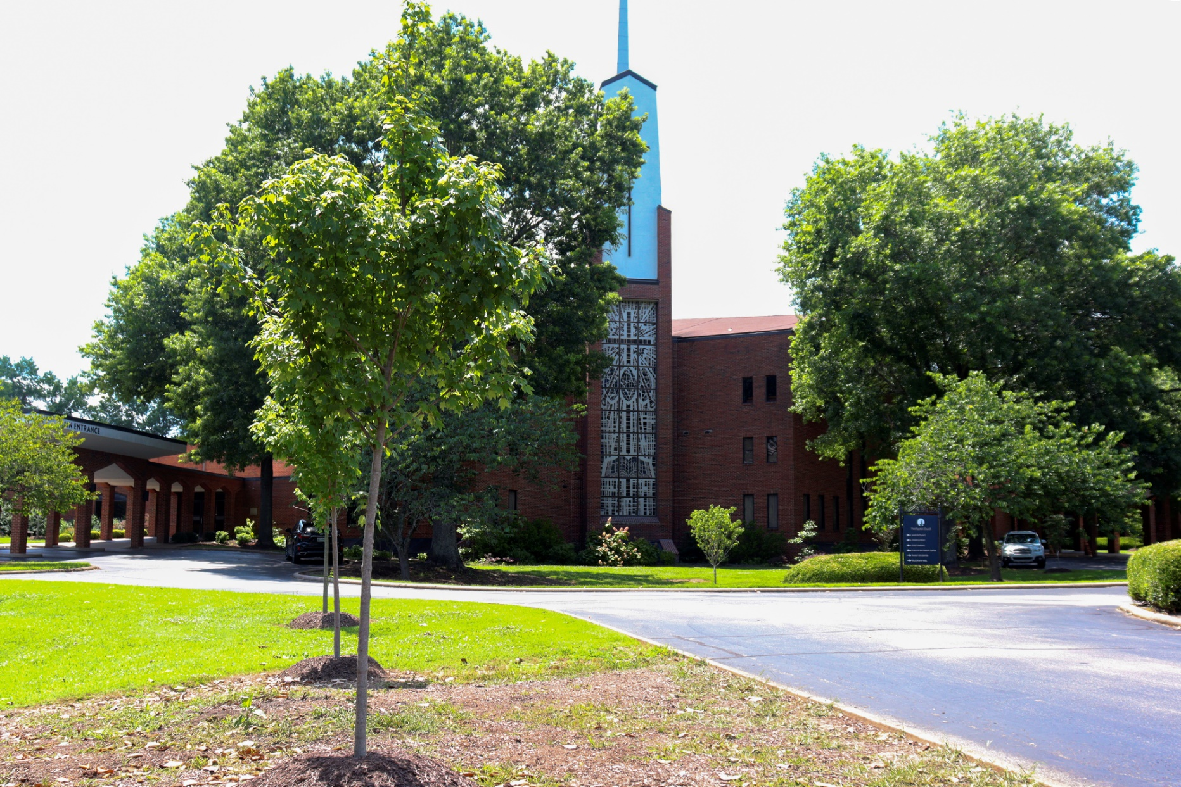
Commercial and Educational
Institution Winners
First Baptist Church-Jackson

Slide 17
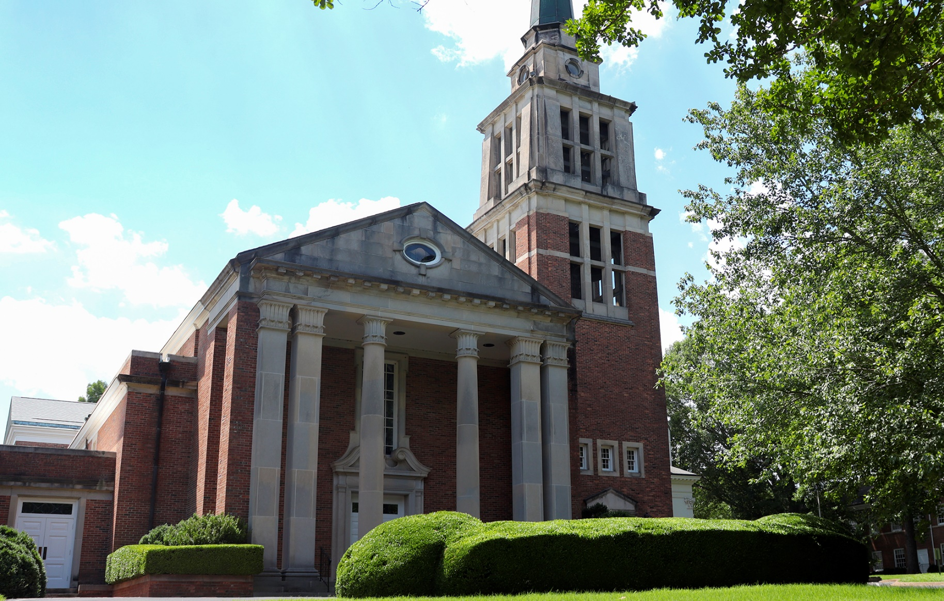
Commercial and Educational
Institution Winners
First Presbyterian Church-Jackson

Slide 18
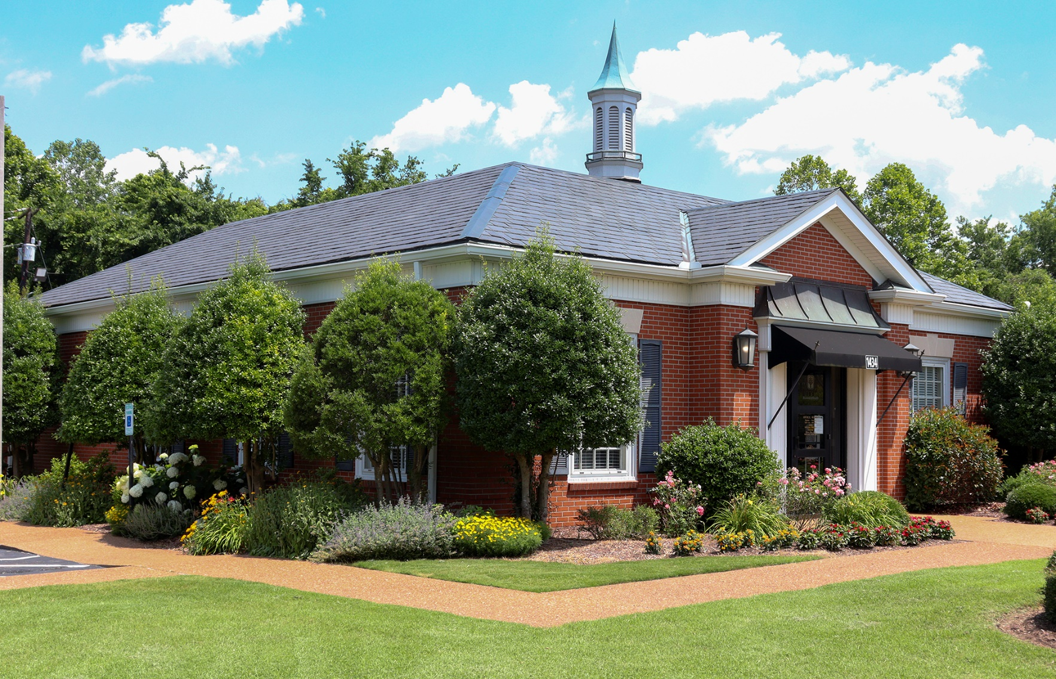
Commercial and Educational
Institution Winners
BancorpSouth
Bemis Branch

Slide 19
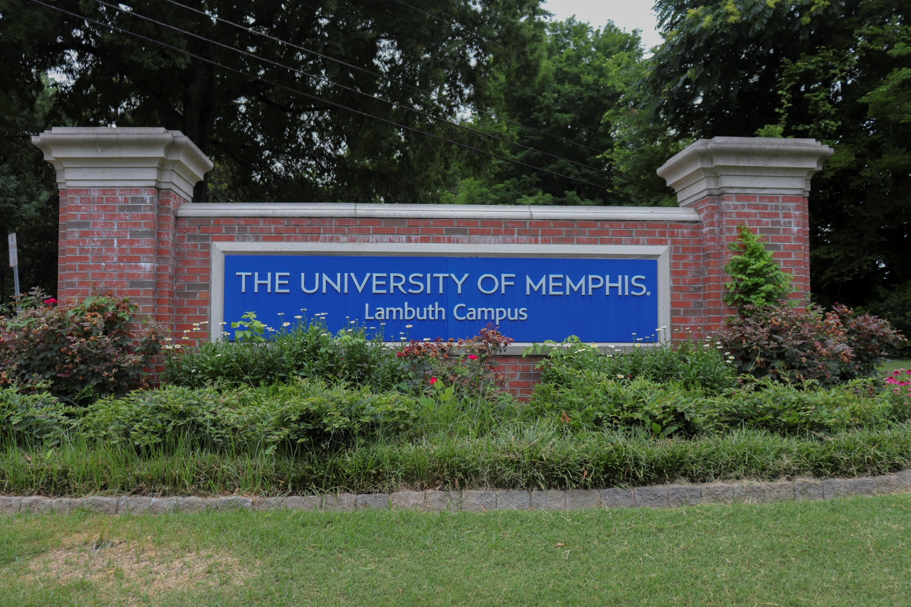
Commercial and Educational
Institution Winners
University of Memphis
at Lambuth

Slide 20
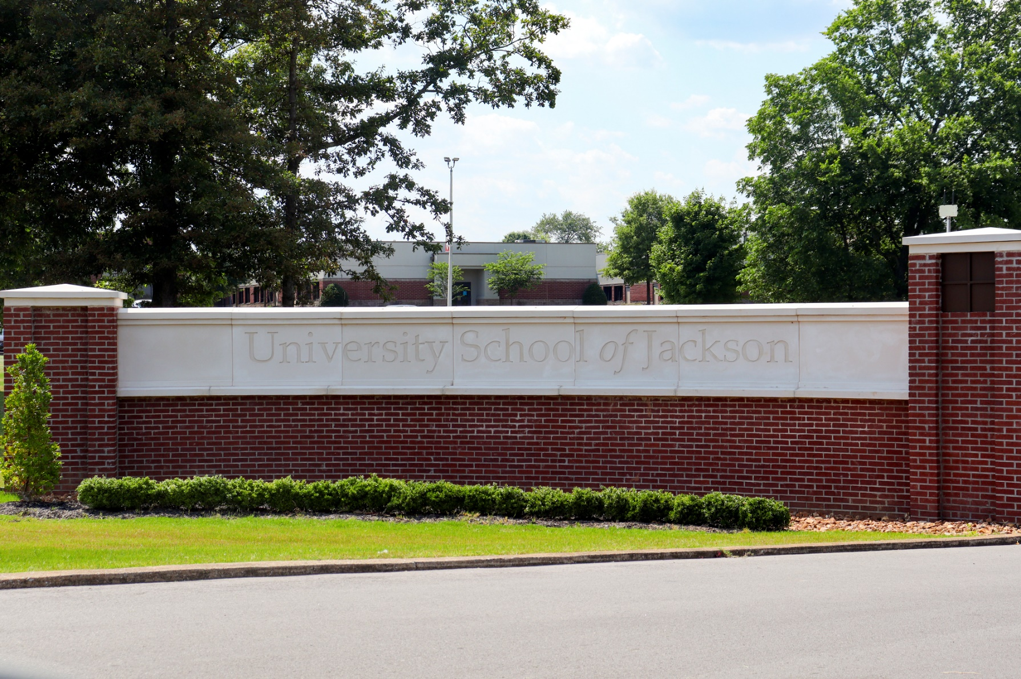
Commercial and Educational
Institution Winners
University School of Jackson

Slide 21
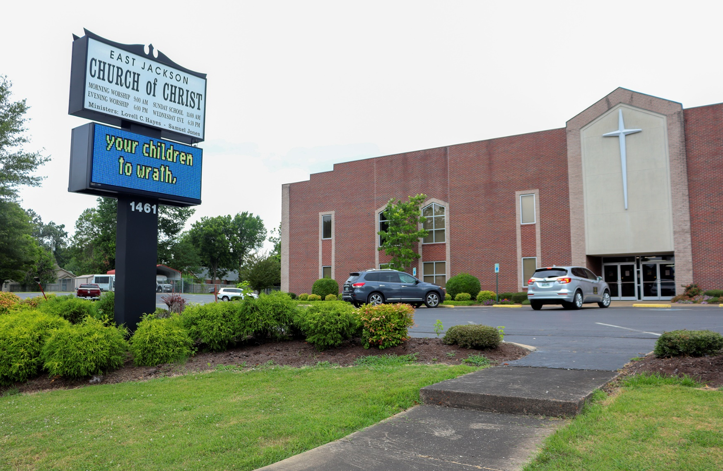
Commercial and Educational
Institution Winners
East Jackson
Church of Christ

Slide 22
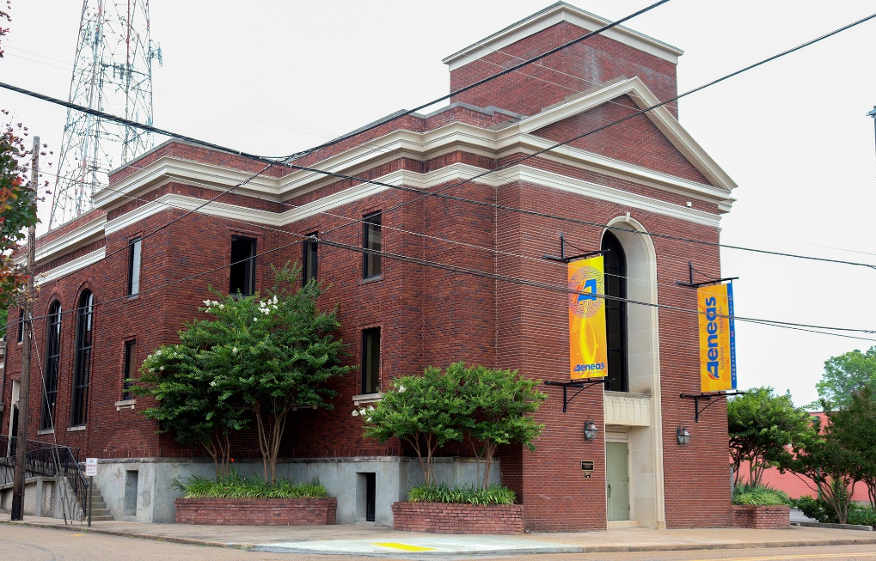
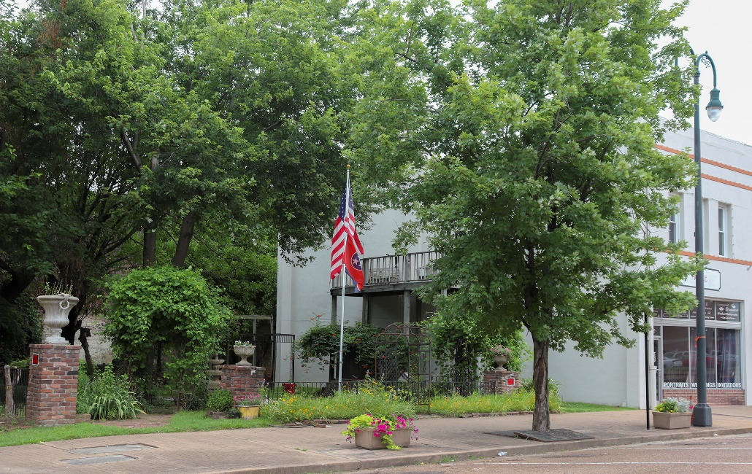
Commercial and Educational
Institution Honorable Mentions
Aeneas Building
Moore Studios

Slide 23
Environmental Stewardship
Award
Packaging Corporation
of America

Slide 24
Special Recognition
-Keep Jackson Beautiful
Committee
-JD Sims
-Whitney Billingsly
-Christi David
-Master Gardeners
- -MCC of Jackson

