Slide 1
Be Specific About Speech Privacy

Slide 2
Learning Objectives
Importance of acoustics and growing need for speech privacy
How sound travels within a space, the A, B, C’ s and common terms for measuring sound
Show you how to achieve speech privacy with sound masking
Review how sound masking works, types of systems, key evaluation criteria, and where and when to use sound masking
Budgeting for acoustics
Federal mandates and industry standards for speech privacy

Slide 3
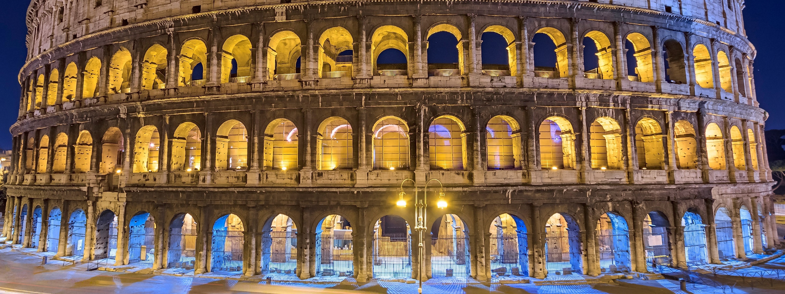
We Live in a Visually Oriented Society
Notes:
Before we begin, I want you to consider the architectural design of the Roman colosseum. Built during the reign of Emperor Vespasiano c. 72 AD. Over 160 feet high with eighty entrances the structure held over 50,000 spectators. Surviving today as only a ruin, the Coliseum is still noted and considered an architectural and engineering marvel. Visually appealing, and built with highly advanced construction techniques, including a focus on advanced acoustics. The ancient architects knew something that we are just relearning now - that in order to make a space work; you need to ensure proper acoustics. Acoustics is not a new consideration but rather an age old science.
Alternate Lead In
Architects and designers create tremendously visually appealing spaces, paying extraordinary attention to design details in order to create spaces with that “WOW” factor.

Slide 4
But often the impact of acoustics is Misunderstood….
Notes:
As I mentioned before, we live in a visually oriented society. But as designers, planners and architects of office space we typically forget to plan for proper acoustics or rather when we do try to incorporate acoustical planning, we choose materials that quiet space as much as possible.

Slide 5
How Often Have You Heard, “It’s a Beautiful Space But..”
“I can’t concentrate”
“I can’t get my work done”
“It’s too noisy in here / It’s too quiet in here”
“I can’t hear myself think”
Notes:
Now imagine for example that you are the only person to walk into your office, you would most likely find that the office is comfortable and easy to work in……it’s nice, it’s quiet. How many of you would prefer to work alone in your current office when trying to concentrate, responding to emails or writing a letter. Now imagine, walking into work the next morning with all of your coworkers. Not exactly as peaceful and quiet as when you worked alone. The simple fact is that when people work next to you in your office you can clearly hear what they are doing and saying.
And in these office spaces, you will often hear comments such as
I can’t concentrate
I can’t get my work done
It’s too noisy in here
I can’t hear myself think

Slide 6
Large Image
So Let’s See Why
We’ve created spaces that are too quiet!
Quiet HVAC Systems
High performing ceiling tiles
Line of site/ COVID-19 partitions
Carpeting
Social Distancing Guidelines
Notes:
Quiet offices aren't really distracting because they're too quiet; rather, they prove troublesome when noise eventually occurs and breaks the silence

Slide 7
And Why Does This Affect Us?
One person can affect up to eight people in his/her surroundings
People need speech privacy with ability to concentrate and communicate
COVID-19 Restrictions: Densely packed offices have been redesigned to allow for fewer occupants in the same space. With less people in every office, even the smallest noise can become a point of great annoyance and fixation.

Slide 8
And Why Does This Affect Us?

Slide 9
Other Factors that Influence Noise Levels
Virtual & in-person meetings
Cell and speaker phone use
Voice activated equipment
Open plan design
Lower Occupancy

Slide 10
Our goal is to provide comfortable spaces that increase speech privacy and improve overall productivity

Slide 11
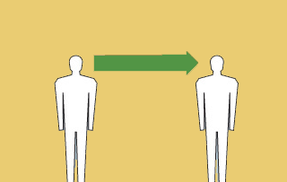
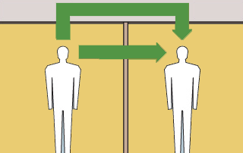
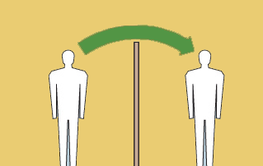
How Sound Travels
Directly
Reflected
Transmitted
Diffracted

Slide 12
For Good Acoustics, Let’s Remember our A, B, C’s
Absorb
Block
Cover

Slide 13
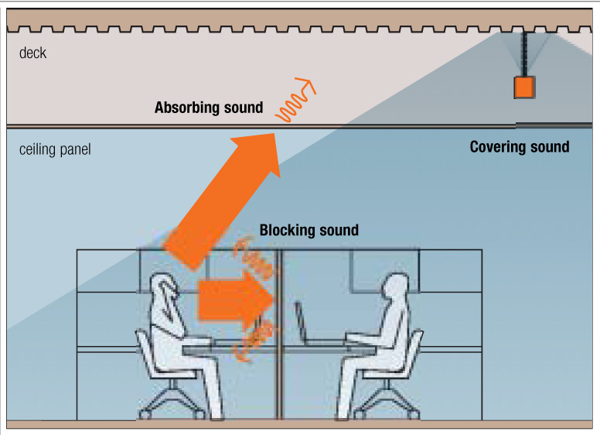
Absorb, Block, Cover

Slide 14
Measurements For Absorbing Sound
NRC or Noise Reduction Coefficient measures the degree to which a surface or material absorbs sound.
AC or Articulation Class measures how well a ceiling panel prevents sound from reflecting down to adjacent workspaces in an open-plan environment.

Slide 15
Measurements For Blocking Sound
STC or Sound Transmission Class measures how well a wall or partition prevents sound from transmitting to the other side.
CAC or Ceiling Attenuation Class indicates the ability of a ceiling panel to block sound transmission.

Slide 16
Measurements For Covering Sound
AI or Articulation Index represents how well speech can be understood in a given space.
PI or Privacy Index represents how well the elements in, and the properties of, a space render outside conversations unintelligible. It is measured in percentage.

Slide 17
A, B, C Recommendations
In an open plan, look for ceiling panels that have high NRC and AC values (.70 NRC and 170 AC).
In a closed plan look for ceiling panels that have a high CAC value (35 or more).
Add sound masking to achieve an Articulation Index (AI) of .2 or lower.

Slide 18
Sound Masking Can Help You Achieve Speech Privacy
So exactly what is Sound Masking?

Slide 19
We Have All Experienced Sound Masking Before

Slide 20
How Does Sound Masking Work in Our Office Environment to Provide Speech Privacy

Slide 21
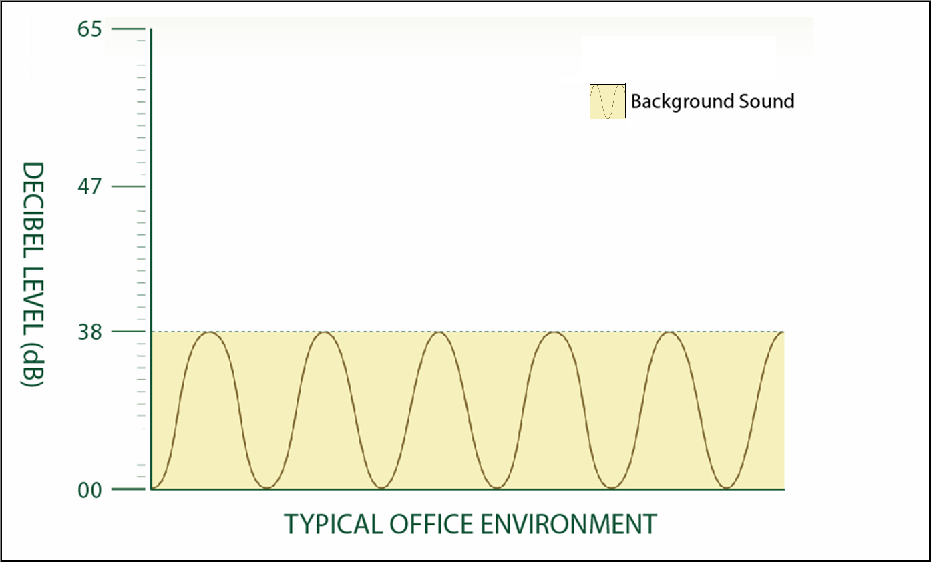
Ambient Background Sound is 38dB

Slide 22
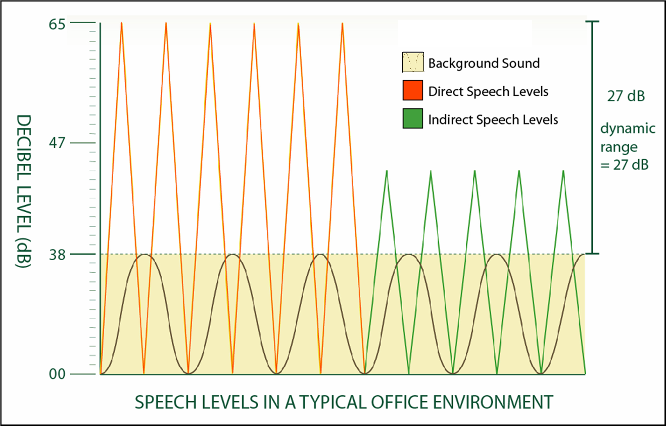
Ambient Background Sound is 27dB No sound masking)

Slide 23
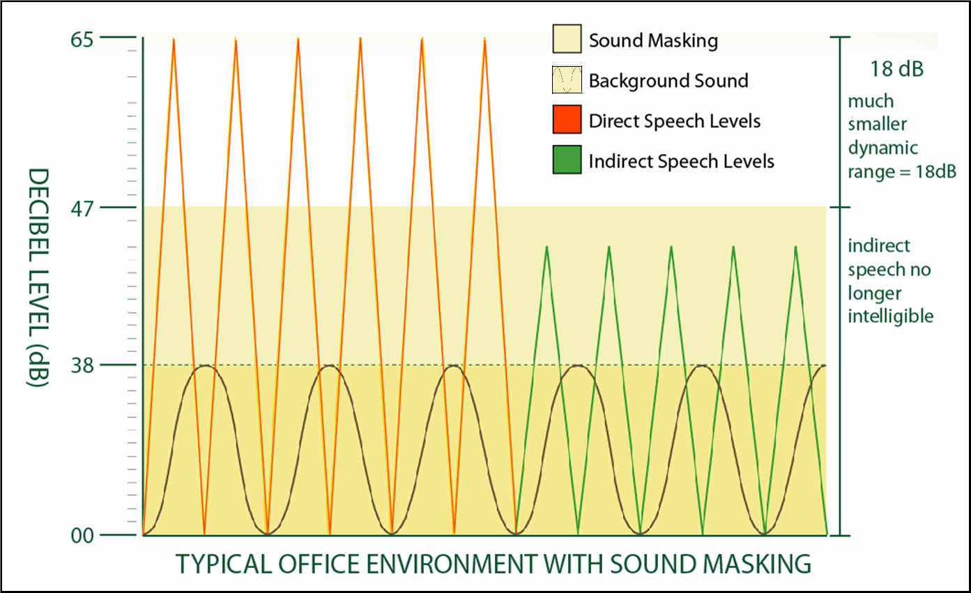
Dynamic Range Reduced to 18dB (with sound masking)

Slide 24
Sound Masking works because….
It provides speech privacy.
It minimizes the dynamic range and increases comfort, thereby improving overall productivity.
It can also improve the performance of your space.
Here’s how….

Slide 25
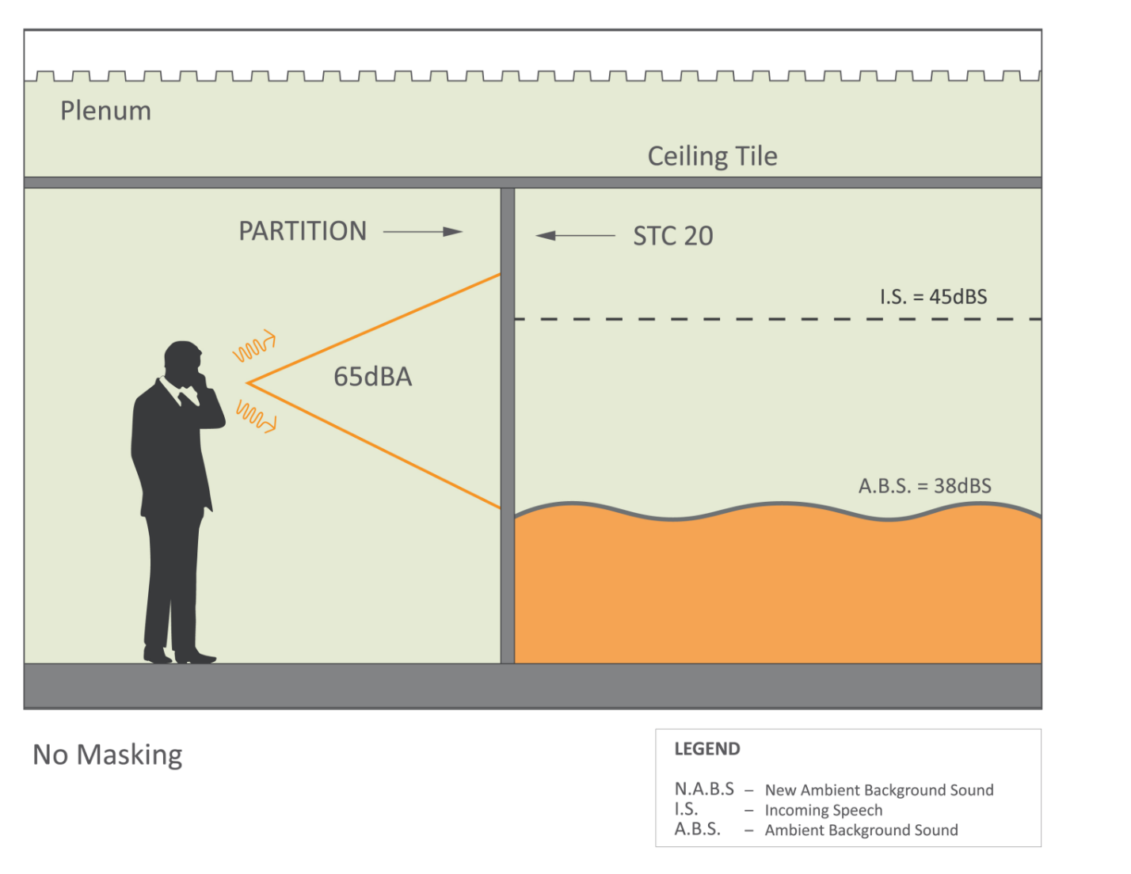
STC 20, No Masking

Slide 26
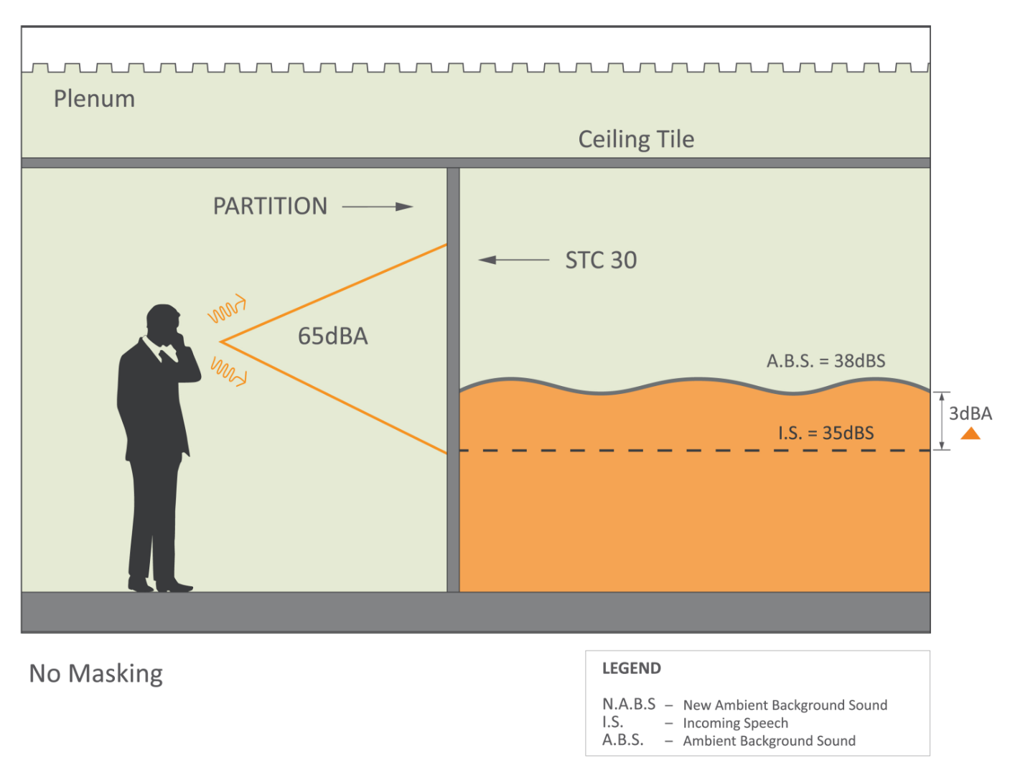
STC 30, No Masking

Slide 27
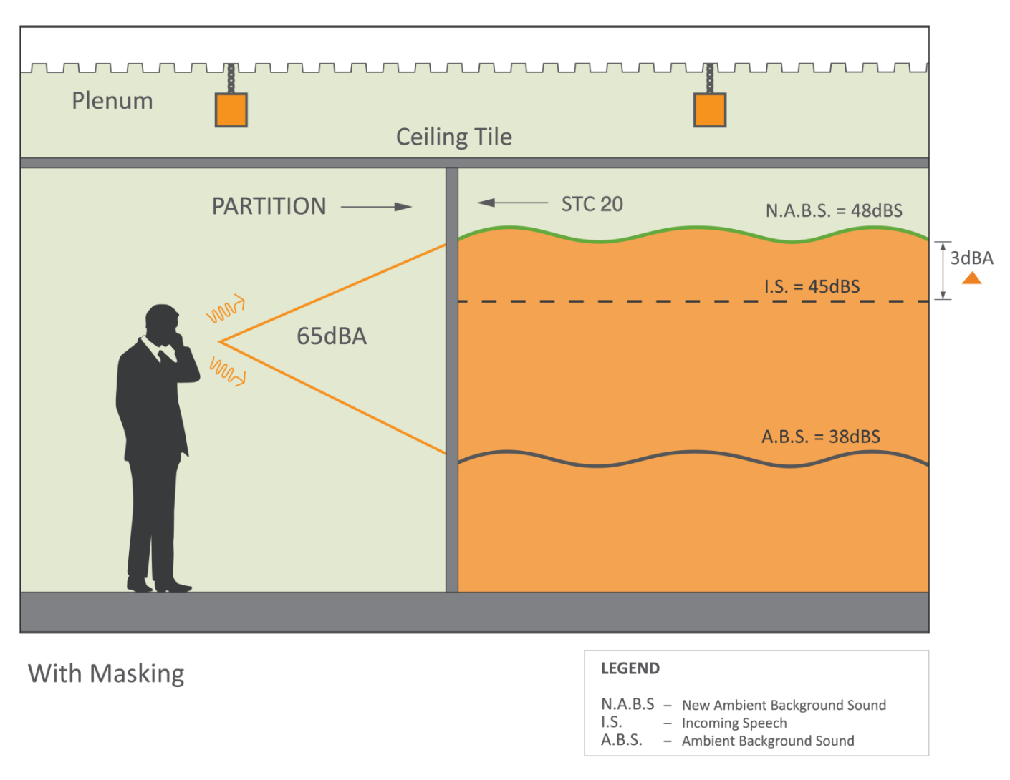
STC 20, With Masking

Slide 28
Before you specify any sound masking system, you must understand the key evaluation criteria.

Slide 29
Key Evaluation Criteria
Speech Privacy
Comfort (sound quality)

Slide 30
How do you include sound masking into your design to achieve speech privacy?

Slide 31
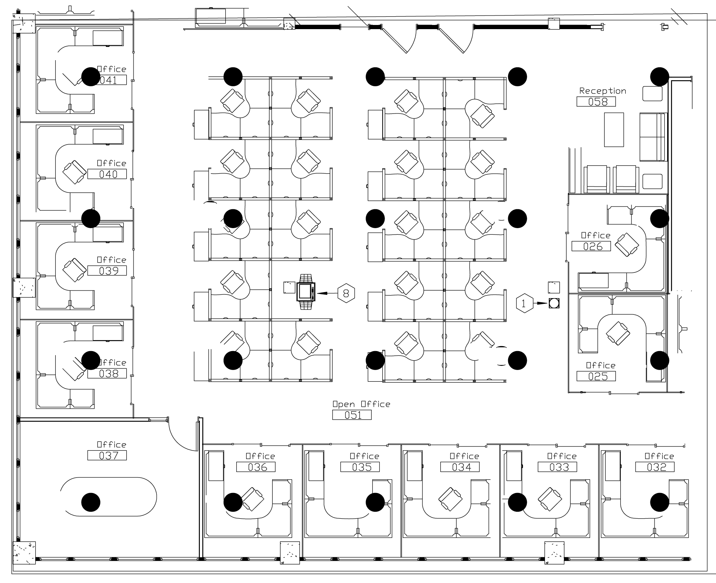
Typical Sound Masking Layout

Slide 32
Three Major Types of Systems
Central Systems
Self-Contained Systems
Networked Systems

Slide 33
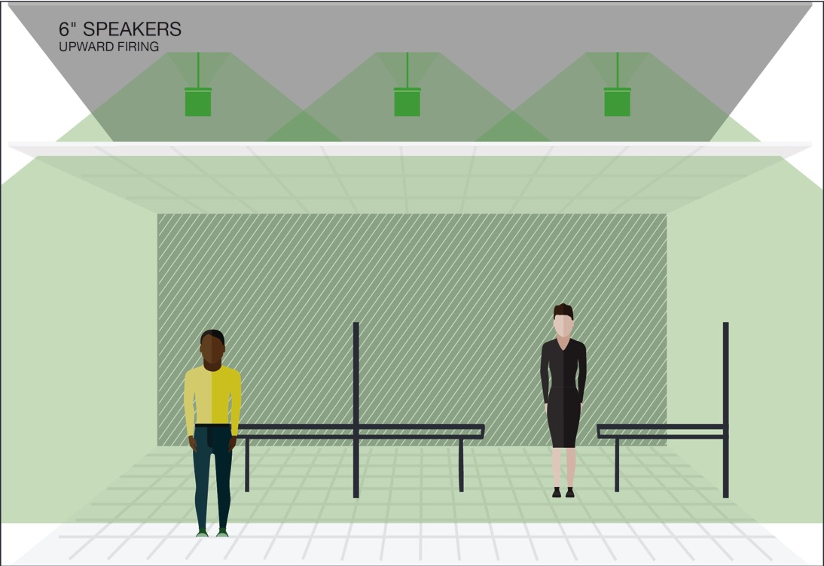
Speaker Orientation
In Plenum
(upward facing speakers)
Ceiling Tile

Slide 34
Speaker Orientation
Direct Fired
(downward facing speakers)
Ceiling Tile

Slide 35
Return on Investment
The value sound masking provides is greater productivity.
Studies show that for every workplace distraction, it can take an average of 25 minutes to return to normal production levels.
That means one distraction per day consumes 5.2% of an 8-hour work-day.
Acoustical condition studies show productivity improvements range anywhere from 3% to 51% with the introduction of sound masking.

Slide 36
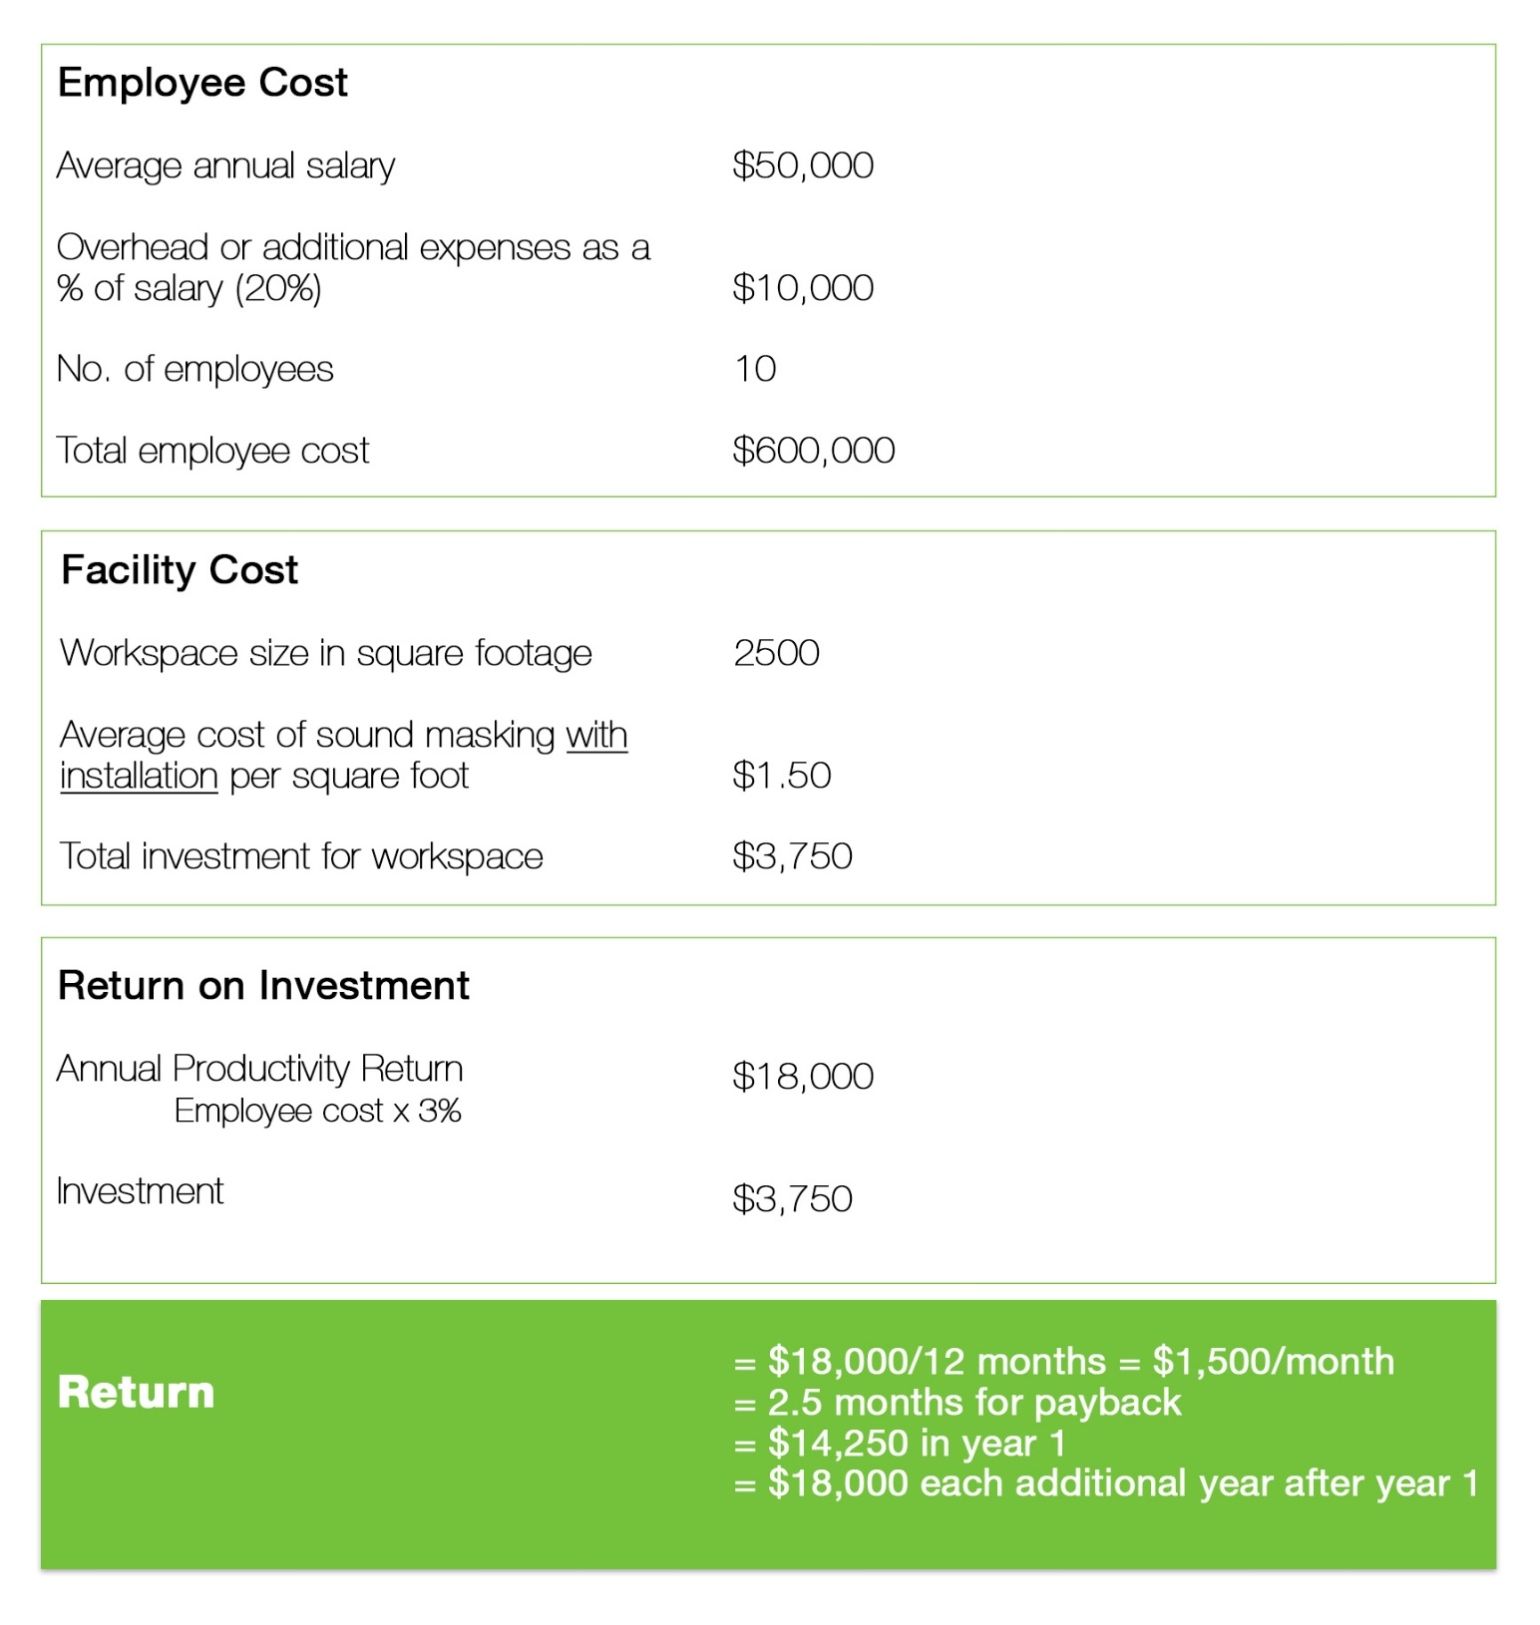
ROI
Sound Masking pays for itself in less than a year

Slide 37
Large Image
Where to Include Sound Masking
Corporate Offices
Healthcare Facilities (Hospitals, Doctors/Dentist offices, Urgent care)
Pharmacies
Law Offices
Financial Offices
Call Centers
Government Buildings
Anywhere you need Speech Privacy!

Slide 38
Large Image
Federal Mandates for Privacy
HIPAA
GLBA
Providing reasonable safeguards and oral privacy solutions

Slide 39
Large Image
Industry Standard for Speech Privacy
ASTM E-1130 American Society of Testing & Materials
Make sure your acoustical solutions meet accepted industry standards.

Slide 40
Large Image
So What Have We Covered Today?
Importance of acoustics and growing need for speech privacy
How sound travels within a space
How to achieve speech privacy and improve productivity with sound masking
How sound masking works and where to use sound masking
Types of systems and key evaluation criteria
ROI
Federal mandates and industry standards for speech privacy

