Slide 1
How to Select Identify & Specify the Right Sound Masking System

Slide 2
Learning Objectives
How Does Sound Masking Work?
Key Evaluation Criteria
Speech Privacy Levels
Managing Expectations
Testing & Evaluating Space
ROI

Slide 3
Let’s Talk About
Sound Masking

Slide 4
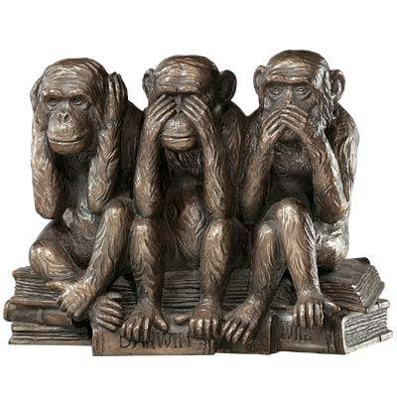
There is More to a Sound Masking System than Providing Privacy

Slide 5
How Exactly Does
Sound Masking Work?

Slide 6
How Exactly Does
Sound Masking Work?

Slide 7
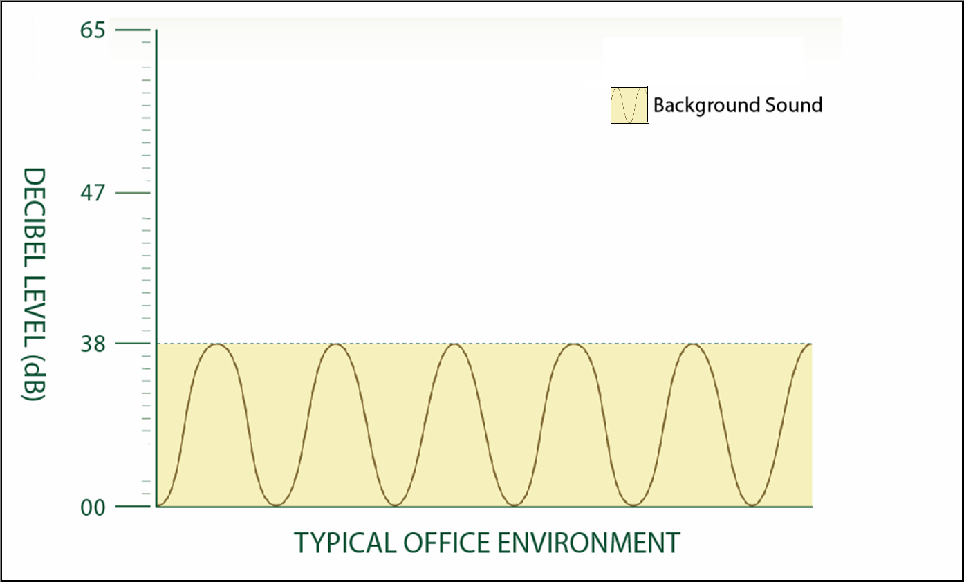
Ambient Background Sound is 38dB

Slide 8
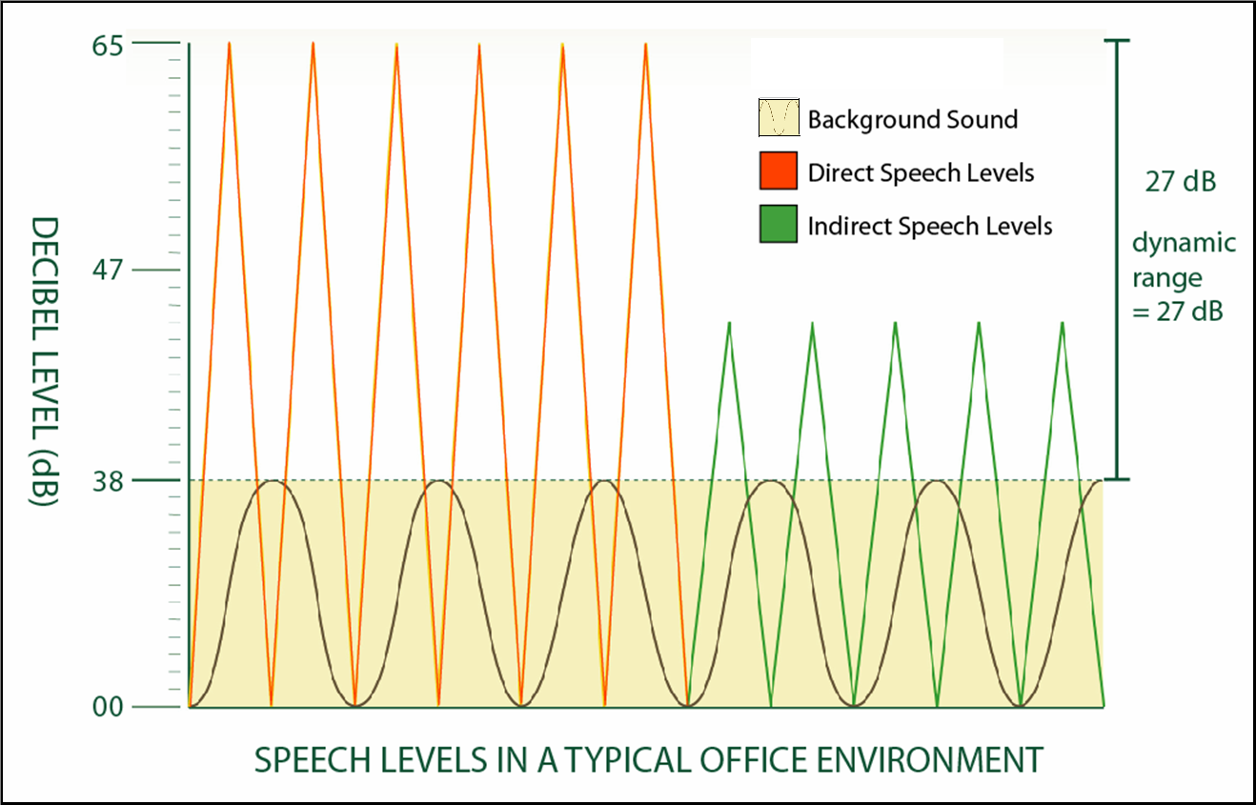
Ambient Background Sound is 27dB No sound masking)

Slide 9
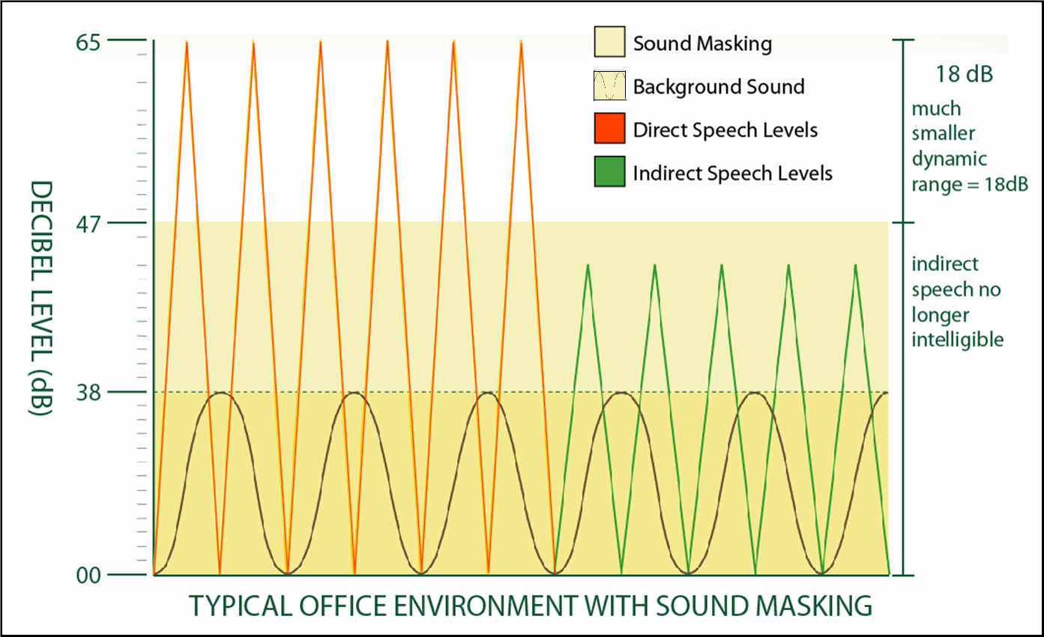
Dynamic Range Reduced to 18dB (with sound masking)

Slide 10
So Now That We Know How it Works…
What key criteria should be used when identifying, evaluating and selecting a sound masking system?

Slide 11
Key Evaluation Criteria Your Sound Masking System Must Provide
Speech Privacy
Comfort (sound quality)
Notes:
In summary, when considering any sound masking system, make sure it meets two criteria before you look at anything else. The masking must provide speech privacy and it must be comfortable. Masking speech believe it or not is the easy part. In fact, I could park a lawn mower in the middle of the space and guess what, your speech would be masked – but it wouldn’t be comfortable.
Keep this always in mind when looking at sound masking systems. It must be proven to meet your particular speech objectives and adhere to ASTM standards for speech privacy. It must minimize the dynamic range to increase comfort and the sound must be comfortable to live in, uniform and unobtrusive. Any company should provide you with a mock-up if you so desire.
The manufacturer should be able to document their system’s performance. Look for a system with longevity, sustainability, and reliability.

Slide 12
How do we achieve a comfortable sound?
Origin of sound
Good wrap around
Multiple noise sources
Distribution & delivery of sound
Uniformity of sound
Tunability of the sound
Notes:
In summary, when considering any sound masking system, make sure it meets two criteria before you look at anything else. The masking must provide speech privacy and it must be comfortable. Masking speech believe it or not is the easy part. In fact, I could park a lawn mower in the middle of the space and guess what, your speech would be masked – but it wouldn’t be comfortable.
Keep this always in mind when looking at sound masking systems. It must be proven to meet your particular speech objectives and adhere to ASTM standards for speech privacy. It must minimize the dynamic range to increase comfort and the sound must be comfortable to live in, uniform and unobtrusive. Any company should provide you with a mock-up if you so desire.
The manufacturer should be able to document their system’s performance. Look for a system with longevity, sustainability, and reliability.

Slide 13
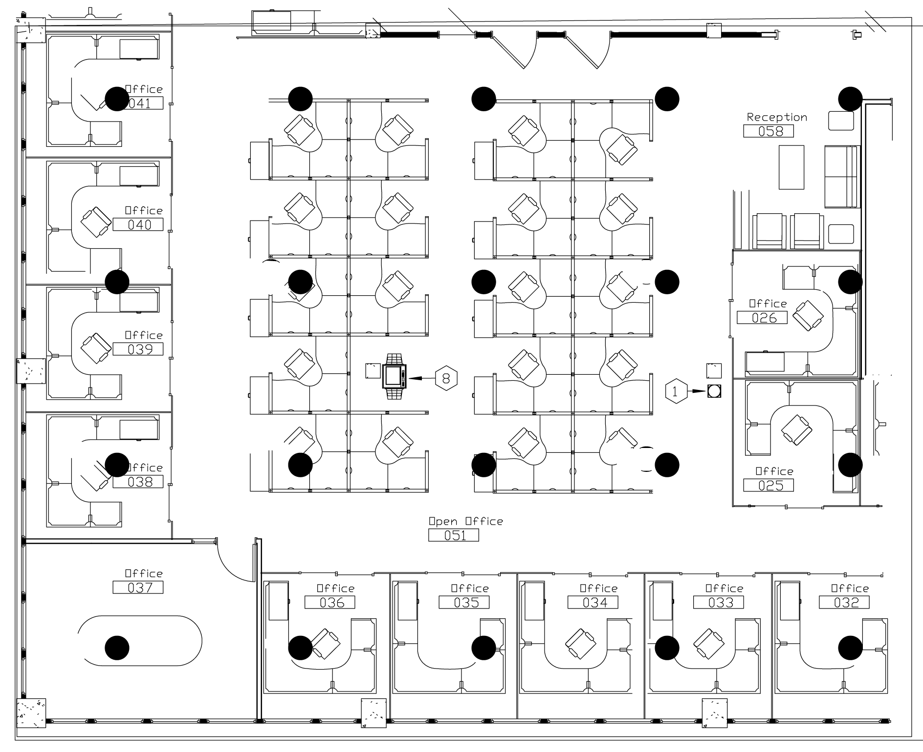
Typical Sound Masking Layout
Notes:
For uniform sound there are industry standards for designing sound masking system layouts. Although every site is different and there are a number of factors and site conditions that should be considered, in general a “good” sound can be achieved by approaching the space and distributing speakers in this fashion.
Think of your sound masking for a minute as a lighting plan – think of how the lighting’s effectiveness would diminish if you suddenly put your lights double the distance apart.
When you look at a sound masking layout you want to make sure you know how far apart your speakers are being placed, and what orientation the speakers are as this will affect the coverage. Typically units are place 15’ o.c., in a space with 9-10’ ceilings and a 3-4’ plenum.

Slide 14
Sound Masking Coverage
Notes:
With a good layout, you can achieve good sound uniformity – and comfort in the space.
Downward lights versus ambient lighting example
HAVE AUDIENCE WRITE THIS DOWN
Be sure to ask your sound masking provider to show you the number of speakers they are quoting for you, and the distance they intend to put these speakers apart. You will want to check your layout drawings to see that the areas you want are being masked and that the areas that you don’t (bathrooms, kitchens, etc.) are not.
Look at this in addition to the intended square foot coverage for the masking. You want to be sure that you are not trying to mask more with less units than can do the job.

Slide 15
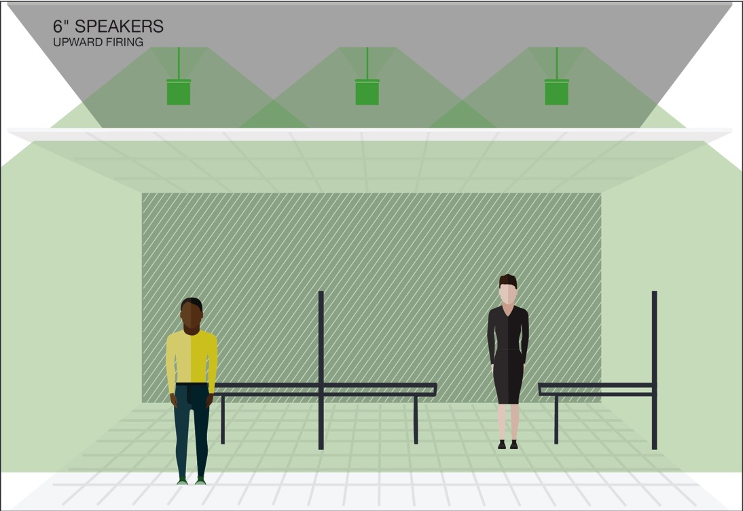
Speaker Orientation
IN PLENUM
(upward facing speakers)
Ceiling Tile
Dispersion – Uniformity – Installation
Notes:
In-plenum
Upward facing speakers
Consider dispersion and uniformity
Installation typically above the ceiling tile (out of sight)

Slide 16
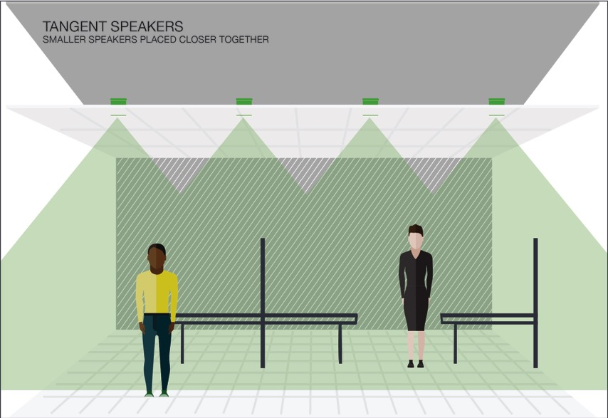
Speaker Orientation
Direct Fired
(downward facing speakers)
Ceiling Tile
Dispersion – Uniformity – Installation
Notes:
Direct Field
Downward facing speakers
Consider dispersion and uniformity (directionality) and coverage
Installation requires cutting holes in ceiling every 10 feet

Slide 17
Now that you’ve got the comfort criteria met, let’s look to see how we can get a sound that achieves speech privacy?

Slide 18
Speech Privacy
What is it?
How is it measured and tested?
How do you interpret these testing results?
Notes:
Speech privacy is a concept that is different for each and every one of us and in different situations, acceptable privacy levels also vary.
Managing expectations.
Consider the speech privacy needs of the White House, or your Human Resource department, or a Military Base SCIF. Your facilities’ unique speech privacy needs must be evaluated along with the space itself.
As a facility manager, know that you can test for and achieve speech privacy according to industry standards. Make sure your sound masking provider understands your speech privacy needs and abides by these standards when providing you with a sound masking system.
Again signal to noise ratio not sound cancellation…
Speech at certain frequencies, speech efforts, AI index….
We get speech privacy by raising the ambient background sound…

Slide 19
Measuring Masking Levels and Speech Privacy in Your Space
What is a dB?
How a sound level meter works
Industry standards
ASTM E-1130
American Society for Testing and Materials
Notes:
Speech privacy is a concept that is different for each and every one of us and in different situations, acceptable privacy levels also vary.
Managing expectations.
Consider the speech privacy needs of the White House, or your Human Resource department, or a Military Base SCIF. Your facilities’ unique speech privacy needs must be evaluated along with the space itself.
As a facility manager, know that you can test for and achieve speech privacy according to industry standards. Make sure your sound masking provider understands your speech privacy needs and abides by these standards when providing you with a sound masking system.
Again signal to noise ratio not sound cancellation…
Speech at certain frequencies, speech efforts, AI index….
We get speech privacy by raising the ambient background sound…

Slide 20
So how do we measure speech privacy?

Slide 21
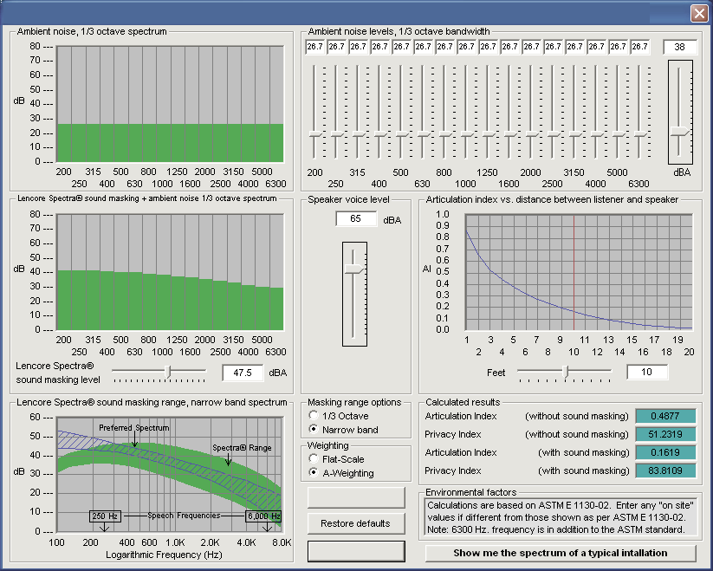
Notes:
Acknowledge that the audience will find this slide difficult to read but that you’ve included this slide as a way to show what kind of reporting is available and that they can ask for from their sound masking provider to show how the speech privacy levels are being met within the space and the dB settings for the masking within the space.
Go into how a sound masking provider can use a spectrum analyzer to harness this data and ….
This type of report is one way to analyze and evaluate your space, but there are many other things to consider when evaluating your space for sound masking.

Slide 22
ARTICULATION INDEX
Confidentiality Speech Privacy | Normal Speech Privacy | No Speech Privacy
AI of .05 or less | AI of .2 or less | AI greater than .2
Notes:
Prior to this index, there had been studies by scientists trying to identify levels of deafness which led others to study levels of intelligibility.
At first it doesn’t seem to be much of a difference between an AI of .2 and an AI of .18 but this is really a tipping point for our brains.
The Articulation Index provides the metrics for speech privacy and speech confidentiality as well as indicating when there is no speech privacy.
The brain tries to create closure – think of the last time you were in a noisy restaurant and caught a few words of conversation from the table next to you – if you caught more than 20% of that conversation they might as well have been talking to you!
As you speak with your sound masking provider, there is another measurement that they may give you and this is called the PI or privacy index. This is basically just the inverse of the AI number.
Let me show you with the following slide why that 20% can mean the difference between understanding and not understanding speech.

Slide 23
Only Great Minds Can Read This
Cna yuo raed tihs?
it dseno't mtaetr in waht oerdr the ltteres in a wrod are, the olny iproamtnt tihng is taht the frsit and lsat ltteer be in the rghit pclae.
Tihs is bcuseae the huamn mnid deos not raed ervey lteter by istlef, but the wrod as a wlohe.
Any Quseiotns?
Notes:
Here take a moment to read this slide….
It is interesting how the brain tries to complete the information here visually, similarly our brains do this with the speech we hear. They say only 55 out of 100 people can read this – how’d we do here in the audience?
Break for any questions.
Now, lets get into how to evaluate your spaces for sound masking.

Slide 24
When Evaluating Your Space for Sound Masking Also Consider
Walls
Workstation Partitions
Ceilings
Fabric Panels
Carpet
Door Seals
Notes:
There are many factors that go into a good acoustic design and sound masking systems are a component of these, but you will need to provide your sound masking provider a birds eye view of your office so that the best system can be designed for your needs. This will include information on the construction of your:
walls and workstation partitions
ceilings
fabric panels
carpet
door seals
There is a help sheet is available at the back as a handout to help you identify the other components in your space that may affect your sound masking needs. Please grab one as you leave or see us after the presentation.

Slide 25
Sound Measurement Terminology
NRC Noise Reduction Coefficient
STC Sound Transmission Class
CAC Ceiling Attenuation Class
AC Articulation Class
AI Articulation Index
PI Privacy Index
Notes:
NRC measures the degree to which a ceiling panel absorbs sound. NRC is represented by a number between 0 and 1.00 which indicates the percentage of sound reaching the panel that will be absorbed. A ceiling panel with an NRC of .50 or higher offers significant sound absorbing properties.
STC measures how well a wall or partition prevents sound from transmitting to the other side.
CAC indicates the ability of a ceiling panel to block sound transmission. A ceiling panel with a CAC of 40 will reduce transmitted sound by 40dB. A ceiling panel with a CAC of 35 or higher offers significant sound attenuation properties.
AC or Articulation Class measures how well a ceiling panel prevents sound from reflecting back down to adjacent workspaces in an open-plan environment.
AI or Articulation Index represents how well speech can be understood in a given space. AI is expressed as a decimal value between 0 (speech is unintelligible) and 1.00 (speech is easily heard and understood). AI can be measured using ASTM Test E-1130.
PI or Privacy Index is the inverse of Articulation Index. The PI represents how well the elements in and the properties of a space render outside conversations unintelligible.

Slide 26
Site Conditions to Consider When Specifying a Sound Masking System
Understand your noise problem
What is the type and size of area to be masked?
What level of controls are needed?
Do special site conditions exist?
Notes:
When looking to get a sound masking quote for your project you must understand a number of things and relay these to your sound masking provider.
First, understand your noise problem as well as:
What type and size of area to be masked? Will it be an executive area or an HR department, the whole building or a series of floors or areas.
What controls are needed – most masking should be set it and forget it, but if IT or building controls are desired, you need to know that there are special systems that meet those needs for networked control
Ceiling and site conditions such as ceiling type and height, plenum height, space obstructions, insulation or asbestos issues
Installation Needs – are there special site conditions that merit special considerations for example is there a gypsum ceiling that might require units that can be installed into the sheetrock?

Slide 27
Choosing the Right Sound Masking System for Your Facility

Slide 28
Three Major Sound Masking System Types
Centralized
Decentralized
Networked
Notes:
Centralized – requires head end equipment, uses 1-2 noise sources and is relatively inexpensive, easy to install, but not always as easy to tune and we’ll get into why in our next slide
Decentralized – has no head end equipment, uses multiple noise sources and…
Networked systems enable users to tie into building systems and interface with the system via …..

Slide 29
Centralized Systems
What are they?
How do they work?
What to look for in a centralized system
Notes:
Central systems were the first type of masking systems that came on the market in the 1960’s. And consist of a series of speakers typically installed in the plenum with the speakers oriented up towards the deck above. The masking sound fills the plenum and filtered by the ceiling tile falls into the space below. The system requires head end equipment to be installed in an electrical of phone closet.
Think of a centralized sound masking system as a stereo on steroids, there is one amplifier, 1-2 noise sources and 1 equalizer. The noise source is fed into an equalizer which shapes the sound to meet speech frequencies and this is fed into an amplifier which then sends this sound out over the speakers.
There is one main volume control to raise and lower the system. If you choose a central system, make sure that you have your sound masking provider designate one noise source for each type of space – for example open office area versus executive or private office areas as the volume needs for each will be quite different. Central systems are used for small and for large facilities, although tuning a large facility with a central system can be time consuming and will require an acoustician or a trained acoustical professional.
You will want to look for central systems that also provide wattage taps at the individual speakers to offer some additional adjustment capability. You want to make sure you ask your sound masking provider if there are on-going tuning or maintenance needs with your central system as this is often the case, but not often figured in the initial budget for the system.
Again, these systems are fairly economical, easy to install but usually require some on-going maintenance and don’t provide as much individual speaker or channel adjustment options as some of the other systems we will discuss.

Slide 30
Decentralized Systems
What are they?
How do they work?
What to look for in a decentralized system
Notes:
Now decentralized systems are similar in the way that they are installed, like the central systems, they are typically installed in the plenum with speakers oriented upwards etc., but the difference is that decentralized systems do not require any head end equipment. The noise source and amplifier are built into the unit – self contained – and the sound is engineered to meet a pre-determined sound masking curve.
The decentralized system doesn’t provide 1/3 band octave adjustment capabilities or the ability to manipulate specific frequencies. However with its multiple noise sources it can provide some of the most comfortable and adjustable options for the masking sound including the ability to adjust up to a single unit (225 square feet) for frequency (contour) and volume.
In a decentralized system look for a system that starts with a quality sound and that provides the tightest tolerances for making adjustments (+/- ½ dB for a total of 1dB is the industry’s best).

Slide 31
Networked Systems
What are they?
How do they work?
What to look for in a networked system
Notes:
Most good masking systems will be the set it and forget it type of systems and will not need continued access to tuning and system checks. But when a Networked Systems is requested because of….
Basically they work by tying the masking into a password protected interface by which adjustments can be made by the sound masking provider, facility manager or end user.
Look for network systems that are non-proprietary and based on open platform protocol. Interoperability with building systems will be an important feature because…
System and node identification is key as troubleshooting a nameless system is very time consuming
Diagnostic Capabilities are another important feature to look for because…

Slide 32
Summary of Sound Masking System Types & Distribution
Centralized
Decentralized
Networked

Slide 33
Now that you’ve identified the right system for your facility, how can your sound masking system pay for itself?

Slide 34
BUDGETING FOR ACOUSTICS
People
In a study undertaken by BOSTI* regarding the primary costs of doing work, people came up as the largest part of corporate dollars spent, ahead of technology, operations, and workplace.

Slide 35
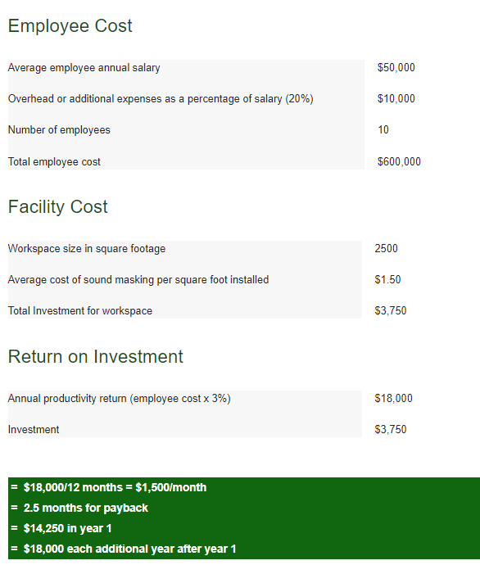
ROI
Notes:
Acknowledge that audience can’t see this but you will go through it. This is part of an available handout we have in the back.

Slide 36
Review for Sound Masking Systems Selection and Specification
Evaluation Criteria
Comfort & Privacy
Number of Speakers
Square Footage Covered
Speaker Dispersion & Speaker Type
Controls & Tunability
Maintenance Contracts
Company Reputation & Warranty
Site Conditions

Slide 37
Final Points & Considerations When Selecting a Sound Masking System
Serviceability of Equipment
One Source Manufacturer
Proprietary Equipment
Security issues IT issues
UL listing for Plenum use
UL listing for safety

