Slide 1
Managing Acoustics in a Millennial Environment

Slide 2
Overview
Who Are the Millennials?
Why Are They Important to the Workforce?
General Needs and Characteristics
Desired Work Environments for Millennials
Today’s Design Trends
COVID-19
Sound Masking as an Option for Today’s Designs

Slide 3
Who Are the Millennials?
Notes:
So, now that we understand how the millennial generation fits in and their characteristics, lets look at how they impact the workplace. Millennials now represent over 30% of the American workforce and that percentage will continue to grow. Baby boomers are retiring and millennials are still just coming on board.
They are referred to as the “open minded, fresh face of the future” because of their ability to adapt to different situations, accept new ways of working, and their willingness to use new products and services.
The last two bullet points are very significant: business need this talent. Most companies have an aging work force that needs to be replaced – but they need to replace it with the best and the brightest. The challenge most companies face is developing an environment where they can attract and retain this talent. What started in the late 90s and early 2000s with the tech companies, before the bubble burst, is a new way of thinking about the office environment. Companies need environments that are attractive, and dare I say entertaining, in order to retain this talent for the future.

Slide 4
Greatest Generation – Pre-1930 – 1946
Coined by Tom Brokaw*
How Do You Argue With a Two War Generation?
Baby Boomers – 1946 – 1964
WWII Ended
Post-War Rise in Standard of Living
Rise of the Nuclear Family
Generation X – 1965 – 1984
“Baby Bust” Generation
Generation Y - ?
“Made Up” Generation
Gets Folded into Millennials
Millennials – 1982 – 2004*
Defined by the Rise of Technology and Social Networks
Will be a New Generation after Millennials - TBD

Slide 5
Millennials
Born between 1982 – 2004
18 – 34 Years of Age in 2015 = 75.4 M
With immigration will peak at 81.1 M in 2036
+25% of the US Population
21% ($ 1 Trillion) of Consumer Discretionary Purchases
2.5x More Likely to be an Early Adopter
Trendsetters
Educated
Career-Driven
Politically Progressive
Brand Loyal – with quality and actively engaged brands

Slide 6
Why are they important to the workforce?

Slide 7
Power of Millennials
Millennials have now surpassed both the Baby Boom and X generations to become the largest in the American workforce
Make up one in three American workers
Referred to as the “open-minded, fresh face of the future”
Businesses are competing fiercely for the best available talent that will replace the retiring Boomer generation in the coming few years
Companies who successfully recruit, motivate and retain this emerging generation position themselves to positively leverage the new talent pool for the future

Slide 8
General Needs and Characteristics
Liked to be loved
Need Team
Family Orientated
Communicators (but use technology)
Need Challenges
Skilled in Technology
Self-Confident
Able to Multi-Task
Highly Energetic
High Expectations for Themselves
Are Creative
Notes:
Millennials seem to crave acceptance and have a need to be loved or praised. They enjoy working with their peers – but do NOT care for hierarchies. When they are part of a team everyone is an equal.
Millennials are family oriented and very much value the work / life balance. They believe that they should spend as much time out of the office engaged in their social lives as they do in the office. Again, this can often be a point of contention with previous generations.
Millennials are communicators but not necessarily talkers. The use of text messaging and other social media communication platforms is preferred to a meeting or a phone call. But they do communicate – it is just differently from traditional methods.
The last real need is to be challenged. Millennials want difficult tasks to solve. They are workers but get greater satisfaction in the recognition of their accomplishment than the accomplishment itself and how it contributes.
Looking a little further at characteristics in the workplace, because of their upbringing with sophisticated technology, Millennials are already very skilled. If they don’t have a particular skillset or don’t know how to accomplish a task they have many resources (such as YouTube) in order to get it done. Being educated and having the amount of technology at their fingertips has helped to make Millennials sefl-confident.
They are also able to multi-task. Again, this is due mostly to the amount of information flowing at them from variousl sourches growing up which makes them less distracted by inputs.
Millennials are highly energetic and also have high expectations of themselves. Millennials are not a lazy generation – at least from a work output perspective – they just approach their challenges differently because of their available resources.
Last, and again I’ll relate this to technology, Millennials tend be be creative. They are problem solvers and also look to provide new types of solutions or deliverables for their organizations.

Slide 9
Desired Work Environment
Collaborative Environment
No Defined Spaces
Huddle Room Accessibility
No Corporate Hierarchy Space
No Barriers to Access
Flexible Work Times / Days
Work/Life Integration
Challenge for Space Allocation
Greater use of Technology
Virtual meetings
Bring Your Own Device
Notes:
Let’s translate this all to the ideal work environment. Millennial nature is collaborative without a defined area. They want to be engaged and interactive almost all of the time – which lends itself to more open environments are spaces with huddle rooms.
Barriers to access is a sticking point for millennials and can be a real issue in retention. Millennials want to be able to engage all employees no matter what level their title shows. You are now seeing more managers working side-by-side their employees in these open spaces. And, although this may cause concerns for management tasks and conversations, it breaks down the barriers millennials are concerned about.
Where and when millennials work is changing the designed workplace. This makes it difficult for space allocation or planning but newer work location policies are being adopted. This is all about work/life balance.
Lastly, their continues to be greater use of technology. Whether employees are using their own devices in the conference rooms or video conferencing – technology is changing how we get our work done.

Slide 10
Today’s Design Trends
Workplace
More collaborative/open environment
Honest material usage (many hard surfaces)
Desired Brand Concepts reflected in space
Hot desking
Activity based work areas
Consolidation of Space Size
Real estate costs driving design
Employers are increasingly adopting modern design concepts to attract new talent
Notes:
Greater usage of reclaimed woods, metals and glass – creates a cool looking environment but sound begins to bounce around

Slide 11
Today’s Design Trends (COVID-19)
Social distancing guidelines
Densely packed offices have been redesigned to allow for fewer occupants in the same space
Eerily quiet
With less people in every office, even the smallest noise can become a point of great annoyance and fixation
Notes:
Quiet offices aren’t really distracting because they’re too quiet; rather, they prove troublesome when noise eventually occurs and breaks the silence. Sound masking can ‘remove’ that silence.
We do not all know what the work environment will look like as a new normal sets in from COVID-19. With many large and small companies re-opening to welcome employees back, while adhering to social distancing guidelines, offices may be quieter than ever. Densely packed offices have been redesigned to allow for fewer occupants in the same space. With less people in every office, even the smallest noise can become a point of great annoyance and fixation –– like the clicking of a neighbor’s pen or the tapping of their foot. And if you’ve ever attended or hosted a virtual meeting, then you know how unsettling it can be for those around you. In fact, certain open office designs make people so uncomfortable that they avoid collaborating with each other.
Sound masking works to eliminate as many distracting noises as possible by introducing sound into the space to ‘feel’ busier. It’s like taking an employee from the library and putting them at the coffee shop. There is a hustle and a bustle feel, but it isn’t distracting and allows the employee to be productive.
By controlling the acoustics of a space, you control both productivity and comfort. Where would you rather have them work – at the coffee shop or your office? With an improved acoustical environment, as we return to the workplace, you can provide a place to speak without having conversations understood by others (speech privacy) and can better concentrate without distraction (greater productivity) therefore improving the overall comfort of the space.

Slide 12
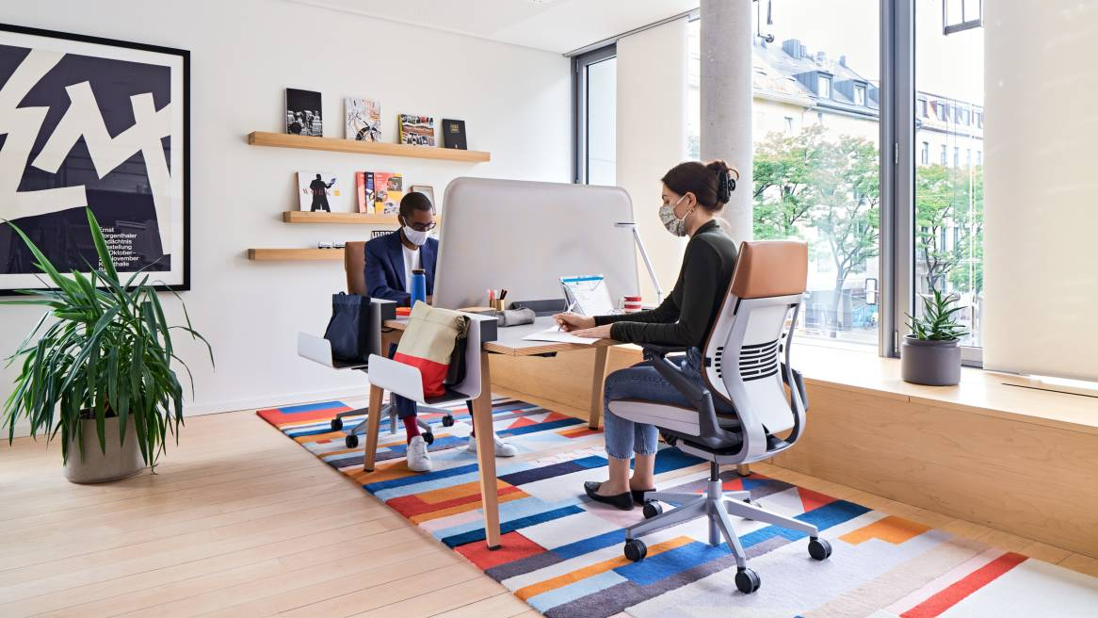
Sound Masking as an Option for Today’s Design Trends

Slide 13
Key Criteria
Speech Privacy
Comfort
Notes:
WHAT IS MISSING IN TODAY’S millennial driven ENVIRONMENT?

Slide 14
How Does Sound Masking Work?

Slide 15
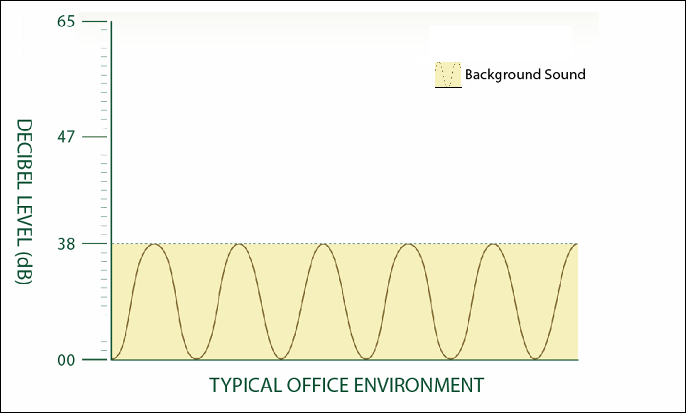
Ambient Background Sound is 38dB

Slide 16
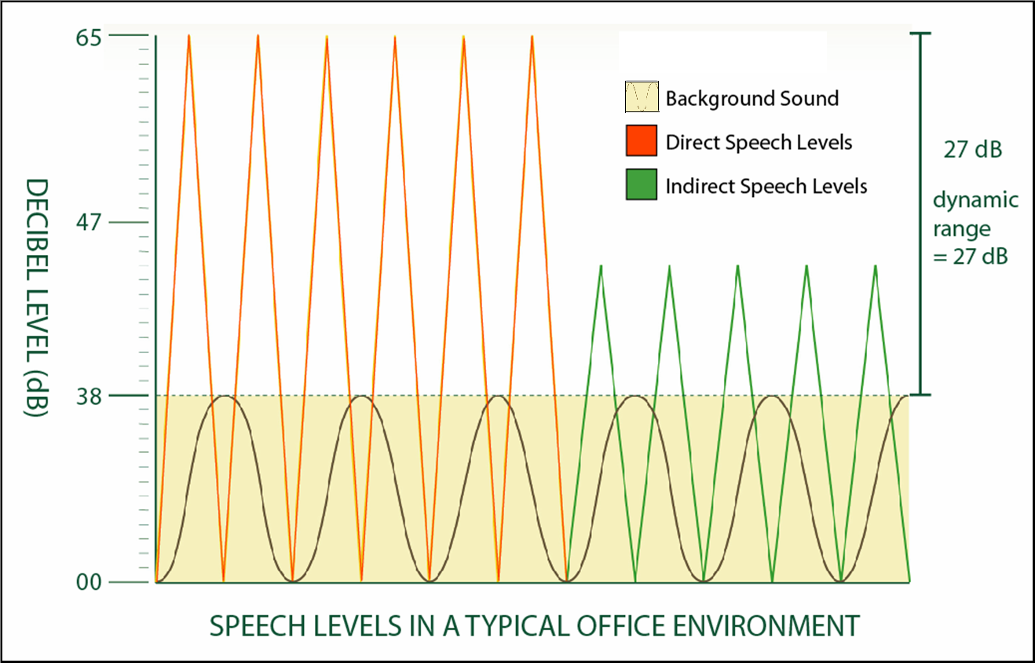
Ambient Background Sound is 27dB No sound masking)

Slide 17
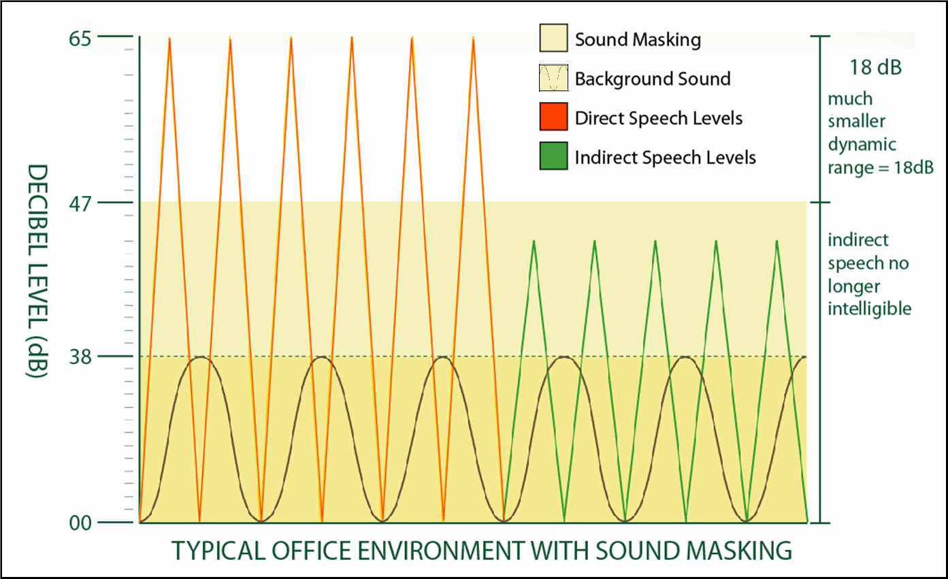
Dynamic Range Reduced to 18dB (with sound masking)

Slide 18
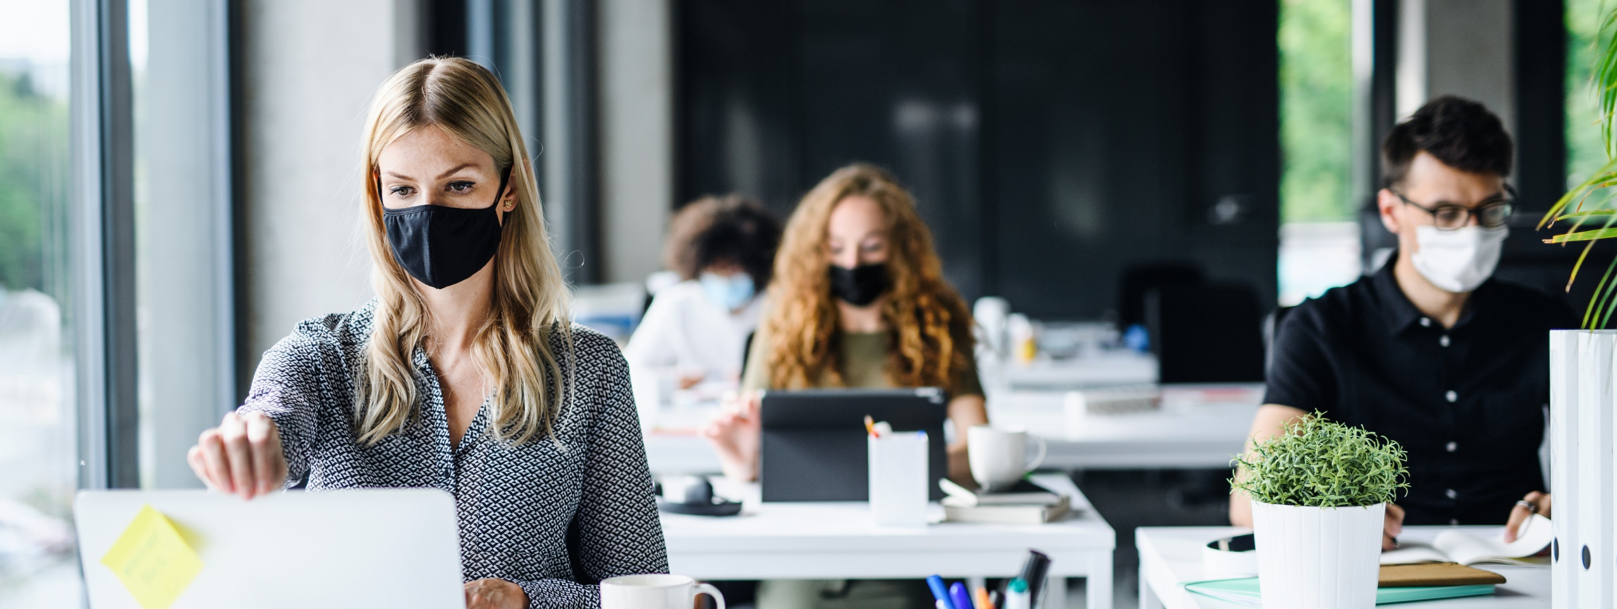
Achieving Privacy

Slide 19
Industry Standard – ASTM E-1130
Confidentiality Speech Privacy | Normal Speech Privacy | No Speech Privacy
AI of .05 or less | AI of .2 or less | AI greater than .2

Slide 20
Achieving Comfort

Slide 21
Origin of sound
Good wrap around
Multiple noise sources
Uniformity of sound
Tuning Flexibility

Slide 22
Summary
Sound Masking is One Solution for Helping to Achieve Privacy and Comfort Today’s Collaborative, Open, Engagement Concepts.
Employee Retention is More Critical Today than Ever Before – and the Designed Workplace is a Major Contributor
Technology and Generational Behaviors Continue to Evolve and So Must the Design Solutions
The work setting is all about balance: balance between working in privacy and working together is critical for any organization that wants to achieve innovation and retain talent

