Slide 1

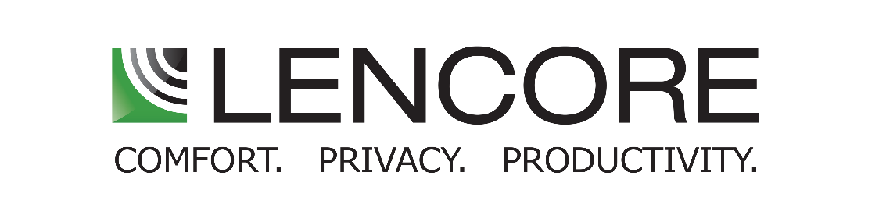
Comfort, Privacy and Safety for Healthcare Facilities

Slide 2

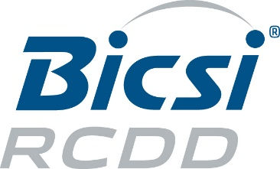


Certifications
Lencore is a Registered Provider with The American Institute of Architects, Bicsi & InfoComm Continuing Education Systems. Certificates will be provided for all members and non-members upon completion of the course.
This program is registered with AIA, RCDD & CTS for continuing professional education. Questions related to specific materials, methods, and services will be addressed at the conclusion of this presentation.

Slide 3
Learning Objectives
Healthcare Industry Challenges
  HIPAA & Oral Privacy
  HCAHPS & Comfort
  Safety in Healthcare
What is Sound Masking
The Future of Healthcare
Q&A

Slide 4
Industry Challenges
  Oral Privacy (HIPAA)
  Comfort (HCAHPS)
  Safety (NFPA 72)

Slide 5
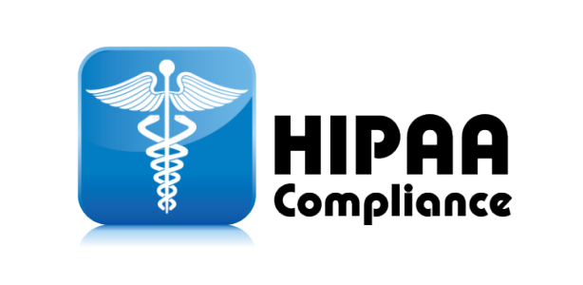
Large Image

Slide 6
HIPAA COMPLIANCE
Large Image
“HIPAA says that patients have a right to medical privacy, including aural privacy, and that healthcare providers need to make an effort to protect aural privacy. However, HIPAA does not go into very much detail about how this should be accomplished.”
Health Insurance Portability and Accountability Act of 1996:
  Federally mandated standards and new requirements for oral privacy
  Penalties for non-compliance

Slide 7
HIPAA COMPLIANCE
Large Image
Health Insurance Portability and Accountability Act (HIPAA)
Standards for Privacy of Individually Identifiable Health Information (“Privacy Rule”)
Protected Health Information (PHI)
1996
2000
2002
  Protected Health Information. The Privacy Rule protects all "individually identifiable health information" held or transmitted by a covered entity or its business associate, in any form or media, whether electronic, paper, or oral. The Privacy Rule calls this information "protected health information (PHI)."

Slide 8

Who is affected by HIPAA?
  Covered Entities
    Health Care Provider, Health Plans, and Healthcare Clearinghouses
  Doctors
  Clinics
  Psychologists
  Dentists
  Chiropractors
  Nursing Homes
  Pharmacies

Slide 9
Oral Communication in Healthcare
is vital to the well being of patients:
  Disclosures
  Minimum Necessary
  Reasonable Safeguards

Slide 10
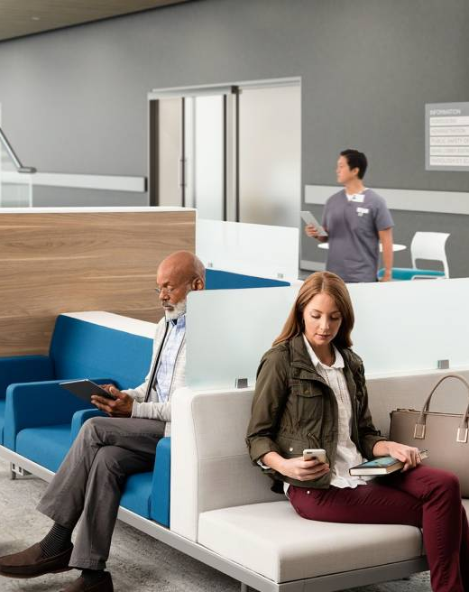
Think about what you overhear in the…
  Waiting Room
  Pharmacy
  Hospital Patient Room
  Hospital Hallway or Elevator Lobby

Slide 11

HCAHPS
Large Image

Slide 12
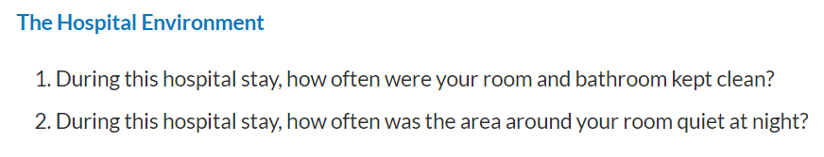
HCAHPS
Large Image
“Maintaining speech privacy in health care settings helps reduce medical errors as it supports open conversations among patients, families, and Patient Care Teams (PCTs) and is believed to influence patient satisfaction.”

Slide 13
HCAHPS
Large Image
Hospital Consumer Assessment of Healthcare Providers and Systems (HCAHPS) Survey is the first national, standardized, publicly reported survey of patients' perspectives of hospital care.
27 Question Survey to Discharged Patients
CMS implemented the HCAHPS survey in October 2006, and the first public reporting of HCAHPS results occurred in March 2008
Since July 2007, hospitals subject to the Inpatient Prospective Payment System (IPPS) annual payment update provisions ("subsection (d) hospitals") must collect and submit HCAHPS data in order to receive their full IPPS annual payment update. IPPS hospitals that fail to publicly report the required quality measures, which include the HCAHPS survey, may receive a reduced annual payment update
The Patient Protection and Affordable Care Act of 2010 (P.L. 111-148) included HCAHPS among the measures to be used to calculate value-based incentive payments in the Hospital Value-Based Purchasing program, beginning with discharges in October 2012

Slide 14
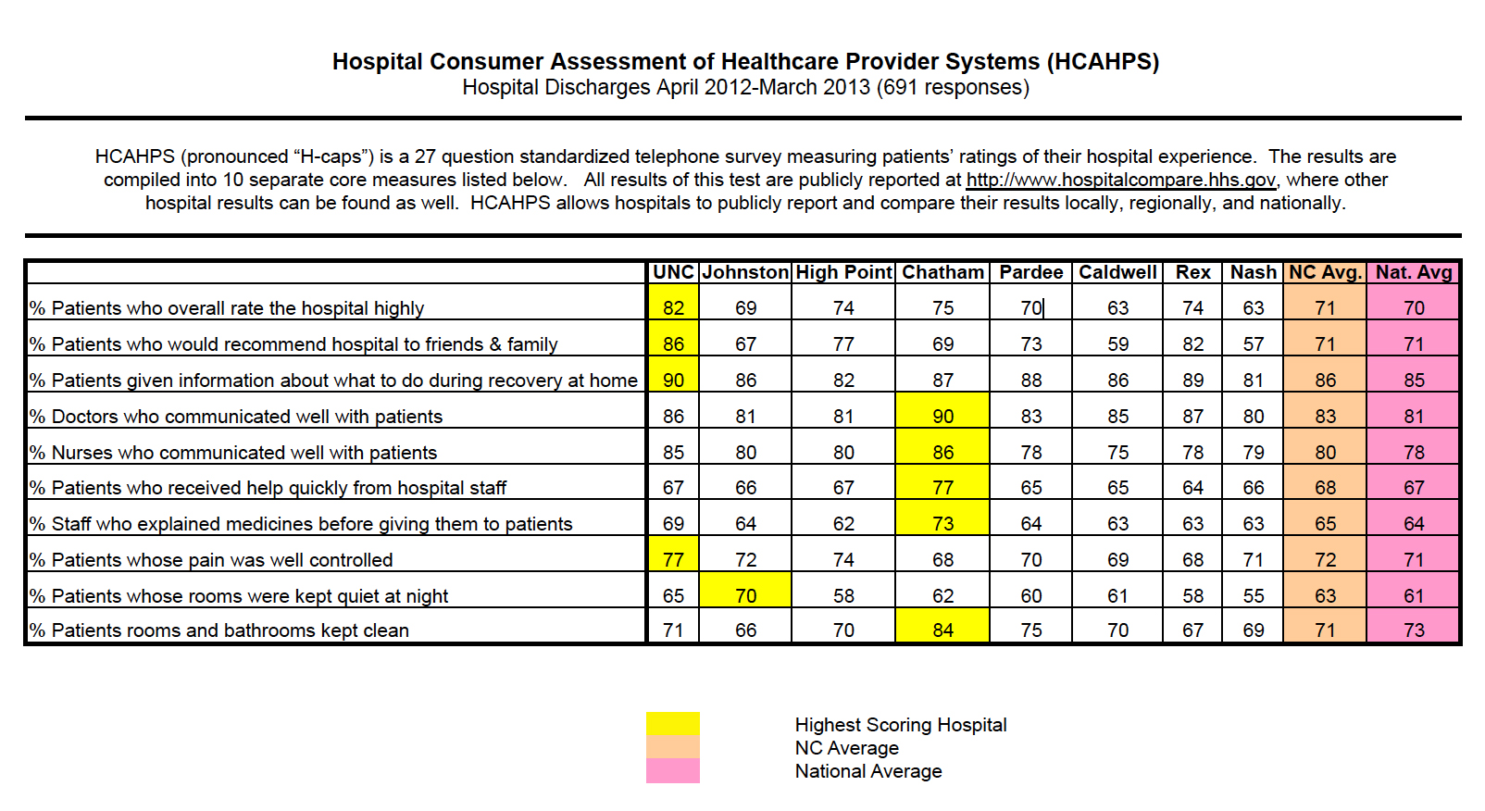
HCAHPS
Large Image

Slide 15
HCAHPS
Large Image
Hospital Consumer Assessment of Healthcare Providers and Systems
  In hospital settings, careful acoustical design can help boost HCAHPS scores which may affect the level of reimbursement from The Center for Medicare & Medicaid Services (CMS).

Slide 16
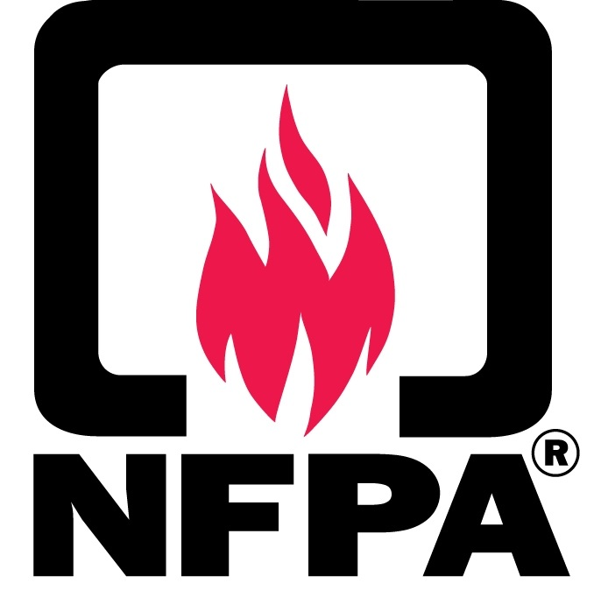
NFPA 72: Fire Alarm and Signaling
Large Image

Slide 17
NFPA 72: Fire Alarm and Signaling
“It’s easy to see that the misapplication of notification appliances in a health care occupancy could be life threatening rather than life saving.”
18.4.1.5* Voice messages shall not be required to meet the audibility requirements of 18.4.3c(Public Mode Audible Requirements), 18.4.4 (Private Mode Audible Requirements), 18.4.5c(Sleeping Area Requirements), or 18.4.6 Masked Thresholds), but shall meet the intelligibility requirements of 18.4.10 where voice intelligibility is required.
It’s About Delivering a Clear, Intelligible Message in Order to Direct Occupants to Safety!

Slide 18

Acoustic Design Is Critical
Large Image

Slide 19
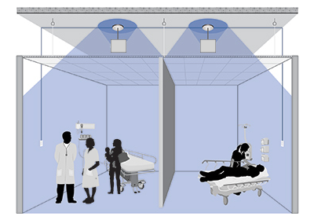
Large Image
ABC’s Of Acoustics
Deck
Absorbing Sound
Absorb
Block
Cover
Ceiling Panel
Covering Sound
Blocking Sound
Covering Sound

Slide 20

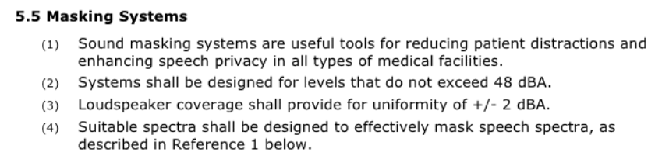
Facility Guidelines Institute

Slide 21
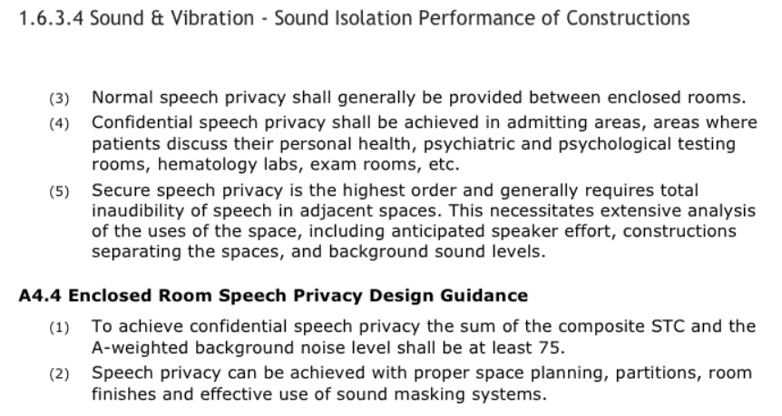
Speech Privacy

Slide 22
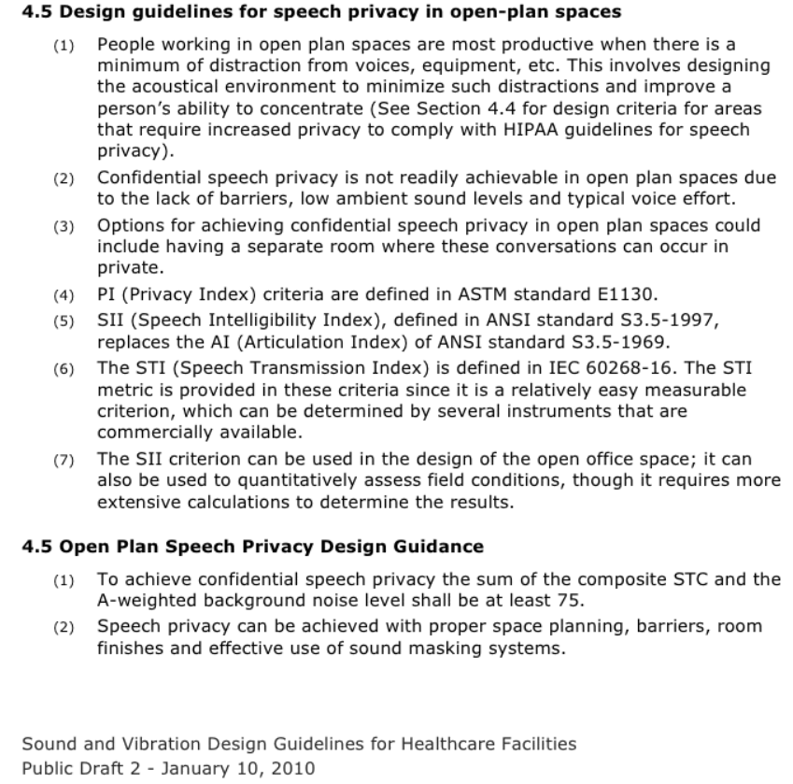
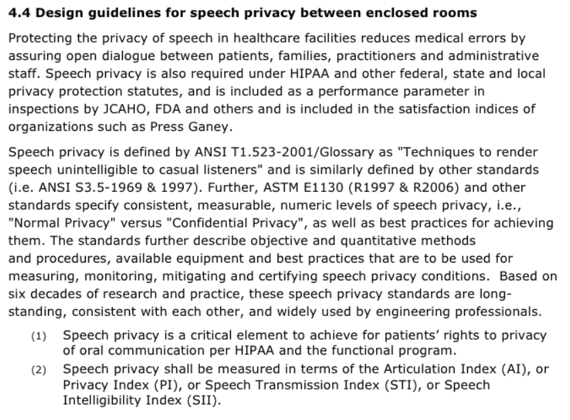
Speech Privacy

Slide 23

Large Image
What is Sound Masking?

Slide 24
Sound masking is the process of adding background sound to reduce noise distractions, protect speech privacy and increase comfort.

Slide 25
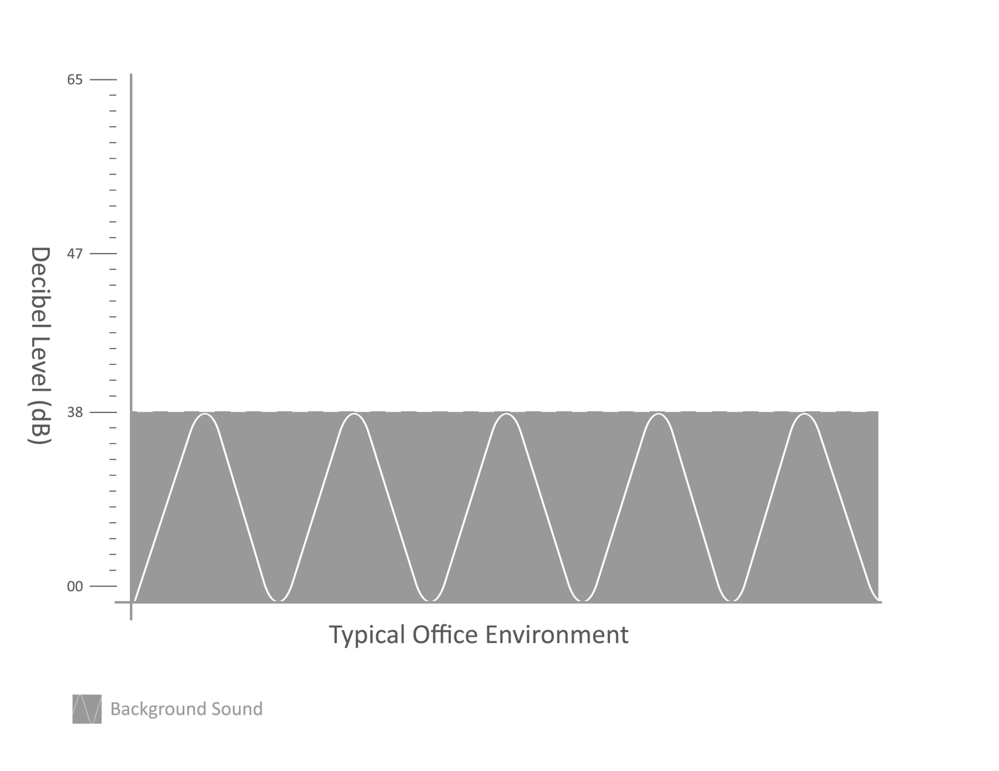

Slide 26
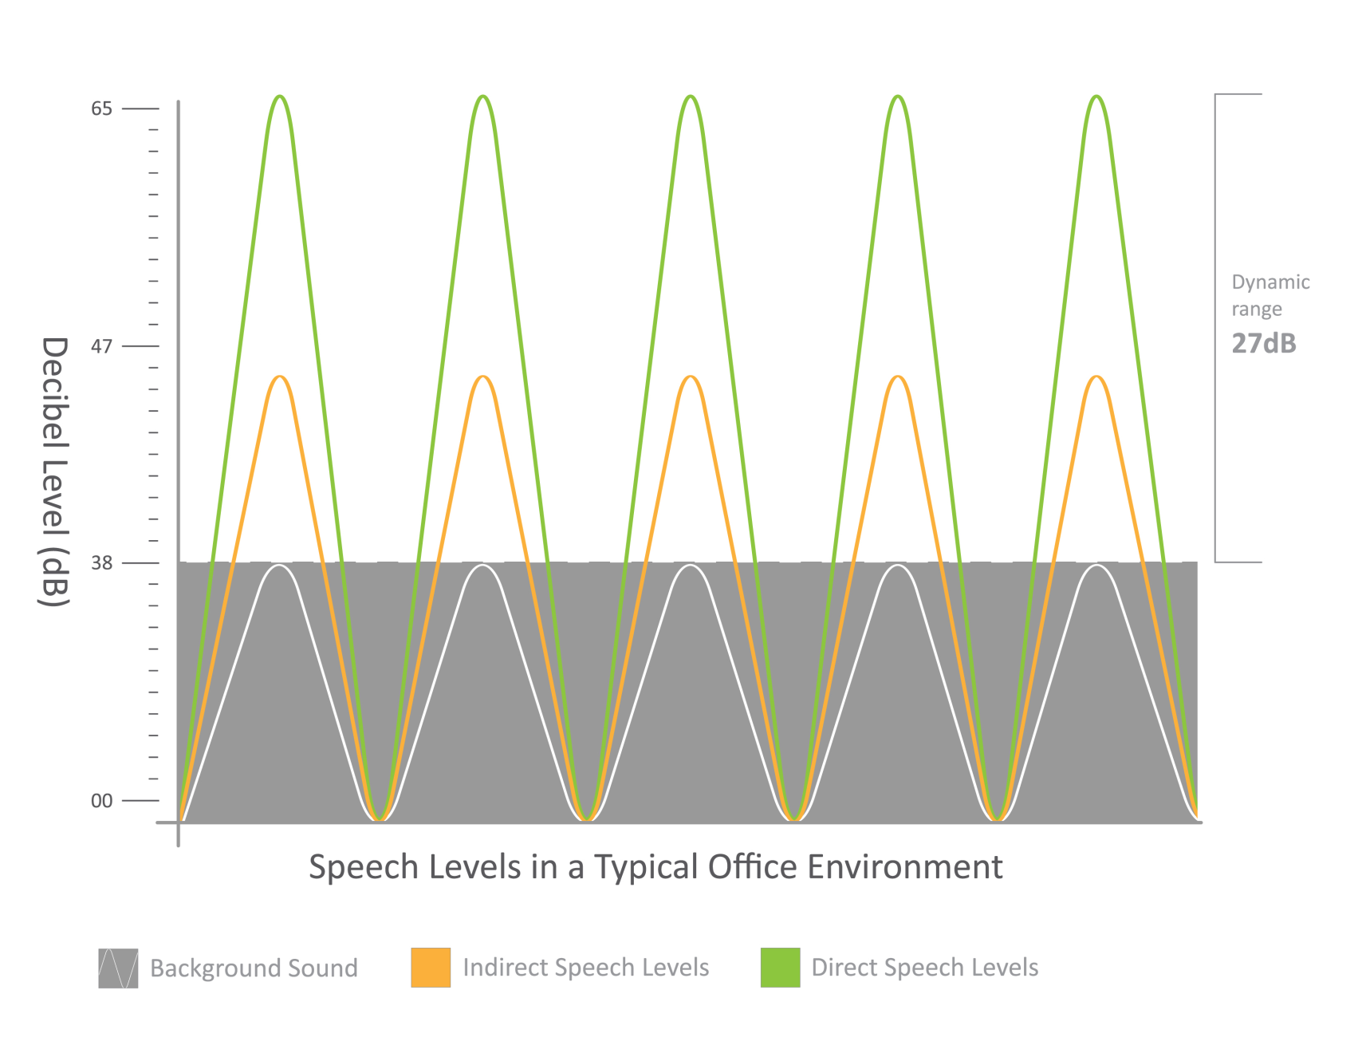

Slide 27
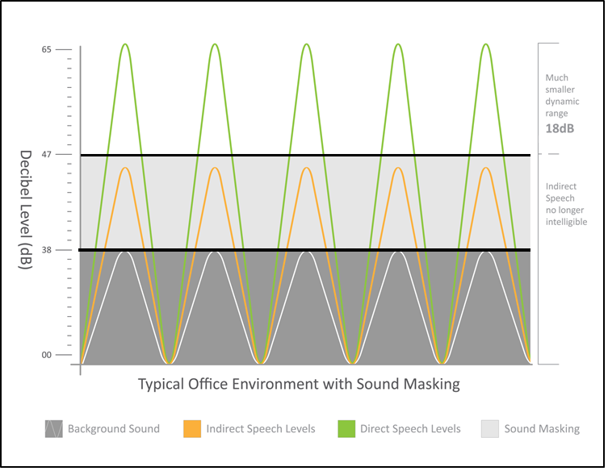

Slide 28
Large Image
Why Sound Masking
Cost Effective Solution
Save thousands on construction costs
Low voltage and energy efficient

Slide 29
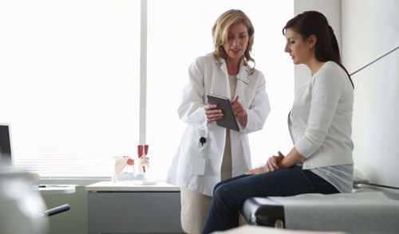
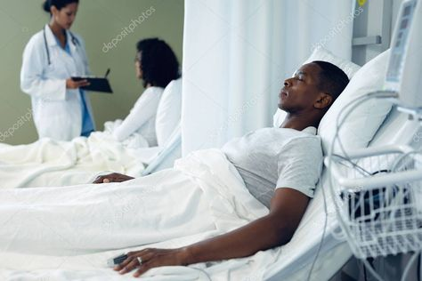

Sound Masking Criteria
Speech Privacy
Comfort
Safety

Slide 30
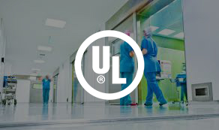
Speech Privacy, Comfort & Safety for Healthcare Facilities
Federal Mandates
(Speech Privacy)
CMS Reimbursement
(Comfort)
UL 2572 Standard
(Safety)

Slide 31
HIPAA Compliance

Slide 32
Reasonable Safeguards
  Make reasonable efforts to minimize overhead conversations
  To do this, use consistent and proven practices to adequately meet the requirements for privacy

Slide 33
Standard for Oral Privacy
  ASTM E-1130: Standard Test Method for Objective Measurement of Speech Privacy in Open Spaces Using Articulation Index.

Slide 34
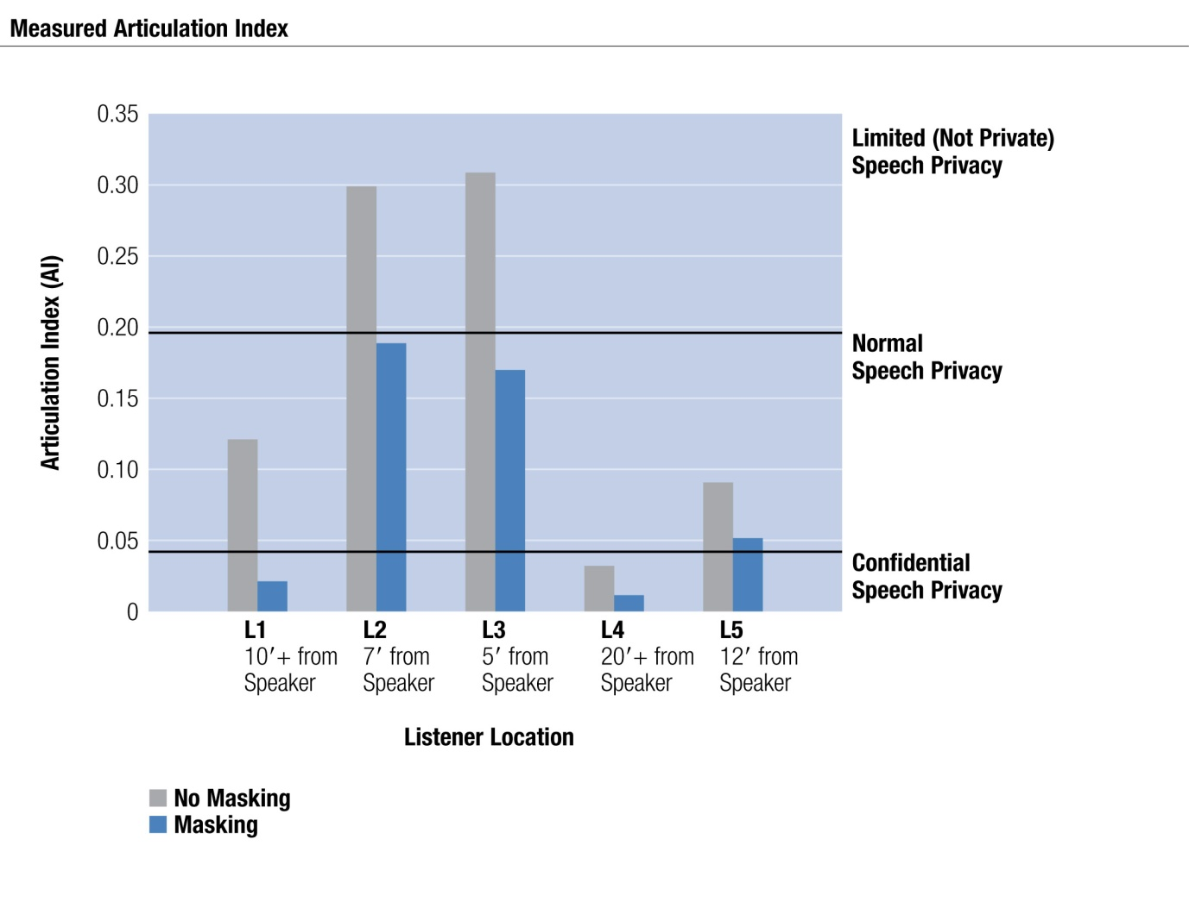
Measuring Articulation Index in Healthcare

Slide 35
Achieving HIPAA
  Sound masking creates a reasonable safeguard by gently raising the ambient background sound above indirect speech levels:
  Makes indirect conversations unintelligible
  Reduces incidental disclosures
  Documented to meet the necessary privacy standard, ASTM E-1130

Slide 36
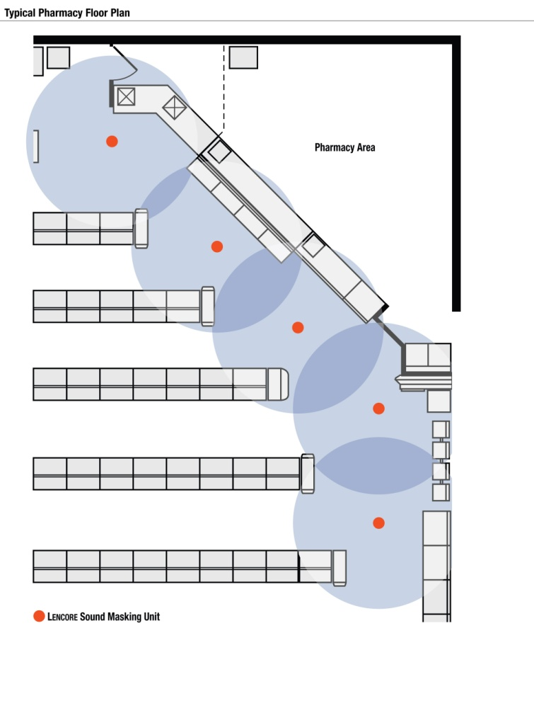
Achieving HIPAA
  Create a buffer to enhance speech privacy between the transaction areas and the waiting areas to create an acceptable degree of privacy to discuss Protected Health Information (PHI).

Slide 37
HCAHPS
Large Image

Slide 38
Acoustics and HCAHPS
  Nationally, the HCAHPS measure for “Quietness Around Patient Rooms at Night” reveals that patients are only marginally satisfied.’
  Excessive noise and the resulting lack of sleep tops the list of patient complaints.

Slide 39
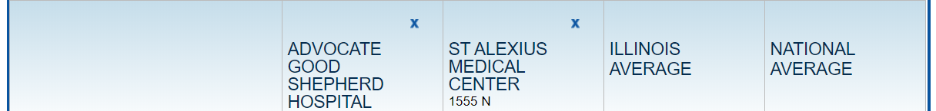
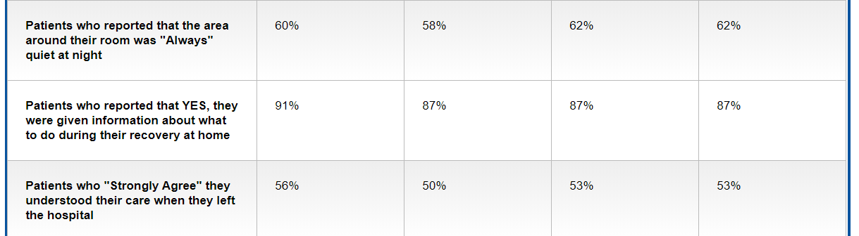
Poor HCAHPS Score Performance

Slide 40
Acoustics and HCAHPS
  A comfortable environment which produces fewer disruptions and allows for more consistent patient rest contributes to faster recovery and lower re-admission rates.

Slide 41

Large Image
Achieving Acoustical Comfort with Sound Masking

Slide 42
Impacting HCAHPS Through Comfort

Slide 43
Sound Masking & HCAHPS
Large Image
A Comfortable Sound Masking System
Promotes rest and relaxation
Helps shorten the time it takes to fall asleep
Prevents unwanted noises from disrupting patients sleep
Result
Patients rest/sleep better, resulting in an improvement of medical outcomes and personal satisfaction as evidenced in HCAHPS survey responses

Slide 44
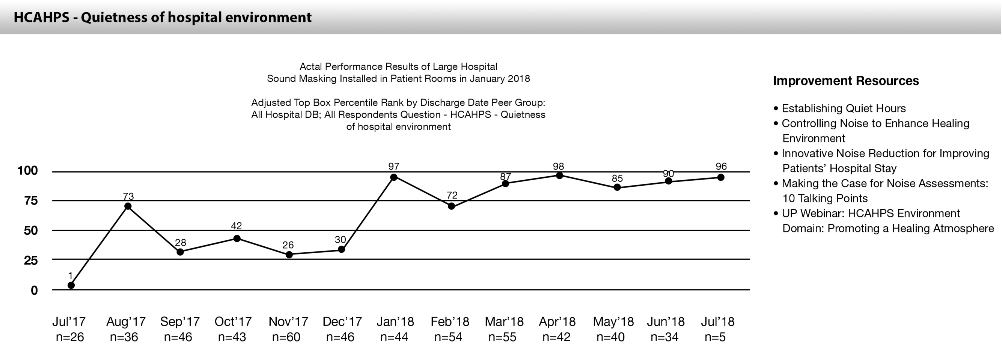
Case Study: i.Net Sound Masking Solution
Large Image
Lencore sound masking resulted in a 183% HCAHPS improvement in one study.

Slide 45
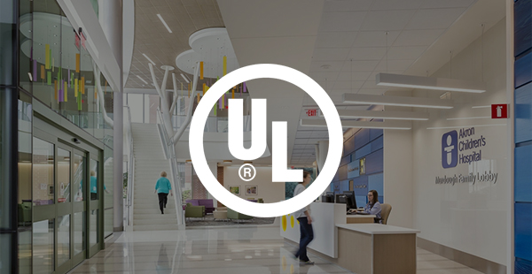
SAFETY
Large Image

Slide 46
Large Image
Sound Masking & Life Safety
Sound masking systems provide speech privacy by making indirect speech unintelligible.
Building fire codes prohibit competing signals that make life safety announcements unintelligible.

Slide 47

UL 2572
Large Image
Underwriters Laboratories (UL) is a safety consulting and certification company focused on the establishment of safety standards for electrical devices and components

Slide 48
Large Image
Sound Masking & Life Safety
Per the NFPA 72, Sound Masking MUST shut off or mute in the event of an emergency to allow for a clear, intelligible message
By muting the sound masking, an intelligible message can be delivered to building occupants directing them to safety

Slide 49
Large Image
Sound Masking & Life Safety
Fire code also works with ADA Federal Law to effectively ensure that all occupants can benefit from fire code standards
These ADA rules are critically important in a healthcare facility, where many patients may have disabilities or limitations

Slide 50
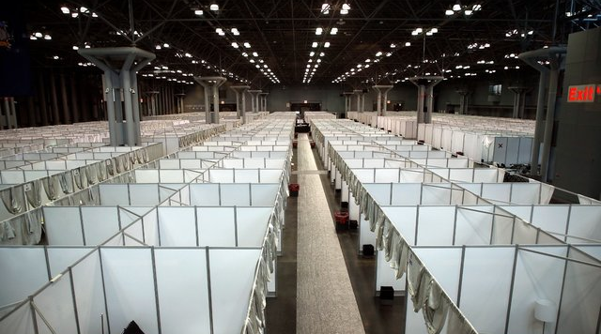
Adapting to Future Needs
Large Image

Slide 51
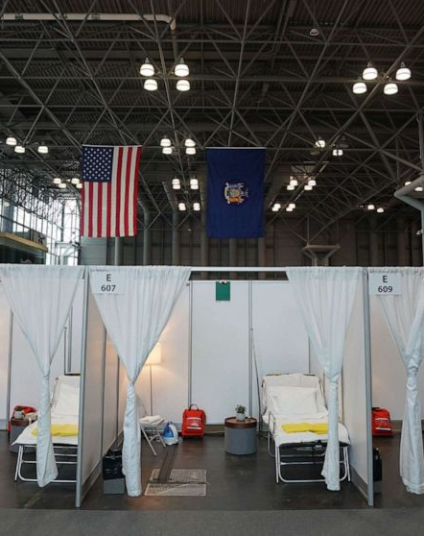
The COVID-19 Pandemic filled emergency rooms and intensive care units across the world, forcing local officials to convert hotels, convention centers, and gymnasiums into new hospital spaces
Stand-alone sound masking are available for mobile units

Slide 52
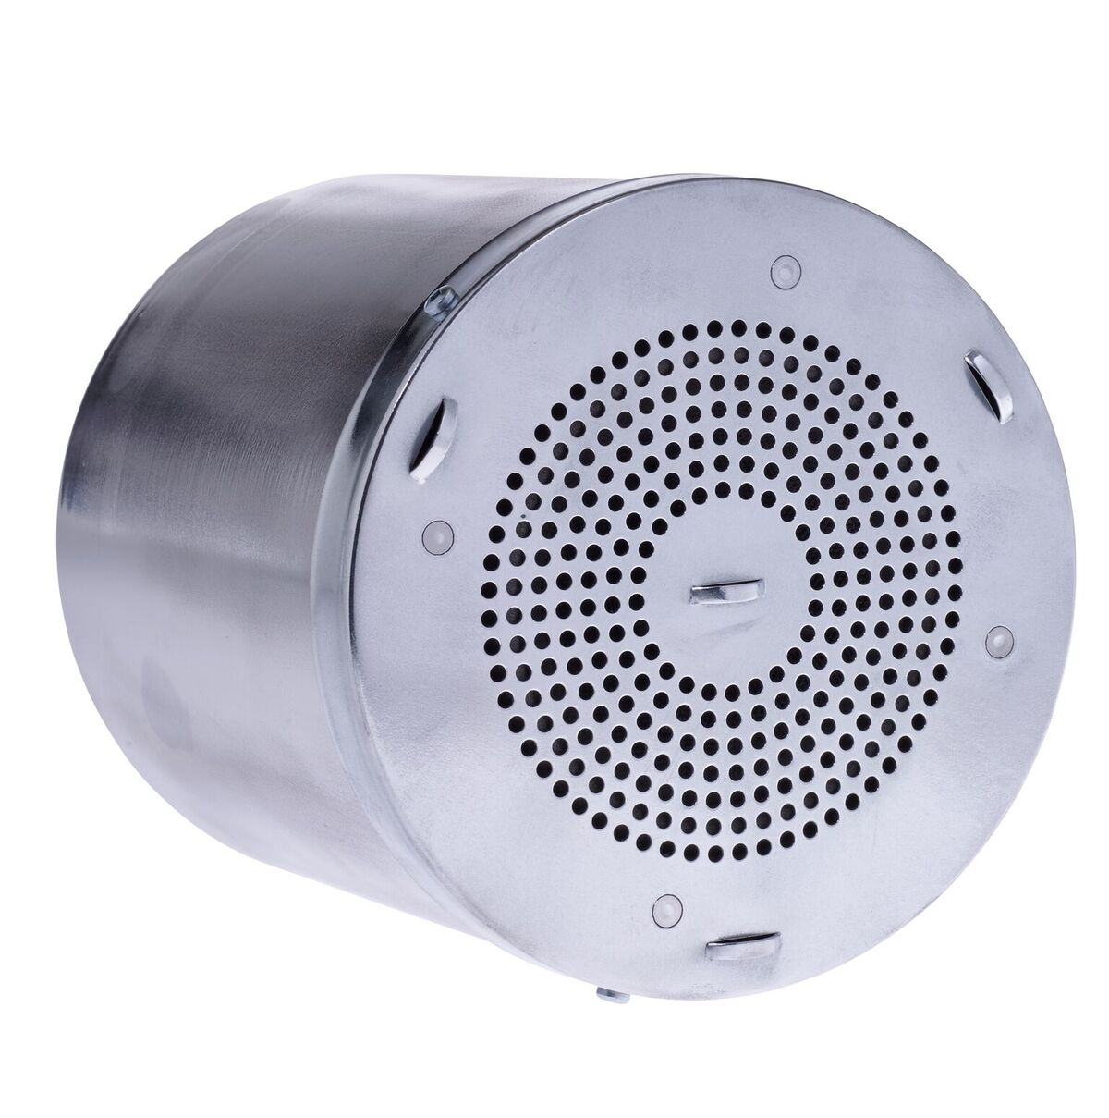
This self-contained system provides superior sound quality, providing both comfort and speech privacy
Can be used to promote rest, relaxation and recovery in these temporary facilities

Slide 53
Summary
From large to small in-patient healthcare facilities where a quiet environment ensures better rest and recovery, and where protecting the privacy of patient information is the law, Sound Masking can provide an improved acoustic environment to help meet the necessary performance objectives
For healthcare, especially Hospital, applications, a sound masking system that meets today's standards for safety with its ability to shut off in the event of an emergency is critical
We must continue to look for creative ways to adapt to the changing healthcare environment with portable or other innovative solutions

Slide 54
Questions?

Slide 55
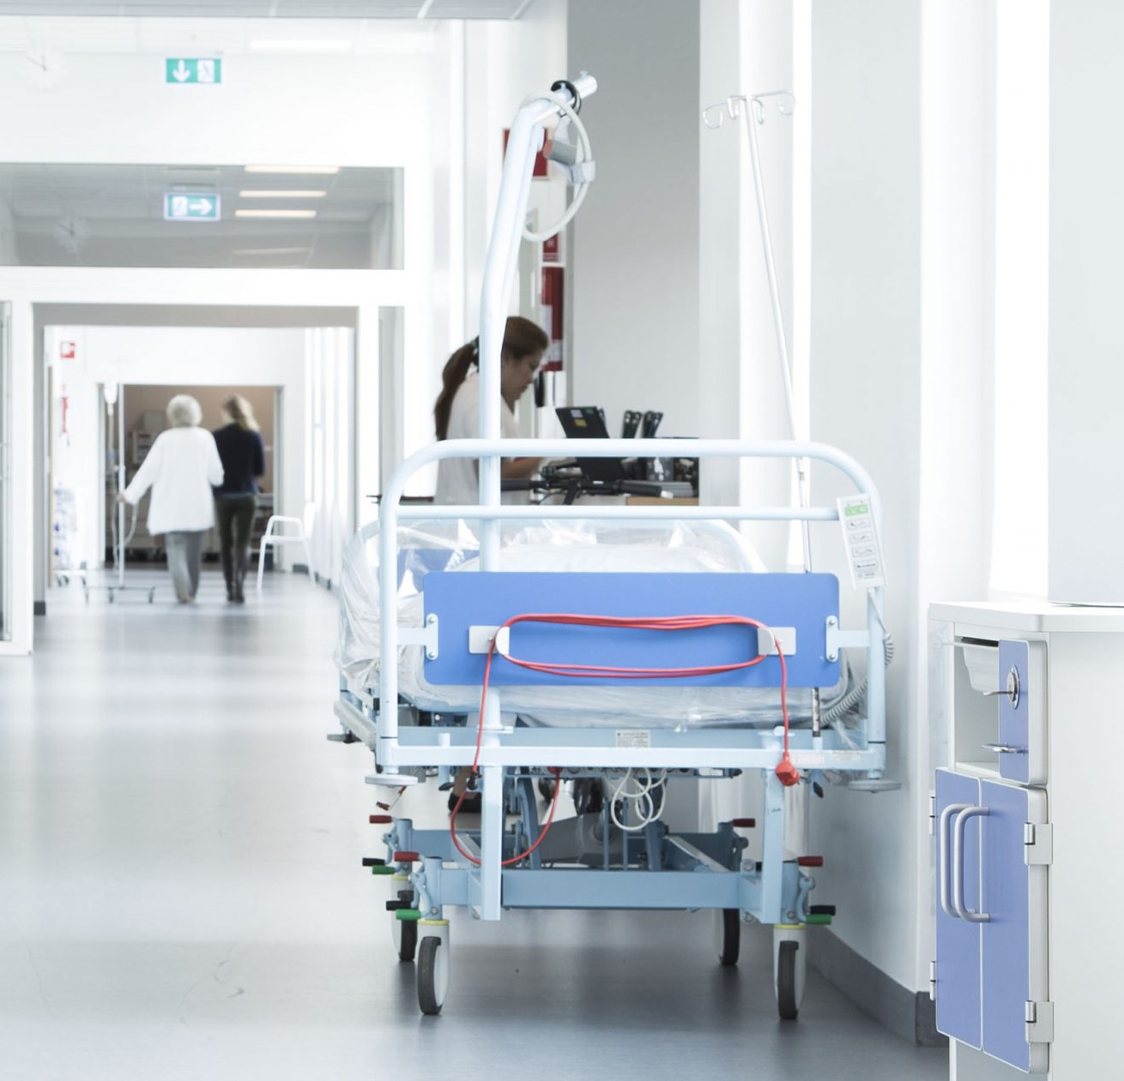
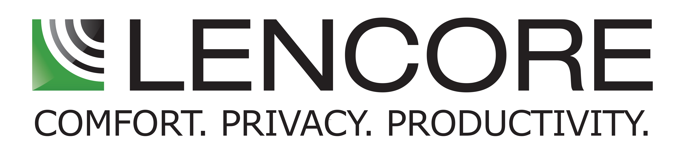



Thank You
516.682.9292
info@lencore.com
www.lencore.com

