Slide 1
Acoustical Impact & Green Office Design

Slide 2
What We’ll Cover
What is LEED? How does it apply towards acoustics & what LEED credits are available for acoustics?
Why do green buildings have more sound problems than traditional office designs?
Sound masking as an effective acoustical solution in green design.
How sound masking can improve speech privacy, comfort and the performance of your spaces.
Notes:
This course will explain how LEED credits can apply towards acoustics and will discuss sound masking as an acoustical solution that is able to be implemented when applying for LEED credits for acoustics. It will explain how sound masking improves the overall speech privacy and comfort for occupants and how it improves the overall acoustical performance of spaces.

Slide 3
So What is LEED?
What does it stand for?
How is acoustics incorporated into the LEED program?
Notes:
Leadership in Energy and Environmental Design.
This is excerpted the USGBC website:
LEED is an internationally recognized green building certification system, providing third-party verification that a building or community was designed and built using strategies aimed at improving performance across all the metrics that mater most: energy savings, water efficiency, CO2 emissions reduction, improved indoor environmental quality and stewardship of resources and sensitivity to their impacts.
LEED was developed by the US Green Building Council (USGBC) and provides building owners and operators a concise framework of identifying and implementing practical and measurable green building design, construction, operations and maintenance solutions.
LEED is flexible enough to apply to all building types – commercial and residential. It works through the building lifecycle – design and construction, operations and maintenance, tenant fit out and significant retrofit.
Participation or the decision to be a LEED building is voluntary, but heavily encouraged and often indentified at state and federal levels. It is quickly winning greater approval and support by corporations worldwide.
In Fact, as per speechprivacy.org, out of 1100 major cities around the country over 900 cities have a minimum LEED status for any new construction.
LEED has so many facets, it is easy to get lost so today we will drill down and identify just where LEED & Acoustics cross.

Slide 4
Important to Know
No one product is LEED approved or certified. Overall solutions, practices and use of products can contribute to LEED.
Be wary of any manufacturer or company that claims they can “guarantee” LEED credits or points.
When in doubt, consult a local LEED professional or contact the USGBC.
People are accredited. Buildings are certified.
LEED Credits are applied to achieve LEED points for Certification – Max 110 points
Notes:
We are acoustic and sound masking professionals providing information on LEED and how it affects our industry and the products that we provide for clients.
Explaining LEED is a tremendous undertaking and there are very qualified people at the USGBC (US Green Building Council) and even locally through LEED AP’s (Accredited Professionals) in your areas that can explain more on LEED.
For our presentation today will discuss the portion of LEED that applies towards acoustics for commercial interiors and in healthcare and how sound masking can help you as an acoustical solution.
If you have questions regarding LEED that fall outside of our area of expertise and understanding, we would like you to take note of two very important websites for additional information.
www.usgbc.org – for questions regarding LEED
www.speechprivacy.org – for questions regarding acoustics and LEED
4

Slide 5
It’s Not Easy Being Green
But it’s worth it!
Green buildings and LEED certified buildings show improved satisfaction in all categories…
Notes:
In reality it is getting easier and more cost effective to build green as manufacturers begin to offer more options for sustainable products and more practices to answer the growing need and demand for these by end users, architects and designers.
LEED buildings make sense environmentally, economically and socially and occupants find greater satisfaction with a variety of elements within the space.

Slide 6
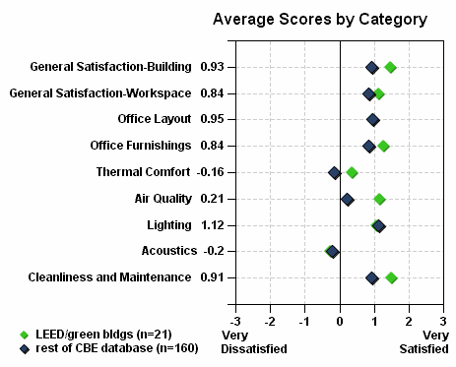
EXCEPT FOR ACOUSTICS
Survey results of one-building / one-vote mean satisfaction scores in LEED-rated/green buildings compared to the rest of the CBE survey database
Center for the Built Environment (CBE) at the University of California, Berkeley
Notes:
The graph above shows data from a study undertaken by the CBE. It shows the satisfaction level rating; -3 being very dissatisfied to +3 being satisfied for a number of categories and elements in the space. The blue diamond stands for non-green building and green diamond being green/LEED building.
We see that the satisfaction has improved considerably for all, expect for acoustics. Acoustics is the only element where the satisfaction score is negative 0.2 and has stayed the same for LEED too. Also for LEED buildings, acoustics did not improve but decreased a bit. So to prove a point, Acoustics is a major issue in both non-green and green buildings.
About the study
In a study and survey involving 21 buildings (of which were 15 LEED certified and 6 green) to 160 non-green buildings.
The data was taken from Center for the Built Environment (CBE) at the University of California, Berkeley for the study.
Satisfaction rates for the workspace were shown to be better in almost every category with the exception of acoustics.
The study was conducted by Sahar Abbaszadeh Fard in Spring 2006.

Slide 7
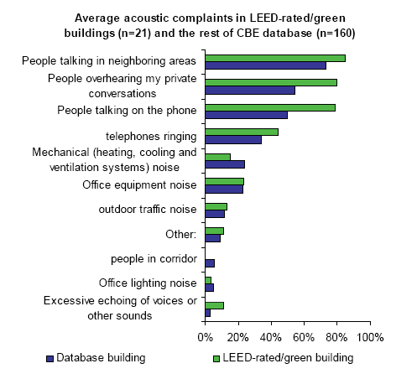
Complaints from Overheard Speech Tops the Chart
*Mean percentage of acoustic complaints in LEED-rated/green buildings and the rest of the CBE database
Notes:
Furthermore, the survey broke down the issues with acoustics into types of noise problems, and among the top offenders were people talking in neighboring areas, people overhearing private conversations, and people talking on the phone.
See the rise in complaints for green/LEED buildings shown in green versus the non-green complaints in blue.
According to the survey, we see that LEED/green buildings seem to have greater acoustical issues.
With proper acoustical planning and practices we can prevent such issues and improve satisfaction.

Slide 8
So What Does This Mean?
Green, Sustainable Buildings are Better
Economically
Socially & Environmentally
But they do create acoustical issues that must be addressed to improve occupant satisfaction and provide better speech privacy.
Notes:
Green buildings are better economically because sustainable workplaces help employees to be more productive while lowering the costs for operation through energy and other cost savings. These buildings integrate renewable and recyclable materials and thereby eliminate waste and improve efficiencies.
Socially these buildings provide better work spaces as increased access to light (daylighting) and natural views helps to lessen stress and pressure and improves job satisfaction. Lower panel heights creates better airflow in office spaces. They also seem to impact the overall morale for employees as employees take pride in their company’s commitment to the environment and social responsibility.
These buildings work environmentally to offer spaces that support better productivity which ultimately impacts your bottom line.
So we know that it makes sense for people and for financial reasons, but now we need to understand how we can address acoustics and why this is such an issue.

Slide 9
So Why The Acoustical Issues?
Let’s consider how we design traditional office spaces:
Quiet HVAC Systems
High performing ceiling tile
Line of site partitions
Carpeting
Fabric acoustical wall panels

Slide 10
The result is..
These systems and materials absorb and block much of the necessary background sound – this makes the environment in effect too quiet.

Slide 11
So, what else is going on in the space?
Communication
Collaboration
Concentration
Notes:
So in these “too” quiet environments we are trying to work, communicate and collaborate. We find that we have created an imbalance between the background sound level and the noise created in the space.

Slide 12
What is Creating All the Noise?
Floor population densities rising
More cell and speaker phone use
Voice activated systems and multimedia
Shared and teaming environments
Open plan design, lower panel heights

Slide 13
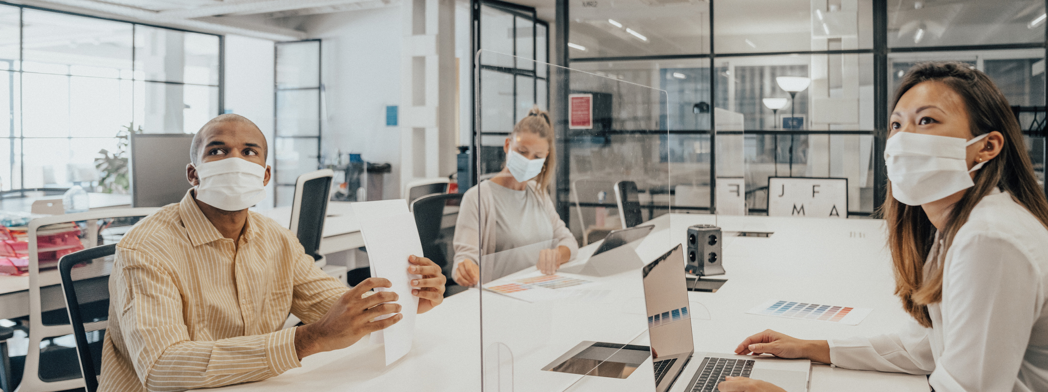
LEED DESIGN
Traditional designs we already have an issue with noise and acoustics… Now, lets see what happens in our LEED designs.
Notes:
So in traditional office spaces, we have quiet environments with a lot of noise. Now let’s look at what happens in some of our LEED designs.

Slide 14
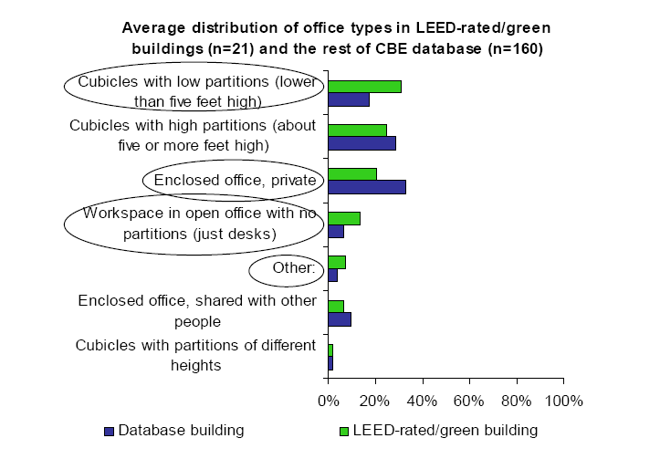
GREEN VS. NON-GREEN COMPARISON
Mean percentage of office types in LEED-rated/green buildings and the rest of the CBE database
Notes:
Open plan and cubicle office types have been around for a long time, and they are especially attractive in green buildings due to their sustainable benefits. These benefits include reduced material and resource use, enhanced views and daylight penetration, improved airflow and natural ventilation. In addition to these, cubicles and open plan offices enhance ease of interaction in workspace.
We truly cannot image a green/LEED buildings without these design considerations. Lets see the comparison of LEED/green design to non-green design in that same CBE study we looked at earlier.
We see the use of lower cubicle heights (lower than 5 ft) has doubled for LEED/green design verses the non-green design providing the benefits of an increase in daylight and views, better airflow, and reduction in material cost.
We see the number of private offices has been reduces by half for LEED/green design compared to non-green design.
Few benefits: Again, reducing space requirements and materials and increasing views, airflow, and daylight.
Finally, we see more than twice the use of open office workspace (just desks, no partitions) in LEED/Green design in comparison to non-green design.
Other changes include using no ceiling tiles or bare concrete for LEED/green design.
All these changes are necessary for LEED design and sustainability. But how do they affect acoustics?
We have reduced the absorbing and blocking in the LEED design. Thus we have further increased the much dealt acoustical issue in our new LEED/sustainable designs.

Slide 15
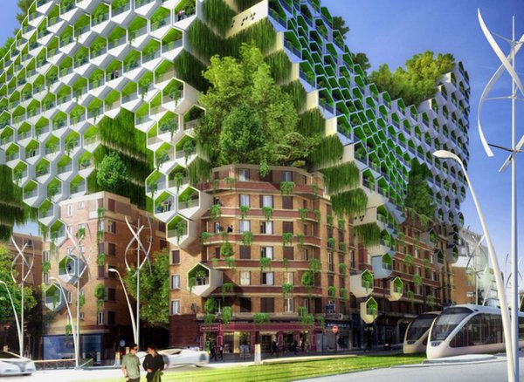
GREENER QUIETER OFFICE DESIGN
Higher efficiency heating and cooling systems
Means quieter operations and cost efficiency
But this also makes ambient background much quieter

Slide 16
Green Office Design- Noisier
Bare concrete ceilings
Improve heating and cooling efficiencies
But causes sound reverberation
Lower cubicle walls
Reduce lighting needs and improve daylight
But causes sound to travel greater distances
Fewer private offices
Improves access to natural daylight
But may mean less speech privacy

Slide 17
Green Offices
Green Offices have quieter building systems
but more noise
How Can We Address This?
Notes:
Green Offices
Green Offices Quieter Building Systems But More Noise How Can We Address This?

Slide 18
First Step
We need improve the
acoustic environment

Slide 19
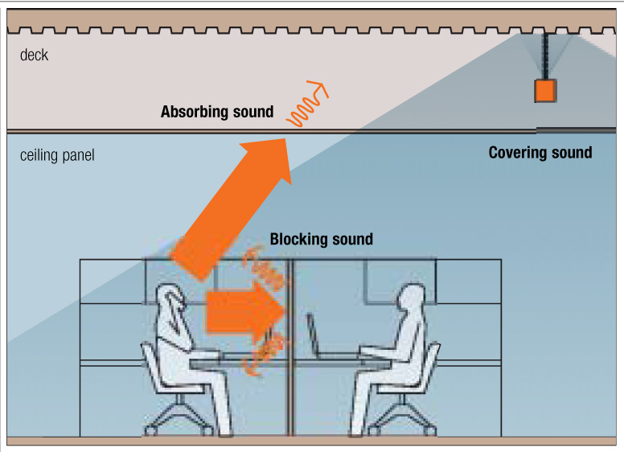
ABSORB, BLOCK, COVER
We can understand the building blocks for proper acoustical design by understanding your A, B, C’s
Notes:
We evaluate space by determining the acoustical efficiency of a space.
Acoustical efficiency is determined by how well a particular space absorbs, blocks and covers sound.
Most absorption takes place at the ceiling, walls, or partitions. Typically fabric acoustical wall panels on wall partitions are used to absorb sound.
Most blocking of sound also takes place at the ceiling, walls and partitions.
Covering of sound is done with sound masking.

Slide 20
Measurements for Absorbing Sound
NRC or Noise Reduction Coefficient measures the degree to which a surface or material absorbs sound.
AC or Articulation Class measures how well a ceiling panel prevents sound from reflecting down to adjacent workspaces in an open-plan environment.
Notes:
20
NRC is represented by a number between 0 and 1.00, which indicates the percentage of sound reaching the panel that will be absorbed.
Acoustical panels convert sound energy into mechanical energy and as the sound waves impact the material, it responds by vibrating the fibers in the material. The ability of a material to convert sound energy to mechanical energy is measured in a test that provides the Noise Reduction Coefficient or NRC. An NRC of 85 means that the material absorbs 85% of the sound that hits it and reflects back 15%.
Sound in an office space is typically absorbed best by high NRC performing ceiling tiles. In addition to ceiling tiles, other elements in the office also help to absorb sound such as acoustical workstation panels, fabric wall panels, ceiling baffles, and carpeting.
The reflection of sound off of a hard surface is called reverberation.
Another measurement called the Articulation Class measures how well a ceiling panel prevents sound from reflecting back into the space. In an open plan office, a measurement of 170 AC or higher is what is generally required for good acoustics.

Slide 21
Measurements for Blocking Sound
STC or Sound Transmission Class measures how well a wall or partition prevents sound from transmitting to the other side.
CAC or Ceiling Attenuation Class indicates the ability of a ceiling panel to block sound transmission.
Notes:
21
Some of the sounds that are not absorbed may be blocked by incorporating line-of-sight partitions, wall, ceiling tile, or other barriers that can stop sound from passing through.
The STC, or Sound Transmission Class, is the ability of a barrier to stop sound from passing through it. A material with an STC of 21 will prevent approximately 21 decibels of sound from passing through it, depending upon the frequency. The most sound that can be expected to be blocked between open workstations is 21 decibels. This is so because sound will diffract or bend, over the top and around the sides of partial height partitions.
The efficiency of ceiling panels is measured by the CAC or Ceiling Attenuation Class. A ceiling panel with a CAC of 40 will reduce transmitted sound by 40 dB. A ceiling panel with a CAC of 35 or higher offers significant sound attenuation properties.

Slide 22
Measurements for Covering Sound
AI or Articulation Index represents how well speech can be understood in a given space.
PI or Privacy Index represents how well the elements in, and the properties of, a space render outside conversations unintelligible. It is measured in percentage.
Notes:
22
Since it is impossible to absorb or block all sound because some will diffract by bending over the top and around the sides of the partitions. Therefore, the remaining sound must be masked by an electronic sound masking system and distributed throughout a space through speakers above the ceiling.
In this way, the masking gently overrides the sounds that are not absorbed or blocked by partitions. We will discuss in detail how this works, a little later in our presentation.
AI or Articulation Index represents how well speech can be understood in a given space. AI is expressed as a decimal value between 0 (speech is unintelligible) and 1.00 (speech is easily heard and understood). AI is measured using ASTM Test E-1130.
PI or Privacy Index represents how well the elements in, and the properties of, a space render outside conversations unintelligible. It is measured in percentage.
PI =(1-AI)*100

Slide 23
A, B, C Recommendations
In an open plan, look for ceiling panels that have high NRC and AC values (.70 NRC and 170 AC).
In a closed plan look for ceiling panels that have a high CAC value (35 or more).
Add sound masking to achieve privacy and an Articulation Index (AI) of .2 or lower.
ASTM E-1130 (Standard Testing Method)
Notes:
23
To review there are some industry standards:
In an open plan, look for ceiling panels that have high NRC and AC values (.70 NRC and 170 AC). Ceiling panels should have high absorptive properties so that sound is not reflected into adjacent spaces.
In a closed plan look for ceiling panels that have a high CAC value (35 or more). Ceiling panels should have good blocking properties to prevent sound from traveling from office to office.
When there is a high sound pressure level or reverberation, add acoustical fabric panels with an NRC of .85 or higher to reduce both.
Finally, add sound masking to achieve an articulate index of 0.2 or lower.

Slide 24
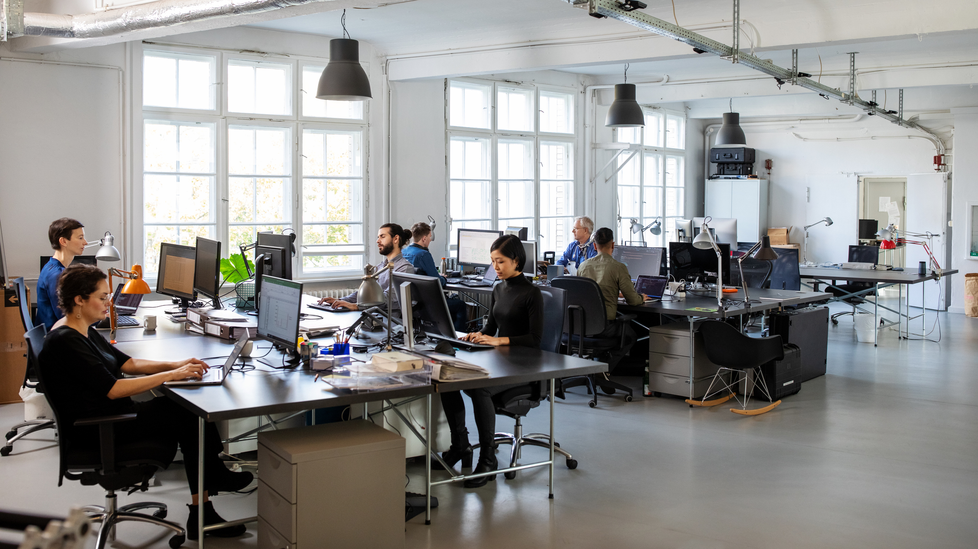
THE ABC’S IN GREEN DESIGN
Let’s Take a Look at What Happens to the ABC’s in Green Design

Slide 25
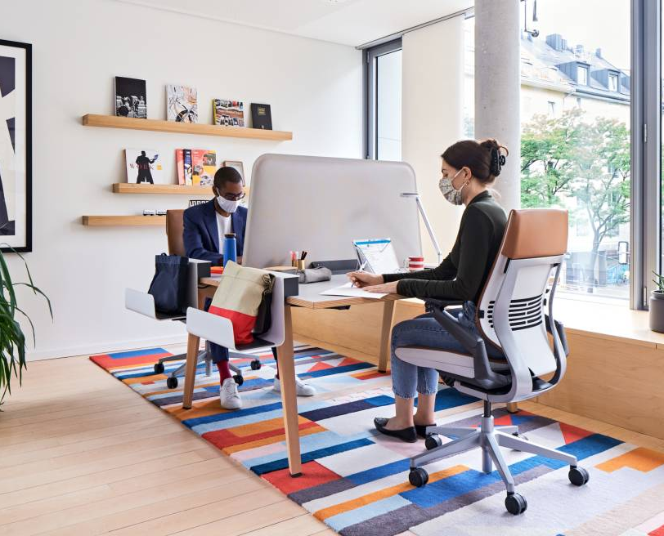
Green Building Design Impacts Acoustics
Less absorption
Bare ceilings
Less blocking
Lower panel heights or COVID barriers
Fewer or no partitions
Fewer private offices
More modular walls

Slide 26
SOLUTIONS
Less “A”
Less “B”
More “C”
Sound Masking helps you provide better acoustics in LEED/Green Building:

Slide 27
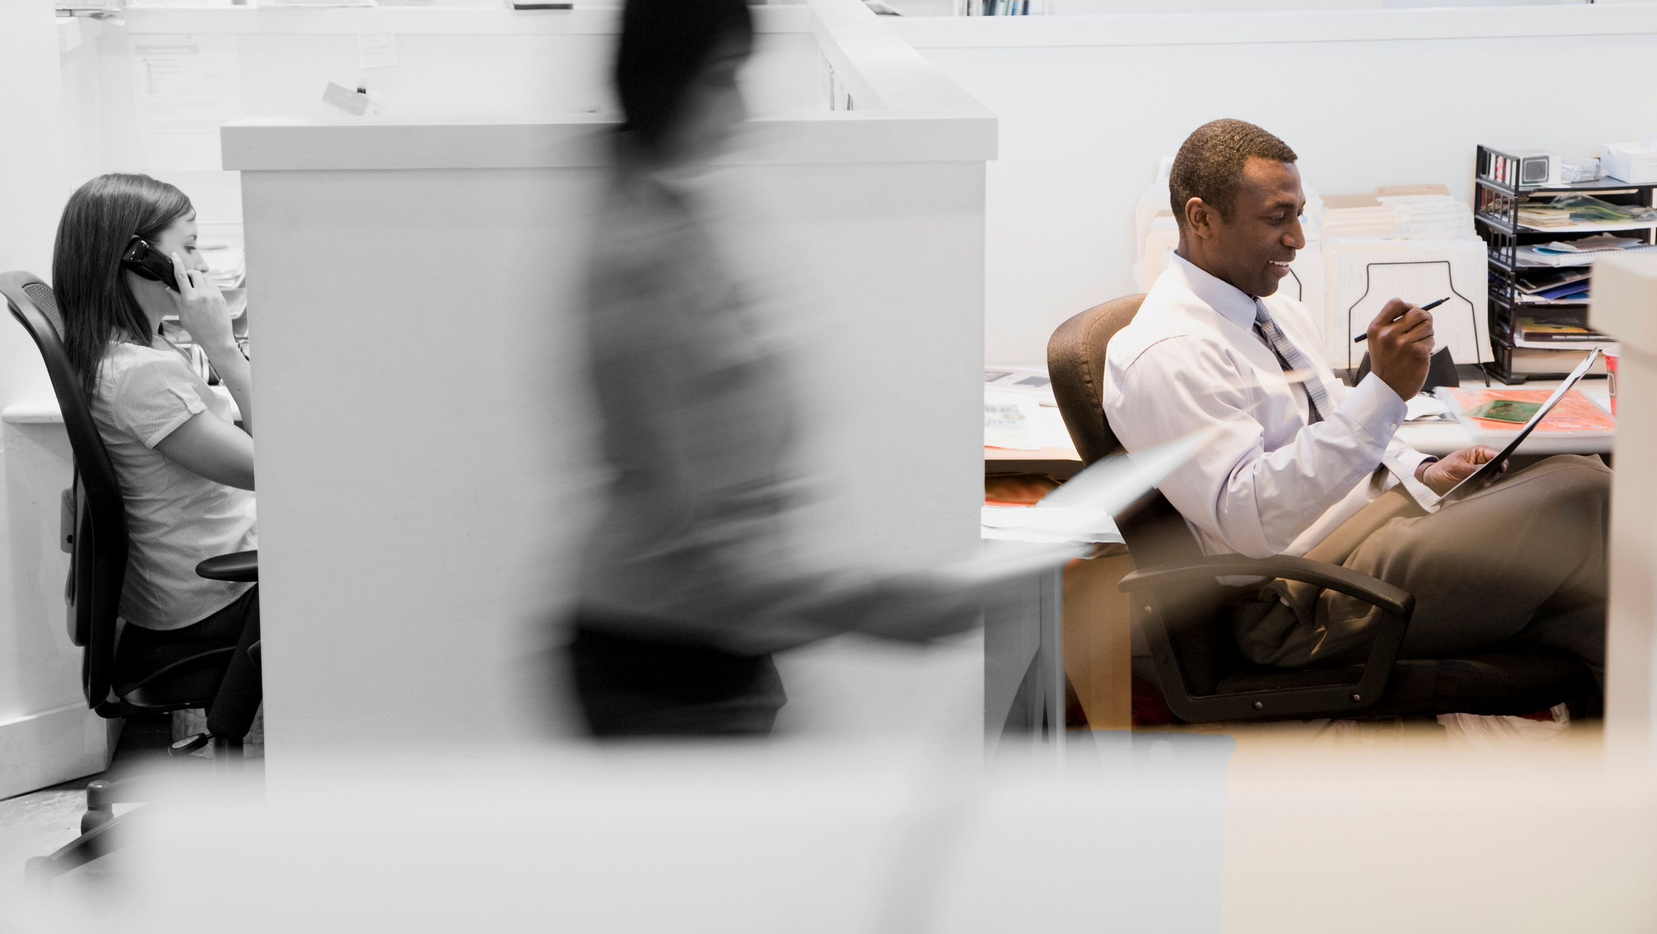
Sound Masking
What is Sound Masking?

Slide 28
Key Criteria
Speech Privacy
Comfort

Slide 29
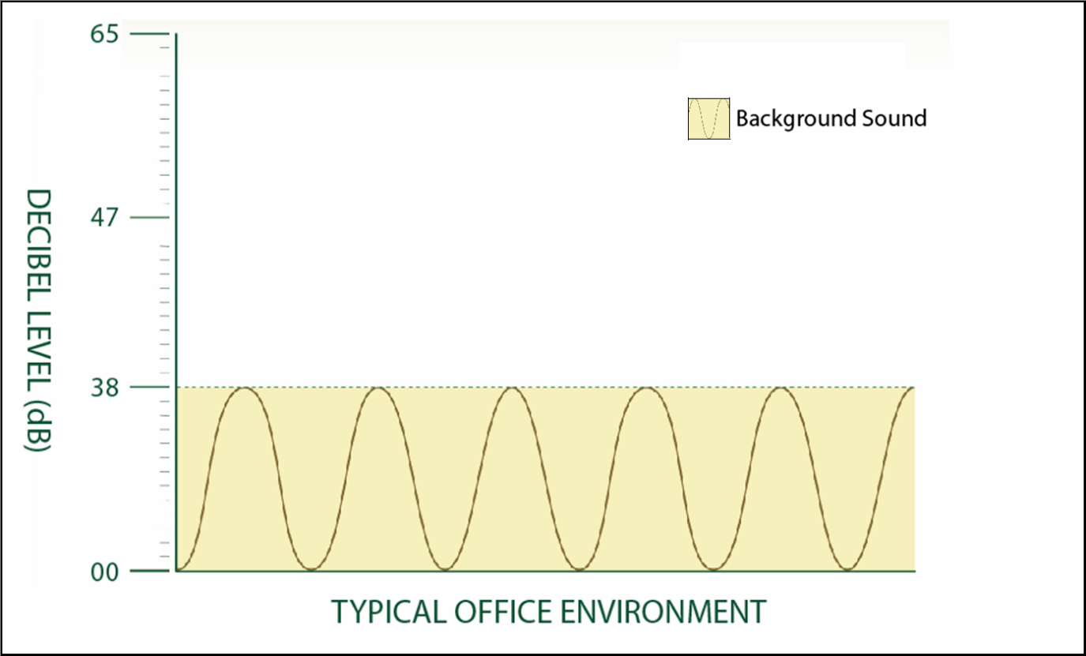
Typical ambient background 38dB
Notes:
Typical ambient background sound in today’s office environment is 38 dB. This measurement is taken without office occupants working or speaking in the space.
Normal speech is measured projected on average at 60 - 65 dB and when heard 15’ away on the side of a wall or partition is measured at 45 dB, which is clearly intelligible.
The dynamic range in a typical office environment is considered as the difference between the ambient background sound level and the prevailing speech or noise levels in the office.
In this graph, the typical ambient background sound is shown at 38 dB.
No occupants.

Slide 30
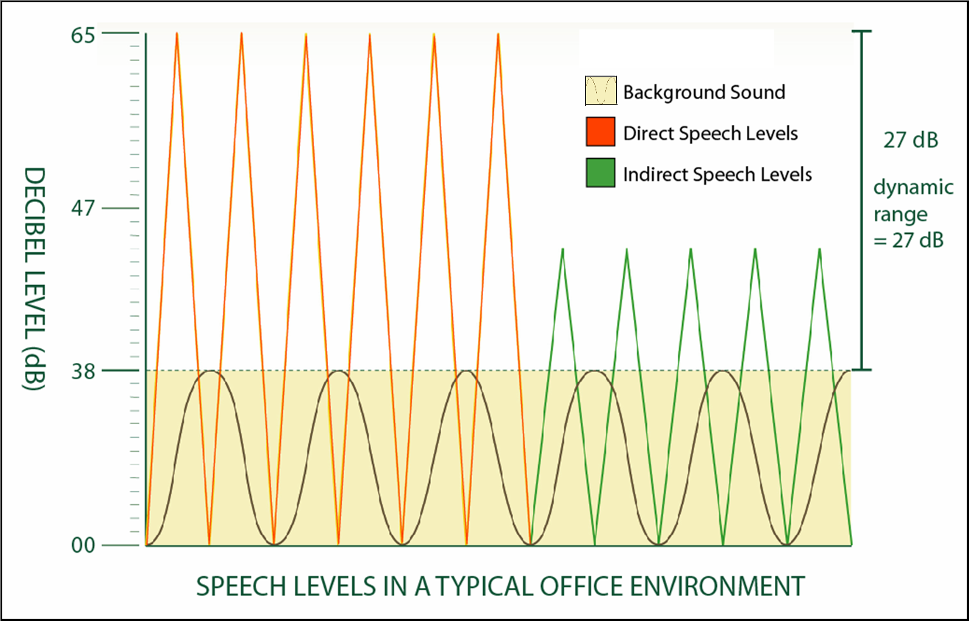
Dynamic Range is 27 dB (No sound masking)
Notes:
Normal speech is projected at 60 - 65 dB and when heard on the other side of a partition or wall at 15’ away is approximately 45 dB.
Here we introduce speech levels at 65 and at 45 dB into the space. 65 dB is direct speech heard a few feet away. The 45 dB level is heard in the next office or workstation. The difference between 65/45 dB and 38 dB is our dynamic range. As you can see here, without sound masking, speech is intelligible on the other side of a wall or partition.

Slide 31
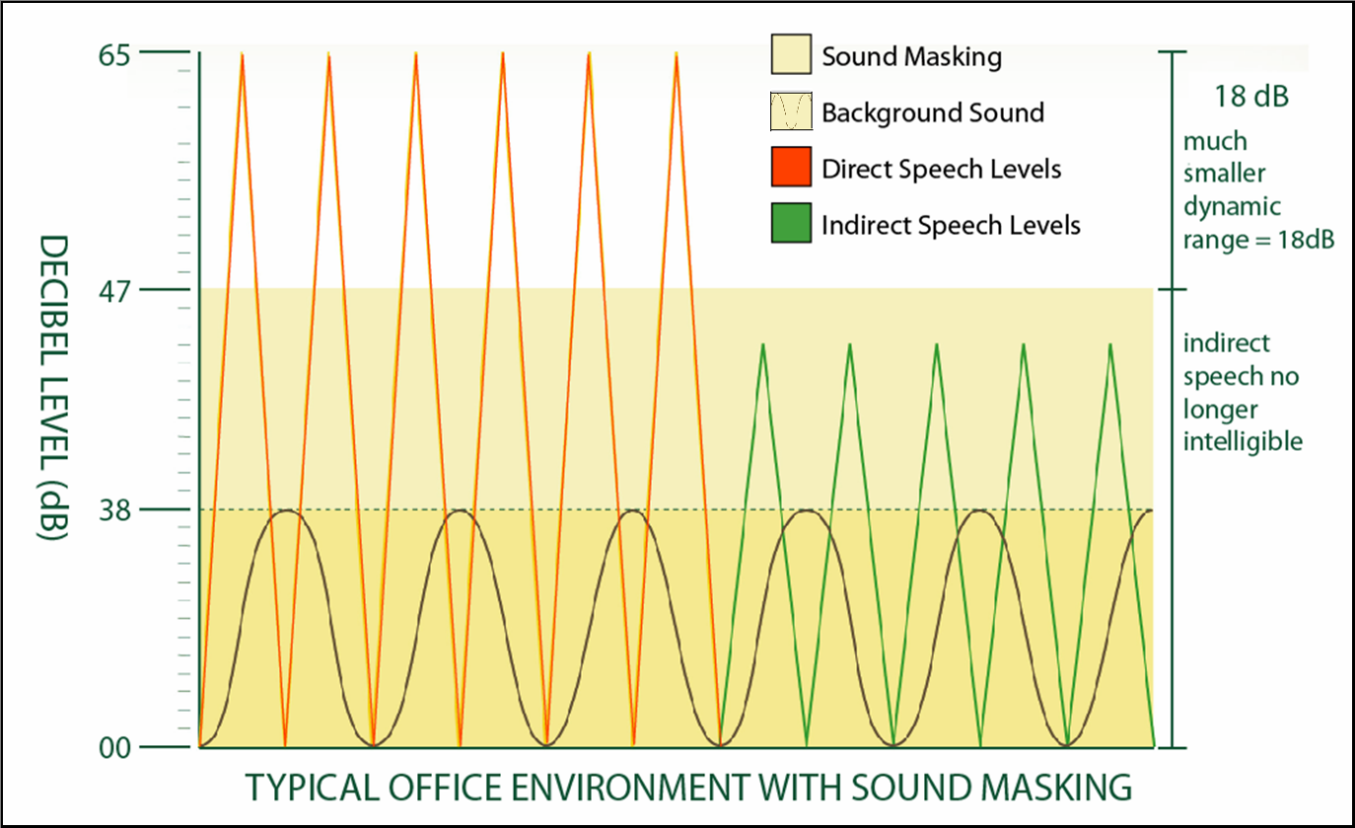
Speech Levels With Sound Masking
Notes:
By introducing sound masking into the space, we gently raise the ambient background sound from 38dB to 47 – 48 dB — just above the level at which speech is heard.
This results in a much smaller dynamic range and provides much more comfort to occupants.

Slide 32
So where should sound masking go?
“Where the ears are”
Open office, private offices & anywhere that you don’t want the speech overheard
Installed throughout a space using in-plenum or direct field speakers throughout the environment
Notes:
Sound masking can be installed in the plenum, in a gypsum ceiling or hung directly from a bare concrete ceiling. Most acoustical journals support an in-plenum type of installation for the best distribution, uniformity and comfort.
Some companies suggest sound masking can be incorporated into walls, furniture or under the floor but this is not as effective as in ceiling systems and not widely recommended or used. When considering comfort, you need to consider uniformity and sound distribution and for the same reason that you would not want to light your space or distribute paging through the furniture or through the floor, you really don’t want to do this with your sound masking system.
But there is a simple test to evaluate the system that works the best. Just have a walk-through in a space where sound masking is installed and hear the difference. You will clearly realize that sound masking installed in the plenum sounds better than other types of installations. In fact, over 80% of installations for sound masking are done in plenum. Remember sound masking must create a comfortable environments and at the same time solve your acoustical issues.

Slide 33
Proper Acoustics & Sound Masking Can Help You…
Achieve
Achieve speech privacy & comfort
Reduce
Reduce the perception of “noise”
Improve
Improve occupant satisfaction
Create
Create better environments
Provide greater productivity
Lower stress/employee turnover
Obtain
Obtain LEED credits

Slide 34
Acoustics & LEED Credits
LEED for Healthcare – 2 Credits
EQ 9.1 and EQ 9.2
States specific goals for speech privacy
Community noise & other acoustics Issues
Intent: Give building occupants an indoor environment conducive to healing and free of disruptive levels of sound
References: “HIPAA & AIA/FGI Interim Guideline on Acoustics”
LEED for New Construction and Commercial Interiors – 1 Credit possible
Innovation in design
Pilot Credit 24 – 1 Credit possible
Innovation in design
LEED for School – 1 Credit possible
Indoor Environmental Quality
Notes:
Each category contains a specific number of credits and each credit carries one or more possible points.
The latest version of LEED (V3) puts the total point level at 110 (100 plus 10 bonus points) and breaks down like this…
Under the LEED based Green Guide for Healthcare V2.2 there are two credits for acoustics in Environmental Quality (EQ 9.1 and 9.2)
Under LEED for New Construction, and under LEED for Commercial Interiors there is one credit available in “Innovation in Design” that can be applied for be applied for with acoustics.
LEED for Schools also addresses and acknowledges acoustics and makes a credit available for addressing this.
FGI – Facility Guideline Institute

Slide 35
So What Have We Covered?
We’ve spoken about LEED and how it applies towards acoustics.
We’ve discussed the LEED credits available for acoustics.
We’ve shown you why green buildings have more sound problems than traditional office designs and why it is even more important to plan for good acoustics.
We’ve identified sound masking as an acoustical solution and showed you how it can improve speech privacy, comfort & overall performance of your space.
Notes:
We’ve talked in general about LEED, what it stands for and the categories that it applies to under acoustics and the credits that may be available for acoustics.
We’ve shown you the difference between traditional design and green design and why our green building designs have less absorption and blocking and how this impacts the sound problems within these spaces and the occupant satisfaction levels with the green design with regard to acoustics.
We’ve told you a little about sound masking, what it needs to do, how it works and why it can be an effective acoustical solution for privacy, comfort, improved occupant satisfaction and enhanced performance of your spaces.

Slide 36
Resources
For information on LEED and Acoustics
Visit www.speechprivacy.org
Visit www.usgbc.org
For more information on acoustics & sound masking visit Lencore online at www.lencore.com or contact us at info@lencore.com or 516-682-9292
Notes:
Lencore strives to be a resource to A&D community and supports LEED/green design and your efforts.

