Slide 1
Essential.

Slide 2
Agenda
What Do We Know To Be True?
Things We Think To Be True.
Essentials.
Lencore Pitch and Position.

Slide 3
What Do We Know To Be True?
Some % will return to full in the office
Some % will stay completely virtual
Some % will have a hybrid working environment
Building Material Prices Continue to Climb
Higher Wages and Perks Necessary to Attract and Retail Talent

Slide 4
Things We Think To Be True.
With Higher Construction Prices, Projects are Likely to be Value Engineered
Many Workplaces are Re-designing their Offices to Adjust:
Fewer Workspaces
More Spacing Between Workstations
More Technology Enablement to Support Hybrid and Remote Work
More Flexibility in Adaptable Spaces
More Barriers
More Hard Surfaces – Anti-Bacterial, Easier to Clean
Fewer Offices
More Collaboration / Huddle Spaces

Slide 5
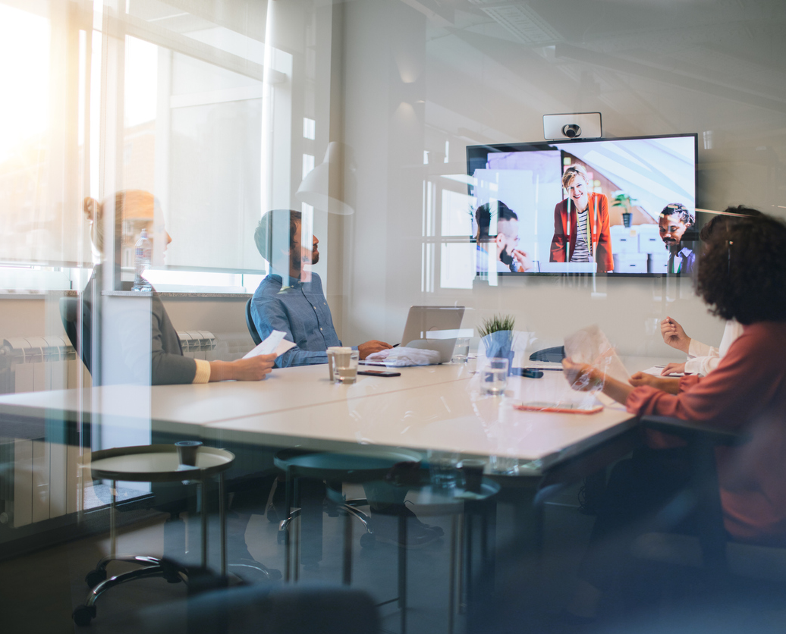
Things We Think To Be True.
Employer Goals:
Health and Safety
Flexibility
Collaboration
Engagement / Incentive
Productivity
Technology Enablement / Capability
Cost Management (Within Budget)

Slide 6
Essentials.
Solutions Must Be:
Essential – A Need To Have
Efficient – Cost + ROI
Adaptive / Flexible – Something that works today AND tomorrow
Effective – Solve Real World Challenges
Essentials:
Safety
Flexibility
Productivity

Slide 7
Lencore Pitch and Position.

Slide 8
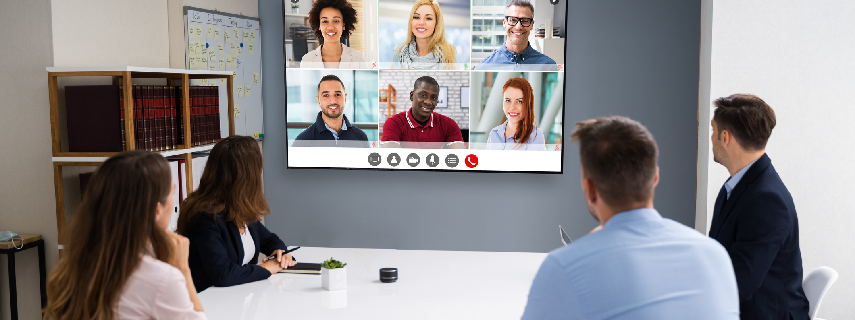
Lencore Pitch and Position.
The future of workplace environments may be uncertain. Our solutions are not.
Through Lencore's state-of-the-art sound masking and audio integration technology, we can engineer the perfect solution for in-office, remote and hybrid work environments.

Slide 9
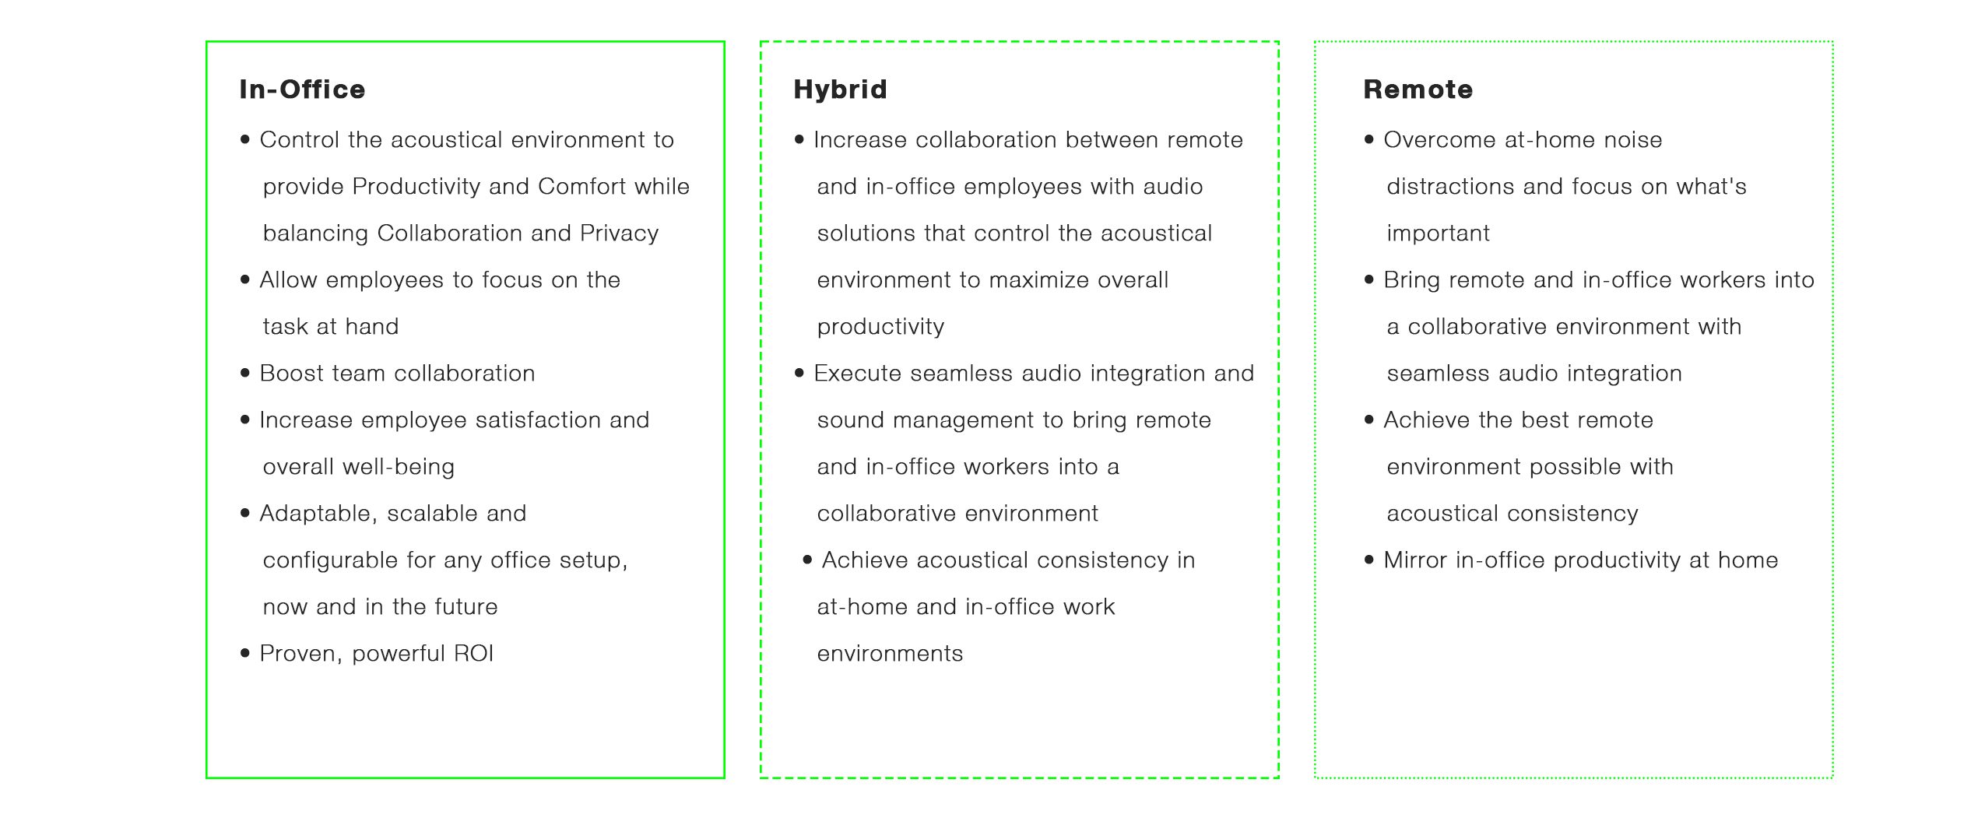
Lencore Pitch and Position.

Slide 10
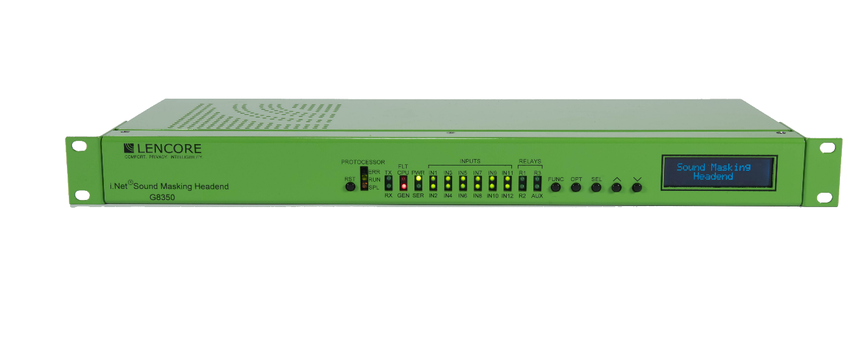
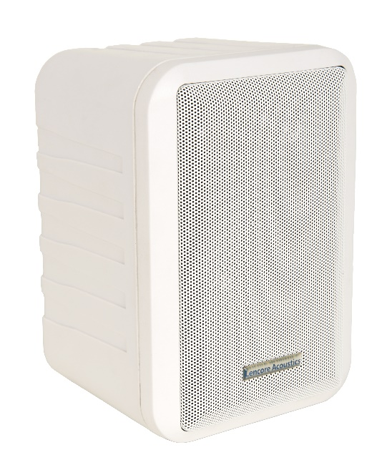
Lencore Pitch and Position.

Slide 11
Questions?

