Slide 1
Overview of Competitor System Types

Slide 2
System types
Centralized
Decentralized
Networked
Speaker Types:
In-Plenum
Direct-Fired

Slide 3
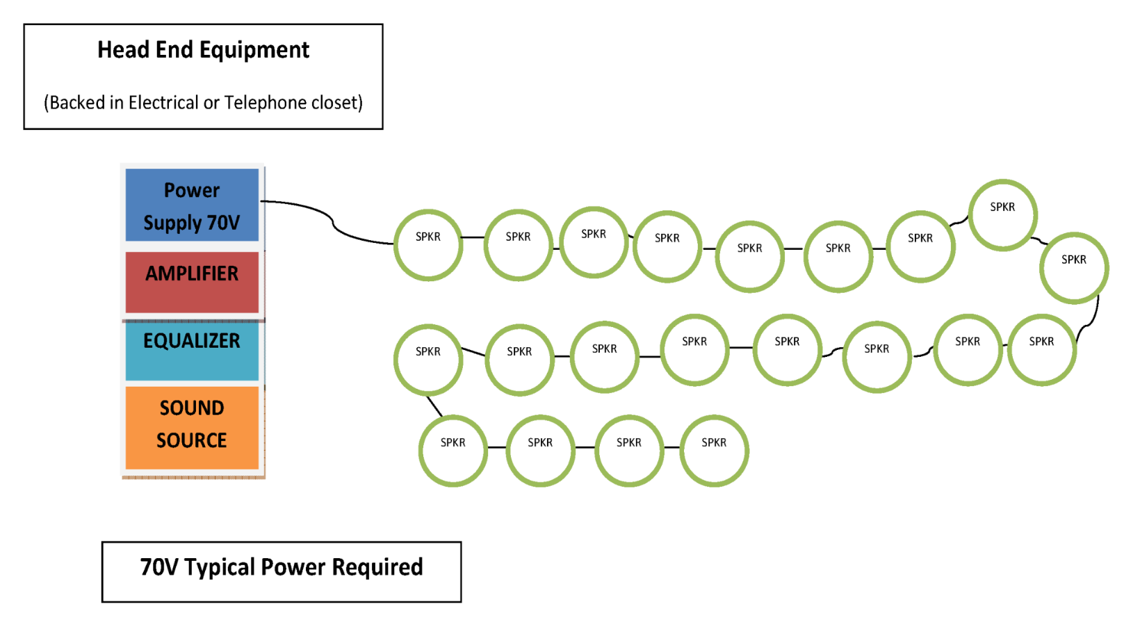
Centralized System
Notes:
Can be a Zoned 70V amp. No limit on number of speakers or wattage used so you could play music and page through the system.

Slide 4
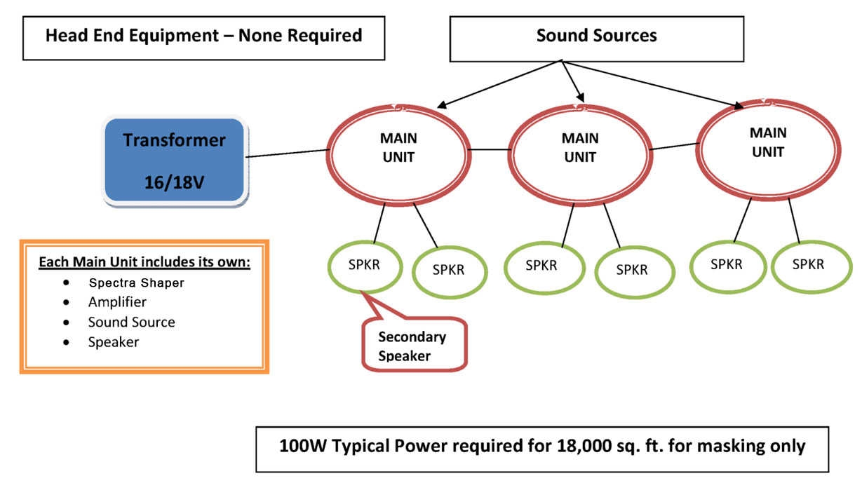
Decentralized System
Each Main Unit includes its own:
Amplifier
Sound Source
Speaker
Spectrum Shaper
Notes:
Decentralized systems. This system is very cost efficient for smaller spaces. All of the signal generation and amplification happens in the main units. As opposed to having a costly head-end driving a small number of speakers. This system does not have network control. It is analog system great for sound masking smaller spaces only. There are 3 transformers available.

Slide 5
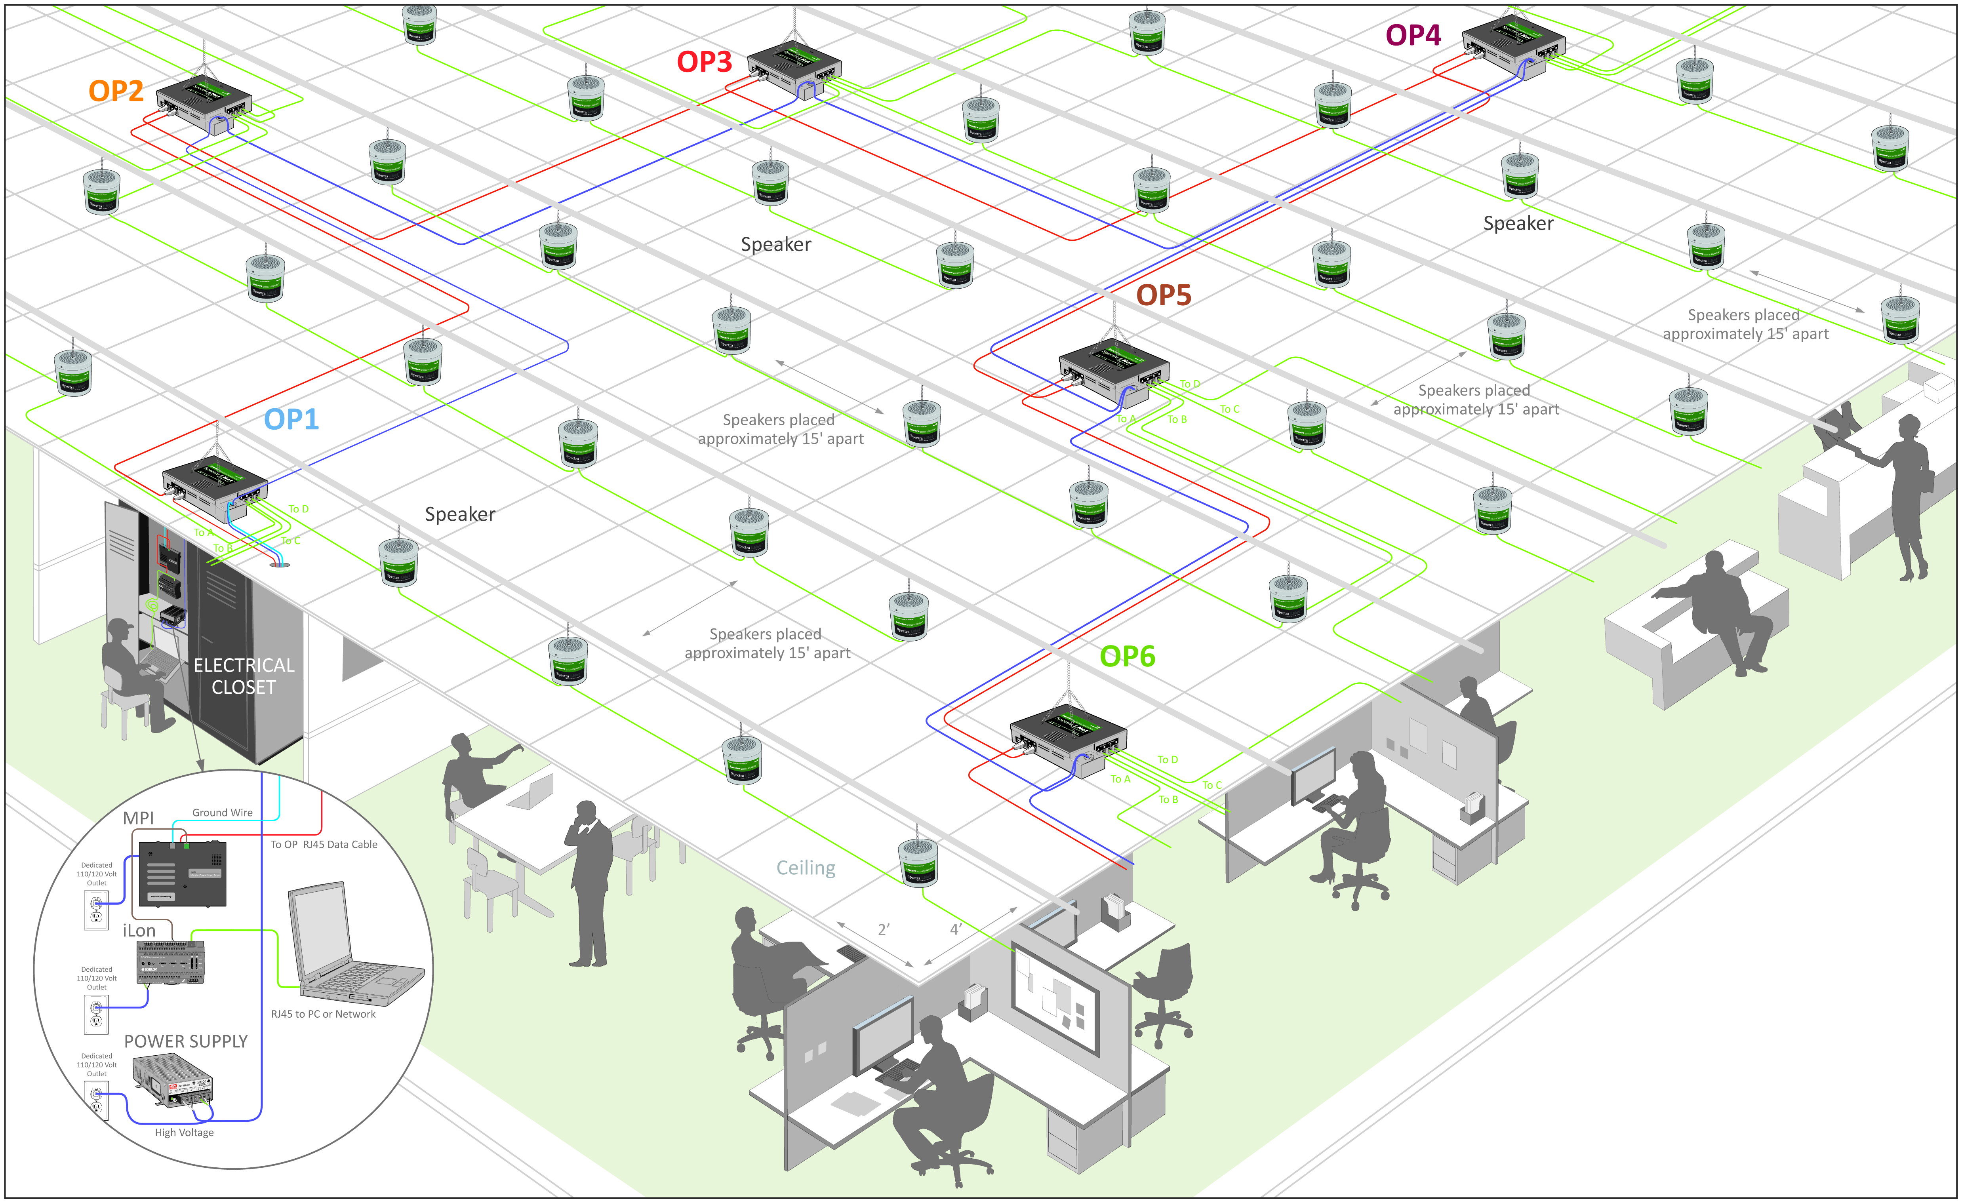
Networked System

Slide 6
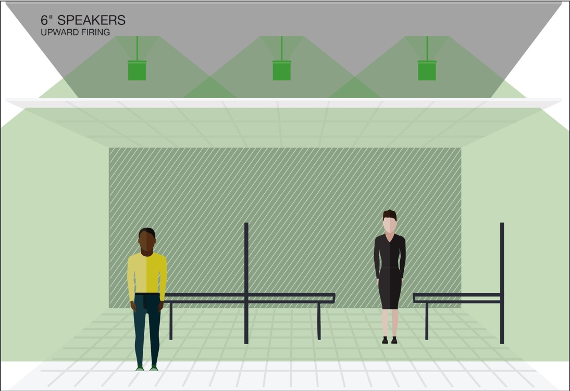
Speaker Orientation
In Plenum
(upward facing speakers)
Ceiling Tile
Notes:
In order to provide privacy and comfort, a quality sound masking system must be uniform and provide consistent coverage throughout a space, and have the ability to make incremental adjustments to achieve tolerances of +/- 1/2 dB.
This will ensure a uniform sound throughout with no hot spots (where sound is too loud) or cold spots (where sound is too low) and will enable you to achieve speech privacy and unobtrusive sound.
In this image, notice that the speakers in the plenum are projecting upwards. This type of placement must be used to achieve uniform coverage; conceptually similar to the way ambient lighting is projected upwards to achieve a more unified light dispersion and coverage.

Slide 7
Speaker Orientation
Direct Fired
(downward facing speakers)
Ceiling Tile
Notes:
Direct fired systems deliver sound directly into a space much like paging systems. These system are most useful when ceiling or site conditions prevent the use of an in-plenum speaker or for spot treatments in transitional spaces (such as pharmacies). Since the sound is so directional it is often less comfortable to listen to and not as uniform. It is important to note that if you use a direct fired system, the speakers must be placed much closer together than with conventional in plenum speakers. A typical formula is to place the speakers the same distance apart as the ceiling height.

Slide 8
Who are our competitors?

Slide 9
Sound masking competitors

Slide 10
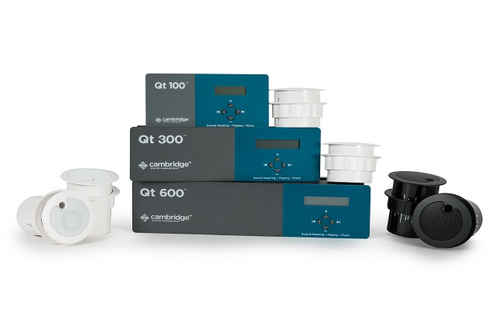
Biamp (Cambridge direct fired system)
Non-Networked System:
QT100 – 1 zone up to 120 speakers Up to 12,000sf (100 Square feet of coverage per speaker)
QT Pro Networked System:
QT300 – 3 zones up to 360 speakers. (120/zone) Up to 36,000sf Rack mounted
QT 600 –6 zones up to 720 speakers (120/zone) Up to 72,000sf Rack mounted

Slide 11
Cambridge Price Comparison

Slide 12
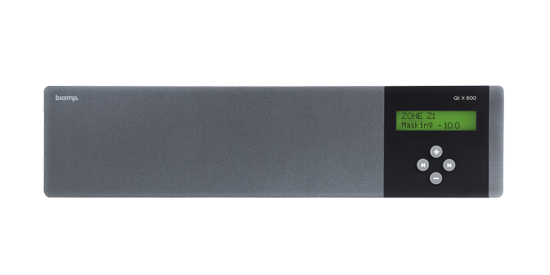
Cambridge Qt-X Systems
Cambridge QT-X Systems:
• Compatible with DynasoundPro™ loudspeakers • Supports up to eight zones • AVB or Dante (800/D) media network • Two audio inputs for paging and music • Adjustable equalizer for masking and audio inputs | • PoE+ Powered with optional 48V dc input • Auto-ramping • 5-year warranty • Event scheduling • Covered by Biamp Systems’ five-year warranty • Manufactured in the U.S.A.

Slide 13
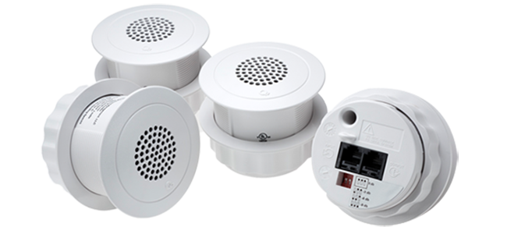
Biamp (Cambridge direct fired system)
Cambridge QT PRO Weaknesses:
Poor Sound quality.
Paging and music done through active system
Proprietary software or TCP/IP
Little customization as they have too many speakers per zone (up to 120)
Speakers are made in China
Only 5 Year Warranty
Uses twice as many speakers as in plenum design
Installation wiring not to code - is laying on tile
Installation timing an issue- product installed after furniture
Many tiles are handled, and holes cut every 100sf

Slide 14
Biamp Cambridge channels
Cambridge – QT PRO:
Markets through AV Dealers and Biamp Reps
They sell low voltage contractors through some Structured Cabling Reps side by side in some markets
Not sold through Distribution.
Steelcase (Confidante)
QT 100 self tunes volume of all speakers the same.(Up to 120 speakers). No customization
Shipping from West Coast Only.

Slide 15
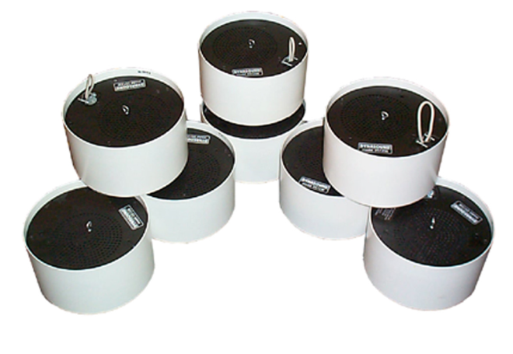
Biamp Dynasound Pro
FAQs:
Purchased by Cambridge in 2016
Now owned by Biamp
Usually sells central system (70 volt)
Has self contained unit but rarely sells it
Networked sound masking system that is individually addressable, rack mounted and uses POE
Has raised floor sound masking system (poor sound quality, ineffective masking)

Slide 16
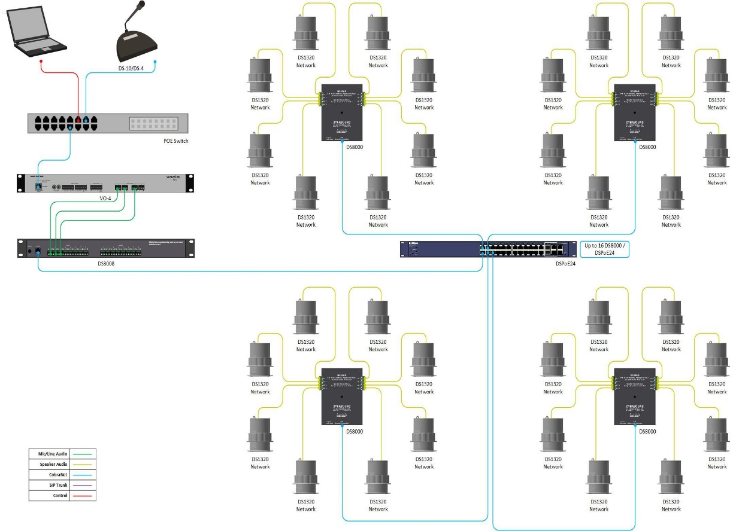
Biamp Dynasound Pro
Weaknesses:
Uses proprietary software to control masking and paging
Requires IP address for each platform-(8 speakers)
IT nightmare (ex. 400 speakers = 50 IP addresses)
Uses old Cobra Net technology with time delay issues.
Uses many Net Gear switches that are very unreliable
Paging underpowered using POE. Must add extra amplifiers
Only 5-year warranty

Slide 17
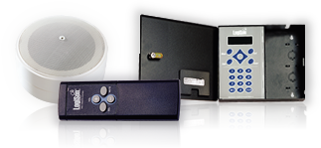
FAQs:
Sells Logison Acoustical Network
Target self tuning of their system
Security software for diagnostics and e-mail notification
Weaknesses:
Proprietary software
Proprietary cables
Many Components to system
Uses many IP addresses (one per control panel)
Point to point network (like Christmas tree)
5-year Warranty
Made in China and imported into Canada
Uncomfortable sound

Slide 18
LOGISON CHANNELS
Markets Direct through Archoustics dealer franchises throughout U.S. & Canada.
Targets architects to get specified and End Users
Has a few dealers that sell Logison but usually just pays them spiffs.

Slide 19
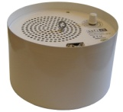
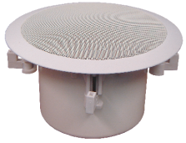
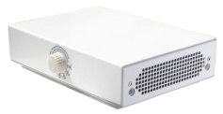
FAQs:
Made in Canada
Sold by MPS in U.S. and Direct Reps in 10 markets
MPS selling as private label under Voice Arrest
Sold in Canada by Canadian Office Acoustics – ON, Soft dB - QC
Acoustic Solutions-AB,BC, Atlantic Alarm Sound-NB
Has central system with 4 wattage taps on speaker to control volume
Has new networked system called SmartSMS-NET
Adjusts SM throughout the day based on the ambient sound in the room
Requires microphones in ceiling every 1000sf to measure ambient sound
Product and support from Canada

Slide 20
Weaknesses:
Volume changes very distracting-Sounds uncomfortable - Gimmick
Poor underpowered paging
Requires proprietary software on computer
Uses Wi Fi platforms that are not hard-wired with potential
Issues with network upgrades, servers going down
Potential conflict and interference issues
Multiple IP addresses needed (IP address for each platform)
IT nightmare tremendous time and effort needed to manage
Privacy issues with sensors (microphones) in ceiling
SOFT DB

Slide 21
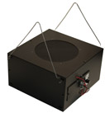
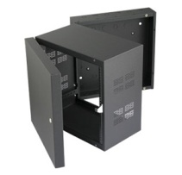
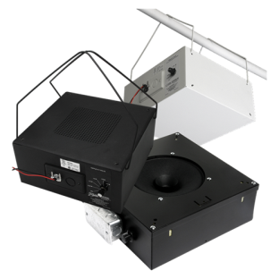
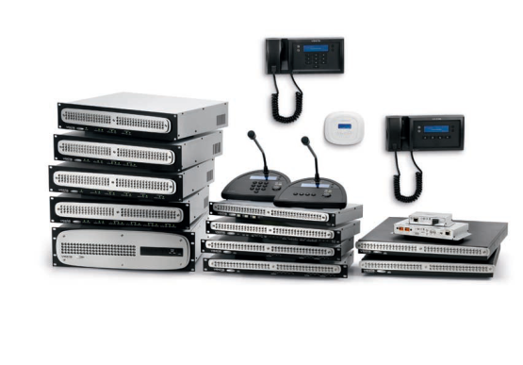
CENTRAL SYSTEMS
Has 70-Volt central system
Sold by AV dealers
1 Year Warranty
Speaker and parts supplier
Sells 70-volt central system
1-year warranty
AV Dealers, Consultants and Distribution
Very inexpensive
“Z-Series” All in One solutions
“Z-Series” 2 Zone and 4 Zone
Notes:
Centralized systems have poor sound quality due to tuning ability.

Slide 22
LENCORE COMPETITIVE ADVANTAGE
Quality of Sound
Available locally through distribution
Lencore has the UL 2572 listing needed to mute sound masking to comply with NFPA72 code
Only sound masking company to have this listing
Non-Proprietary System
Made in the USA
10 Year Warranty
Ease of installation

Slide 23
POSITIONING

Slide 24
QUALITY OF SOUND
It’s all about the quality of the sound
If the sound masking is annoying, they will lower the volume or shut it off
Lencore’s sound is the most comfortable in the industry

Slide 25
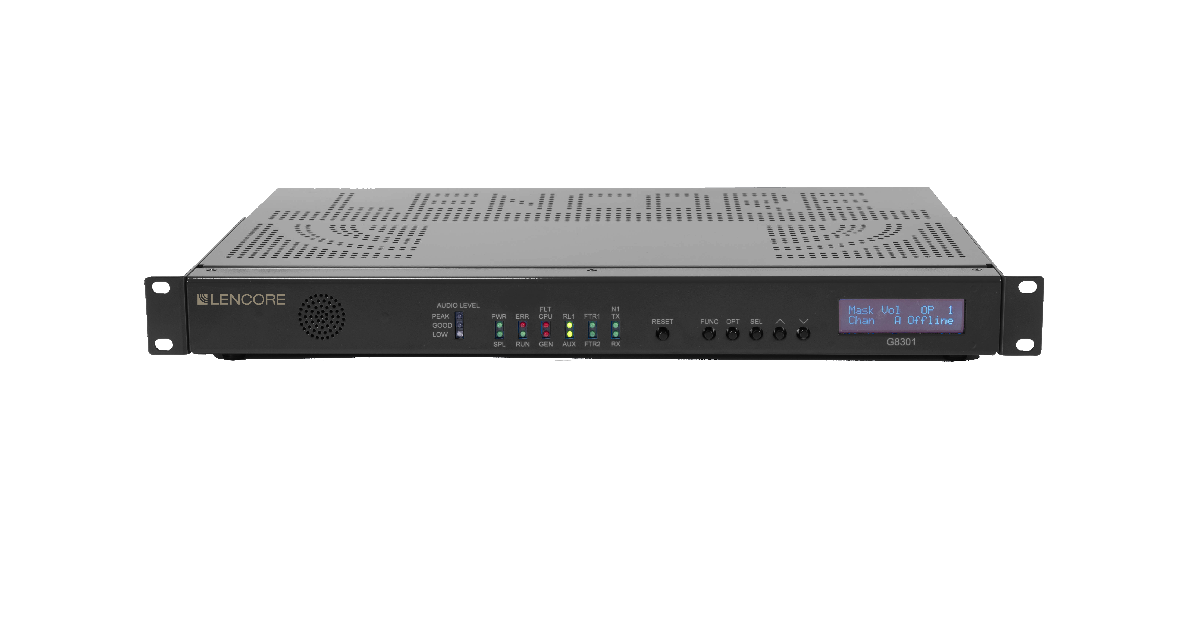
Lencore Systems
i.Net
Classic
Gold
Notes:
The Lencore systems that comply with NFPA72 and meet UL2572 requirements is our i.Net rack mount head end equipment.

Slide 26
CLASSIC
Self Contained system that can generate sound masking, paging and music
Positioned for small projects less than 24 speakers
When clients want paging on a smaller project

Slide 27
GOLD
Positioned for spaces up to 7,000sf direct fired, 12,000sf in plenum
i.e., Doctor’s / Dentist’s Office / NOT Expandable
1 RU Rack / Wall Mountable Easily Adjusted
Front of Panel / System Manager

Slide 28
I.NET
Positioned for large projects of up to 1,500,000 Sq Ft Multi-floor projects / 255 Zone Networked Solution
When clients want sound masking, paging & music
99 paging zone capacity
Has the UL 2572 listing and complies with NFPA 72 Code

Slide 29
MOST IMPORTANT POSITIONING CRITERIA BY COMPETITOR
Atlas – Price. Cheapest components in market
Biamp Cambridge – Speakers facing downwards
Biamp Dynasound – Individual speaker controllability
Logison – No more than 3 speakers per channel/zone
Soft dB – Need to raise and lower volume based on volume of sound in the space

Slide 30
Contractors - Buying Commscope, Belden, Superior Essex vs General Cable or Hitatchi
Furniture Dealers – Buying systems furniture from Steelcase, Herman Miller vs Compatico or Friant
AV Dealers – Buying Shure microphone vs Samson
End User – Staying at Marriott Hotel vs Motel 6 or Super 8
EFFECTIVE POSITIONING ANALOGIES

Slide 31
Questions?

