Slide 1

Sound Masking for the Redesigned WorkSpace
Notes:
SOUND MASKING HAS TO BE COMORTABLE

Slide 2
What We’ll Cover
What is sound masking and how does it work
Key Elements
A,B,C’s of Acoustics
COVID-19 and the future office space
Sound masking as a solution
Notes:
SOUND MASKING HAS TO BE COMORTABLE

Slide 3

Sound Masking by Definition
Sound masking is the addition of an unobtrusive background sound, like airflow, or waves on a beach. This reduces the intelligibility of human speech and reduces distractions.

Slide 4

WHAT IS SOUND MASKING?

Slide 5

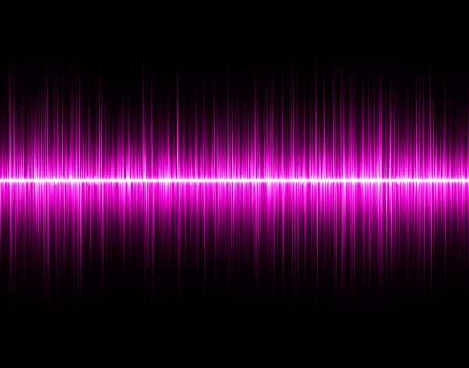
Green Sound™
A unique, custom-tailored sound innovated to be the most COMFORTABLE in the industry. Neither White nor Pink.
White Noise
An equal level of energy at all frequencies - sounds like static
Pink Noise
An equal level of energy at all octaves – more bass - warmer
Notes:
We call it Green Sound
It is a combination of White and Pink noise that the installer has the ability to adjust for the specific space they are in.

Slide 6
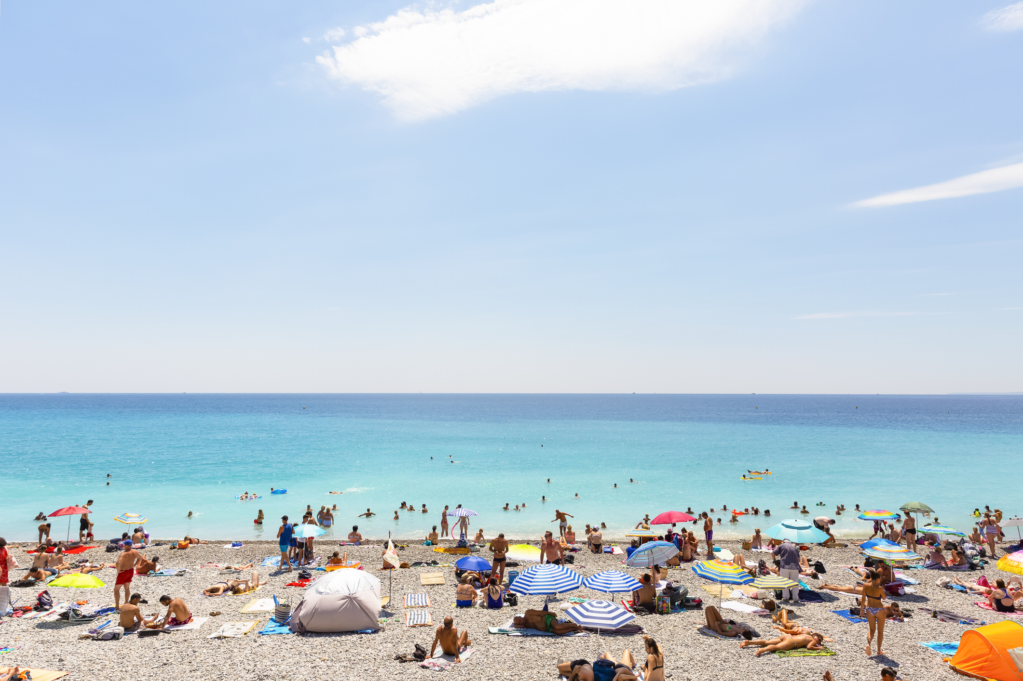
WE HAVE ALL EXPERIENCED SOUND MASKING BEFORE

Slide 7

What is Speech Privacy
Notes:
SOUND MASKING HAS TO BE COMORTABLE

Slide 8

Distraction
Notes:
SOUND MASKING HAS TO BE COMORTABLE

Slide 9

Key Elements: Comfort

Slide 10

SOUND MASKING MUST BE COMFORTABLE
Sound Masking has to be comfortable to work under in an office environment OR it will simply just be turned off.
Notes:
Sound Masking has to be comfortable to work under in an office environment it will simply just be turned off.
Lencore has engineered the best sound masking signal on the market.

Slide 11

5 Criteria for Comfort: #1
Broadband Sound
65hz – 13Khz

Slide 12

5 Criteria for Comfort: #2
Good Wrap Around
No noticeable repeat

Slide 13

5 Criteria for Comfort: #3
Multiple Noise Sources
Randomness is relaxing

Slide 14

5 Criteria for Comfort: #4
Uniformity of Sound
      +/- dB

Slide 15

5 Criteria for Comfort: #5
Tuning Flexibility
Easily adjusted for privacy and comfort

Slide 16
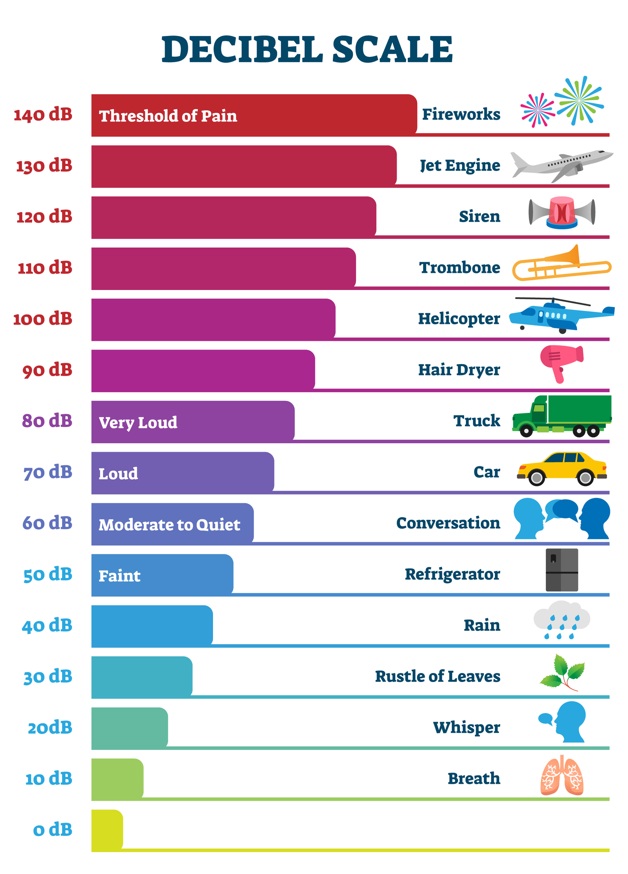
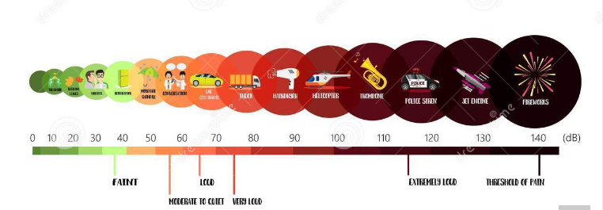
Sound Level: Comparing Common Noises to Sound Masking
Ambient – Relates to the immediate surrounding of something as light, temperature, & sound.
Decibel - are the measurement of the intensity of all frequencies , as a frequency is increased in intensity the dB level increases

Slide 17
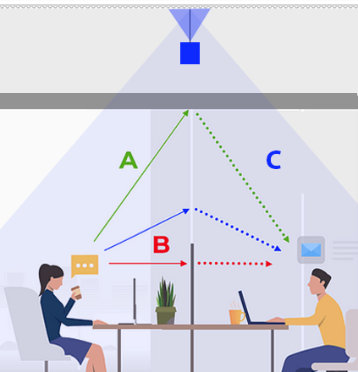
The A,B,C’s of Acoustics
Absorb
Block
Cover

Slide 18

Cover
Covering sound

Slide 19
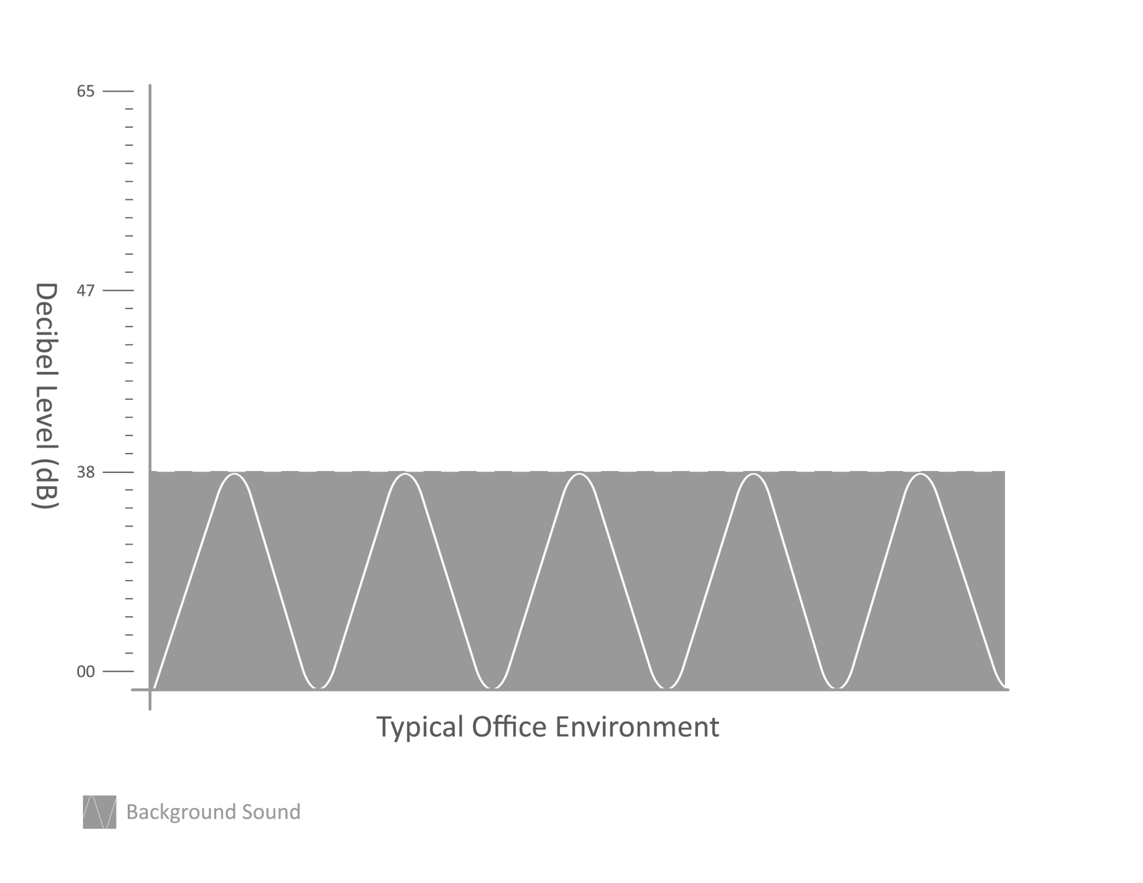
How sound masking works

Slide 20
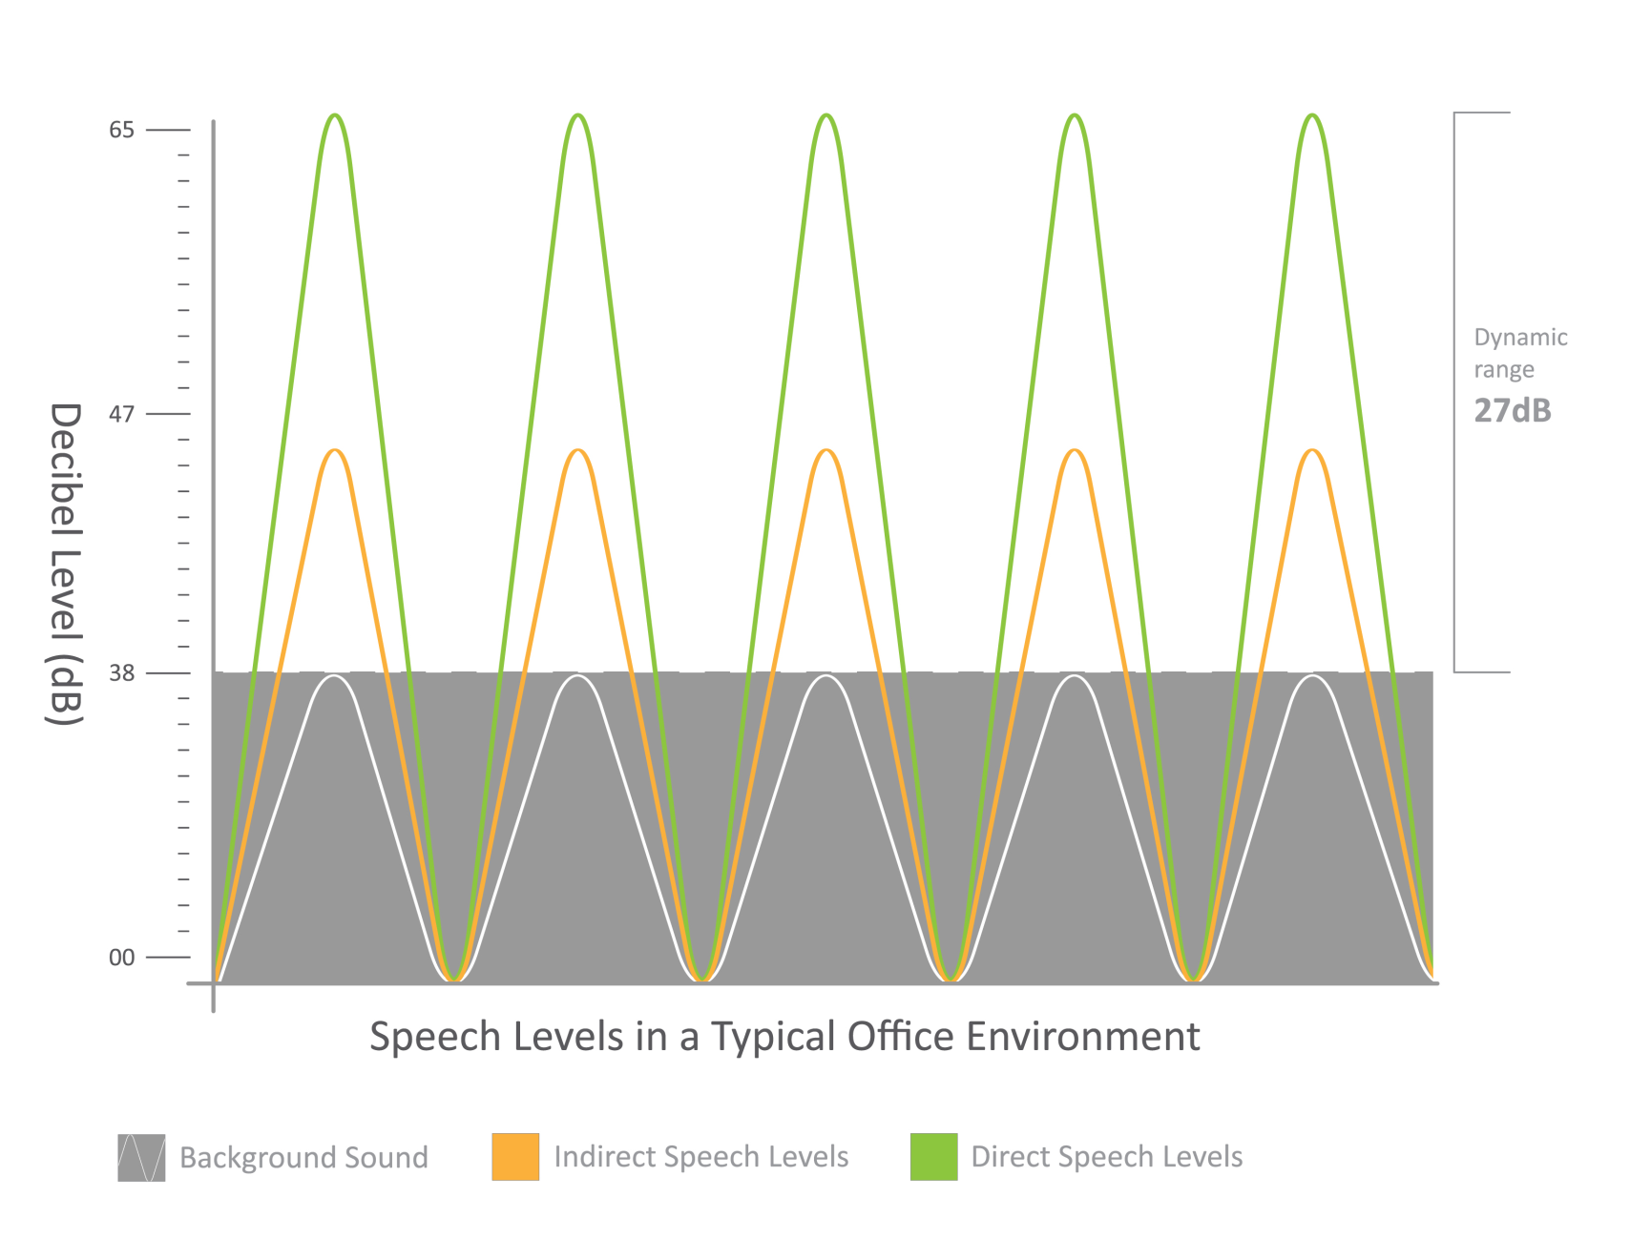
How sound masking works

Slide 21
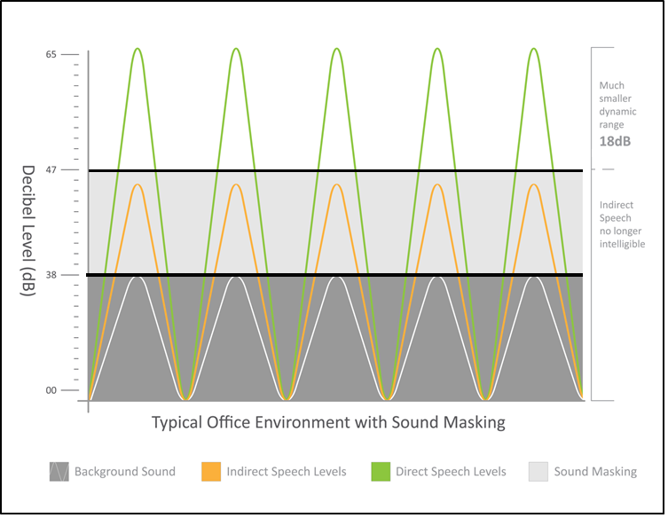
How Sound Masking Works

Slide 22

Let’s look at the current office space
Why is there a need?

Slide 23
COVID-19: Types of changes Leaders have made, or plan to make in the physical workspace:
84% - Physical separation of workstations
69% - Install physical barriers between workstations
41% - Change surface materials to antiviral
Source: Mckinsey & Company: How US Companies are planning for a safe return to work

Slide 24

Open Office

Slide 25
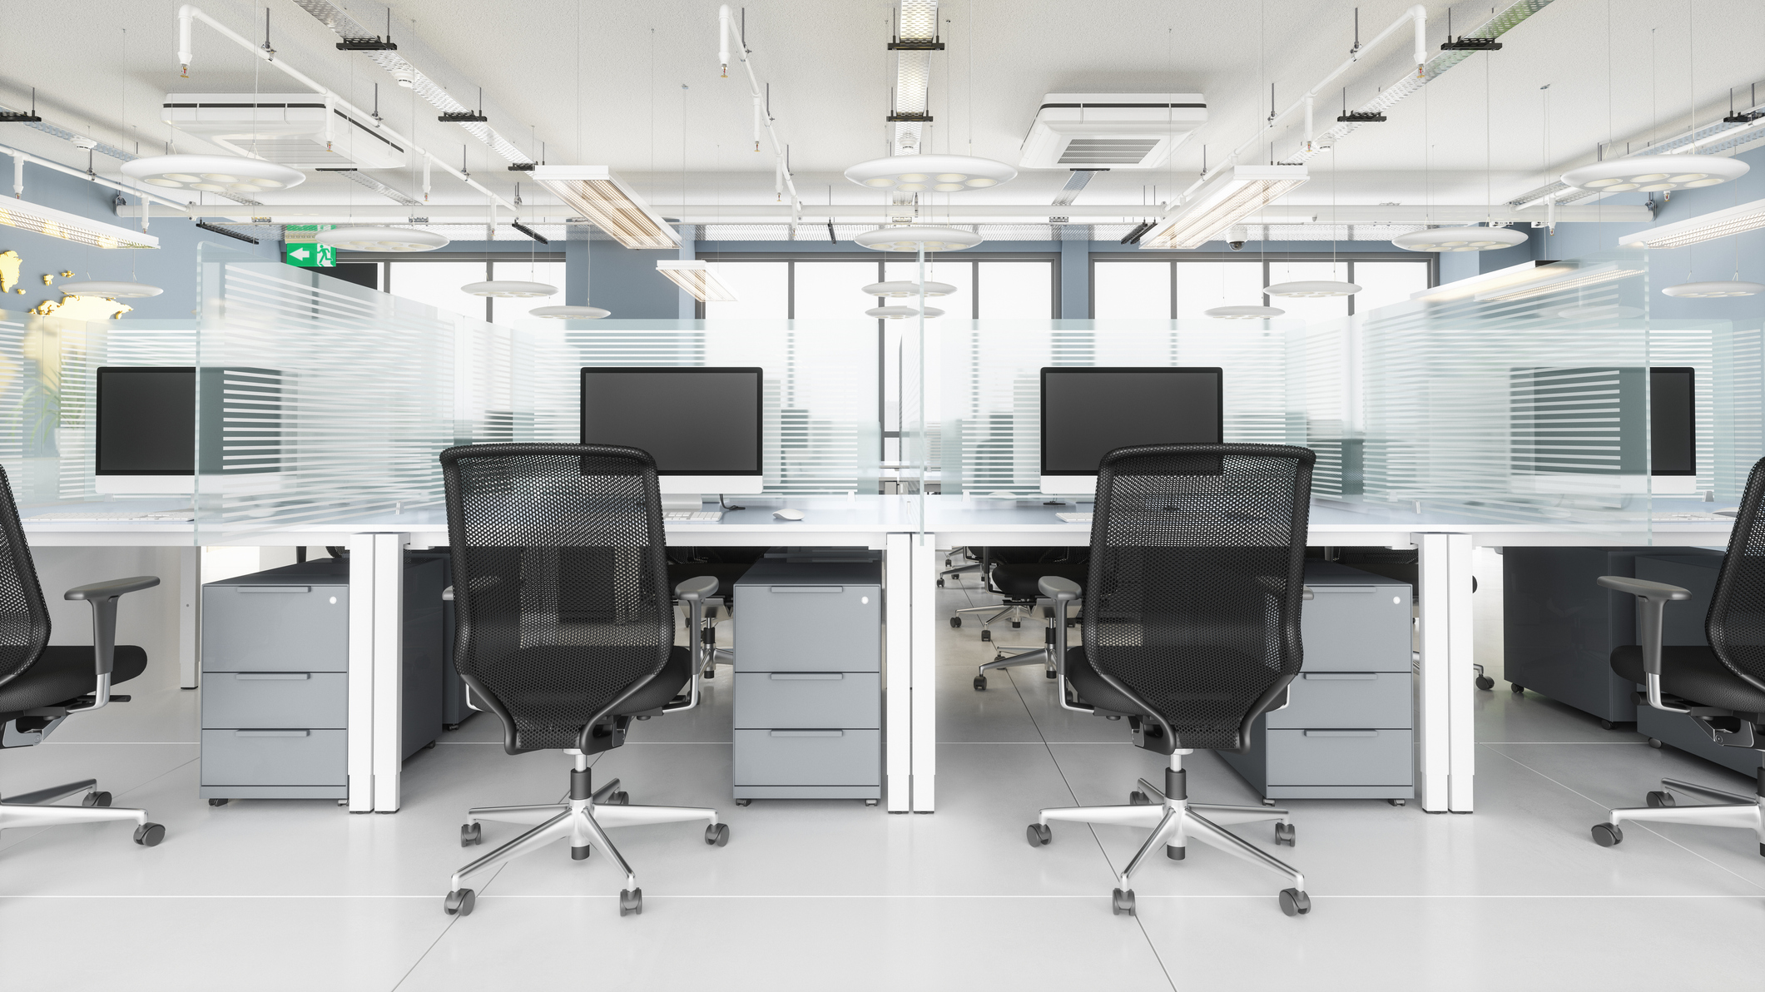
Traditional Office

Slide 26

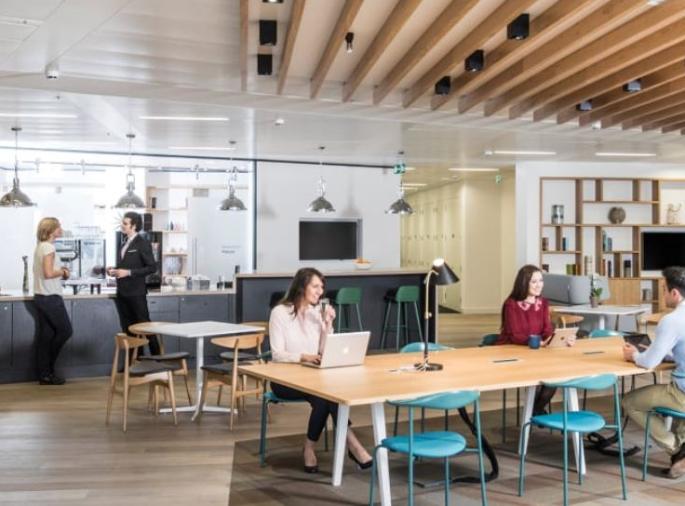
Reimagined Workspaces
Sound Masking allows collaboration to happen in small groups within the same space

Slide 27

How Sound Masking Can Help the Workplace

Slide 28
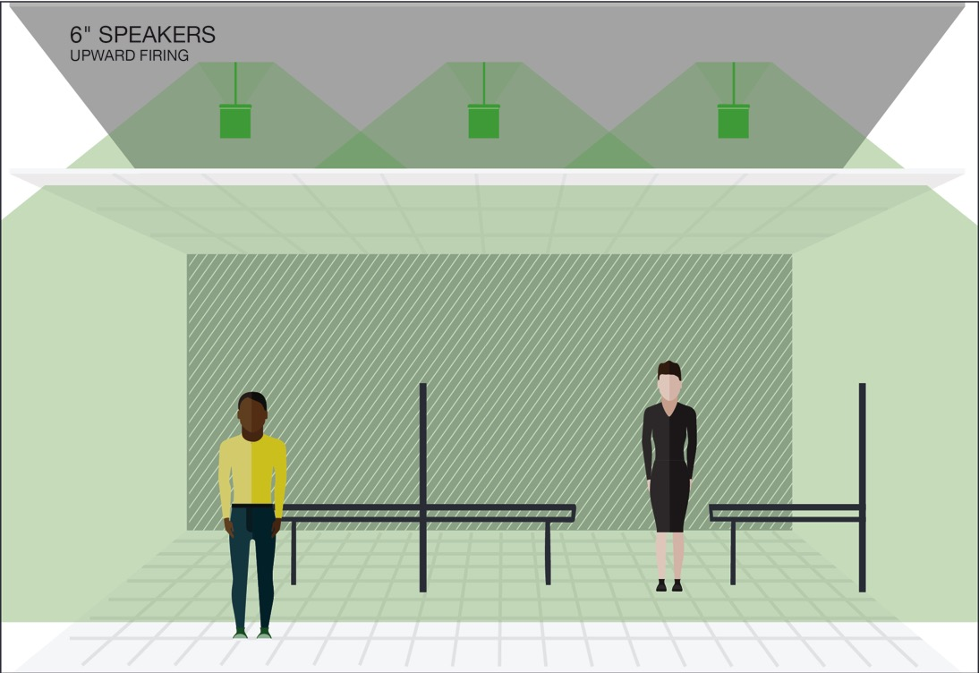
Sound Masking Coverage
In Plenum
(upward facing speakers)
Ceiling Tile

Slide 29
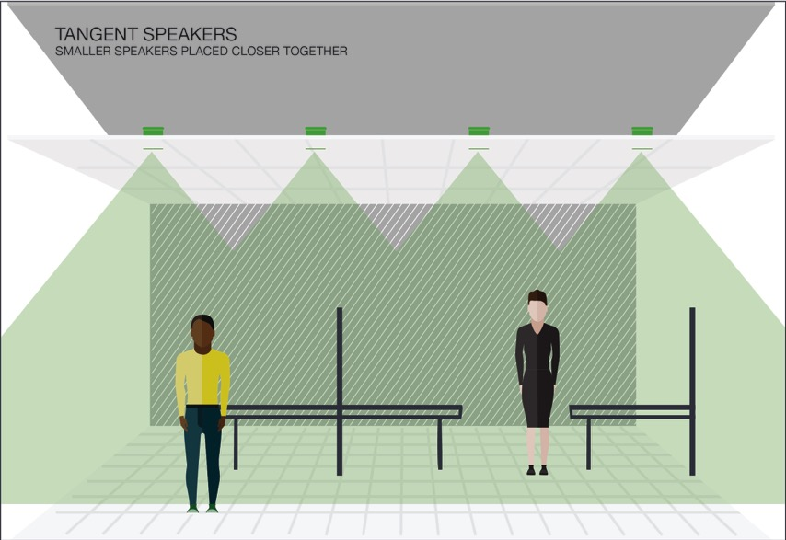
Sound Masking Coverage
Direct Fired
(downward facing speakers)
Ceiling Tile

Slide 30
Lencore Solutions
i.Net - Networked System
Gold - Stand Alone Networked System
Classic - Distributed Non-Networked System

Slide 31
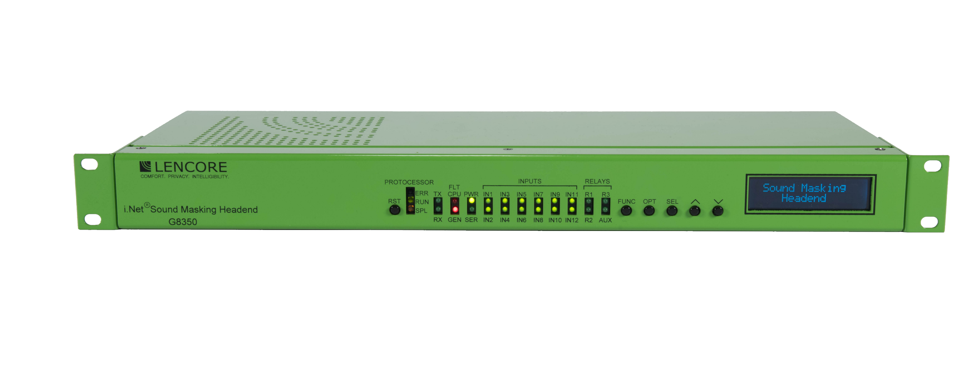
i.Net
Networked Solution

Slide 32

KNOW THE CODE!
Sound Masking Shutdown Sequence

Slide 33
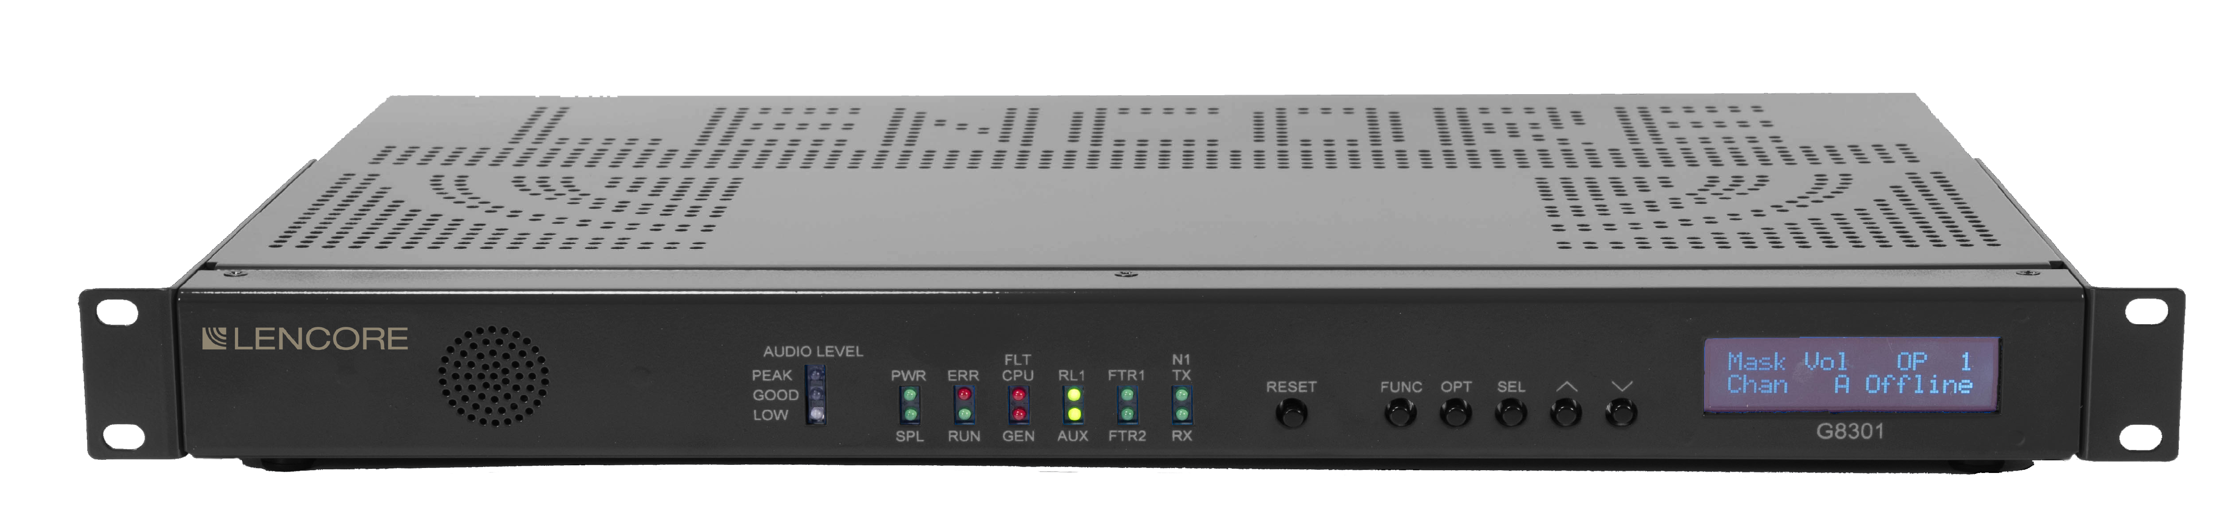
A1U Stand Alone Masking
Two (2) Operating Platforms
8 independent channels
Total of 64 speakers
One (1) Audio Source Input
Up to 12,000 square feet of coverage in a 1RU Rack Device

Slide 34
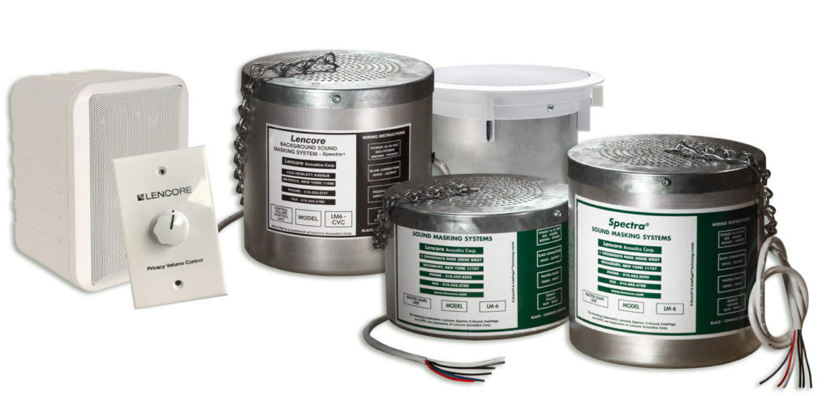
NON-NETWORKED SOUND MASKING
CLASSIC

Slide 35

It’s Not Just for Offices
Healthcare
Finance
Call Centers
Government
Legal
Finance
Hospitality

Slide 36
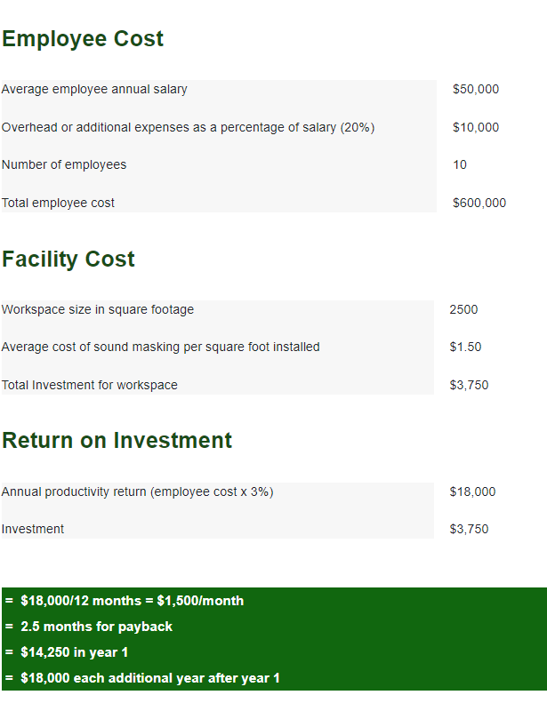
ROI

Slide 37





Thank You for attending
516.682.9292
info@lencore.com
www.lencore.com

