Slide 1
Lencore Acoustics LLC
Comfort. Privacy. Productivity

Slide 2
Agenda
About Us
Our Story
Mission
Values
Solutions
Competitive Advantage
Intro to Sound Masking
Sounds used in Sound Masking
The A,B,C’s of Acoustics
How sound masking works
Solutions
Industry verticals
Product portfolio

Slide 3
Our Story
Founded in 1990
Parent Company: Emmis Corporation
Corporate Offices: Huntington NY
Manufacturing offices: Indianapolis, IN
Products: Made in the USA

Slide 4
Mission
To engineer comfortable, private and productive environments through superior products with a commitment to outstanding service

Slide 5
Our Value Proposition
Lencore empowers businesses to create essential workspaces no matter where they are or how they work. Our solutions are comfortable, collaborative and productive all while adding a sense of privacy in open environments.

Slide 6
Values
We share a sense of values and commitments to our customers, our teams, and to each other. In that spirit, we are all responsible and accountable to:
Strive for excellence in all we do
Design and provide the industry’s best products
Take ownership of our customers’ problems and solve them
Communicate openly, share information, and invest in developing our people

Slide 7
Solutions
Sound Masking & Noise Management
Music, Audio & Paging
Speakers
Lencore’s portfolio of products provides a solution for any application, regardless of size, scope or budgetary requirement

Slide 8
Competitive Advantage
System Design
Quality of Sound
Customer excellence

Slide 9
OUR POSITION
The future of workplace environments may be uncertain. Our solutions are not.
Control the acoustical environment to provide productivity and comfort while balancing collaboration and privacy
Allow employees to focus on the task on hand
Boost team collaboration
Increase employee satisfaction and overall well-being
Adaptable, scalable and configurable for any office setup, now and in the future
Proven, powerful ROI
Increase collaboration between remote and in-office employees with audio solutions that control the acoustical environment to maximize overall productivity
Execute seamless audio integration and sound management to bring remote and in-office workers into a collaborative environment
Achieve acoustic consistency in at-home and in-office work environments
Overcome at-home noise distractions and focus on what’s important
Bring remote and in-office workers into a collaborative environment with seamless audio integration
Achieve the best remote environment possible with acoustical consistency
Mirror in-office productivity at home
IN-OFFICE
HYBRID
REMOTE
Notes:
Through Lencore's state-of-the-art sound masking and audio integration technology, we can engineer the perfect solution for in-office, remote and hybrid work environments.

Slide 10
Solutions
Noise Management
Productivity & Focus
Audio & Speech Privacy
Music, Paging & AUDIO
Notes:
Sound Masking works because:
It provides Speech privacy
It minimizes the dynamic range of speech thus reducing distractions.
It increases comfort in the space and improves worker productivity.

Slide 11
WE HAVE ALL EXPERIENCED SOUND MASKING BEFORE

Slide 12
Sound Masking by Definition
Sound masking is the addition of an unobtrusive background sound, like airflow, or waves on a beach. This reduces the intelligibility of human speech and reduces distractions.
Notes:
We will use the term distraction a lot in this presentation. The specific use of sound masking is to reduce distractions from conversation and create a more comfortable work environment.

Slide 13
Types of Sounds Used in Sound Masking
Green
Green Sound is a proprietary noise that consists of a unique blend of white and pink noise that we have been innovating for 30+ years
White
White Noise: an equal level of energy at all frequencies, very similar to static on a TV set
Pink
Pink Noise: an equal level of energy at all octaves - more bass – warmer
Notes:
Lencore uses a custom engineered sound we have trade marked “Green Sound” this was developed exclusively by Lencore to have the most comfortable Sound Masking signal in the industry.
It is an engineered combination of White and Pink noise that the installer or user has the ability to adjust for the specific space they are in.
With All the “Calm” commercials I am seeing on TV (even during the Superbowl) there is a lot of focus on different colors of sound or types of sound. And for personal use whatever works for you is fine (Brown, Pink, Biophilic) whatever!!!
But when it comes to Sound Masking in the workspace a little more science needs to be involved. It is the energy of White Noise that interferes with Speech. So, some white noise needs to be present to effective mask speech.
In audio, noise signals are divided into colors according to their frequency spectrum. This happens because noise running at different frequencies is perceived differently. Different types of noise have unique properties and can be used for relaxation and other therapeutic purposes. colored noise such as white, pink, and brown noise can be defined as a random sound signal playing at a constant spectral frequency. Each color of noise has a particular density.
Both light and sound are made of waves that can be perceived by the human brain. It’s our perception of light that allows us to discern that the color red is different from the color green (for example). The same concept applies to colored noise. Just like Pink is determined by the frequency of light waves, Pink noise is determined by the frequency of sound waves.

Slide 14
Let’s look at the current office space. Why is there a need for Sound Masking?

Slide 15
Sound Masking allows collaboration to happen in Small Groups Within The Same Space

Slide 16
The A,B,C’s of Acoustics
Notes:
There are three tools we use to achieve good room acoustics 1) Absorb, 2) Block 3) Cover

Slide 17
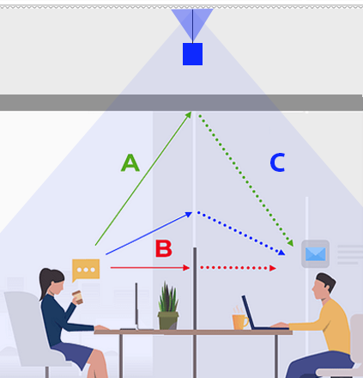
Absorb, Block, Cover
Notes:
Acoustical efficiency is determined by how well a particular space absorbs, blocks and covers sound.
Most absorption takes place at the ceiling, walls, or partitions. Typically, fabric covered acoustical panels are used to absorb sound.
Most blocking of sound also takes place at the ceiling, walls, partition heights.
Covering of sound is done with sound masking.

Slide 18
Cover
Covering sound
Notes:
Active sound masking deals directly with Covering sound to reduce distraction. That is where Lencore comes in. We Actively cover sound with Our Sound Masking Systems.

Slide 19
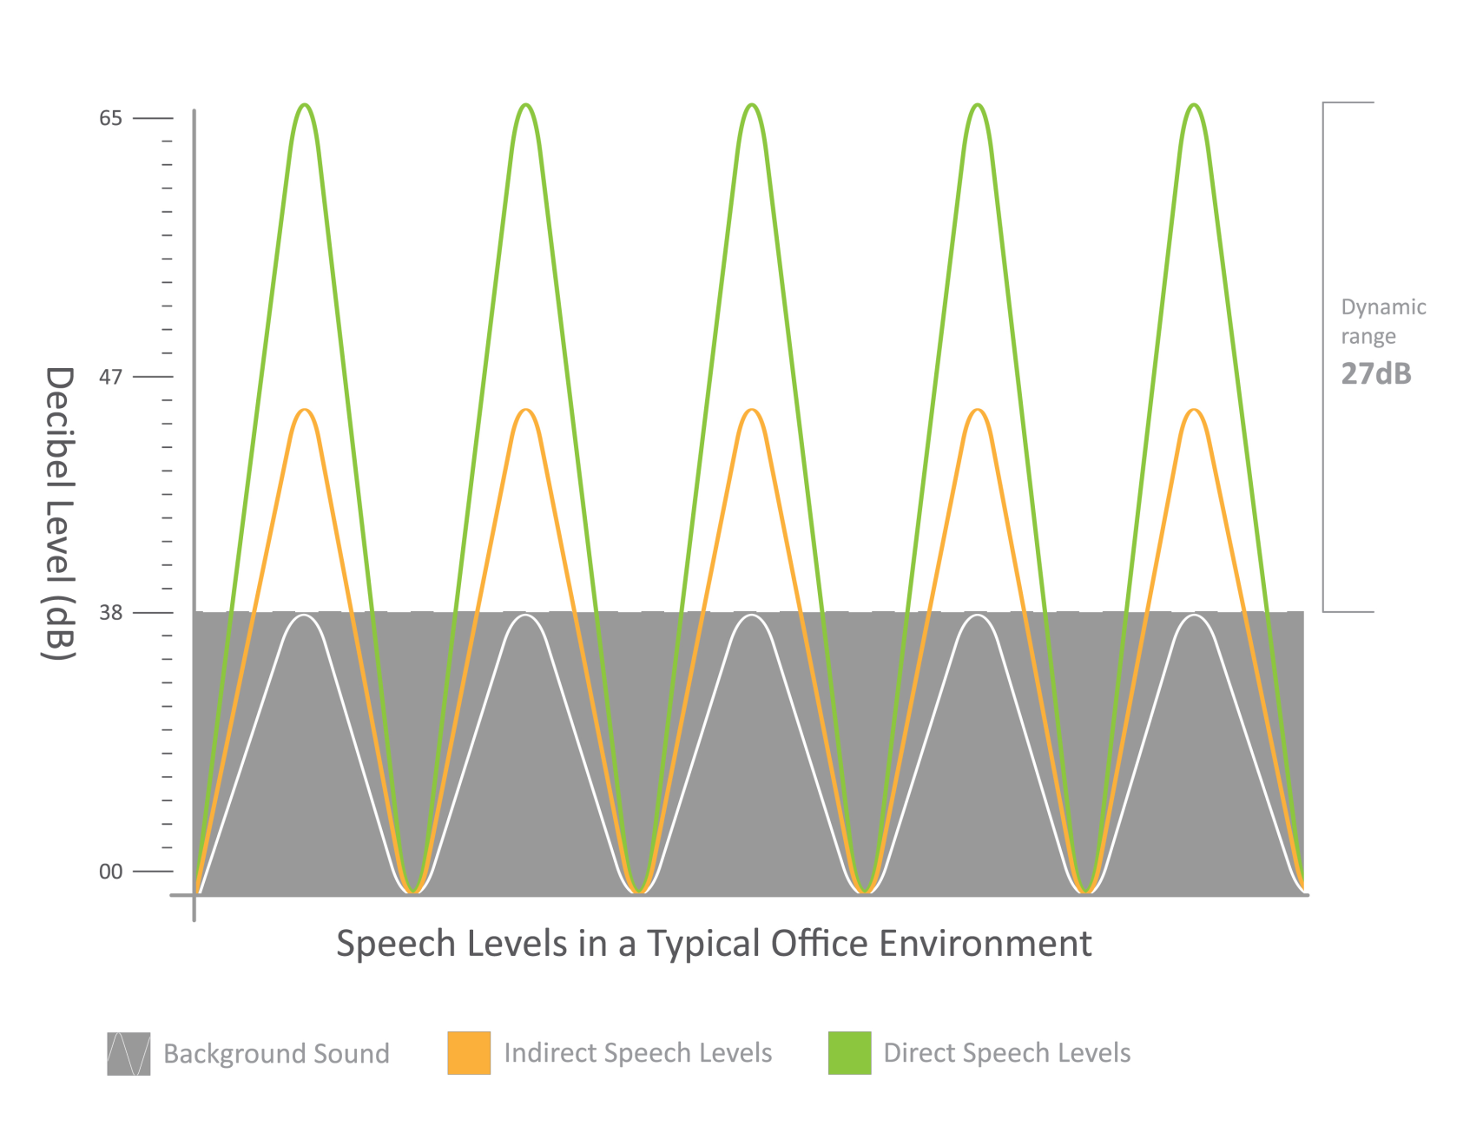
How sound masking works
Notes:
The following Graphs will help to paint the picture of how Sound Masking works in an office. If you were to measure sound with a decibel meter in an empty office, you would see somewhere around 38 decibels.

Slide 20
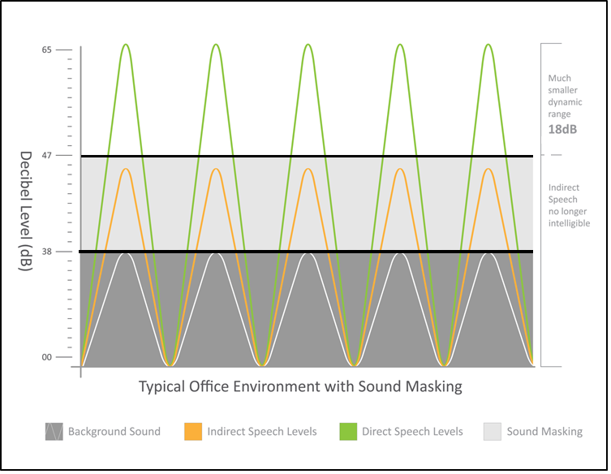
How sound masking works
Notes:
When you add people into the space it looks dramatically different. You have two different types of speech Direct Speech between 60 – 65 decibels (IN GREEN).
And indirect speech ( IN ORANGE) somewhere around 45 decibels which is conversation at distance. Both of these contribute to the decibel level in the space.

Slide 21
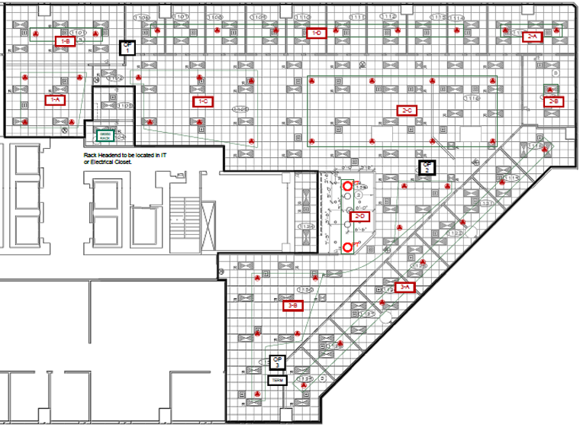
Option 1
Direct Speech Impact, 40 feet
Notes:
If you apply this to an office layout, the outer ring shows a 40 FEET area. Although social distancing guidelines will reduce the number of people in a space, Al will still disrupt and distract anyone within 40 feet (inside the circle) while talking in a normal tone.

Slide 22
Option 1
Direct Speech with Masking, 10-12 feet
Notes:
The outer ring shows a 40 FEET area. With sound masking, AL will disrupt less people in the same space (black ring) while talking in a normal tone.

Slide 23
Speech Without Sound Masking
Option 2
65dB
40 Foot
Notes:
To look at this a different way we will use an illustration. A normal voice in an office with an Ambient background level of 38 dB, Al will be heard and understood at 40 FEET. 40 Feet he will be clearly understood!!!

Slide 24
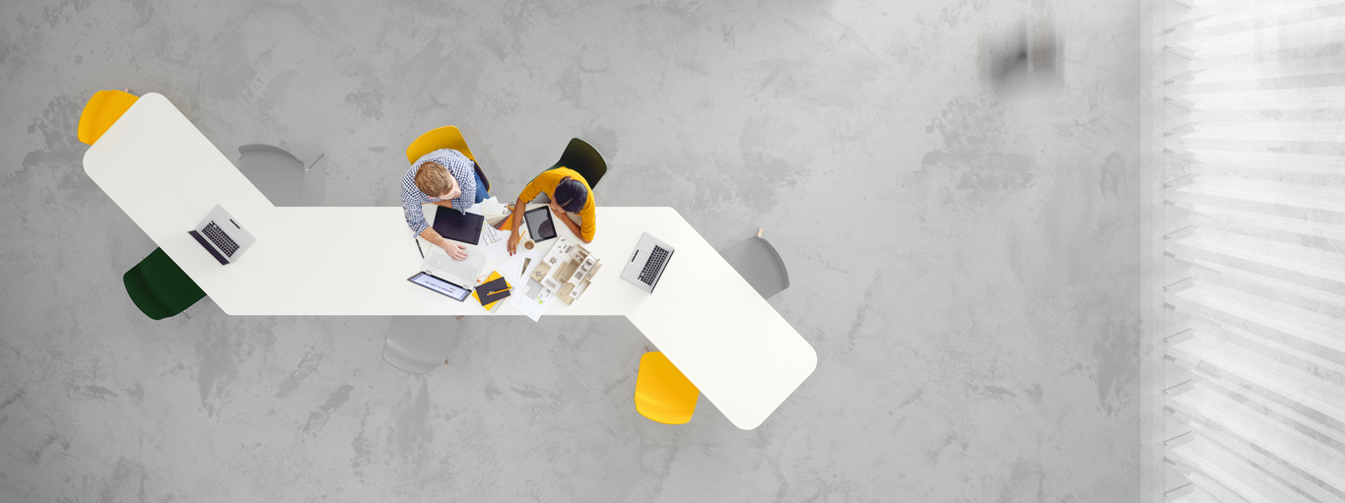
Speech With Sound Masking
Option 2
65dB
8-10 Foot Average
Notes:
So looking at the illustration again with sound masking the affected area is reduced to about 10 feet.

Slide 25
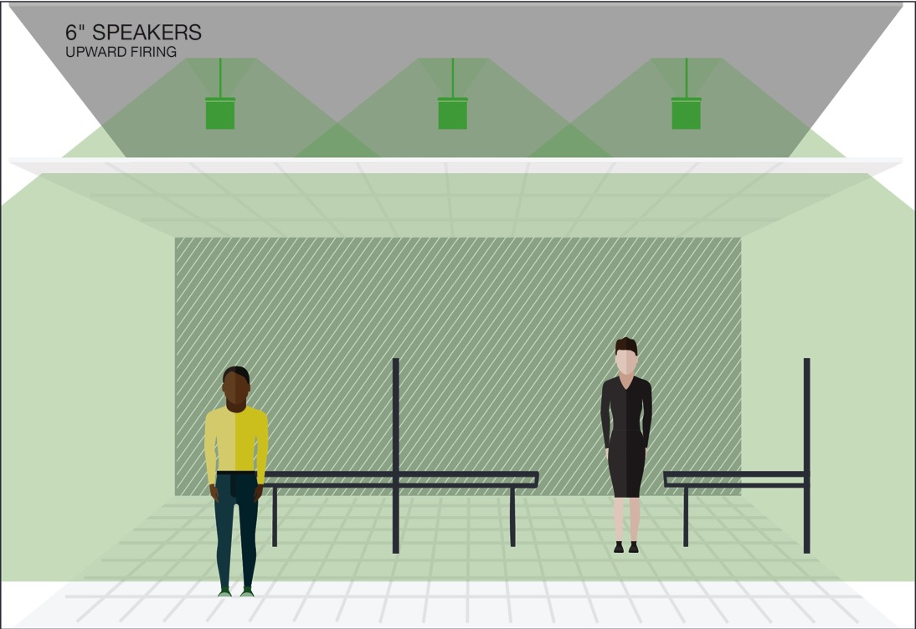
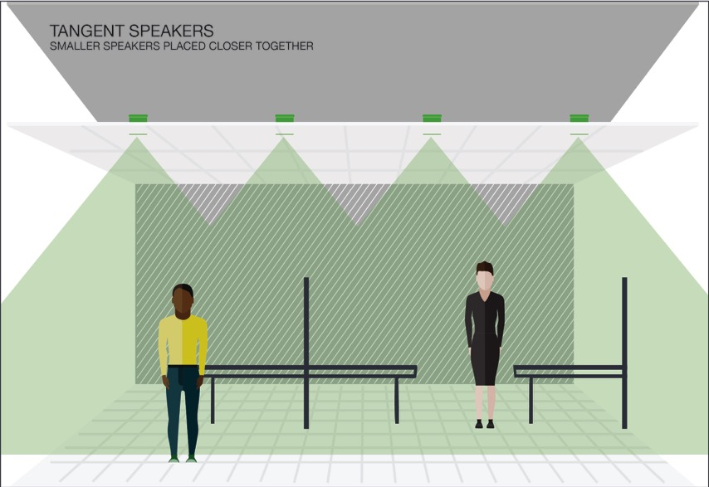
Sound Masking Coverage
In Plenum
(upward facing speakers)
Direct Fired
(downward facing speakers)
Ceiling Tile

Slide 26
SOUND MASKING WORKS BECAUSE:
It provides speech privacy.
It minimizes the dynamic range and increases comfort.
It will also improve the performance of your space.
Notes:
Sound Masking works because:
It provides Speech privacy
It minimizes the dynamic range of speech thus reducing distractions.
It increases comfort in the space and improves worker productivity.

Slide 27
Industry Verticals
Corporate Office
Healthcare
Government & Military
Legal & Financial
Call Centers & Open Floorplans
Hospitality & Retail

Slide 28
Product Offerings
Enterprise Networked
Small to Midsized Facility Networked
Non-Networked + Small Spaces

Slide 29
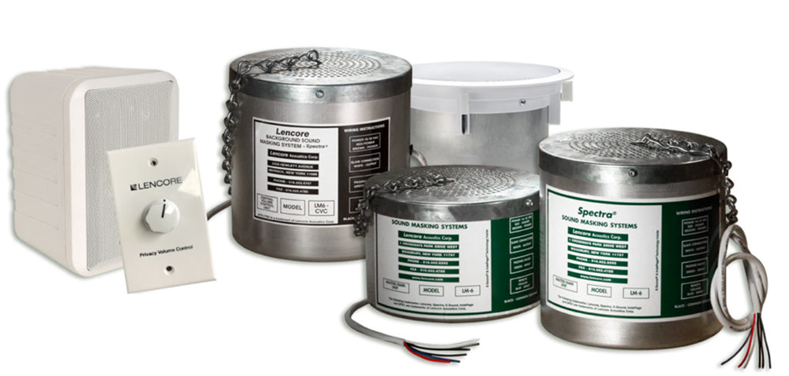
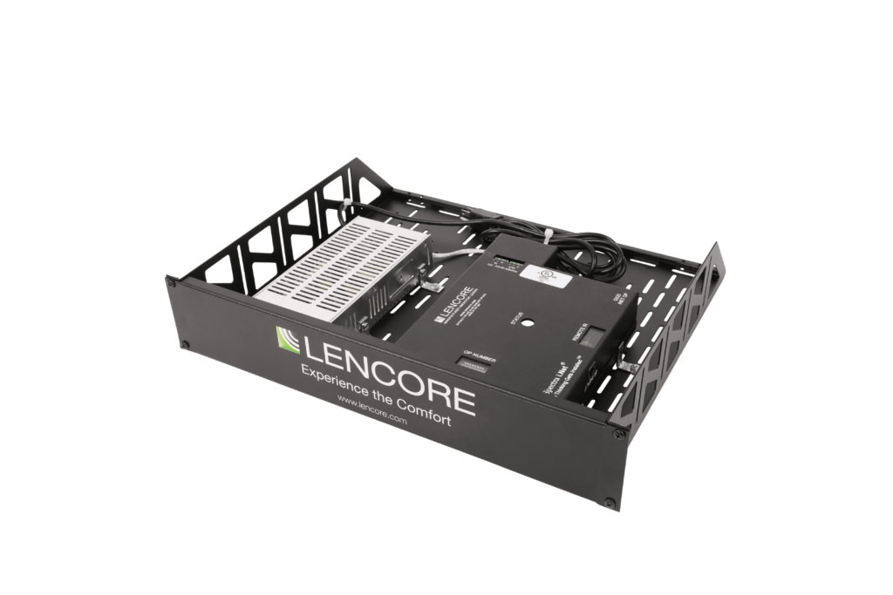
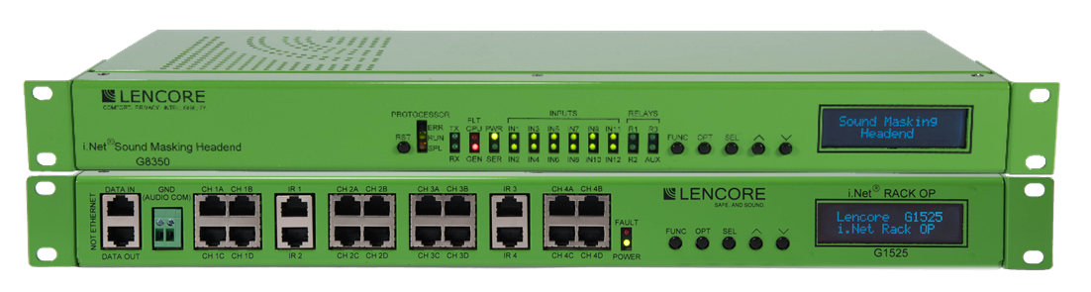
Sound Masking and Noise Management Portfolio
Features | Classic | Silver | Gold | i.Net Enterprise
Coverage Area | Up to 6K SF | Up to 6K SF | Up to 12K SF | Up to 1.5M SF
Maximum # Speakers | 32+ | 32 | 64 | Unlimited
# Independent Channels | 1+ | 4 | 8 | Unlimited
Rack Mountable (units) | N/A | 2U | 1U | 2U+
Sound Masking | Yes | Yes | Yes | Yes
Music Capable | Yes | No | Yes | Yes
Paging Capable | Yes | No | Yes w/ 3rd Party | Yes
Network Capable | No | No | Yes | Yes
Integration Capable | No | No | No | Yes
Control: Web Interface (Sys Mgr.) | No | No | Yes | Yes
Control: Front Panel | No | No | Yes | Yes
Control: Handheld Remote | No | Yes | No | Per Design
Control: Wall Dial/Pad Capable | Yes | Yes | Yes | Yes
Scalable | Limited | Yes / Redesign | No | Yes
10-Year Warranty | Yes | Yes | Yes | Yes
Category Cabling | No | Yes | Yes | Yes
Compatible with all i.Net Speakers | No | Yes | Yes | Yes

Slide 30
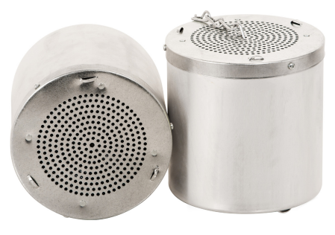
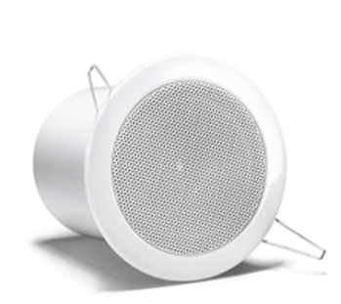
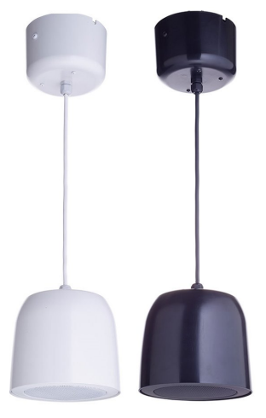
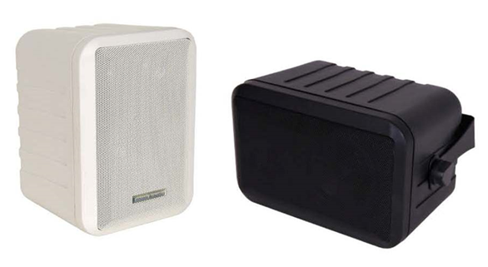
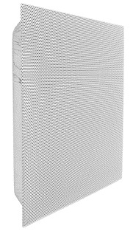
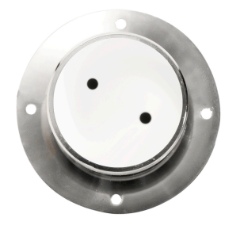
We have Green Sound speakers for every occasion
Part / Description | G545 Universal Plenum Speaker | G950 Tangent Speaker | G875 Decorative Pendant | G54 Decorative Swivel Speaker | G22 2x2 Tile Speaker | SDSPKR3 Solid State Speaker
Mounting Application | In-plenum or open ceiling | Acoustical tile or gyp ceiling | Open ceiling environment | Open area, surface mount | Acoustical tile | Gyp board, wood, glass
Orientation | Up-firing or down-firing, field switchable | Direct-fired | Downfiring, Up-firing option | Directionally-fired | Direct-fired | Surface emitting
General Coverage | > 200 s.f. (Up-firing) | Approx. 100 s.f. | Approx. 120-200 s.f. | > 100 s.f. | Approx. 100-120 s.f. | Approx. 12-15 s.f.
Typical Spacing | Approx. 15' apart | Approx. 10-11' apart | Approx. 12-15' apart | Approx. 10-12' apart | Approx. 10-12' | Approx. 12-15 s.f.
Potentiometer Option | Yes | Yes | Yes | No | No | No
Remote Dial Option | Yes | Yes | Yes | No | No | No
Available Colors | Aluminum, white, black, custom | Available white, black | Available white, black | Available white, black | White, black | Steel
Install Detail | Up-firing - plenum depth 3-5' | 4"hole saw included | Includes mounting plate | Standard swivel bracket | Add 24" t-bar for cutting 2x4 tiles | Use 3M Super 77 on gyp ceiling
 | Down-firing – In-plenum depth < 2' or > 5' | Tension clips | Can attach to 4" box |  | (not included) | Spec'd w/bracket for studs
 | Chain included, 2-ft | Tile bridge available (TB-4) | 6" slack in housing, |  |  | Max 2 speakers / OP channel
 | Custom lengths available |  | Custom lengths available
General Points | Requires less speakers than direct-fired speakers, high uniformity | Wide dispersion, quality sound | Sleek design, variable height | Used in challenging ceiling spaces | Quick installation, retro-fit or new applications | Turns surfaces into speakers No extra power amp req'd
All speakers are used with Silver, Gold, and i.Net Systems

Slide 31
Why Lencore
Quality of Sound
System Design
Customer Excellence
Sound Reproduction: Lencore speakers reproduce sound more accurately and with greater clarity
Unlike pure White noise, our Green Sound™ is as comfortable and effective at providing the ideal acoustic environment while limiting unwanted noise
Lencore is the only sound masking company to monitor the UL 2572 listing needed to mute sound masking to comply with NFPA72 code
Lencore speakers offer greater control over the sound masking signal, allowing users to adjust the frequency, volume, and other parameters to suit their specific needs
Ease of use installation, tuning and balancing
Only manufacturer to warranty our equipment with a 10-year warrantee
Lencore proudly manufactures its products in the United States of America. Our products meet or exceed the requirements of the Buy American Act
Lencore’s sound manager allows for multiple zone sound contouring
Custom Solutions: Our Design & Quote team never takes a one-size fits all approach. Every quote we provide is customized to the exact specifications of the job environment:
Design
Installation
Tuning
*Industry leading turnaround times: 24-48 hours
Live Technical Support + CIT Education with industry experts
*Turnaround times may vary by the size of the job

Slide 32
Comprehensive Design Support
Submit via Lencore.com
24-48 hours turnaround
Reflected Ceiling Plan
Coverage areas, ceiling heights, etc.
Unique requirements
*Turnaround times may vary by the size of the job

Slide 33
Thank you
Questions?

Slide 34
Appendix
Product detail
System Manager
Floor Plans
Speakers
Best Fit for Lencore

Slide 35
i.Net System Overview
Headend - Controls Operating Platforms (OPs)
OP’s - Controls the Speakers
MPI - Provides Music and Paging Interface (optional)
Speakers - Audio Output
System Manager – Software Interface
Notes:
Sound Masking works because:
It provides Speech privacy
It minimizes the dynamic range of speech thus reducing distractions.
It increases comfort in the space and improves worker productivity.

Slide 36
Enterprise Systems i.Net Headend
Large Image
All-In-One Networked solution for projects up to 12,000 square feet. Delivering superior comfort and privacy in sound masking and clarity in audio.
State-of-the-Art Networked sound masking, paging & music system
Manages 1.5 million Sq Ft of Space from single unit
Flexibility to monitor and control the sound masking from virtually anywhere
Ability to use up to 255 individual zones for masking
Meets UL2572 and UL864 standards allowing it to interface with a fire alarm control unit (FACU)

Slide 37
Enterprise Systems i.Net Quad OP
Large Image
1-RU Operating Platform
16-Channels & up to 8 speakers per channel
Quad OP covers up to 24,000 Sq Ft
Increases Installation Efficiency
Multiple, random sound masking sources
Independent equalizers for unprecedented tuning
Each channel has a separate and independent 1/3rd octave band equalizer for tuning when needed

Slide 38
Enterprise Systems i.Net Music & Paging Interface
Large Image
Ability to play background music, break tones, pre-recorded messages and doorbell chimes
One direct mic input and a second line-level mic input for paging
Front panel LEDs
Analog phone input
Built-in speaker for testing/troubleshooting
Single turn pot to adjust the paging and music input signals levels
Ability to connect a Global MPI

Slide 39
Cat 5e or better
8 speakers per channel
150’ to 1st speaker
300’ on the channel

Slide 40
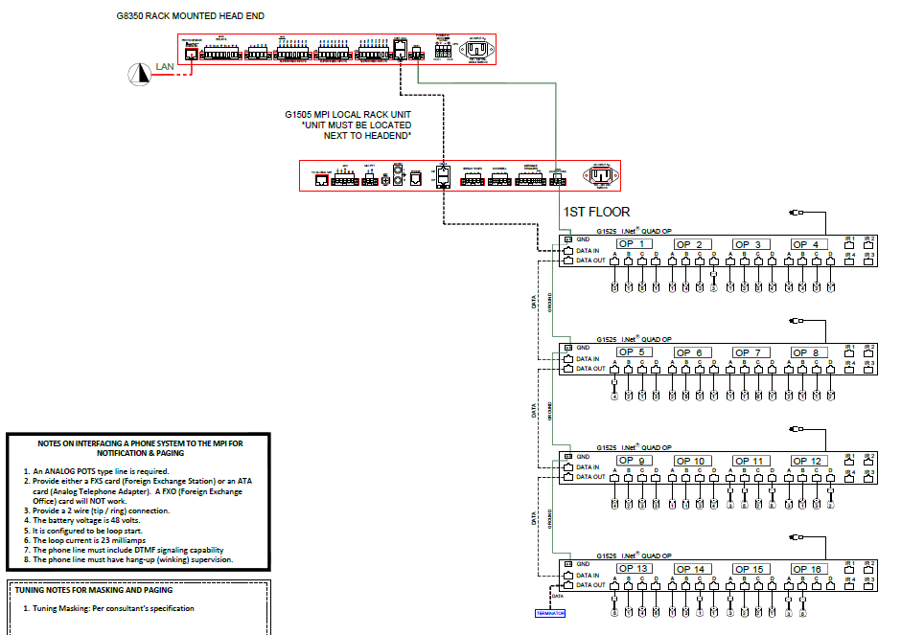

Slide 41
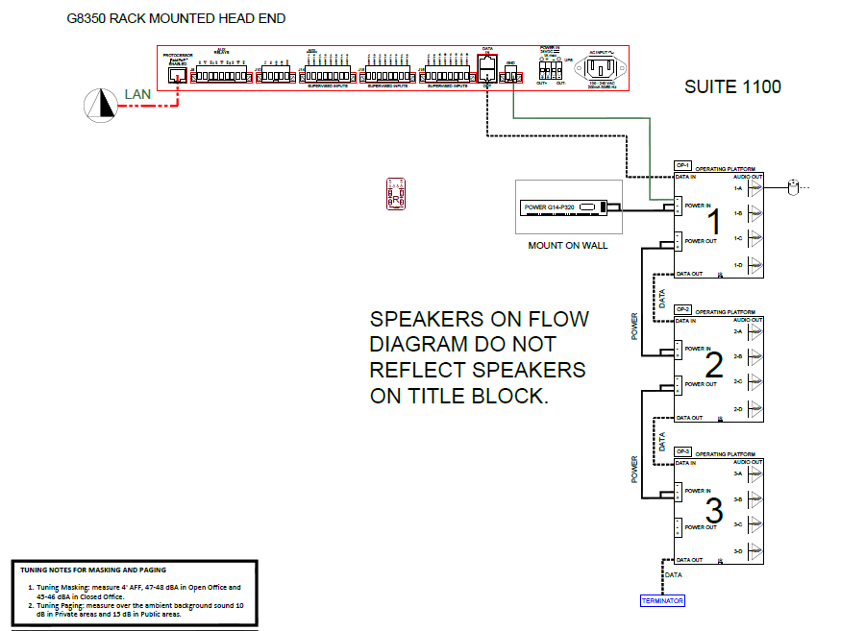
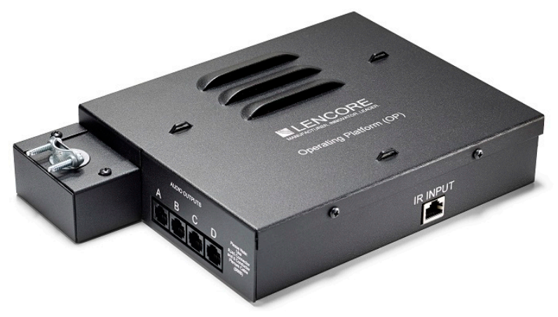
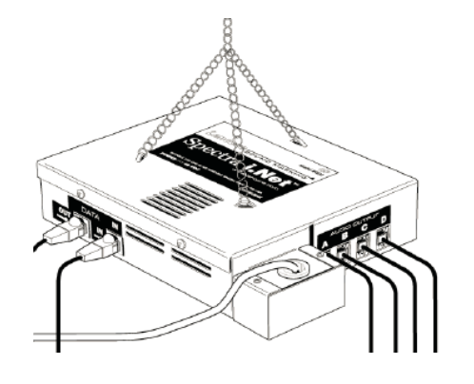
Distance issues
Port / channel utilization
Budget constraints

Slide 42
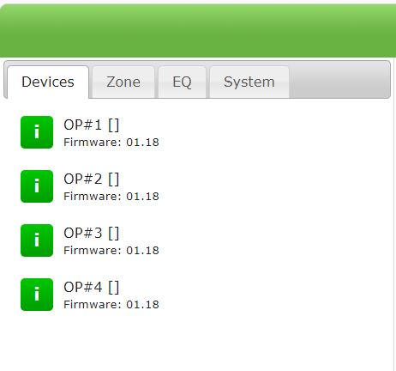
Central Control – System Manager

Slide 43
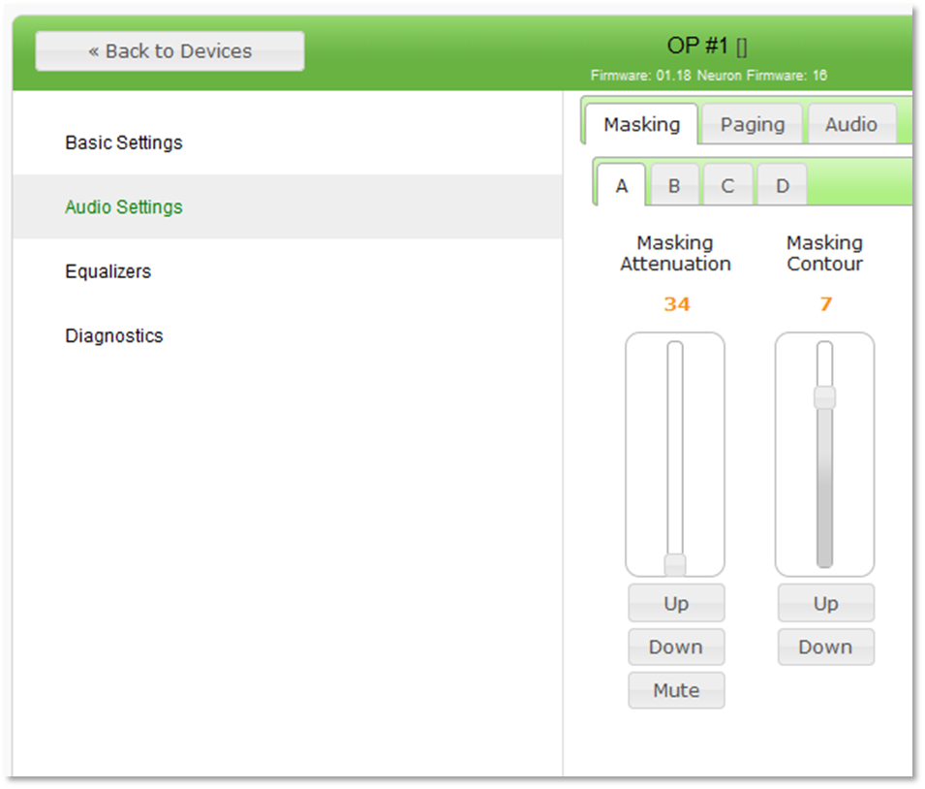
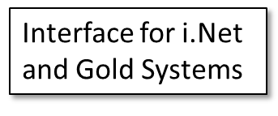
Central Control – System Manager
COMFORT

Slide 44
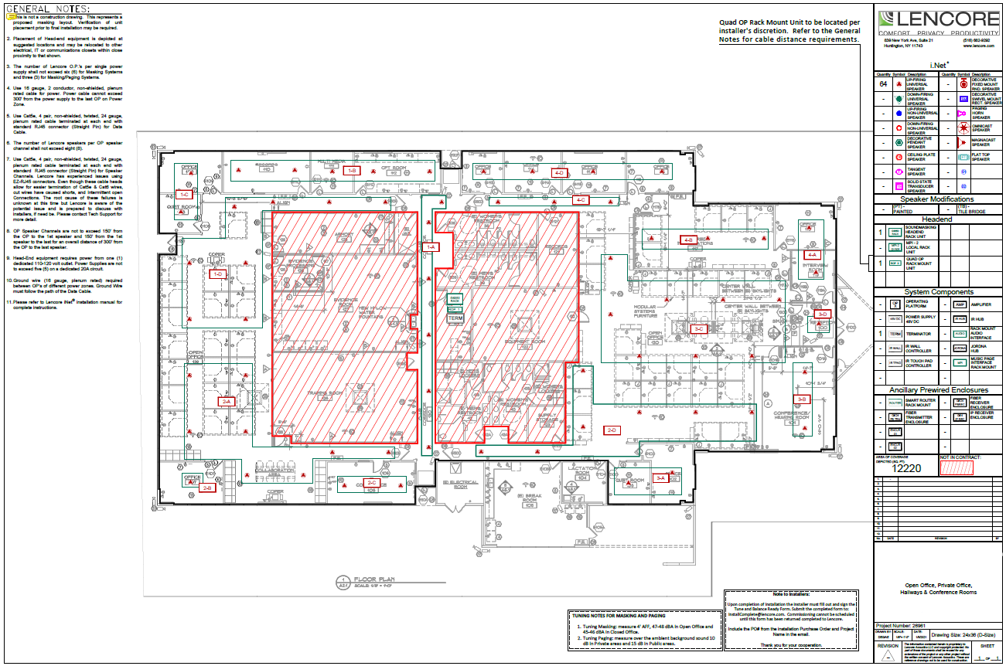

Slide 45
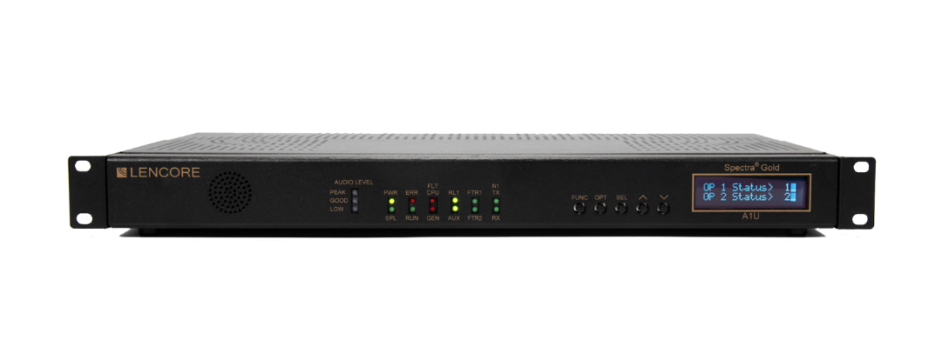
Gold
Large Image
All-In-One Networked solution for projects up to 12,000 square feet. Delivering superior comfort and privacy in sound masking and clarity in audio.
Easy to use fine- tuning capabilities adjustments for individual or all zones
8 independent channels (for a total of 64 speakers)
Two IR Ports
Front Panel push buttons for user input and setup
Integrated LCD screen for displaying information
Built in Processor to control the networked system from virtually anywhere
Internal monitoring of system performance (including the operation of the network, program, memory, power, and characteristics of sound masking

Slide 46
Silver
Large Image
Out-of-the-box, sound masking only system for facilities up to 6,000 square feet.
This single, 2 RU rack mounted solution replaces the bulky headend equipment previously associated with sound masking systems.
4 independent channels (for a total of 32 speakers)
4 zones
Remote control for volume and contour adjustments
Optional wall-plate controller available
Works with any Lencore networked speaker

Slide 47
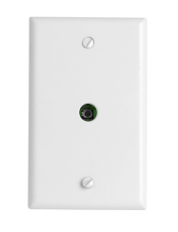
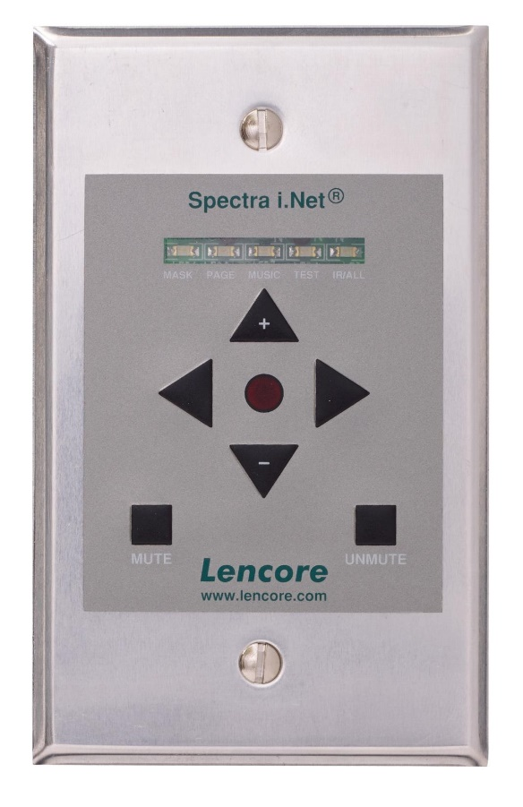
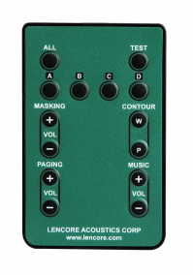
Local Control IR Keypad
Gives the user control over a local area
Dip Switches on the inside of the Wall Plate correspond with the OP Channels.
Channel A
Channel B
Channel C
Channel D
The IR Keypad (G41) by default is set to control all four OP channels.
Can be set to control a single channel
Keypads can work in tandem with an IR HUB to control each channel with its own Keypad
Wired up using Category cable

Slide 48
Classic
Large Image
All-In-One Networked solution for projects up to 12,000 square feet. Delivering superior comfort and privacy in sound masking and clarity in audio
Self Contained Non-Networked system that can generate sound masking, paging & music in multiple ceiling conditions
Positioned for small projects with less than 32 In-plenum speakers, or 17 Direct-fired speakers & 3 RCVC’s max
Spot Sound Masking
When clients want paging on a smaller project

Slide 49
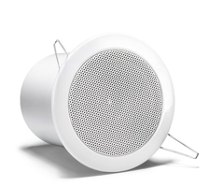
i.Net Tangent
i.Net Tangent offers a commercial grade direct fired speaker using higher quality construction and sound quality than competitive systems.
Installation is simplified using plug and play Cat 5e cable with standard RJ45 connections.
The i.Net Tangent speaker is equipped with torsion springs to ensure a smooth installation in ceiling tile or gypsum board.
LOUDSPEAKER
Power Rating – 10 watts
Frequency Response – 90-18 kHz
SPL for Masking Output: 90 dB
Impedance – 32 Ohms + Speaker Weight – 1.1 lbs

Slide 50
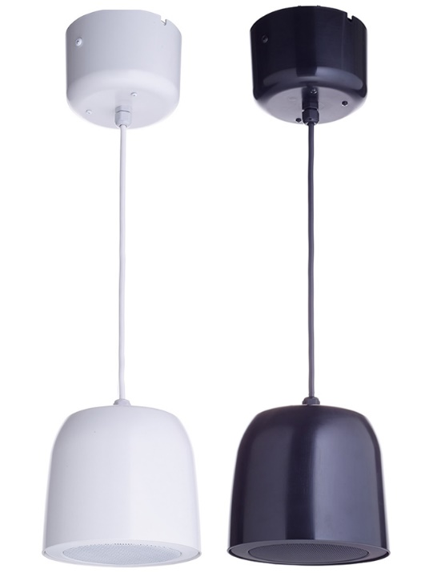
i.Net G950
The speaker is constructed of high-quality materials, delivers the superior sound quality Lencore is known for, and is easy to install.
The Pendant Speaker comes with a gem box for Cat5e connections at the deck location which minimizes cable exposure for the client
The G875 ships with 12” of wire exposed with an additional 6 inches tucked in the Gem box. 18” total.
LOUDSPEAKER
Power Rating – 10 watt continuous, 20-watt peak
Frequency Response – 90-18 kHz
SPL for Masking Output: 90 dB
Impedance – 32 Ohms
Speaker Weight – 1.1 lbs
Notes:
The Pendant Speaker offers a decorative, direct fired option when aesthetics is a concern. With more open environments and exposed ceilings becoming the norm, a decorative solution for sound masking has been difficult to find.

Slide 51
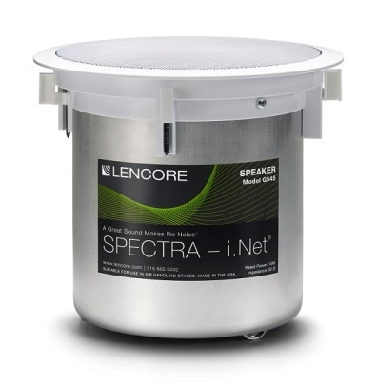
i.Net G545
The direct fired speakers have decorative speaker grills that blend seamlessly into your designs. The flush mounted speaker gently introduces the sound masking directly into the environment below.
The inline speaker option also provides an additional volume control with an attenuator conveniently located next to the connectors. 0 to -12 dB adjustments can be made with a flathead screwdriver.
Speakers used in the i.Net system are configured with integrated RJ45 connections for plug and play and ease of installation.

Slide 52
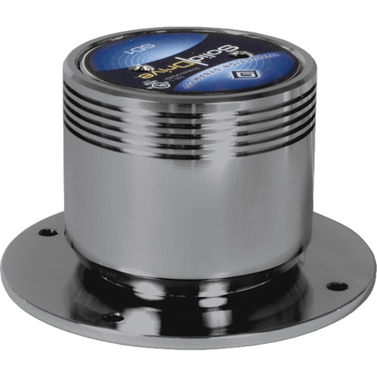
Solid drive
Unit turns a structure’s surface into a high-quality sound source
Remains completely hidden from view
Solid Drive can generate sound from solid surfaces by utilizing only 5 to 20 watts.
Speaker is thermally protected - can also be used in high-output applications
Typically installed on drywall ceilings and walls.

Slide 53
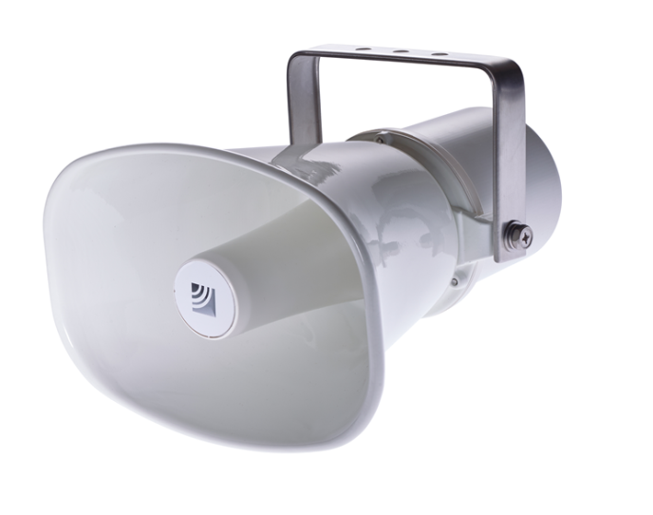
Paging speakers
Lencore’s decorative paging horns are available when a surface mounted speaker is desired or necessary due to site configuration or condition.
Lencore's paging horn provides intelligible voice paging for indoor and outdoor use or in areas where the ambient background noise is already greater
Lencore’s Decorative Swivel Mount Rectangular speakers are available when a surface-mounted speaker is desired or necessary due to site configuration or conditions.
Our Decorative Swivel Mount speaker is capable of supporting sound masking and paging.

Slide 54
Best Fit for Lencore
Projects where sound quality may be more appreciated
Projects with diverse ceiling types and finishes
Projects with bundled applications: Masking, music, paging
Projects with plenum spaces (less speakers)
High-maintenance clients
Tough to compete on projects with paging only or retro-fit in ACT only.

