Slide 1

Hot Fresh & Fun
Full Power Radio / uscountry995.com / P: 860.464.1065 / F: 860.464.8143

Slide 2




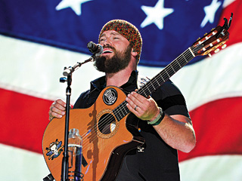
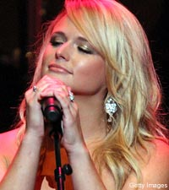
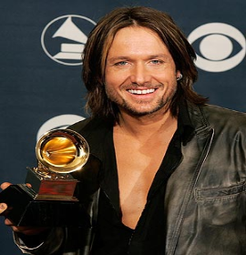
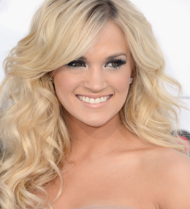

Dial Position: 99.5 FM /106.5 HD2
Call Letters: WBMW HD2
Web Site: www.us995country.com
Format: Hot Country
Coverage: Eastern CT, Western RI, Eastern Long Island
Audience: Adults 18-54
The Station
U.S. Country 99.5 is New London County’s newest music station playing Hot Country. The Hot Country format has mass appeal with audiences ranging from 18-54 years of age. U.S. Country 99.5 provides music, entertainment, and news with an upbeat “Hot, Fresh and Fun” presentation! We are consistently conducting music studies to make sure we are playing the music that our listeners want to hear. Grow your business today with New London County’s “Hot Country”, U.S. Country 99.5
The Music
Carrie Underwood, The Band Perry, Zac Brown Band, Kenny Chesney, Blake Shelton, Keith Urban, Darius Rucker, Taylor Swift, Little Big Town, Brad Paisley, Eric Church, Luke Bryan, Miranda Lambert, and more.

Slide 3
6am-10am: Bobby Bones Show
The Bobby Bones Show is an nationally syndicated weekday country radio morning show. The Bobby Bones Show originates from Nashville, Tennessee. The show launched nationwide on Country radio in February 2013 and reaches millions of listeners on nearly 100 stations, including markets such as Washington, D.C., Boston, MA, Miami, FL and here in New London, CT. The Bobby Bones Show is an upbeat morning show featuring guests like Carrie Underwood, Keith Urban and other country and Hollywood Stars while playing today’s best country and featuring local weather, news and traffic.
10am-2pm: Wendy Young
2pm-7pm: Brooke Preston
7pm-12m: The Lia Show

Slide 4

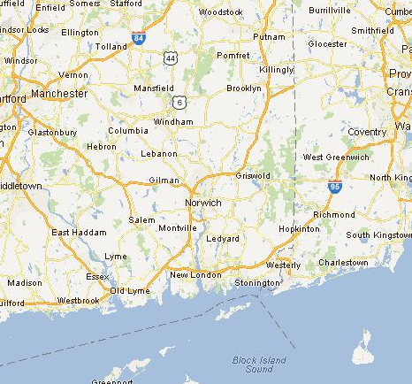

99.5 & 106.5 HD2
Coverage MAP
Broadcasting High Above The Sub Base!
106.5 HD2
99.5 FM

Slide 5


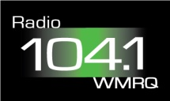





Full Power Radio’s Family Of Radio Stations
New London
Hartford/Waterbury
Springfield
New Haven/ Bridgeport
Providence
Burlington, VT

