Slide 1
CT’s Exclusive Adult Alternative Locally Owned & Operated
- 50,000 watts of pure radio power -

Slide 2
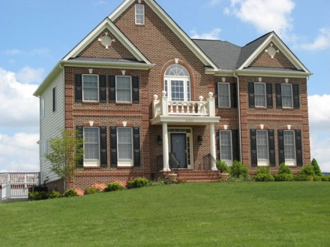
Our amazing listeners
The Radio 104.1 listener is in the “age of acquisition.” A young adult probably married, with at least one child, maybe two, in their first home, buying their first and second family vehicle. They are coming into their own, established in their career and life choices.
They are spending money on products and services like furniture, life insurance, automobiles, electronics, clothing, etc. Radio 104.1 listeners are applying for mortgages and buying engagement rings.
Radio 104.1’s Listeners are ACTIVE – belong to a gym, swimming, jogging, hiking, camping, fishing, golf, mountain biking, boating, canoe/kayak and extremely high in skiing and snowboarding.

Slide 3
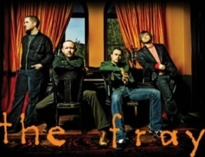
Who are we?
Call Letters WMRQ-FM – CT’s Most Marketed Radio Station!!!
Dial Position 104.1 FM
Website www.radio1041.fm
Format Adult Alternative Rock
Coverage Hartford, New Haven, Springfield, Waterbury, & Danbury
Signal 50,000 watts broadcasting from Meriden Mountain
Audience Adults 25 to 49
The music – Mainstream Adult Alternative
Florence and the Machine, Dave Matthews Band, U2, Coldplay, Pearl Jam, MGMT, Red Hot Chili Peppers, Bob Marley, The Fray, Nirvana, Foo Fighters, Green Day, Blink 182, Linkin Park.
A VERY DIVERSE RANGE OF ARTISTS!

Slide 4
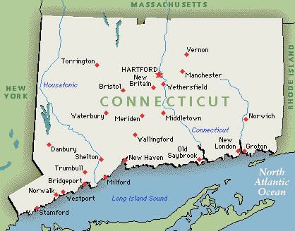
50,000 Watts of statewide coverage!!!

Slide 5
Rates & Features
Just a few of our opportunities
Noon Rewind with Amy Grey
Facebook Video of the Day – AM Drive with Fisch
Traffic Reports – weekly packages and naming rights packages are available.
Customized promotional plans, spec ads, in-house creative services, ETC...
Your Marketing Specialist can outline these opportunities in detail.
Daypart | :60sec. | :30sec. | :15sec.
M-F – 6am-10am | $125 | $80 | $50
M-F – 10am-3pm | $125 | $80 | $50
M-F – 3pm-7pm | $125 | $80 | $50
M-F – 7pm-12mid | $65 | $50 | $30
M-Sun – 6am-12mid | $85 | $60 | $40
Sat-Sun – 6a-7pm | $65 | $45 | $35
Our marketing team specializes in creative advertising solutions to help your business grow!!!

Slide 6
Meet our network!!!
Red Wolf Broadcasting Family
New London, CT Burlington, VT Hartford, CT
Long Island, NY & New London, CT
Bridgeport. CT

