Slide 1
Broadband Plan Report Sangamon County, IL
CCG Consulting & Finley Engineering
February 14, 2023

Slide 2
Benefits of Improved Broadband
Working from Home
School / Homework / Training
Telemedicine
Increased Home Values / Property Taxes
Growth / New Housing Opportunities
Easier to Create Rural Businesses
Connected to the Modern World – Everything Moving Online

Slide 3
Online Residential Survey Results
7% of households don’t have home broadband.
70% of respondents have somebody working at home at least part-time. 20% of homes have somebody working full-time. 38% of respondents said they would work from home more often with better broadband.
29% of respondents lack workable cell coverage at home.
Average price being paid for broadband is $83.
  We typically see an average of $75 in other communities.
66% of residents support building a fiber network. Another 33% might support the idea but need more facts.
39% said they would buy from a new fiber network. 29% said they would probably buy.

Slide 4
Business Surveys and Interviews
The most common problems we heard were slow broadband in the daytime, occasional multi-day outages, and regular shorter outages.
We heard that it is difficult to sell rural homes that don’t have good broadband.
Farmers are mostly using fixed wireless. They were happy with this when it first came ten years ago but it is now inadequate. Some farmers can get faster broadband from T-Mobile or Starlink.

Slide 5
The RDOF Issue
RDOF - Rural Development Opportunity Fund
10-year subsidy created by the Federal Communications Commission (FCC) to entice ISPs to build broadband networks in fully-unserved areas.
Two companies were awarded funding in the County:
  Largest winner is AMG Technologies (NextLink) which promises fast wireless technology.
  Mercury Broadband won funds in the county. Mercury Broadband is implementing a hybrid of fixed wireless and fiber-to-the-home for its RDOF awards. There is no way to know which technology will be used in the county.

Slide 6
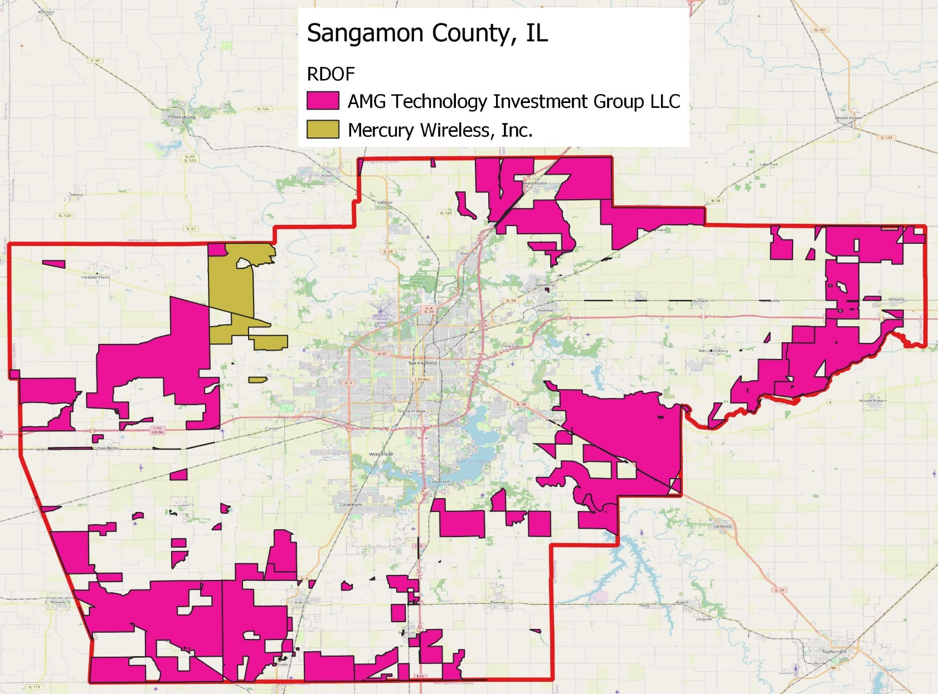

Slide 7
Who Doesn’t Have Good Broadband?
Following are two maps:
  The first is a map of the parts of the County that don’t have good broadband today, and no known broadband solution is underway. (Shown in blue and yellow)
  The second map shows the impact of layering on the RDOF awards. (Shown in orange)
This is important to understand, because the RDOF areas will likely be wireless broadband, and those areas are now ineligible for other federal and state broadband grants.

Slide 8
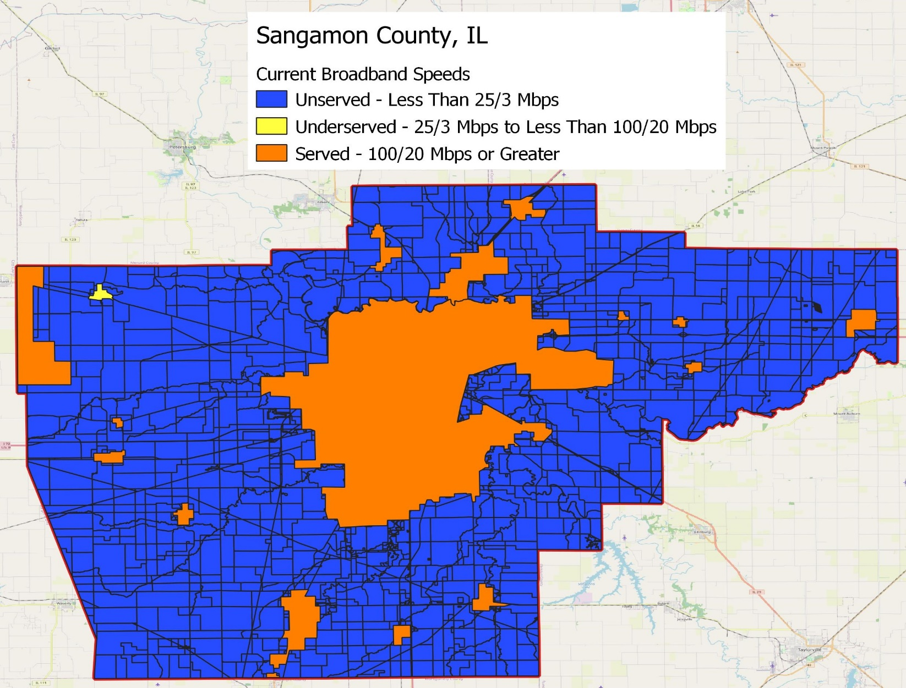

Slide 9
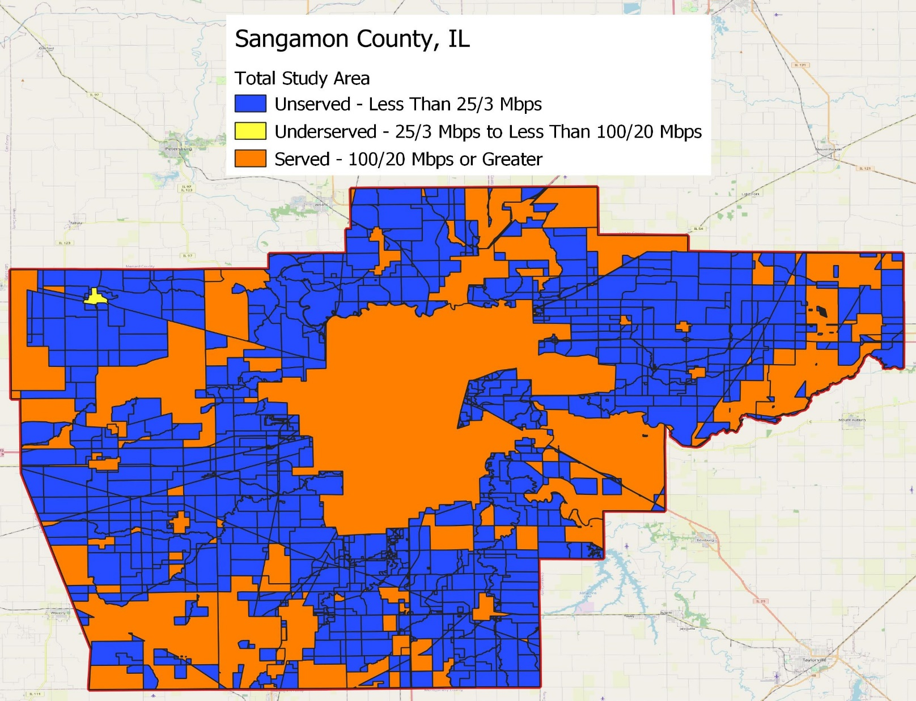

Slide 10
Locations Without Good Broadband
Without After
Speeds RDOF RDOF
Unserved (Less than 25/3 Mbps) 6,457 5,277
Underserved (25/3 to 100/20 Mbps) 352 352
Served (100/20 Mbps or faster) 85,410 86,590
Total 92,219 92,219

Slide 11
Technology
The RFP asked us to consider what technologies might be used to close the broadband gaps. Finley Engineering considered both wireless and fiber technologies.
  We could not find a comprehensive wireless solution that made sense due to the housing density, trees, and topology.
  We considered several fiber technologies and determined that passive optical network fiber technology is the best fit for the County.
Network designed with XGS-PON technology capable of delivering 10-gigabit broadband.
Required fiber: 1,956 miles whole study area, 1,332 miles in rural areas, and 920 miles in non-RDOF areas.

Slide 12
Cost of a New Network
60% Penetration 70% Penetration
Fiber $ 37,189,682 $ 37,195,137
Drops $ 2,787,708 $ 3,238,990
Electronics $ 2,739,701 $ 3,018,377
Huts $ 910,000 $ 910,000
Operational Assets $ 219,057 $ 221,449
Total $ 43,846,158 $ 44,583,953
Passings 5,629 5,629
Cost per Passing $7,789 $7,920

Slide 13
Financial Analysis – Total Study Area
Substantial Grants Needed
Penetration Assets Breakeven % of Assets
50% $43.1 M $31.7 M 74% 55% $43.5 M $29.9 M 69% 60% $43.8 M $28.1 M 64%
65% $44.2 M $26.6 M 60%
70% $44.6 M $25.0 M 56%
Note: No ISP will be interested in a breakeven business, so realistically grants will need to be higher.

Slide 14
Grant Funding
Congress passed infrastructure bill with over $42.5 billion for broadband funding – will mostly be aimed at rural areas, but the state will have a say in who gets funding. Illinois’ share likely over $1 billion.
The State of Illinois will have several rounds of state broadband grants in the near future.
There will be a few other smaller federal grant programs during 2023.
With some minor limitations the County can use ARPA funding for broadband projects.
There is also funding available for digital literacy and getting computers into homes.

Slide 15
Strategic Questions
Is the County Willing to Help Fund a Solution? If so, how much and in what manner?
Think about the Digital Equity Gap. Not only is there an opportunity to build rural broadband infrastructure, but there is an opportunity to find grant funding for digital inclusion.
Middle Mile Grants. The engineering study did not find many fiber routes going in and out of the county. The county should work with local ISPs to consider pursuing middle-mile fiber and last-mile grants.
What is the County’s Best Role in Finding a Solution? As a partner in grants or a supporter? Digital equity grants on top of infrastructure?

Slide 16
Next Steps
Identify Staffing Resources. Moving forward needs dedicated local effort.
Reach out to ISPs. We recommend talking to potential ISPs as an early step. Informal discussions, RFI, or RFP?
Community Outreach. How to involve the public in the process.
Review County and Local Fiber Policies. Are there any barriers for ISPs that want to build a fiber solution?
Tackle the Other Broadband Gaps. The report outlined other gaps the County could tackle, such as the homework gap, computer ownership gap, and the digital literacy gap.

Slide 17
Contacts
Tim Arbeiter, Director – Broadband Consulting
Finley Engineering
t.arbeiter@finleyusa.com
(816) 944-9113
Doug Dawson, President, CCG Consulting
blackbean2@ccgcomm.com
(202) 255-7689
Daily blog: https://potsandpansbyccg.com/

