Slide 2
Welcome
to the
Competitive Art Show Award Ceremony

Slide 3
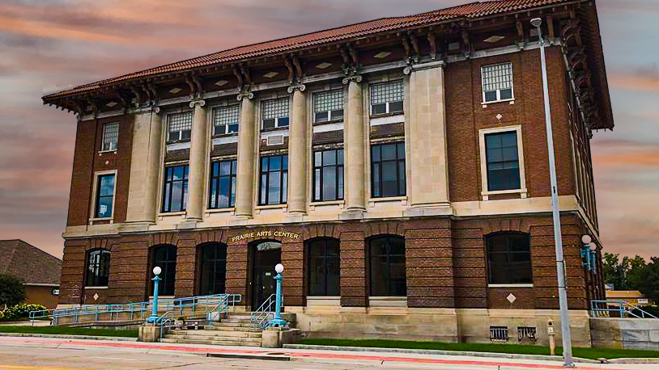
At The Historic PRAIRIE ARTS CENTER

Slide 4
3-D

Slide 5
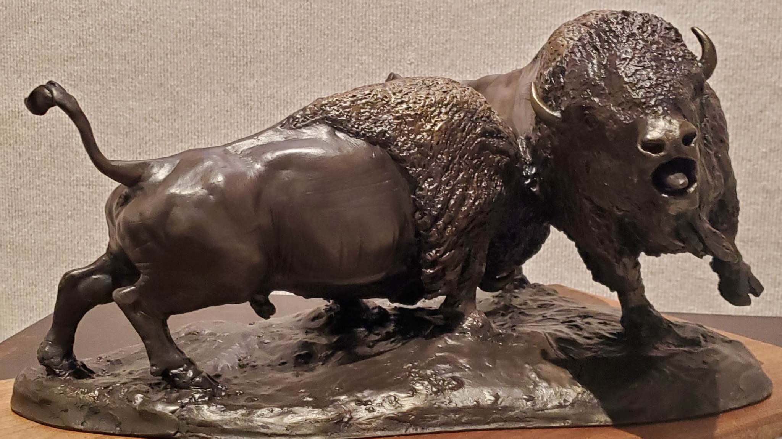
3-D
3rd Place
War Dance
Cole Brockmoller

Slide 6
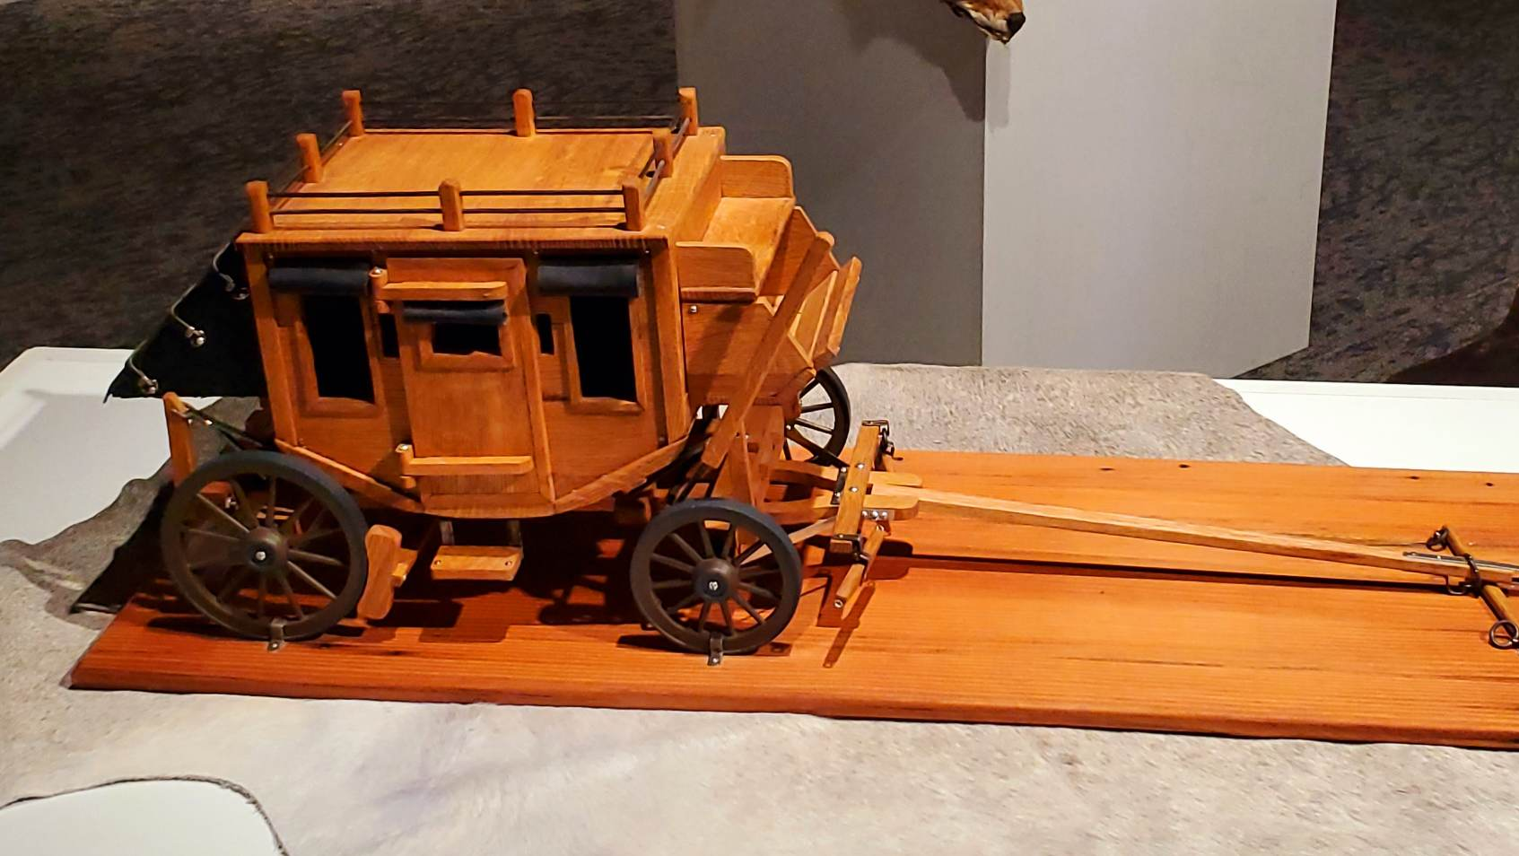
3-D
2nd Place
Stage Coach
Roger Herrick

Slide 7
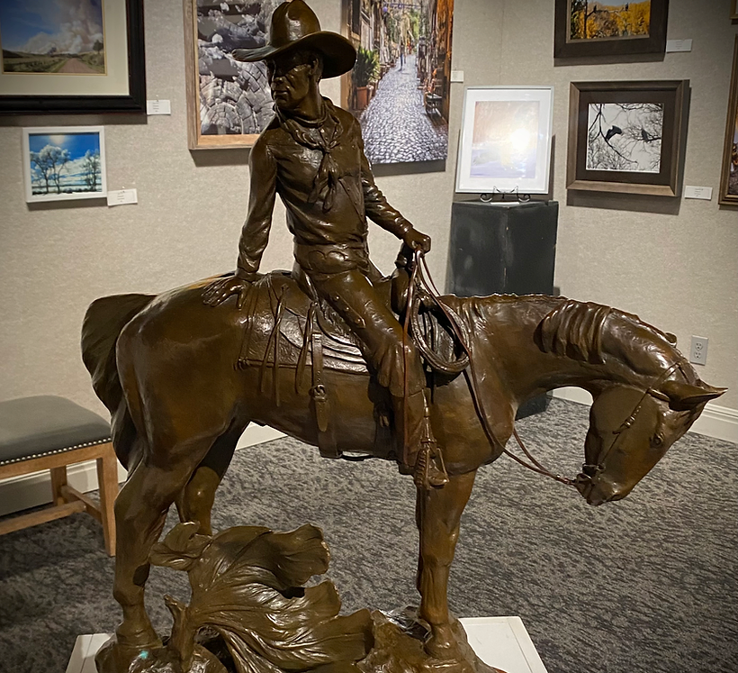
3-D WINNER Lookin’ Back Linda Egle

Slide 8
Photography

Slide 9
Landscape

Slide 10
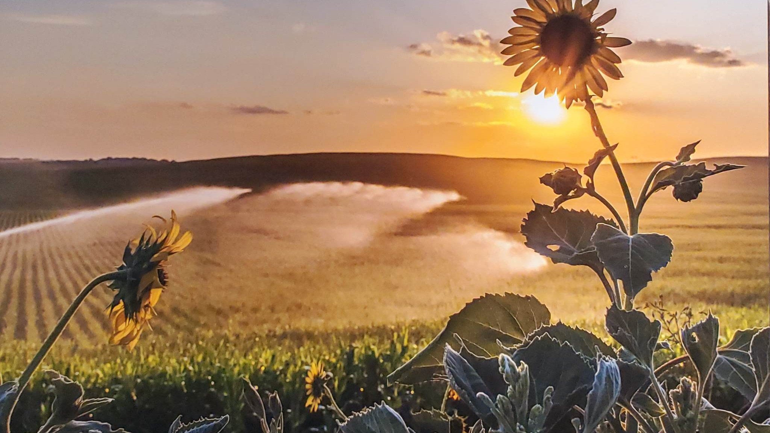
Photography Landscape 3rd Place Nebraska Sunset Pat Schoenfelder

Slide 11
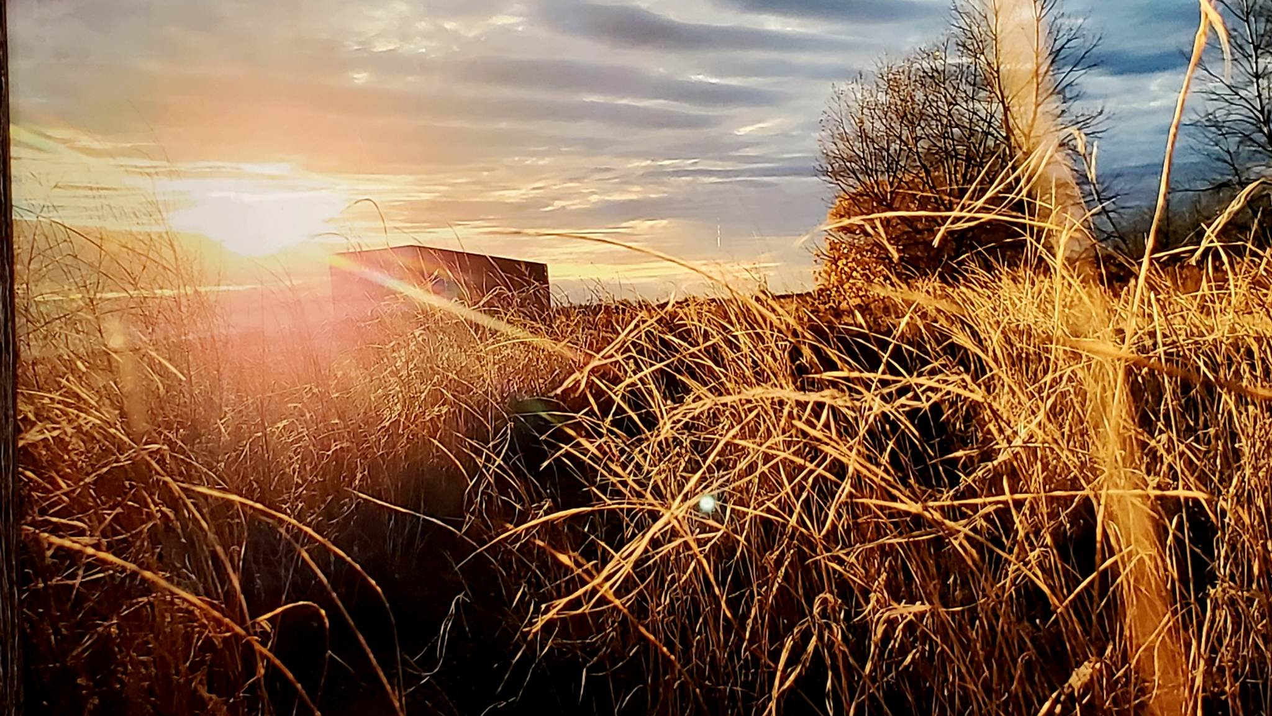
Photography Landscape 2nd Place
Blades of Brilliance Jess Smith

Slide 12
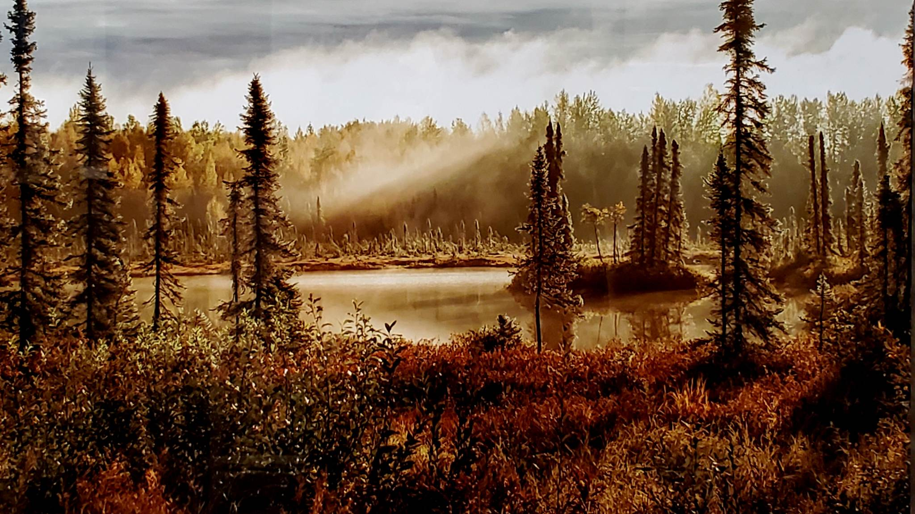
Photography Landscape WINNER Everything The Light Touches Keith Howe

Slide 13
Wildlife

Slide 14
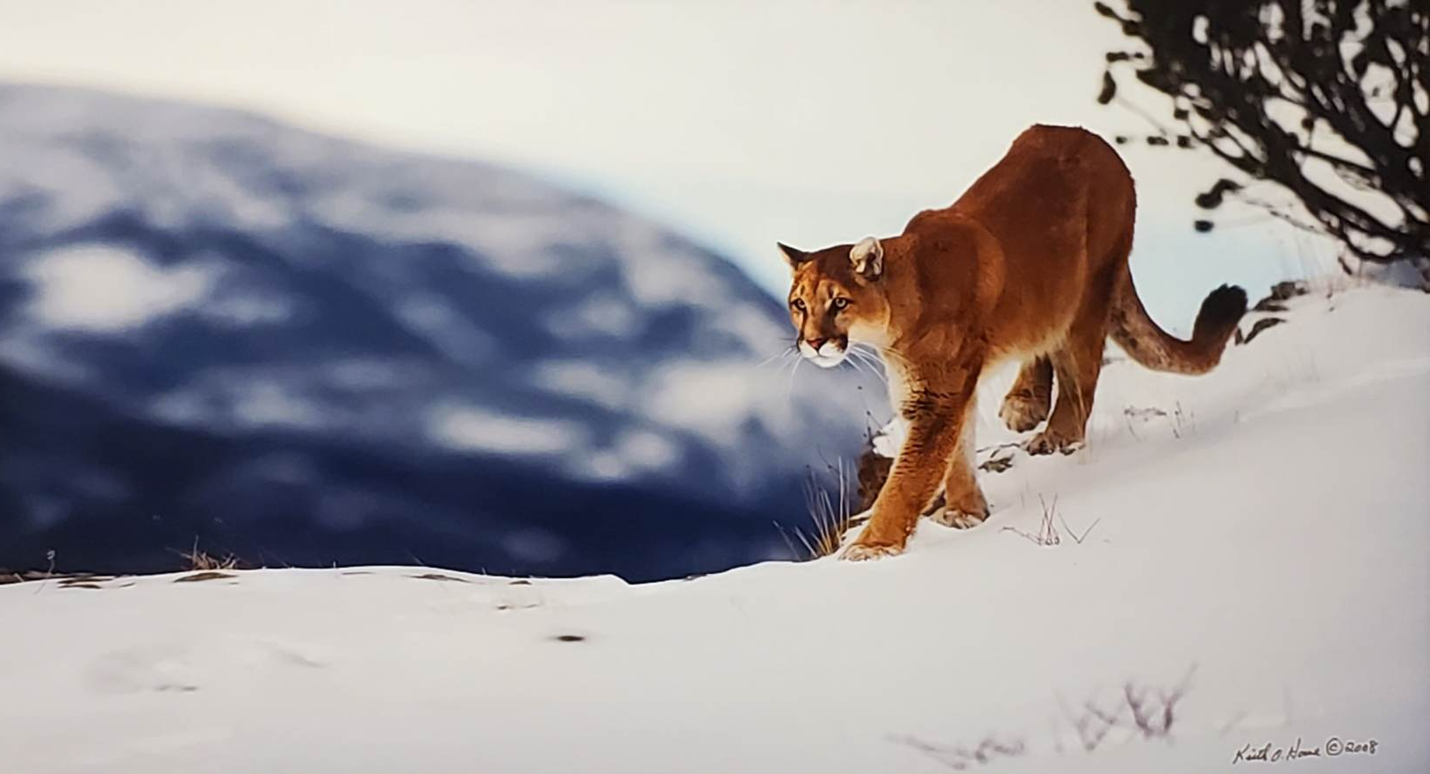
Photography Wildlife 3rd Place It’s Lonely At The Top Keith Howe

Slide 15
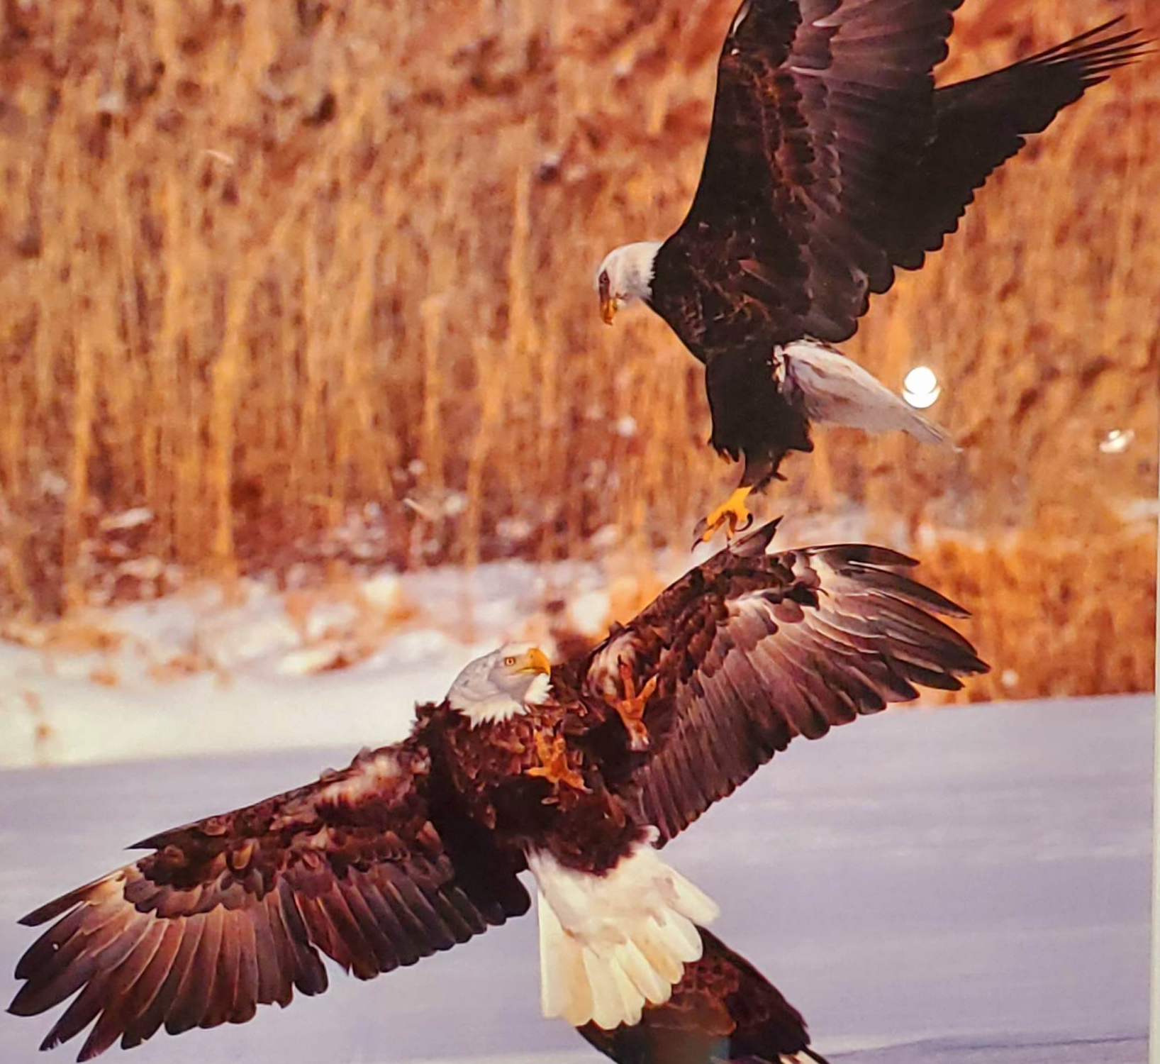
Photography Wildlife 2nd Place Fight Or Flight Marella McCarthy

Slide 16
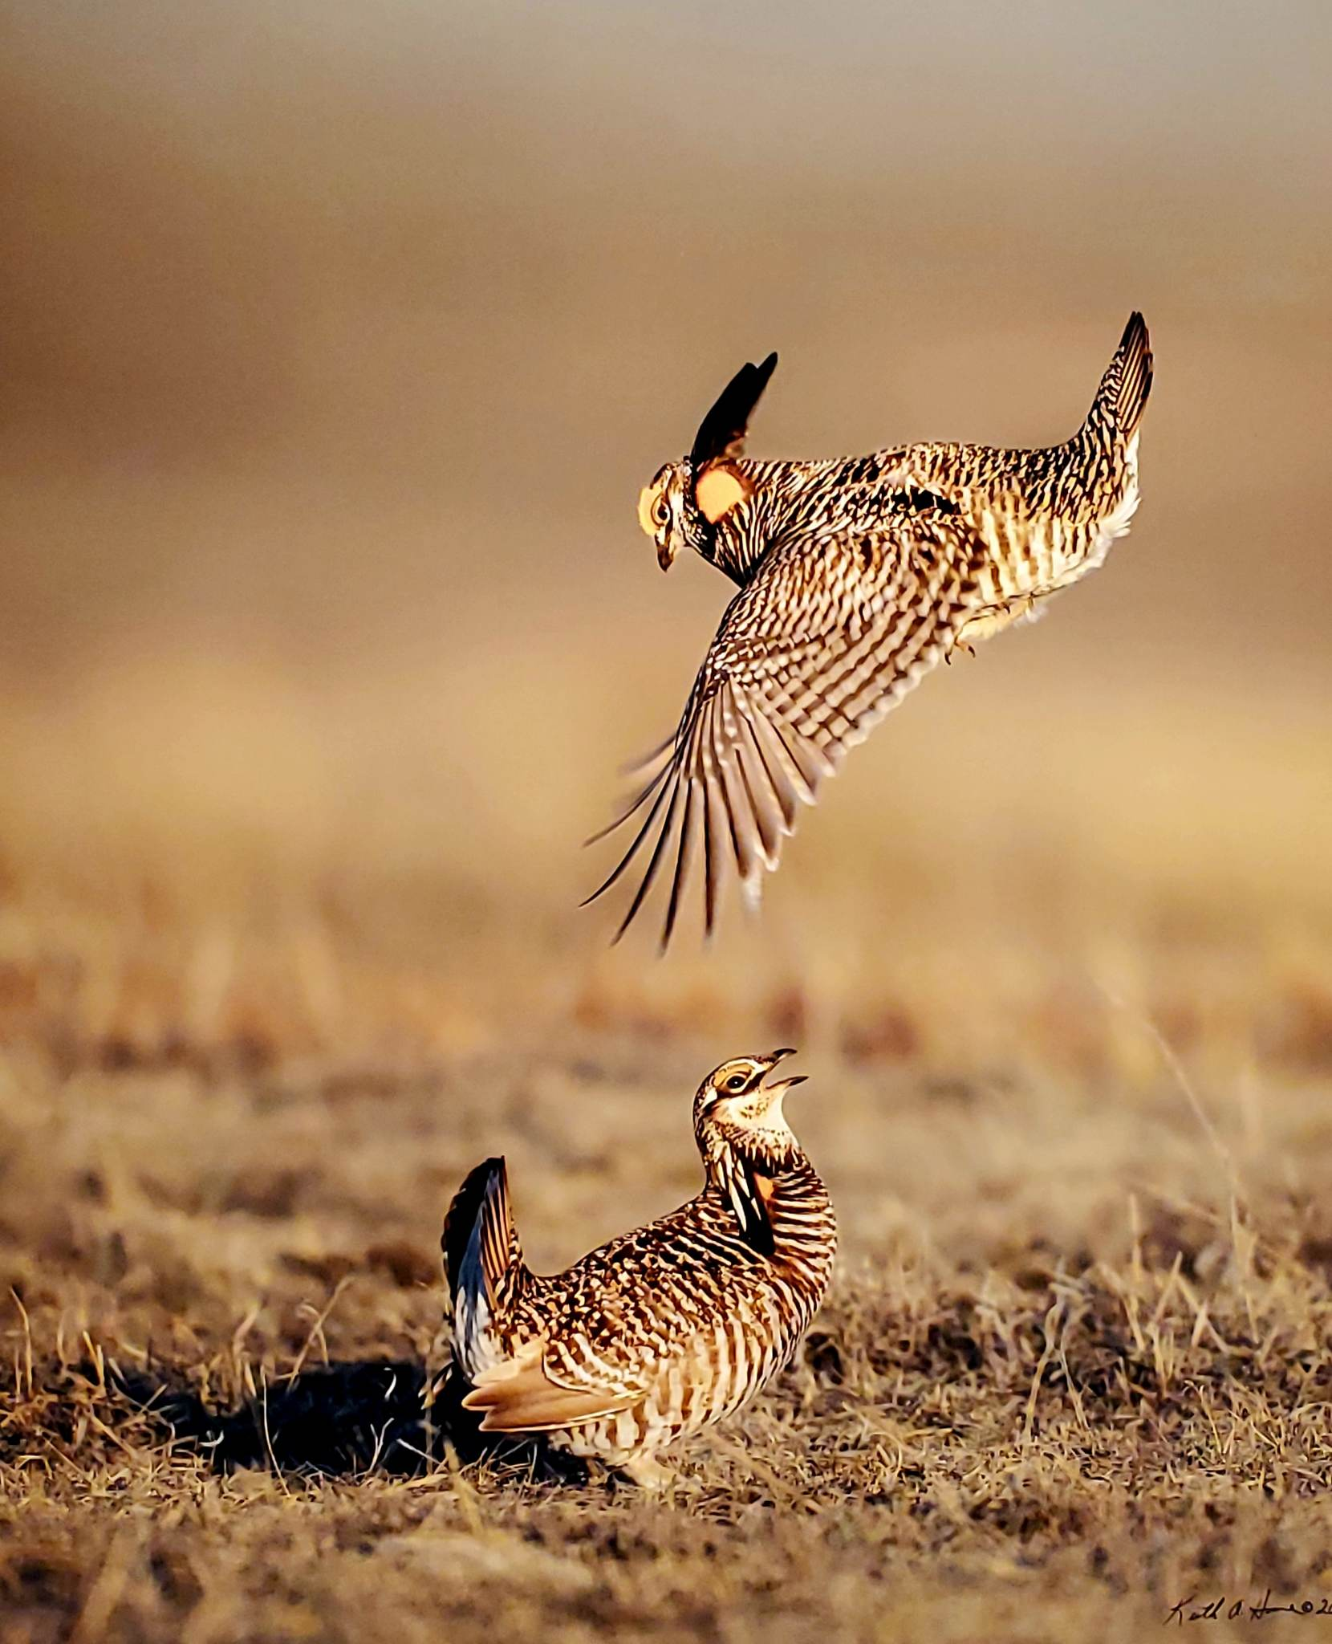
Photography Wildlife WINNER Look Out Below Keith Howe

Slide 17
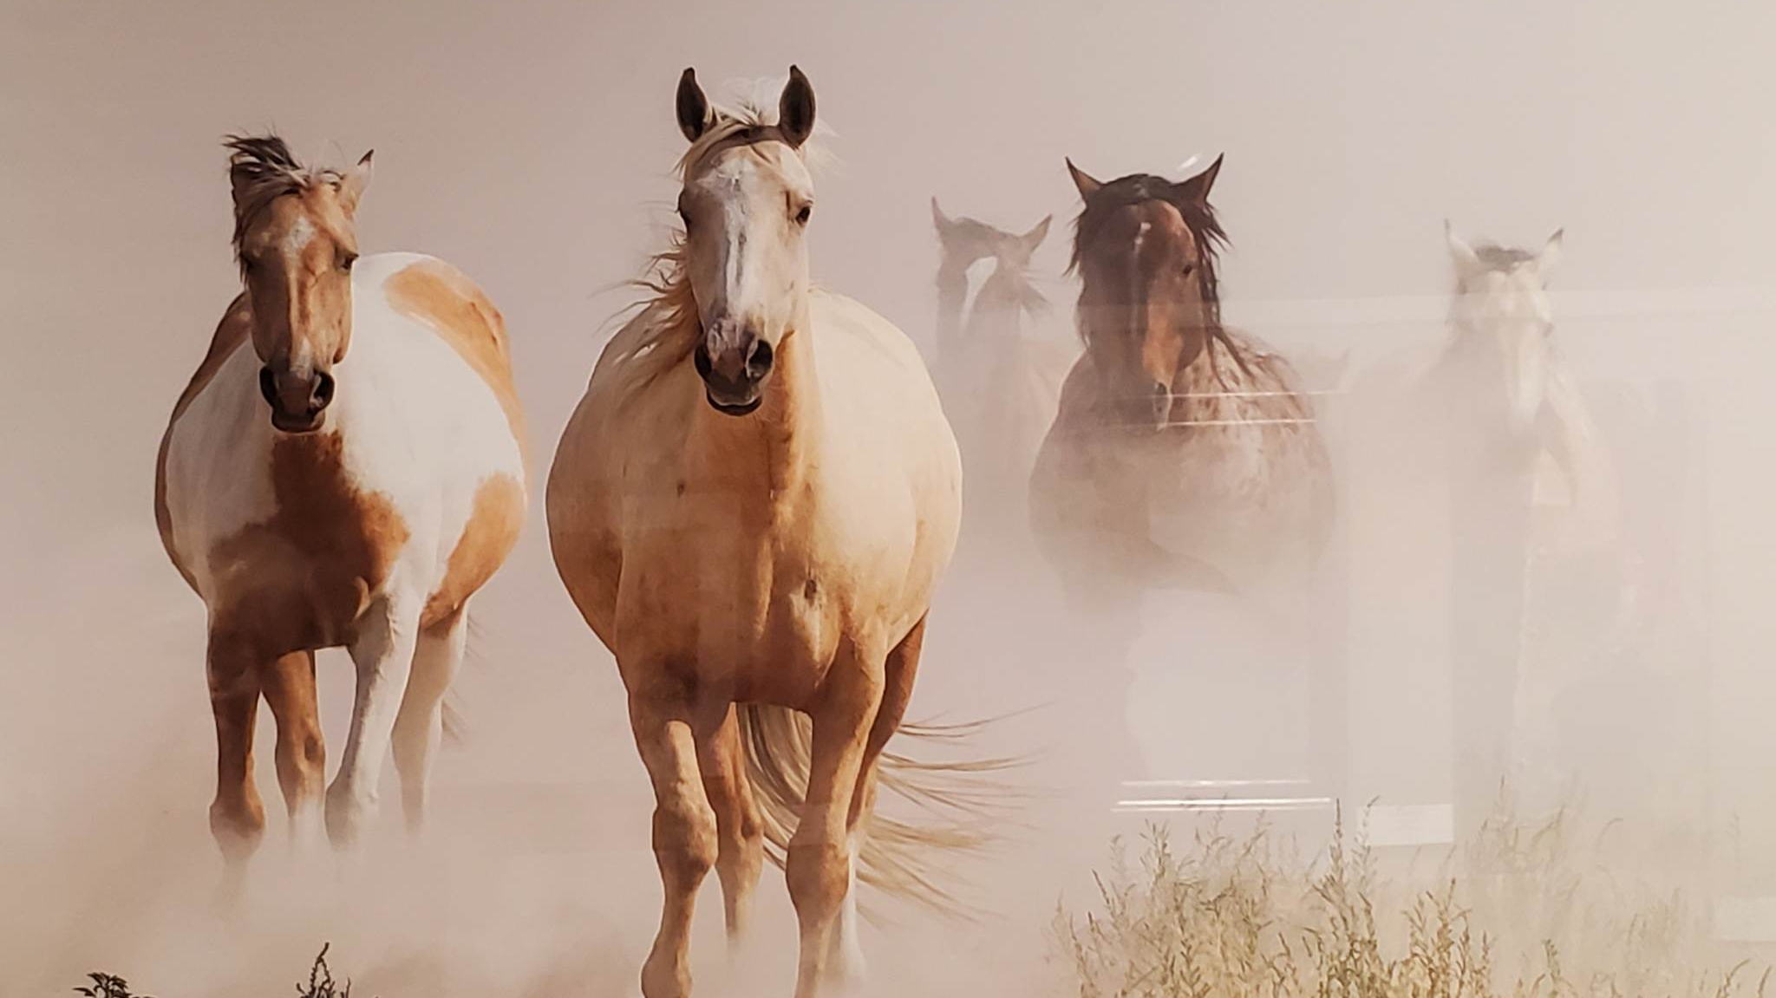
Photography Western 3rd Place
Onaqui Dust
Rachel Reeves

Slide 18
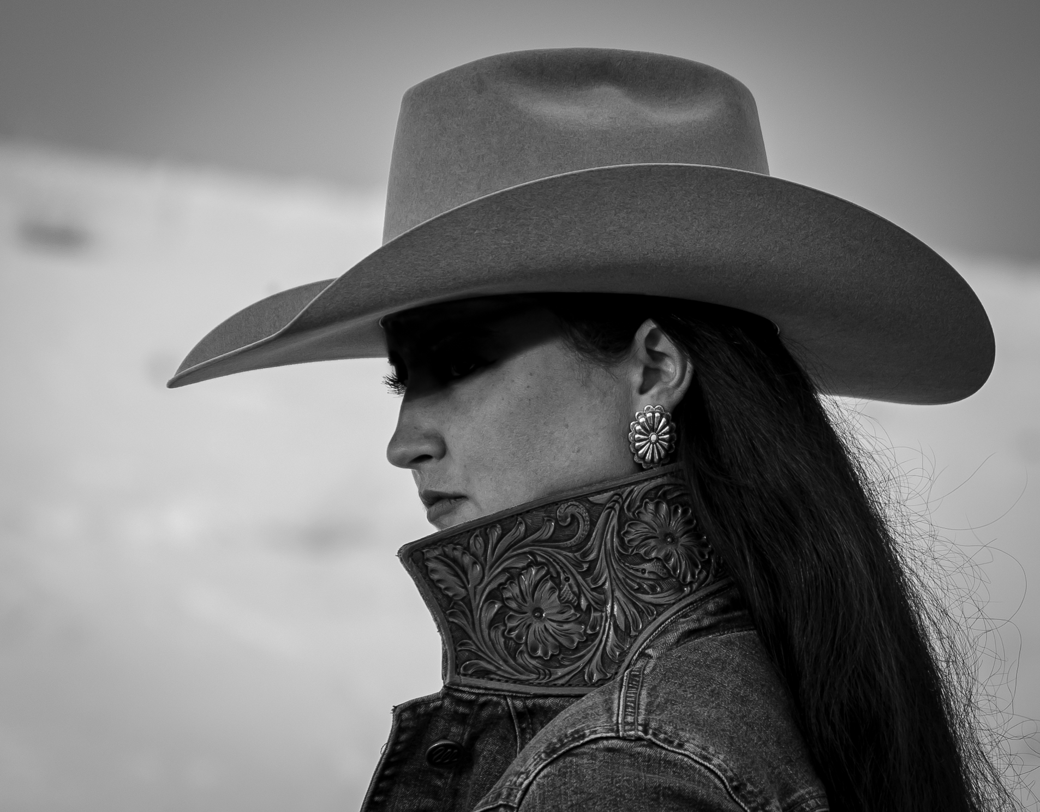
Photography Western 2nd Place Sharp Brim Brandy Jamerman

Slide 19
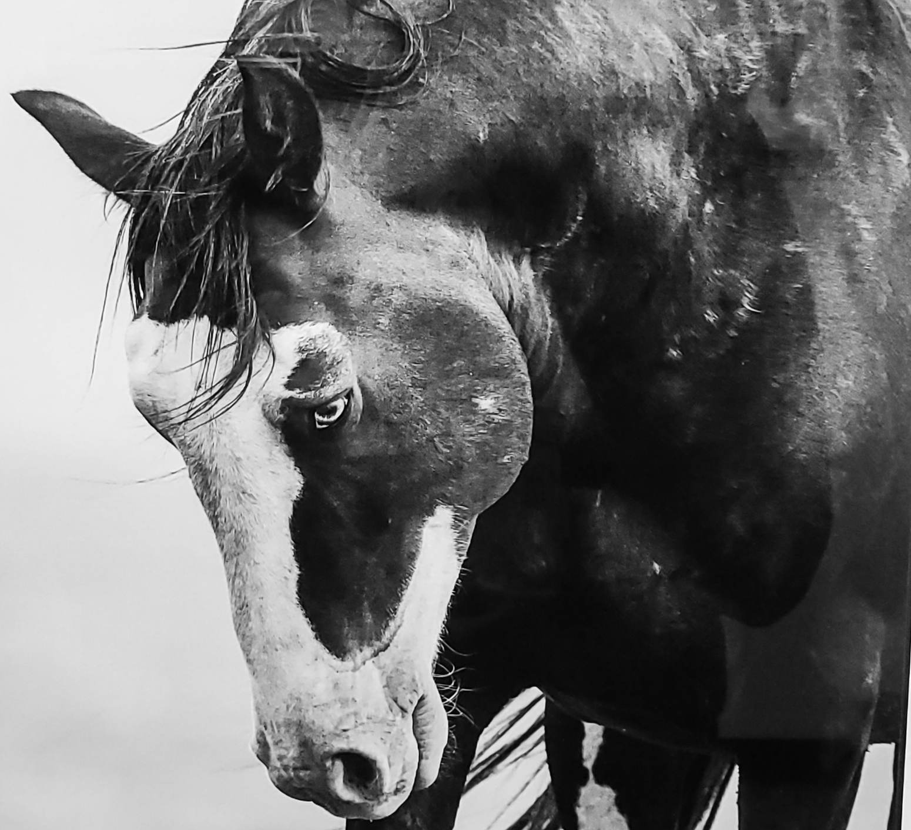
Photography Western WINNER Salt Wells Stallion Rachel Reeves

Slide 20
2-D

Slide 21
Landscape

Slide 22
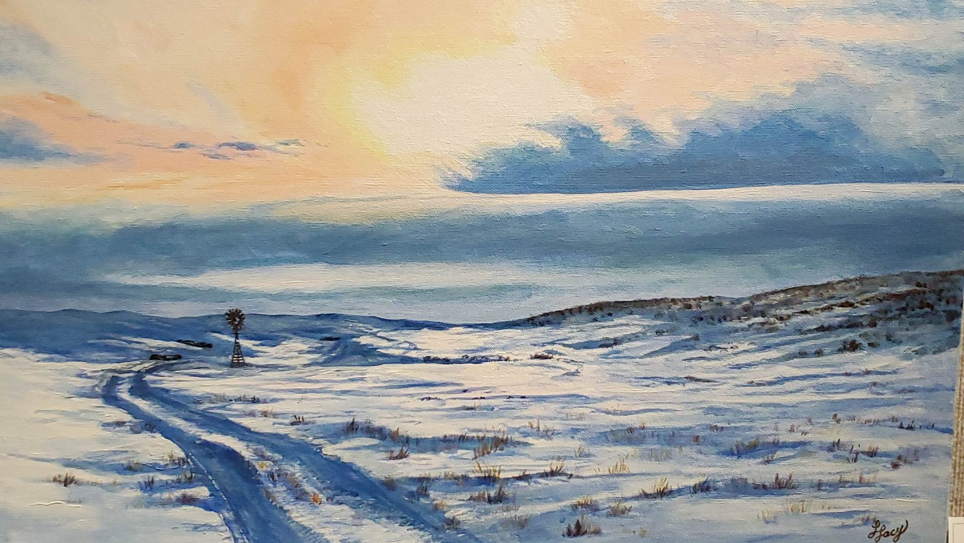
2-D Landscape 3rd Place Apricity Trouville Linda Lacey

Slide 23
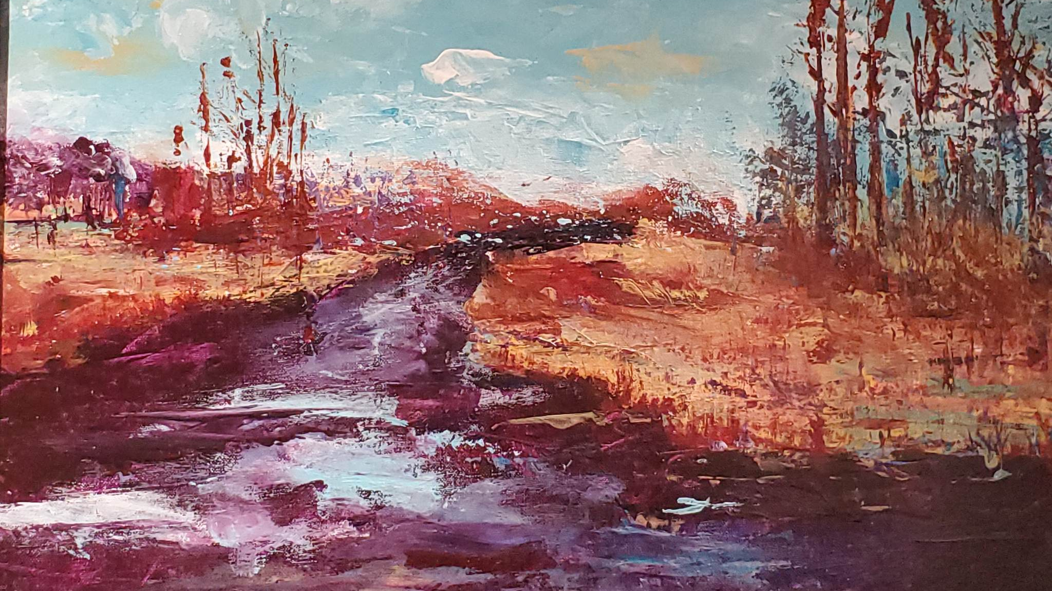
2-D Landscape 2nd Place Grassy Waters Sharon Skinner

Slide 24
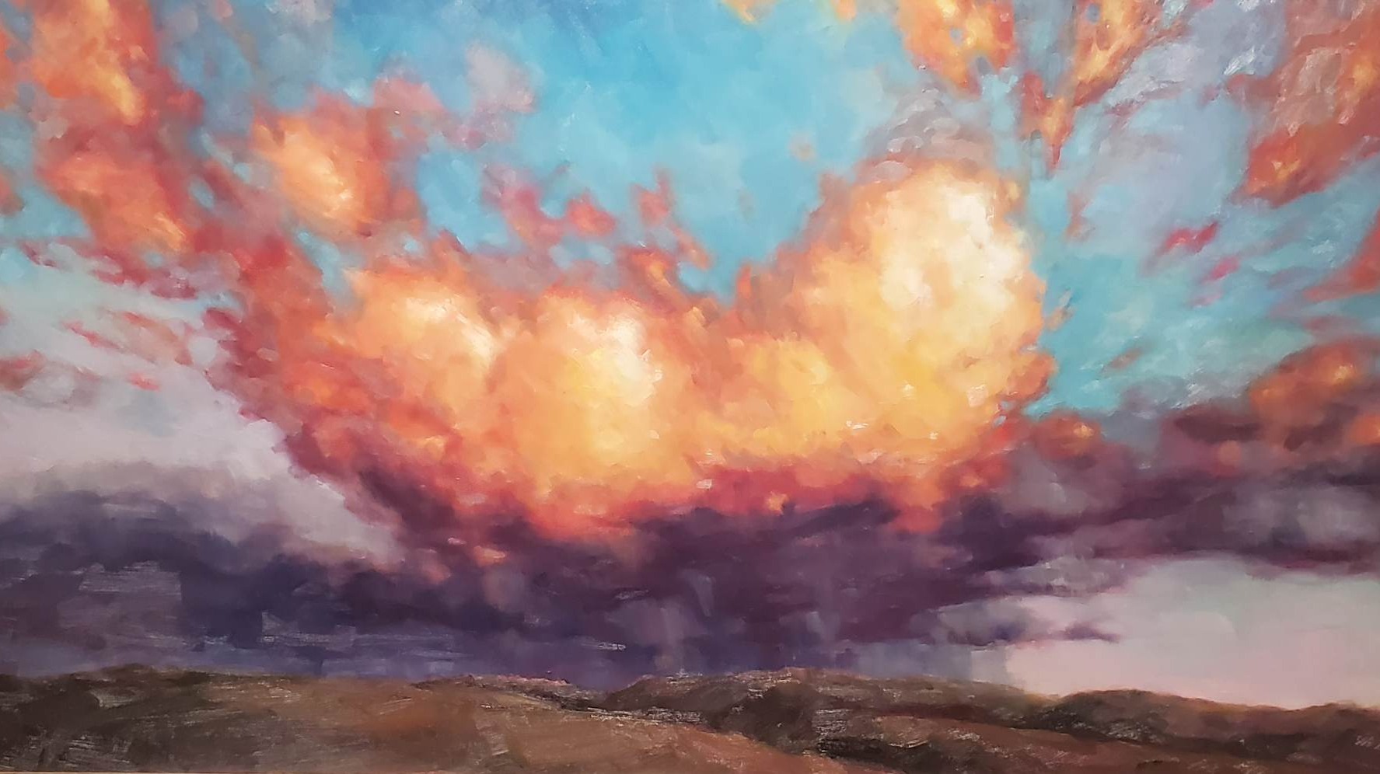
2-D Landscape WINNER Fiery Chariots Yelena Khanevskaya

Slide 25
Wildlife

Slide 26
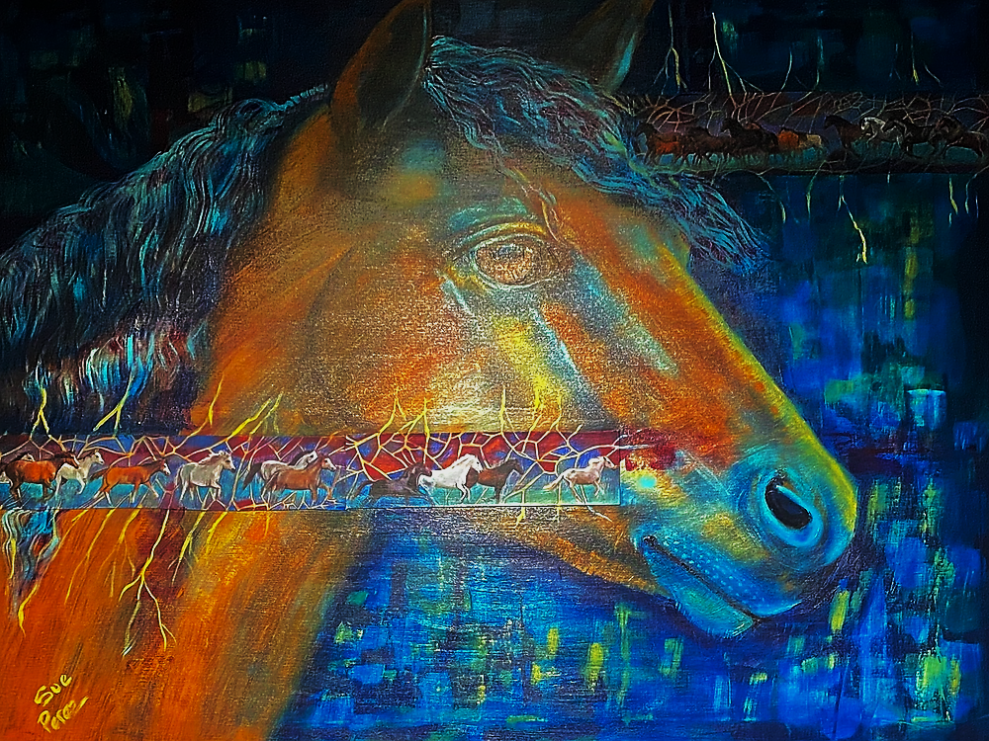
2-D Wildlife 3rd Place Run Wild Sue Perez

Slide 27
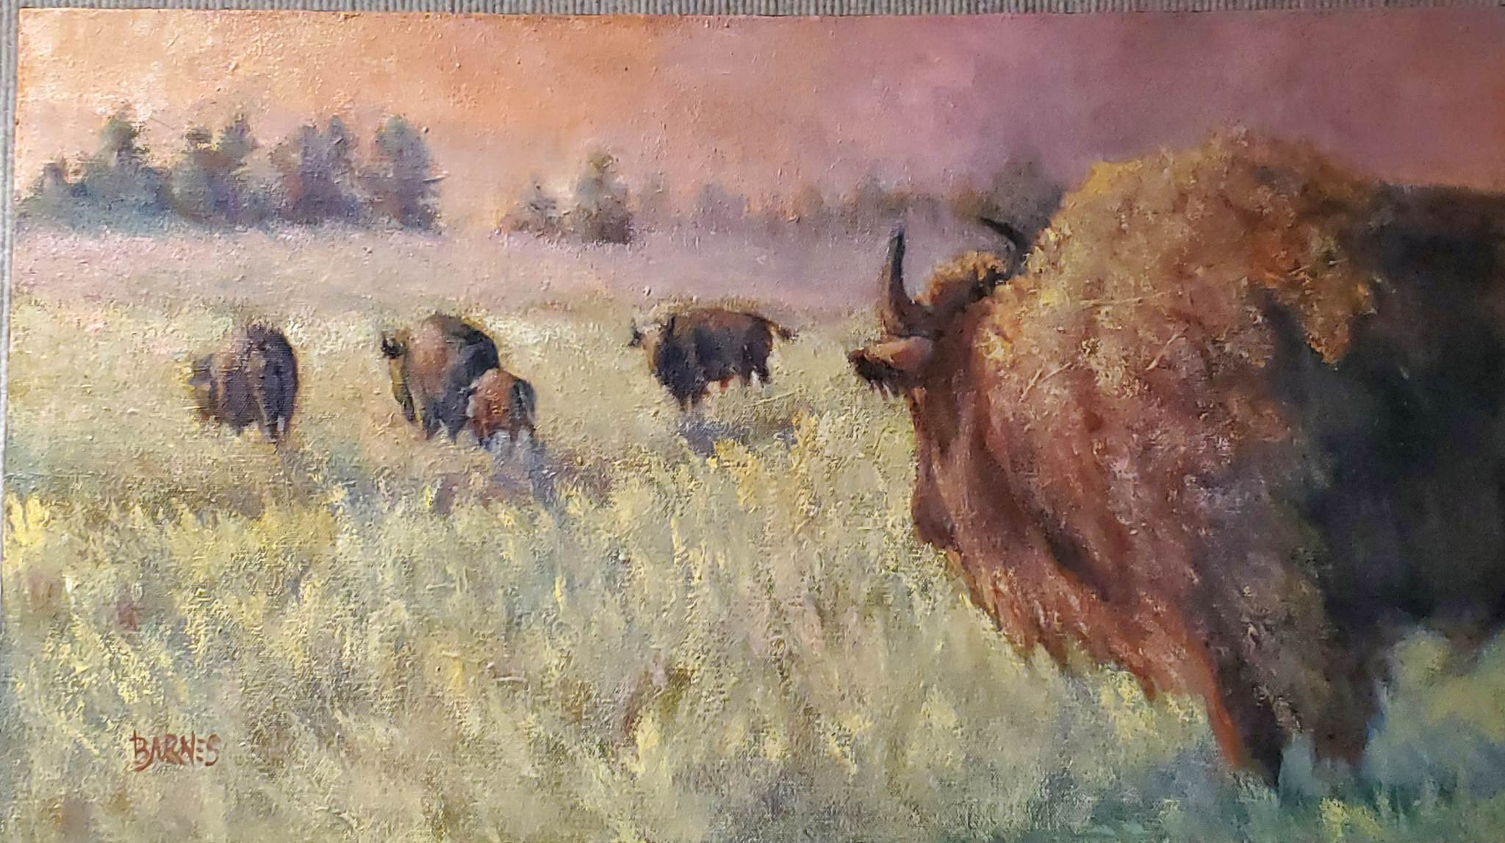
2-D Wildlife 2nd Place When the Dust Settles on the Day Roberta Barnes

Slide 28
2-D Wildlife WINNER Whisper of Strength Tim O’Neill

Slide 29
Western

Slide 30
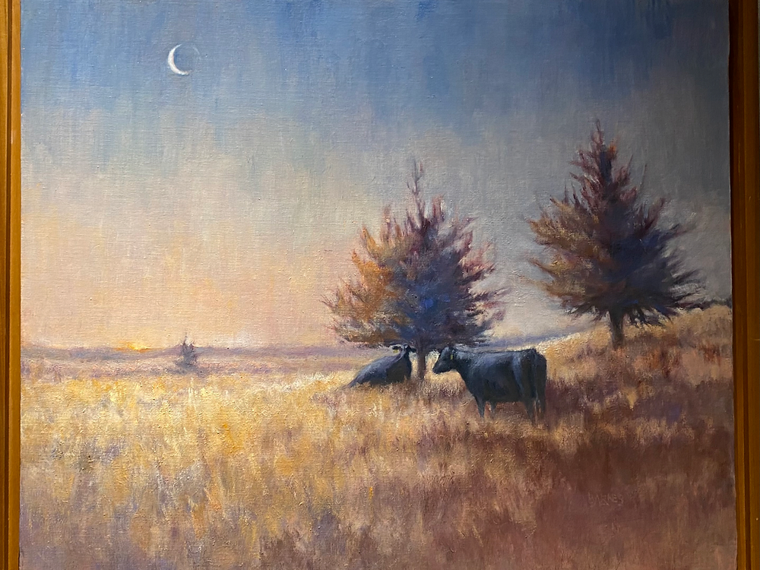
2-D Western 3rd Place Morning Meditations Roberta Barnes

Slide 31
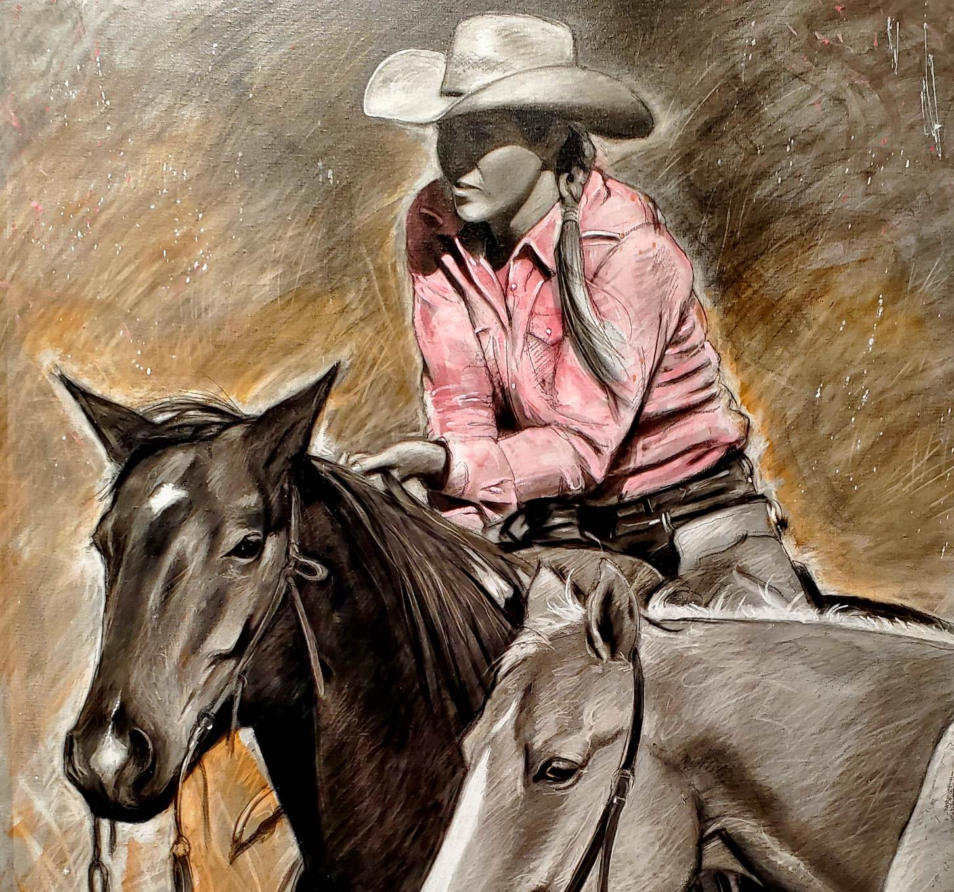
2-D Western 2nd Place Pretty In Pink David Dorsey

Slide 32
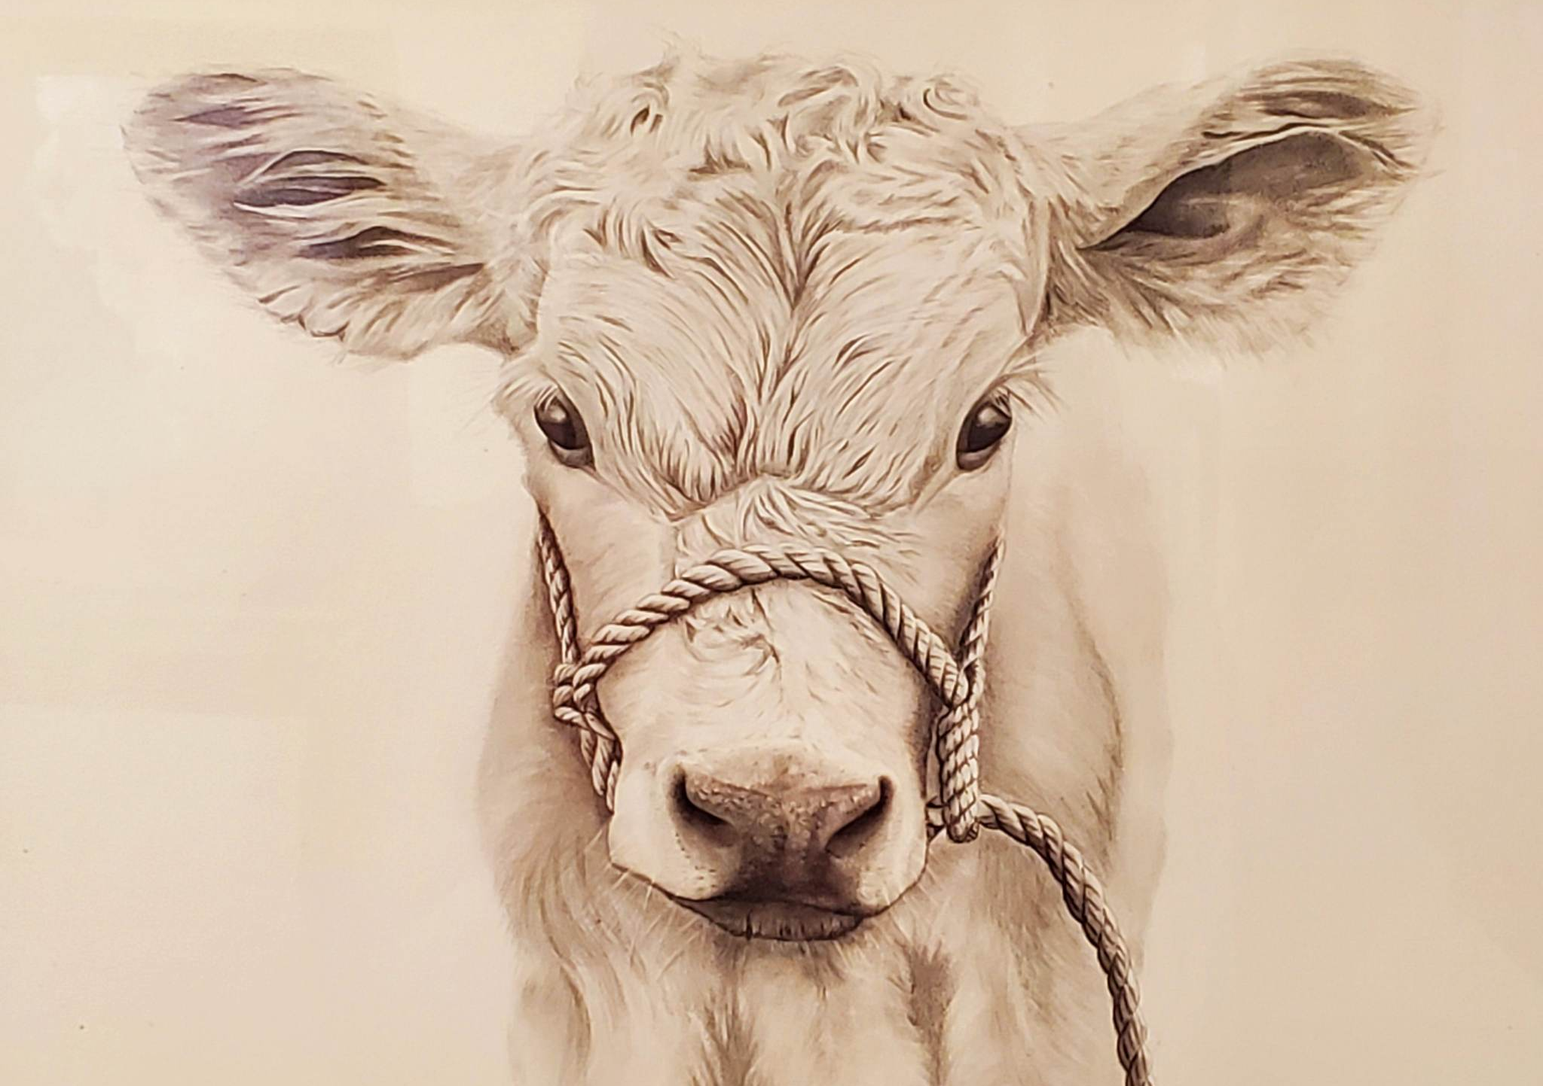
2-D Western WINNER Buddy Taylor Majerus

Slide 33
Peoples Choice

Slide 34
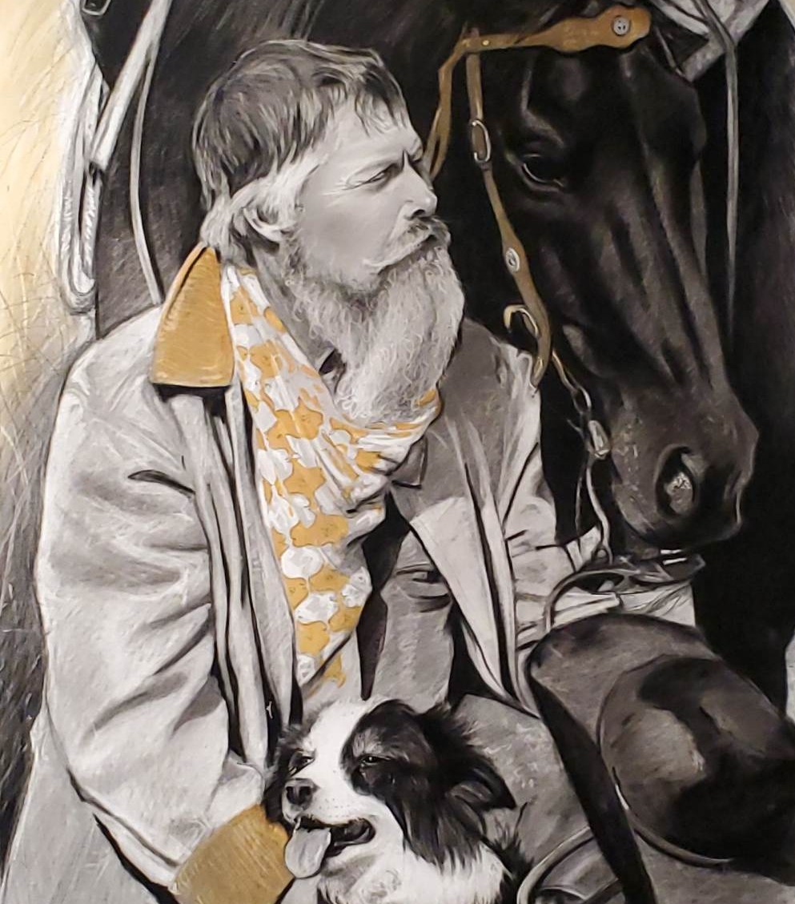
Three For The Road David Dorsey

Slide 35
Best of Show

Slide 36
2023 Nebraskaland Days Competitive Art Show BEST OF SHOW Lookin’ Back Linda Egle

Slide 37
Art is something that makes you breathe with a different kind of happiness. -Anni Albers
Thank You, Artists,
Happy Trails Till Next Show!

