Slide 1
The Facts About a New Carroll County, IA Law Enforcement Center

Slide 2
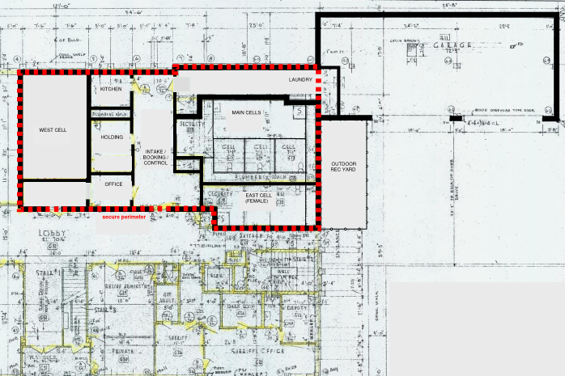
Why do we need a new County Jail?
The current Sheriff’s Office and Jail, located on the lower level of the courthouse, was built in 1965 with a housing capacity of 14 beds…the building is 53 years old!
The existing jail is a linear design making it difficult for staff to view inmate housing areas from a single control point.
It has 3 housing units and one holding cell making it extremely difficult to provide adequate classification/separation by gender, risk level, pre-trial and sentenced.
As a result, the county is regularly full and frequently looking for beds in neighboring county jails.
That costs the taxpayers more money.

Slide 3
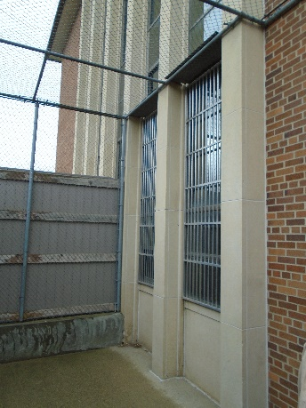
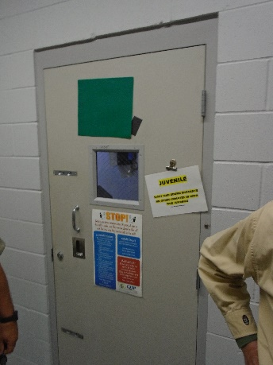
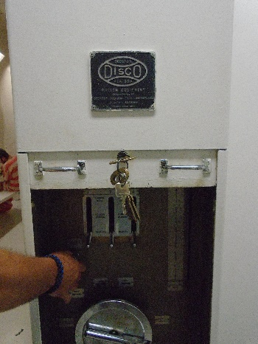
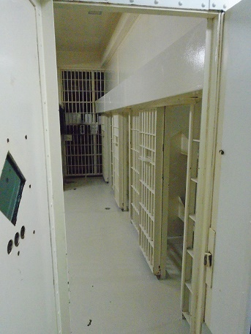
TAKE A CLOSER LOOK AT OUR CURRENT JAIL
Facility does not meet minimum Building Code for Jails
No sprinkler system
No smoke evacuation system
Facility does not meet minimum Iowa Jail Standards (IJS) requirements
There are no maximum security cells, meeting minimum Iowa requirements.
There is not natural light provided for inmates.
Inability to provide adequate classification, separation of inmates.
Severe lack of space for administration, processing and booking.
Lacking a “secure perimeter”, with interlocked security doors. (A single door is all that separates public from secure inmate areas.)
Not ADA handicap accessible.
“Carroll County Jail is an older facility that does not meet the current needs ofthe prisoners, staff, or public. The design of the facility is not user friendly, classification is non-existent and creates a safety and security concern.” Chief Jail Inspector Delbert Longley, 2017 Jail Inspection Report.

Slide 4
So How Do We Fix It?
Phase 1 - Law Enforcement Center Addition with 32 Beds (with 6 Classification Units) and 4 Intake Holding Cells
Future Phase(s) – Additional Capacity to add 8 beds without additional construction; Ability to expand Housing (12-16 Additional Beds)
The entire project will conform to minimum Iowa Jail Standards (IJS) and Building Code requirements in order to improve the safety, security and liability risk to the County.

Slide 5
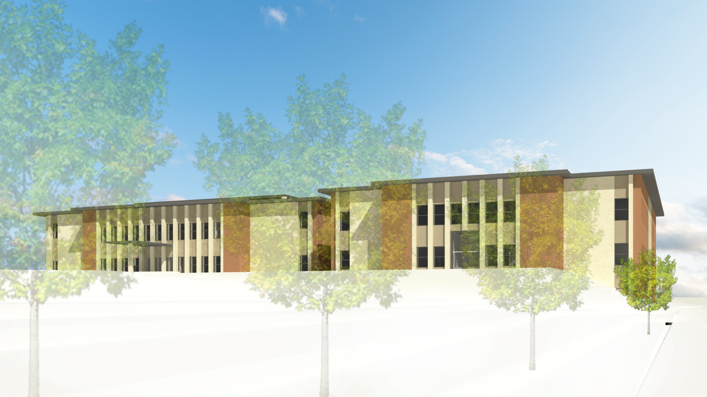
View from the northwest

Slide 6
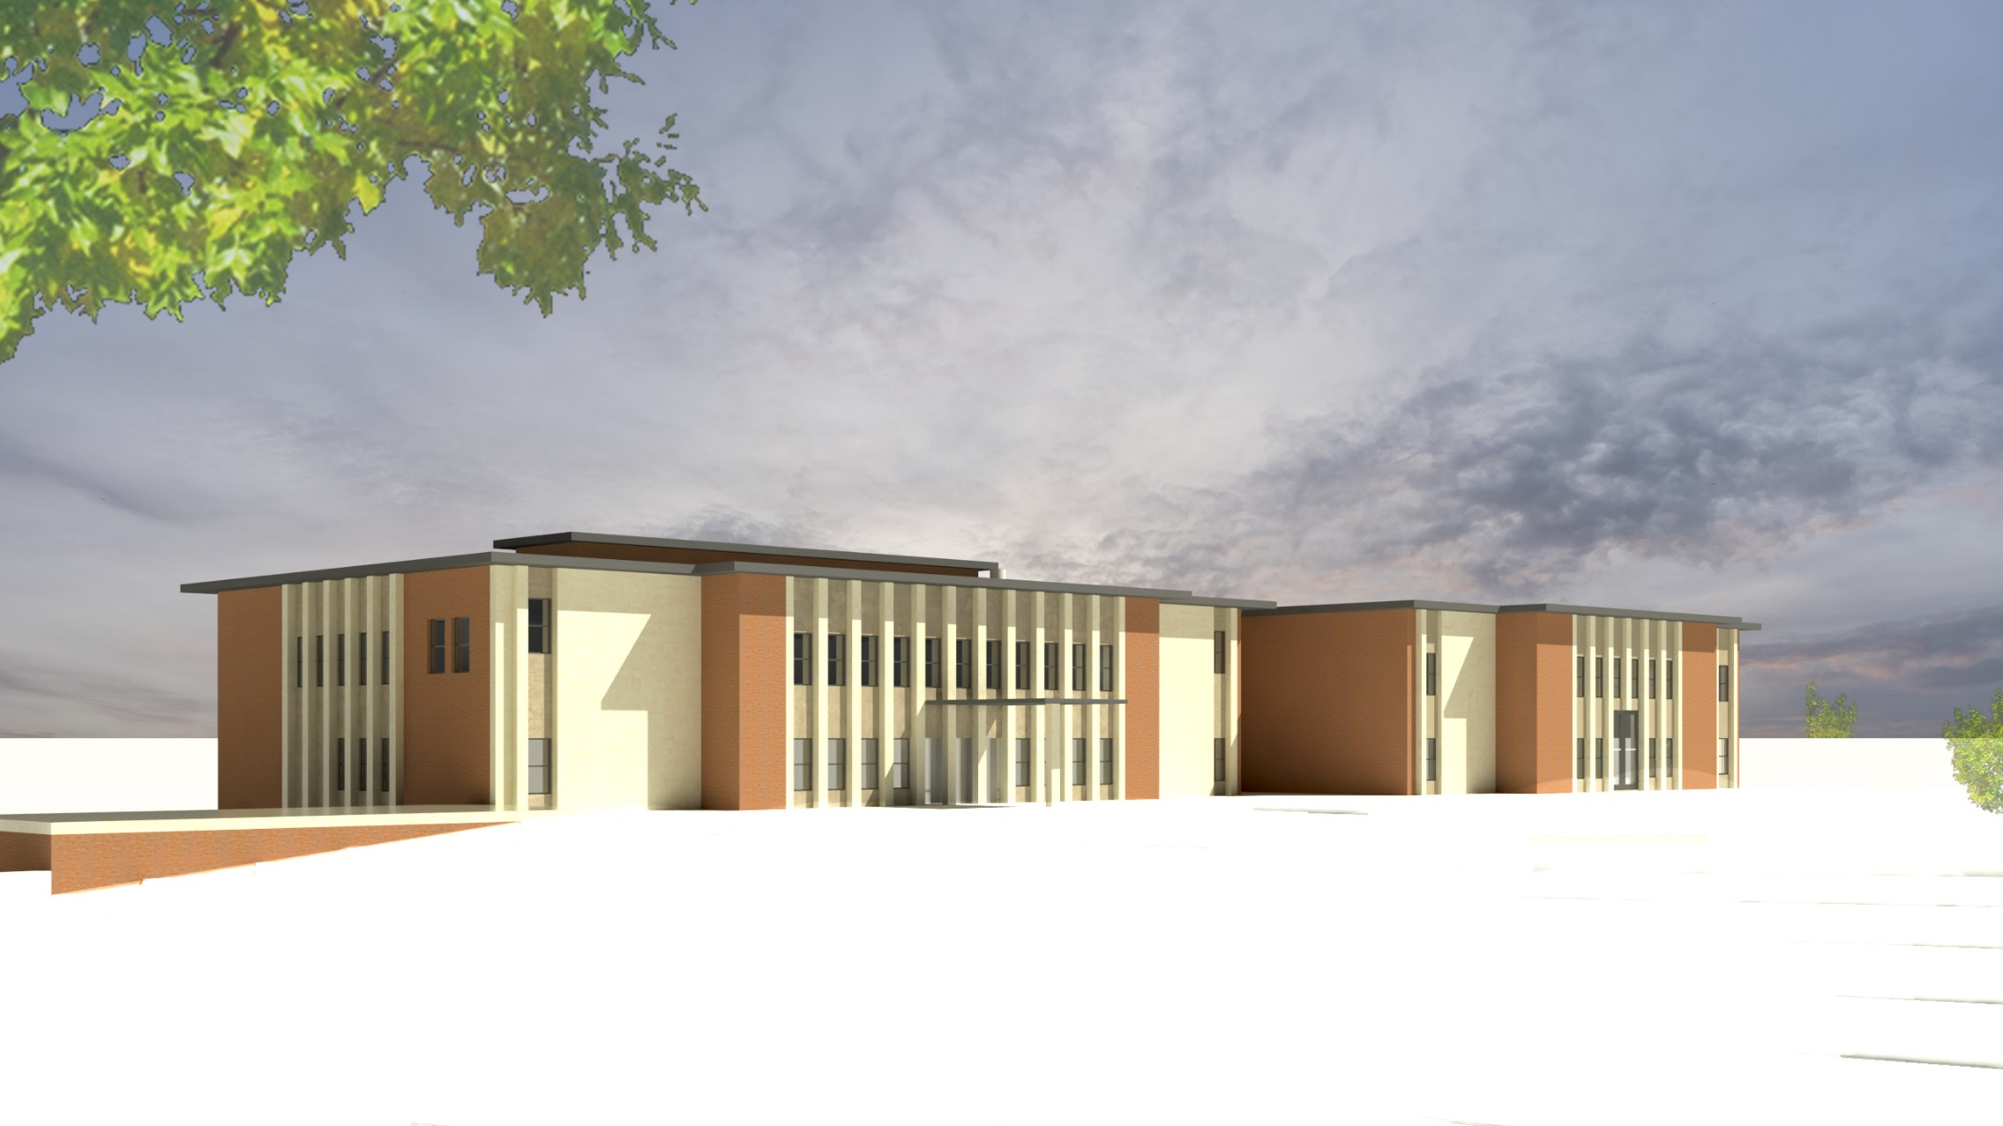
View from the northeast

Slide 7
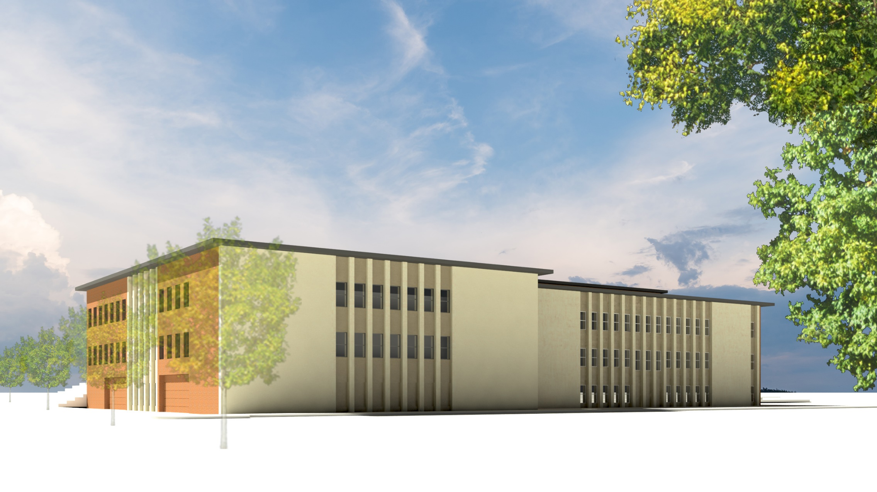
View from the southwest

Slide 8
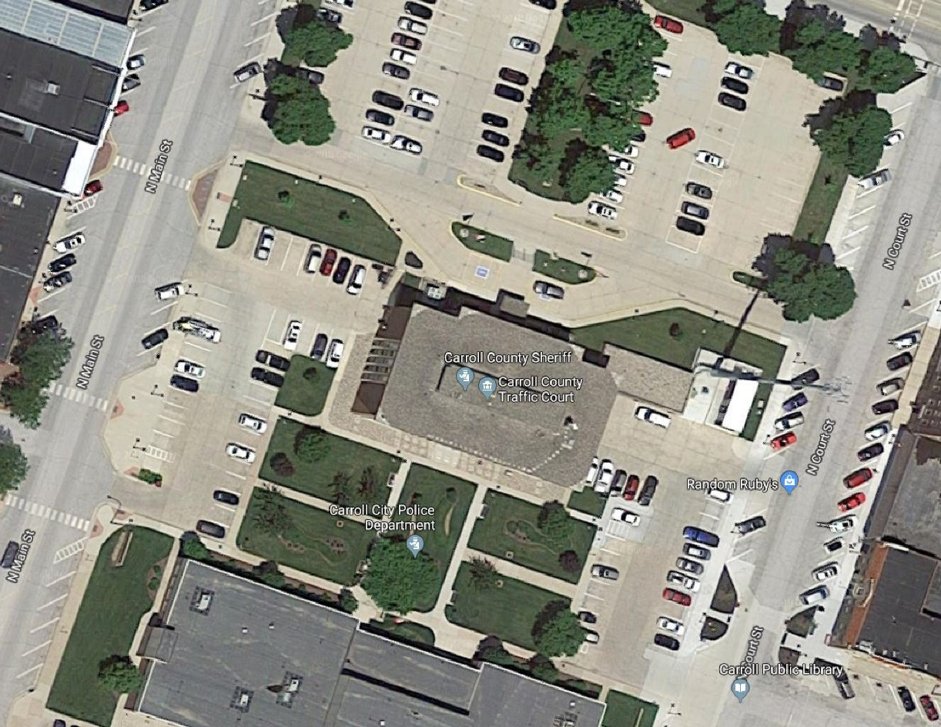
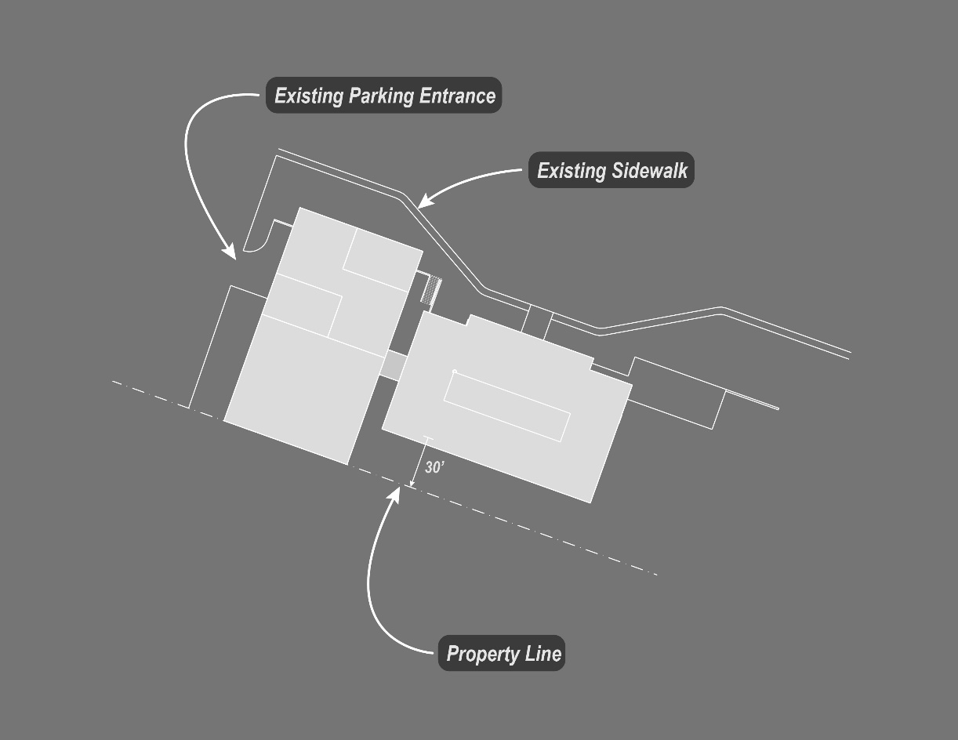

Slide 9
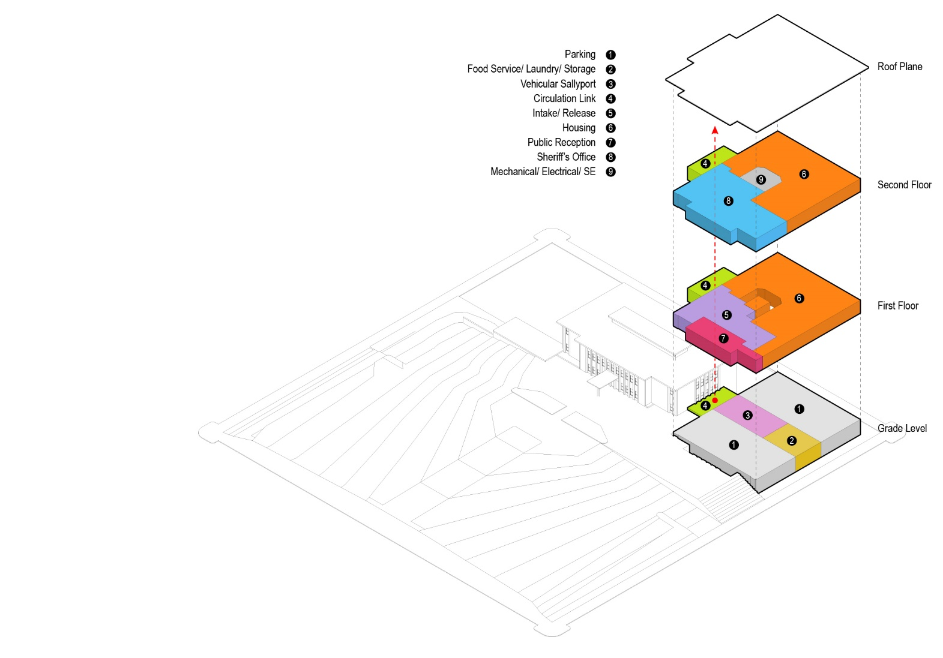
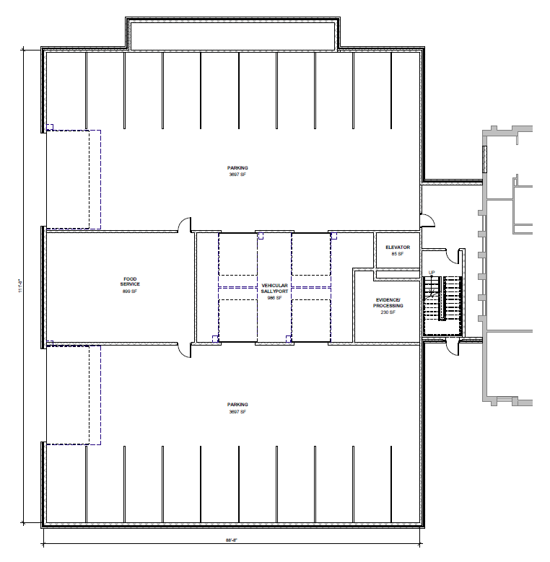
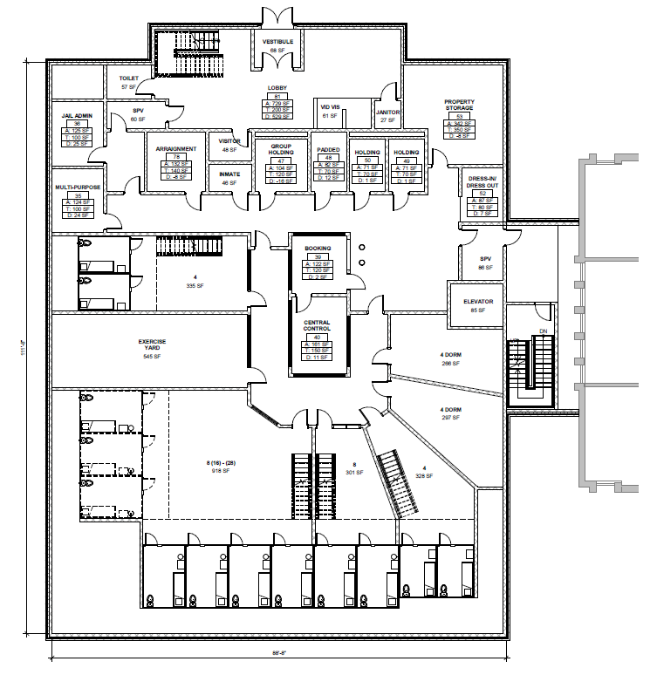
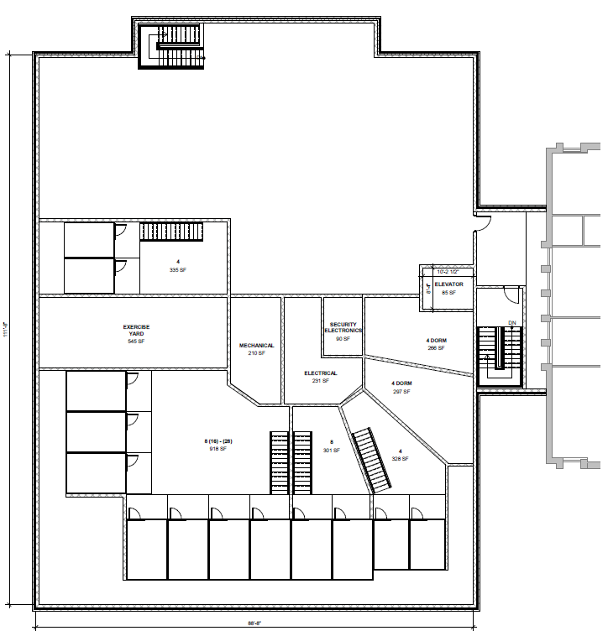
Grade Level
First Floor
Second Floor

Slide 10
Why that many beds?
We can’t afford a short-term fix.
With only 3 housing units, Carroll County cannot currently provide adequate separation of inmates. The current jail does not meet current building code requirements for jail facilities. Carroll County has been operating outside of state standards at the discretion of the jail inspector.
Consultants studied the number of beds we would need for the next 20 years and 30 years.
With the study, and given the continued demographic changes regarding incarceration, the 32-bed number solution was identified to meet the 30-year need.

Slide 11
How much will it cost?
The estimated Project Cost for the jail is $8,950,000.
This will include everything;
Construction (building and site), professional fees, furniture fixtures, cameras, security systems, locks/ door controls, and detention equipment.
$8.950
MILLION

Slide 12
How will we pay for it?
The voters will have to approve a bond referendum for construction of the law enforcement center/jail.
That will expire in 20 years or earlier once the project is paid off.
The county has identified the potential to house out of county inmates from other jurisdictions, which would generate revenue that could be used to pay off the bond earlier than projected.

Slide 13
PLEASE CONSIDER THESE FACTS:
If we do not do this and the current jail is closed for any reason, it could cost the taxpayers an additional $315,000 in the first year to house inmates to other counties. This number will increase every year you do not have a jail when the jail closes. That is money we don’t have.
Given Iowa Jail Standards space requirements and Building Code requirements, it would not be possible to modify the current Courthouse to continue, including a jail. In addition, any significant remodeling of the current Courthouse would require the entire Courthouse be brought up to current code compliance.
Safety / Security and compliance with the Code Requirements is a significant issue requiring resolution and action at this time to protect restrained occupant life safety.

Slide 14
ABOUT THE BOND REFERENDUM
A bond referendum is proposed which requires 60% plus 1 vote for passage. This is tied to property tax and would only affect property owners in county.
The impact of the bond referendum to the taxpayers can be explained by a trip to McDonald’s. The cost is the equivalent to a dollar sized drink and cheeseburger once a month, or in this case it will cost you the estimated $2.06. (Based on a $100,000 residential property value in Carroll County, IA).
If you factor in the estimated operational savings, there is actually a cost savings compared to housing inmates out of county.
This bond referendum will address this critical need and improve public safety.
Notes:
About bond for Carroll county, iowa

Slide 15
BOND BREAKDOWN
HOW MUCH WILL THE
New Law Enforcement Center/Jail
COST ME PER YEAR?
$24.76
$18.98
for a $100,000
residential property value
or $2.06 per month
for a 40-acre
assessed agricultural land value
or $1.58 per month
Law Enforcement
Jail
Public Safety

Slide 16
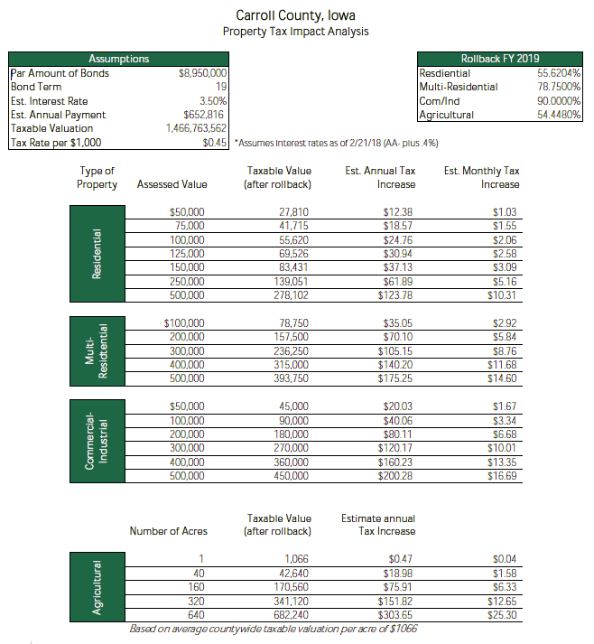
BOND BREAKDOWN

Slide 17
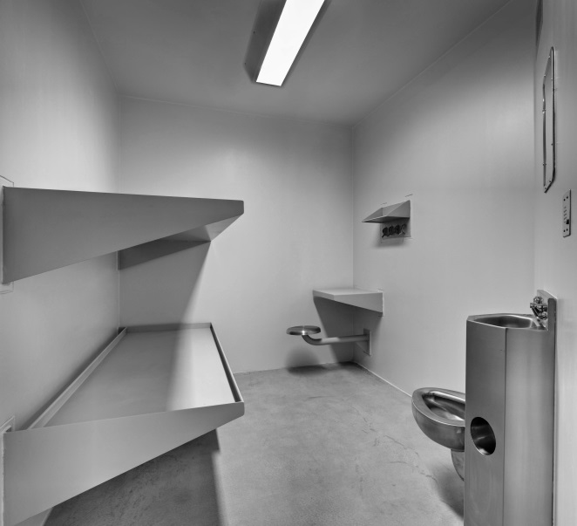
Are we spending money on luxury for inmates?
We are not building better quarters for the inmates. We will be following legal standards to provide a safe work environment for staff and liability protection for the County. The new jail will be made of concrete, block and steel. The average inmate cell is 92 sf (8’ x 11’-6”) with two steel bunks, a stainless steel toilet and sink with a small steel desk and seat permanently attached to the wall.
Not exactly the “Hilton”.

Slide 18
How will the new Jail benefit the taxpayers?
Increased Public Safety: The new jail will be much more secure, reducing the danger of escapes and assaults on jail officers.
Decreased Liability Risk: Protect the County from lawsuits for failing to provide minimum jail housing standards for inmates.
Tax dollars will stay at home. The County will keep our tax dollars here at home instead of sending them to other counties for housing our inmates.

Slide 19
Carroll County Needs Your Support
Ask Questions/Find Answers and Make an Informed Decision
Contact any County Supervisor (712) 792-4923 or the Sheriff’s Office (712) 792-4393, for more information

